Slide 1
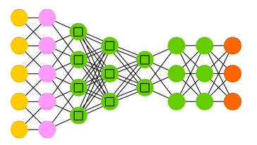
Stochastic Gradient Descent (SGD)
using Back-Propagation (BP) of errors
Artificial Neural Networks are functions represented as graphs.
They convert input to output.
To train a network means to solve a minimization problem.
We find parameters of the network (weights of connections)
causing the network to convert input to a desirable output
(minimizing the discrepancy / error).
Modern networks have up to 600 millions of weights (and more). Most common way of calculating these weights (and biases) is to use step-by-step (and layer-by-layer) adjustments using one of common methods:
- https://www.neuraldesigner.com/blog/5_algorithms_to_train_a_neural_network
Gradient descent
Newton method
Conjugate gradient
Quasi-Newton method
Levenberg-Marquardt algorithm
In next slides we will concentrate on the most common approach
using Stochastic Gradient Descent & Back-Propagation.
Input
Output

Slide 2
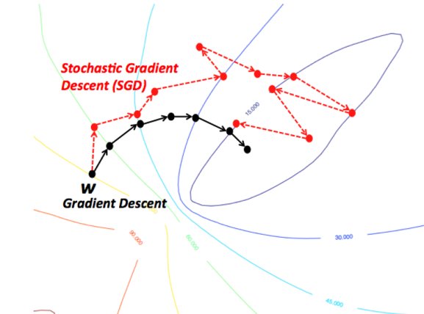
Stochastic Gradient Descent (SGD)
- https://en.wikipedia.org/wiki/Stochastic_gradient_descent
Modern deep networks have tens of millions of weights (sometimes hundreds of millions). Computing true gradient becomes very expensive when number of dimensions is large. Solution – SGD: we calculate gradient for a small random subset of dimensions. Each step is much “cheaper” to calculate. We may need more steps, though. But it is still cheaper.
Léon Bottou
has introduced stochastic gradient descent in 1998
- Bottou, Léon (1998). "Online Algorithms and Stochastic Approximations".
At Facebook Research since 2015
Past: AT&T Bell Laboratories, AT&T Labs, NEC Labs America, and Microsoft Research.
- https://research.fb.com/people/bottou-leon/
- http://leon.bottou.org
- https://scholar.google.com/citations?user=kbN88gsAAAAJ

Slide 3
SGD = Stochastic Gradient Descent
Stochastic Gradient Descent is a variation of the gradient descent algorithm that calculates the error and updates the model for each example in the training dataset – but using only random subset of dimensions.
Pros: frequent updates, simple to understand, faster learning, noise helps to avoid local minima (premature convergence). Cons: noisy gradients can cause errors, can be computationally expensive.
Batch Gradient Descent - calculates the error for each example in the training dataset, but only updates the model after all training examples have been evaluated.
Pros: fewer updates to the model – less calculations. More stable gradient. Easy to do parallel processing. Cons: more stability can lead to premature convergence. Additional complexity of accumulating prediction errors across all training examples – can require more memory. model updates may become very slow for large datasets.
Mini-batch Gradient Descent – a compromise. It splits the training dataset into small batches that are used to calculate model error and update model coefficients.
Mini-batch size is usually tuned based on number of CPUs or GPUs and memory size. Common default is 32. Common values are powers of 2 (32, 64, 128, 256, etc.)

Slide 4
Back Propagation
Forward Propagation:
From input – calculate activations of nodes in 1st layer
From 1st layer – calculate activations in 2nd layer
etc.
(note - cache activations, will need them for backprop)
Calculate the output, calculate value of loss/error E
(E ~ diff between calculated and target values)
Backpropagation (back-propagation of errors, backprop, BP) is a method used in artificial neural networks to calculate gradients that are needed to calculate the weights and biases in the network.
Backpropagation computes gradients "layer by layer" using the chain rule.
Backward propagation:
Calculate dE/dW[ij] for all layers using the chain rule
calculate layer by layer going backwards
using cached activations from forward pass

Slide 5
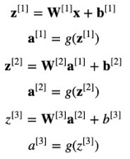
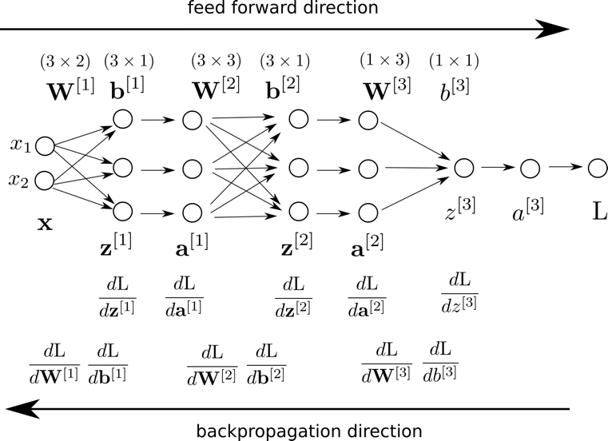





Back Propagation – example with 2 hidden layers
Calculating Forward:
adapted from: http://saitcelebi.com/tut/output/part3.html
Input
Output
Calculating Backwards:
= Loss
etc ..., then updating weights:
w = w – step*dL/dw

Slide 6
Intuition why Back Propagation works – p.1
Yp = w*x
Example 1 – the simplest possible example
w
x
y
Suppose that we want to train network so that
prediction Yp = wx will simply copy input x to output.
Obvious solution: w=1
Suppose for simplicity that x==1 always.
If we start with w = 0.5, then prediction Yp = w*x = 0.5.
Error E = (Yp-Y)²
dE/dw = 2(wx-Y)*x = 2*(0.5-1) = -0.5
update step s=0.001
updated value of w:
w = w – s*(dE/dw) = w – s*(-0.5) = w + s*0.5 # So w is growing
Similarly if we start with w = 2, then:
dE/dw = 2(wx-Y)*x = 2*(2-1) = 2
w = w – s*(dE/dw) = 0.5 – s*2 # w is decreasing
So if we repeat the steps multiple times, the process will
converge to w = 1

Slide 7
Intuition why Back Propagation works – p.2
relevant feature
Example 2 – two features
1,1,1,1,...
x1
w1
Suppose that x1 has consistent values == 1
And that x2 has random values (-1 or 1).
We want to train the output to be 1.
So x1 is the important feature, and x2 is not.
Obvious solution: w1=1, w2=0
Suppose we start with w1=w2=0.6
If data point is (x1=1,x2=1),
then Yp = x1*w1+x2*w2 = 0.6+0.6 = 1.2
Error E = (Yp-Y)²
dE/dw1 = 2(w1*x1+w2*x2-Y)*x1 = 2*(0.2)*1 = 1
dE/dw2 = 2(w1*x1+w2*x2-Y)*x2 = 2*(0.2)*1 = 1
w1 = w1 – s*(dE/dw1) = w1 - s # decreases
w2 = w2 – s*(dE/dw2) = w2 - s # decreases
But if data point is (x1=1,x2=-1),
then Yp = x1*w1+x2*w2 = 0.6 - 0.6 = 0
dE/dw1 = 2(w1*x1+w2*x2-Y)*x1 = 2*(-1)*1 = -2
dE/dw2 = 2(w1*x1+w2*x2-Y)*x2 = 2*(-1)*(-1) = 2
w1 = w1 – s*(dE/dw1) = w1 – s*(-2) # strongly increases
w2 = w2 – s*(dE/dw2) = w2 – s*2 # strongly decreases
y
1,1,1,1,...
1,-1,1,-1,...
x2
w2
irrelevant feature
If we repeat those steps randomly multiple times, w2 will consistently decrease, while w1 will go up and down, but mostly up.

Slide 8
Intuition why Back Propagation works – p.3
Example 3 – two layers
w1
w2
1,1,1,1,...
x
h
y
1,1,1,1,...
Suppose that x has consistent values == 1
We want to train the output to be 1.
We start with w1=w2=0.6
h = h(x,w1) = x*w1 = 0.6
Yp = Yp(h,w2) = h*w2 = 1*0.6*0.6 = 0.36
Error E = (Yp-Y)² = (h*w2 - Y)² = (x*w1*w2-Y)²
dE/dw2 = 2*(h*w2-Y)*h = 2*(-0.64)*0.6 = -0.768
dE/dw1 = dE/dh * dh/dw1
dE/dh = d((h*w2 - Y)²)/dh = 2*(h*w2-Y)*w2 = 2*(-0.64)*0.6 = -0.768
dh/dw1 = x = 1
So
dE/dw1 = -0.768 * 1 = -0.768
w1 = w1 – s*(dE/dw1) = w1 – s*(-0.768) # increases
w2 = w2 – s*(dE/dw2) = w2 – s*(-0.768) # increases
So both weights will increase.
If we start with weights > 1, then both weights will decrease.

Slide 9
Intuition why Back Propagation works – p.4
Here are some YouTube videos giving more examples:
Neural Network Backpropagation Basics For Dummies https://www.youtube.com/watch?v=8d6jf7s6_Qs
Stanford University, Lecture 4 - Introduction to Neural Networks https://www.youtube.com/watch?v=d14TUNcbn1k
Welch Labs - Neural Networks Demystified [Part 4: Backpropagation] https://www.youtube.com/watch?v=GlcnxUlrtek
Back Propagation in Neural Network with an Example https://www.youtube.com/watch?v=GJXKOrqZauk
Note that in real networks the back-prop is more complex because:
hidden layers have multiple nodes
hidden layers have nonlinear activation functions (RELU, leaky RELU, Sigmoid, Max, etc.)
we also need to calculate biases, not just weights
different error functions are used instead of MSE(L2) Mean-Squared-Error sum(Yp-Y)² . Most typical is softmax function for normalization, followed by cross-entropy error function
different patters of connectivity between layers (for example, in CNN – convolutional layers, pooling layers, fully-connected layers)
there may be skip-connections between non-consecutive layers
there may be logical units (gates) – LSTM, GRU, etc.
there may be "sampling" layers (like in variational auto-encoders)
etc., etc.

Slide 10





Who Invented Back Propagation ?
- https://www.quora.com/Why-did-it-take-so-long-to-invent-the-backpropagation-algorithm-Isnt-it-just-a-straightforward-albeit-cumbersome-application-of-the-chain-rule
- https://en.wikipedia.org/wiki/Backpropagation
- http://people.idsia.ch/~juergen/who-invented-backpropagation.html
David E. Rumelhart,
Geoffrey E. Hinton, & Ronald J. Williams
Nature, 1986 - "Learning representations by back-propagating errors"
Yann Lecun
In 1985 Ph.D. Thesis (in French) published back-propagaion algorithm.
Seppo Linnainmaa
In 1970 in his master's thesis (in Finnish) he has introduced the method to compute a derivative of a function when the function can be represented as a graph.
The computation is done by recursively applying the chain rule to the building blocks of the function's graph.
Paul John Werbos In 1974 in is dissertation he has described the process of training artificial neural networks through back-propagation of errors. He also was a pioneer of recurrent neural networks.

Slide 11
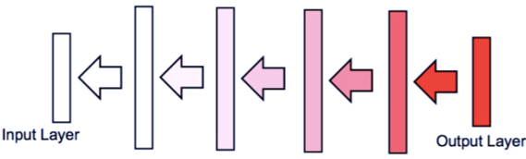
Vanishing Gradient Problem
Solutions to Vanishing Gradient Problem
Multi-level hierarchy (Jürgen Schmidhuber, 1992) – pre-training one level at a time. Similar approach - Hinton et al. (2006) - deep belief network model, training one layer at a time.
Gated nodes - LSTM = Long Short-Term Memory (Hochreiter & Schmidhuber, 1997, winning in 2009) and GRU (Gated Recurrent Unit).
Residual networks (Microsoft ResNets) – adding skip-connections between remote layers helps to eliminate the problem.
Faster hardware – helps.
Using ReLU activation function helps, because they only saturate in one direction.
Other methods:
- rely only on sign of the gradient (not on the value).
- using random search or genetic algorithm instead of gradient.
Using backpropagation we calculate gradients layer by layer going backwards using the chain rule:
dW[m] = dW[N] * dW[N-1] * ... If gradients become small (for example due to saturation of activation functions in nodes), and number of layers is large, then we will be multiplying multiple small numbers. The result will become vanishingly small.
This was shown to prevent successful training of deep neural networks (especially RNNs - Recurrent Neural Networks).

Slide 12
Dynamic Learning Rate
Main idea – achieve faster conversion of the model by dynamically
changing (decreasing) the learning rate during training.
There is no consensus on which algorithm is better. The most common algorithms: - Stochastic Gradient Descent (SGD)
- SGD with momentum
- RMSProp
- RMSProp with momentum
- AdaDelta (see https://arxiv.org/pdf/1212.5701.pdf )
- Adam (2014-2015 - https://arxiv.org/pdf/1412.6980.pdf , https://machinelearningmastery.com/adam-optimization-algorithm-for-deep-learning/ )
Adam has become the default choice in most libraries.

Slide 13
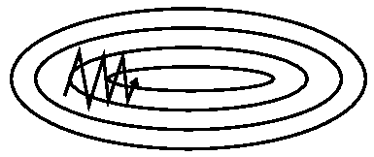
SGD - Stochastic Gradient Descent
… it is common to decrease the learning rate linearly until iteration certain τ, and after that keep it constant (usually at ~1% of the initial value). SGD has trouble navigating ravines, i.e. areas
where the surface curves much more steeply in one dimension than in another (it oscillates across the slopes
of the ravine while only making hesitant progress along the bottom towards the local optimum).
-- AdaGrad - Adapts the learning rates of all model parameters by scaling them inversely proportional
to the square root of the sum of all of their historical squared values.
Problem - accumulation of squared gradients from the beginning of training can result in a premature and excessive decrease in the effective learning rate.
--
RMSProp - Changing the gradient accumulation into an exponentially weighted moving average.
It is similar to AdaGrad but performs better in non-convex scenarios. Eﬀective and practical. One of the go-to optimization methods. -- Momentum - (Polyak, 1964) - accumulates an exponentially decaying moving average of past gradients and continues to move in their direction. Physical analogy: the negative gradient is a force moving a particle through parameter space. We assume unit mass (m=1), so the velocity vector v may also be regarded as the momentum of the particle. People actually use two forces:
One force is proportional to the negative gradient of the cost function. We can think of the particle as being like a hockey puck sliding down an icy surface. Whenever it descends a steep part of the surface, it gathers speed and continues sliding in that direction until it begins to go uphill again.
Second force - viscous drag resistance proportional to –v(t). This force is necessary, because without it the particle will never stop.
--
Nesterov Momentum - the gradient is evaluated after the current velocity is applied (thus correcting the standard method of momentum).
--
Adam - a variant on the combination of RMSProp and momentum. - https://machinelearningmastery.com/adam-optimization-algorithm-for-deep-learning/
--

