Slide 1
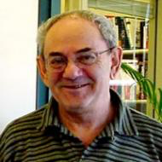
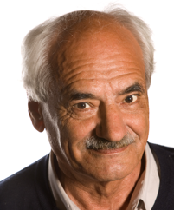
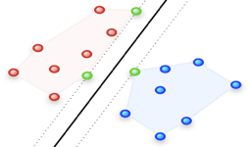
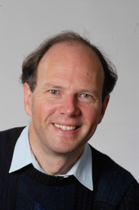
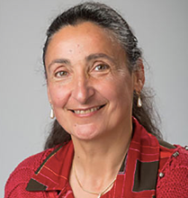
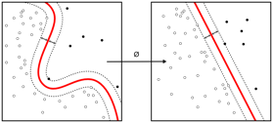
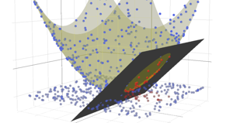
Support Vector Machine (SVM)
The original SVM algorithm was invented by Vladimir N. Vapnik and Alexey Ya. Chervonenkis in 1963. (Computers were called Machines in Russia).
In 1992, Bernhard E. Boser, Isabelle M. Guyon and Vladimir N. Vapnik suggested a way to create nonlinear classifiers by applying the kernel trick to maximum-margin hyperplanes.
Vladimir N. Vapnik
Alexey Chervonenkis
A vanilla SVM is a type of linear separator. We find closest several points between two classes, and draw a straight line (plane) in the middle to separate data into two classes.
If we can't draw a linear separator, then we can try to transform the data (using "kernel functions") into a feature representation (higher-dim space) where linear separation becomes possible.
We can write the distance between points in this higher dimensional space in terms of coordinates in the original space. This is called “kernel trick” and allows to do calculations faster (without ever computing the coordinates of the data in the new feature space).
Isabelle M. Guyon
Bernhard E. Boser

Slide 2
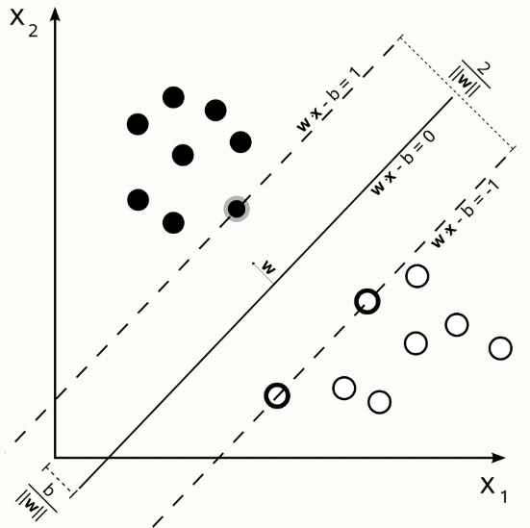
How SVM algorithm actually works?
This StackExchange discussion has very good clear explanation
by Franck Dernoncourt:
https://stats.stackexchange.com/questions/23391/how-does-a-support-vector-machine-svm-work
also see this paper: "Duality and Geometry in SVM Classifiers" :
- http://www.robots.ox.ac.uk/~cvrg/bennett00duality.pdf
Why SVM (Support Vector Machine) is called this way?
The SVM finds a line (a hyperplane) that separates data points
(also called samples or input vectors).
It doesn’t just separate, it also tries to make that separation as wide as possible.
It maximizes the distance between the separator and the closest data points
(called “support vectors” ).
The word “Machine” comes from “Machine Learning”,
because SVM performs automatic calculations.

Slide 3
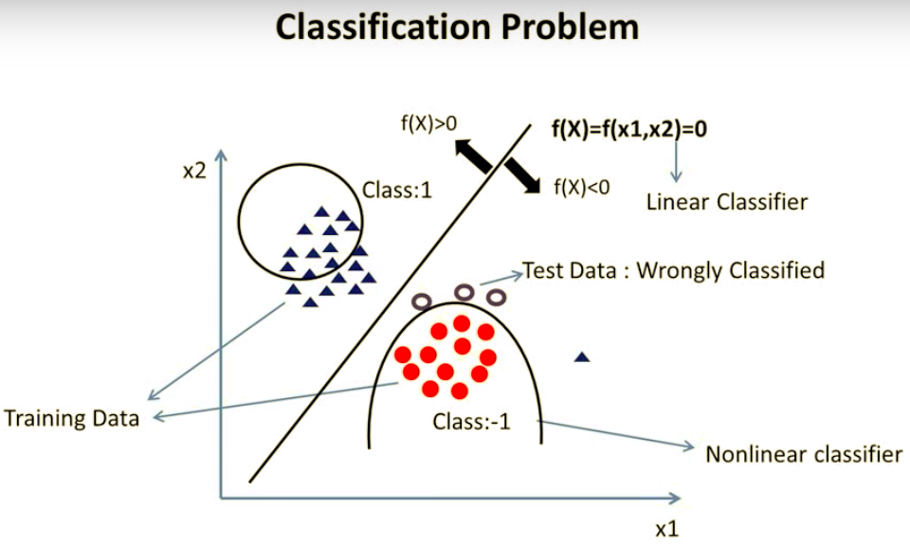
Increasing complexity of the model (from straight line to 2nd order, for example),
usually helps to decrease the error on the training data, but may increase error
on other data (test data).

Slide 4
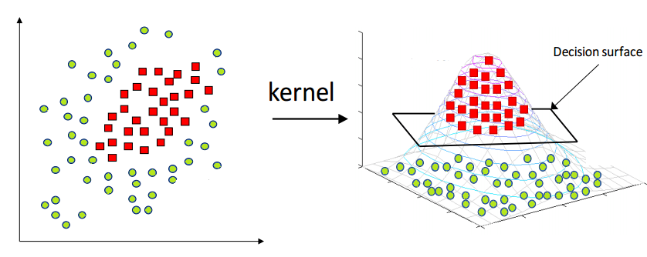
A nonlinear classification problem can be converted to a linear classification problem by mapping the input vectors from the input space to a higher dimensional feature space.
A kernel is a similarity function. It is a function that you, as the domain expert, provide to a machine learning algorithm. It takes two inputs and spits out how similar they are. You use kernels instead of dot-products of your vectors.
Many machine learning algorithms can be expressed entirely in terms of dot products.
Mercer's theorem: Under some conditions, every kernel function can be expressed as a dot product in a (possibly infinite dimensional) feature space.
In many cases, computing the kernel is easy, but computing the feature vector corresponding to the kernel is really really hard. The feature vector for even simple kernels can blow up in size.
For kernels like the RBF (Radial Basis Function) kernel ( k(x,y) = exp( -||x-y||^2),
the corresponding feature vector is infinite dimensional. Yet, computing the kernel is almost trivial.
Many machine learning algorithms can be written to only use dot products,
and then we can replace the dot products with kernels.
By doing so, we don't have to use the feature vector at all. This means that we can work with highly complex, efficient-to-compute, and yet high performing kernels without ever having to write down the huge and potentially infinite dimensional feature vector.
Polynomial kernels can be thought of projecting a vector into a higher dimensional space. Gaussian kernel can be thought as a projection into infinite-dimensional space because its Taylor expansion has infinite number of elements.

Slide 5

RBF Kernels
The (Gaussian) radial basis function kernel, or RBF kernel,
is a popular kernel function.
The RBF kernel on two samples x and x', represented as feature vectors in some input space, is defined as:
The RBF Kernel acts like a low band pass filter in that it preferentially selects smooths solutions.
If you were painting a picture of a tree, you could represent the basic shape
of the leaves by some overlapping green circles.

Slide 6

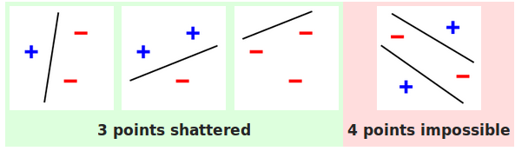
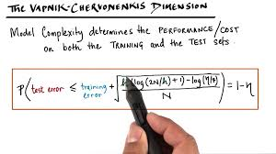
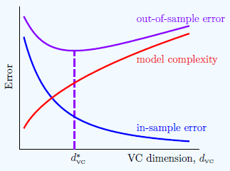
VC Dimension is a measure (number) of the capacity (complexity, expressive power, richness, or flexibility) of a space of functions that can be learned by a statistical classification algorithm.
It is defined as the cardinality of the largest set of points that the algorithm can shatter.
( VCdim = D+1 for linear case )
Vladimir Vapnik
Institut problem Upravleniya, Moscow
Columbia University, NY
Alexey Chervonenkis
Institut problem Upravleniya,
Yandex, MPTI, Moscow
- VC Dimension (Vapnik–Chervonenkis theory)
- SVM (Support Vector Machines, clustering)

