Slide 1
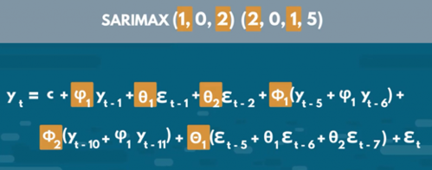
AR, MA, ARMA, ARIMA, ARIMAX, SARIMAX
AR = Auto-Regressive (next point as linear combination of several previous) Y_forward1 = B0 + B1*Y + B2*Y_lag1 + ...
MA = Moving Average Y = B0 + B1*E_lag1 + B2*E_lag2 + ... + Bn*E_lagn , where "E" = residual errors (which change as we iteratively train the model)
"I" = Integrated (use differences to remove trend while modeling): Y_forward1 - Y = B0 + B1*(Y - Y_lag1) + B2*(Y_lag1 - Y_lag2) + ...
ARMA = AR + MA = Auto Regressive Moving Average model
ARIMA = AR + I + MA = Auto-Regressive Integrated Moving Average model
"X" = eXogenous variables (additional variables, think "multivariate regression")
ARIMAX = ARIMA with exogenous variables. An exogenous variable is a covariate that influence the observed time-series values
SARIMAX = Seasonal ARIMAX – includes seasonal factors
ACF = Auto-Correlation Function
PACF = Partial ACF
.. https://people.duke.edu/~rnau/411arim.htm
ARIMA(p, d, q) = ARIMA (AR, I, MA)
p = number of lagged values in AR model (number of autoregressive terms)
d = order of differencing (used for stationarity)
q = number of lagged errors in MA model
ARIMA(1,0,0) - 1st order autoregressive model
ARIMA(2,0,0) - oscillations
ARIMA(0,1,0) - random walk
ARIMA(1,1,0) - differenced first-order autoregressive model
ARIMA(0,1,1) - simple exponential smoothing:
ARIMA(0,1,1) - simple exponential smoothing with growth
ARIMA(1,1,1) - ...
ARIMA(0,2,1) - linear exponential smoothing
ARIMA(0,2,2) - linear exponential smoothing
Great explanation: .. https://towardsdatascience.com/understanding-arima-time-series-modeling-d99cd11be3f8
More links:
.. https://en.wikipedia.org/wiki/Autoregressive%E2%80%93moving-average_model
.. https://en.wikipedia.org/wiki/Autoregressive_integrated_moving_average
.. https://www.statsmodels.org/dev/examples/notebooks/generated/statespace_sarimax_stata.html
.. https://365datascience.com/tutorials/python-tutorials/sarimax/
.. https://people.duke.edu/~rnau/411arim.htm
Autoregressive Model: - https://www.youtube.com/watch?v=5-2C4eO4cPQ -
Autocorrelation and Partial Autocorrelation - https://www.youtube.com/watch?v=DeORzP0go5I -
ACF and PACF:
- https://towardsdatascience.com/significance-of-acf-and-pacf-plots-in-time-series-analysis-2fa11a5d10a8
SARIMAX

