Slide 1
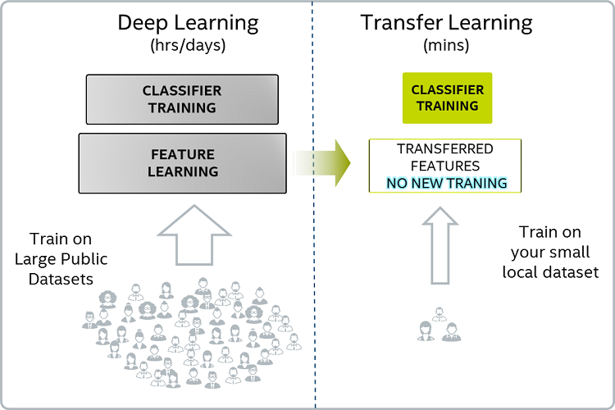
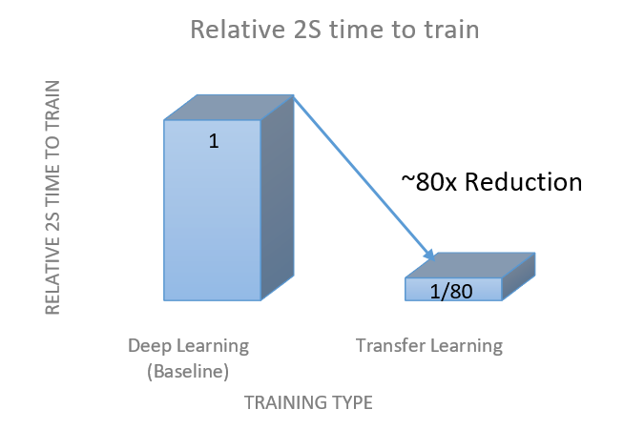
Transfer Learning
Transfer Learning is the key to general intelligence
- Demis Hassabis
Solve one problem, use gained knowledge to solve a different but related problem.
Ex. : Train a CNN to recognize cars. Then use first pre-trained layers of this CNN to effectively train new CNN to recognize trucks - using very small dataset of trucks. If objects a similar in nature, we can freeze these first layers, and only train the output fully-connected layers of the CNN. Which makes training much faster and easier.

Slide 2
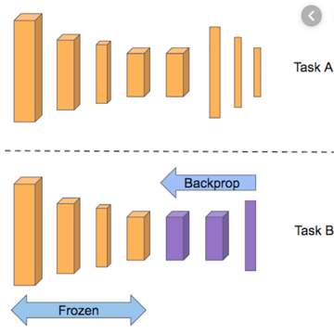
Transfer Learning
Transfer learning is a machine learning method
where a model developed for a task
is reused as the starting point for a model on a second task.

