Slide 1
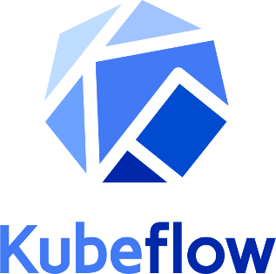



Kubeflow
Kubeflow began as an internal Google project,
it is a simple a way to ran TensorFlow on Kubernetes.
Kubeflow was open sourced at Kubecon conference (USA, December 2017).
Later it was expanded to be a multi-architecture, multi-cloud framework
for running entire ML (Machine Learning) pipelines.
Purpose - to make training and deployments of ML on Kubernetes simple, portable and scalable.
Kubeflow allows to:
do python coding in Jupyter notebooks
use popular training libraries and formats: TensorFlow, PyTorch, scikit-learn, XGBoost, ONNX - https://www.kubeflow.org/docs/components/serving/kfserving/
run code efficiently and securely in Kubernetes, isolated namespaces
portability between your laptop, on-prem cluster, or any of major clouds
portability between teams
Kubeflow’s hyperparameter tuner (Katib) saves days of training
Kubeflow Pipelines - build ML workflows for integration and deployment
- https://github.com/kubeflow/kubeflow/blob/master/ROADMAP.md
- https://www.kubeflow.org/docs/about/use-cases/
- https://en.wikipedia.org/wiki/Kubeflow
- https://medium.com/kubeflow/kubeflow-1-0-cloud-native-ml-for-everyone-a3950202751
Kubeflow was co-founded by Google engineers
Jeremy Lewi Google
David Aronchick Microsoft, Azure
(originally - Google)
Vishnu Kannan Google
David Aronchick - Azure, Microsoft (former Google)
- https://www.linkedin.com/in/aronchick/
Jeremy Lewi - Google - https://www.linkedin.com/in/jeremy-lewi-600aaa8/
Vishnu Kannan - Google - https://www.linkedin.com/in/vishnukanan/

