Slide 1
"AI is the New Electricity"
Andrew Ng, 2017

Slide 2

About me:
Lev Selector, Ph.D. – Mathematical Modeling, ML & AI
1977 - first programming project: Fortran, punch-cards
... - 1994 - math. modeling in biophysics
... - present – Data Science, Machine Learning & AI.

Slide 3
“AI is Life Extinction Event ?”
“AI - Tsunami ?”

Slide 4

“AI is the New Electricity”
AI like electricity will also change our lives in many ways which is difficult to predict.
Electricity came into our life ~120 years ago:
lamps and motors
telegraph, telephone, radio, TV, Internet
computers, IT, Machine Learning, AI
finance, trading
science, education, medical diagnostics
automation, robotics,
etc. etc.
Andrew Ng
co-founded and led Google Brain
was the chief scientist at Baidu Research (~1,300 people) for 3 years
adjunct professor at Stanford University
co-founder and chairman of Coursera - https://en.wikipedia.org/wiki/Andrew_Ng - https://www.coursera.org/learn/machine-learning - https://www.deeplearning.ai/
Landing AI - https://landing.ai/
Artificial Intelligence is the New Electricity - https://www.facebook.com/andrew.ng.96/videos/1268821713173733/ - https://www.youtube.com/watch?v=21EiKfQYZXc

Slide 5
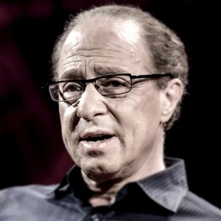
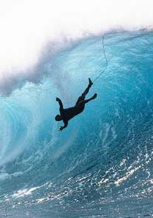
Ray Kurzweil, chief engineer for Google and famous futurist stated that "... ultimately, AI will benefit us in the same way that previous technologies have. ... My view is not that AI is going to displace us, ... (but) ... It’s going to enhance us. It does already.”
You need to get into AI asap to be able to surf the new wave, or this wave will drown you.
Ray Kurzweil
Millions of jobs will be "outsourced" to AI.
Also you will see new jobs, like "Chief AI Officer", AI departments.
We already see big shortage in AI specialists. Top AI talent is paid millions of $$.

Slide 6
Artificial General Intelligence (AGI)
AI that could successfully perform any intellectual task that a human can
(Turing test (1950), ...)
Artificial Intelligence (AI)
ML (DL) learning "human" abilities (speech and music recognition, conversation, visual recognition, video prediction, reasoning, self-driving cars, playing games, etc.)
Deep Learning (DL)
ML implemented as Neural Network
Machine Learning (ML)
DS where algorithm learns from data to make predictions
Data Science (DS)
computer skills + statistics
CSV files, SQL, PowerPoint

Slide 7
Overview of Machine Learning Models
Machine Learning Systems = Prediction Machines
ML = "Cheap Predictions"
AI = "Cheap Predictions"
Ajay Agrawal
University of Toronto

Slide 8
OK, so what is Machine Learning?
- A computer program
- used to describe data in a compressed way
- to make predictions and take actions
- most common ML tasks - regression or classification
Neural Networks (Deep Learning)
Standard ML
Simple Analytics
Other standard ML models may have up to 1-2 thousand parameters.
Classification & Regression
Logistic Regression
Decision trees (Random Forest, XGBoost)
K-Means, KNN, SVM (Support Vector Machines), PCA (Principal Component Analysis), LDA (Linear Discriminant Analysis), etc.
Example - classification – dog or cat. Model is usually implemented as a Convolutional Neural Network, and may use millions of parameters. Deep learning text (NLP) models can have up to 175 Bln parameters.
Some applications:
Recognizing images, music, speech
NLP = Natural Language Processing
Machine Translation
supervised, unsupervised, reinforcement learning
Generative Models (GANs)
Linear Regression y = f(x) = ax + b
Model uses only two numbers:
a = slope,
b = intercept

Slide 9
Recent breakthroughs in DL methods
made them practical
(effective, affordable, and easy).
Instead of software engineers manually coding if/else logic, DL algorithms can train networks equivalent to Billions of if/else-s. (Record of year 2020 – 175 Bln nodes)
Nowadays you can choose from a variety of pre-trained / pre-configured networks on the cloud. You don't have to code from scratch. You don't have to train from scratch
Distributed ML on Cloud (Google, Microsoft, Amazon, Intel, IBM, etc.) allow you to achieve ~100s petaFLOPS (x10,000 performance increase over the last 4 years). You don't have to build your own infrastructure
Prices dropping down precipitously

Slide 10
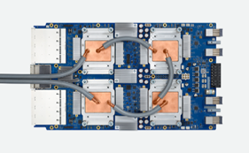
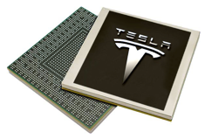
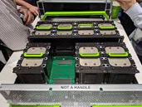
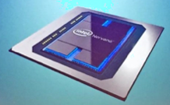

Specialized hardware.
Modern Neural Networks has become big – up to 175 Billion parameters (GPT-3, in 2020).
Common practice today is to split big NNs to train separately (in parallel on multiple computers).
Inference can also be parallelized.
GPU (NVIDIA, CUDA)
Intel Nervana
Facebook Zion Accelerator Platform
Google TPU v4 (2021)
(Tensor Processing Unit)
A single v4 pod contains 4,096 v4 chips, and can deliver more than one exaFLOPS (10¹⁸ Floating Point Operations per sec)
Tesla Dojo D1 AI chip
(2021, 1.08 exaFLOPS)
There are also many other vendors:
QUALCOMM
AMD
APPLE
Xilinx
IBM
HiSilicon
Amazon (FPGAs)
Microsoft (FPGAs)
and many more
HPC = High-Performance Computing InfiniBand = fast communication
FPGA = Field-Programmable Gate Array

Slide 11
Where and How ML & AI are used ?
ML = Machine Learning
AI = Artificial Intelligence
predictions (predictive analytics, forecasting, trends, investments, elections, sport & weather, news, etc.)
optimization of business processes, reducing costs
extracting information from text, fuzzy deduplication
image and face recognition
recommender systems
detection (anomaly, fraud, crime, terrorism, climate change, etc.)
self-driving cars (planes, boats, drones, construction/rescue machines, etc.)
robots (at home & at work), manufacturing robots
universal language translator, language understanding, concepts learning
music & literature composition, games and math.
medical diagnostics (using genomic, phenotypic, social, etc. data), surgery
intelligent secretary/helper, process management, traffic management
agriculture (pooling weeds, watering, etc.)
toys, military
combining AI with Virtual Reality and 3D printing
effective direct interface with human brain
etc. etc. etc.

Slide 12
AI in Context
Years
Artificial Intelligence (AI)
ML performing “human” functions
Deep Learning (DL)
ML implemented using multi-layered
structure (Neural Network)
Machine Learning (ML)
DS algorithm learns from data
Data Science (DS)
data + computer/statistics
Reinforcement Learning
alpha-Go
Unsupervised Learning
no labels, Google Translate
Supervised Learning
labeled data
Reasoning,
Inductive & Deductive Logic,
Knowledge Representation,
Ontology
2015
NLP,
Extracting Data from Text
2010
Chatbots,
Conversational
interfaces
Forecasting,
investments,
Resource Mgmnt
2005
Fraud Detection, Security,
Risk Mgmnt
2000
Recommender
Systems
Vision,
Robotics
Amount of data
Compute Speed

Slide 13
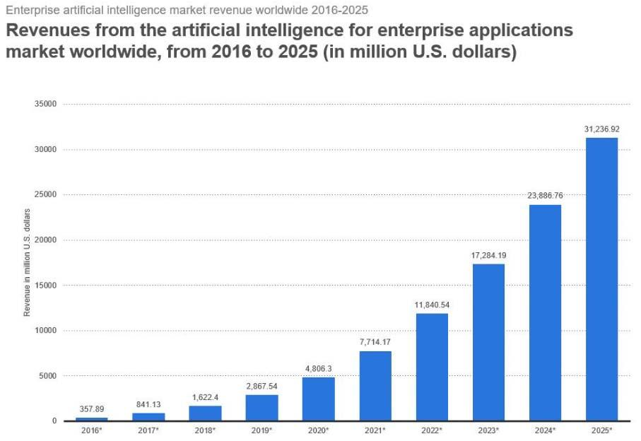
AI Growth Predictions
(Forbes, 2018)

Slide 14
Machine Learning & AI
How To Start
1. Are you a business owner or executive,
and want to start using ML & AI in your organization ?
2. Do you want to become a Data Scientist
and use existing ML technology?
3. Are you an enthusiast who wants to develop
new ML & AI methods?

Slide 15
If you are an Executive:
AI staff - create an AI department, host AI conferences and training, invite the best AI talent
Data – 80% of work. Get serious about collecting, cleaning, and labeling data
Compare and select ML tools from different vendors instead of building "from scratch"
Use pre-trained models
It is OK to use cross-cloud solutions. Do not lock yourself into a single vendor
Comply with GDPR (General Data Protection Regulation) and other regulations to assure privacy and fairness
Accent on "explainability" of algorithms
Use "human-in-the-loop" approach

Slide 16
If you want to study to become a Data Scientist.
Things change fast - you need to learn constantly. Subscriptions, YouTube, Twitter. Get YouTube Premium.
Start following some famous people on YouTube, Facebook, Twitter: (Yann LeCun, Geoffrey Hinton, Ian Goodfellow, Yoshua Bengio, Jürgen Schmidhuber, Andrew Ng, etc.)
Learn (youtube, coursera, …) : .. Python programming (also Pandas, Numpy, Scikit-Learn) .. Unix commands (Linux or Mac) .. SQL, Excel .. Some Statistics (youtube, ...) - Normal distribution, CLT, Binomial Distribution, Hypothesis testing, P-value, t-test, Chi-square test, Linear Regression .. Logistic Regression .. Standard Machine Learning (Linear & Logistic Regression, Random Forest, XGBoost, etc.) .. Deep Learning ( deeplearning.ai or some other course )
Listen to podcast: Sam Charrington – “This Week in Machine Learning & AI”
Follow Siraj Raval on youtube,
Follow Chris Olah: colah.github.io , distill.pub
Learn 100-200 terms (dictionary) related to .. training and evaluating models (error / loss function, Precision and Recall, Accuracy, ROC curve, confusion matrix, regularization, cross-validation, folds, etc.) .. other terms related to Data Science, Machine Learning, and AI – google them, make your own dictionary
Look at AutoML (h2o.ai, Microsoft AutoML, etc.)

Slide 17
If you want to develop new ML & AI methods.
Become a Researcher.
First study to become a Data Scientist.
Then you need to find a place where people do research.
It is usually a university of one of just a handful of companies:
Google
Facebook
Open AI
Microsoft
Apple
Baidu
etc.

