Slide 1
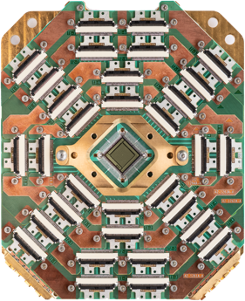
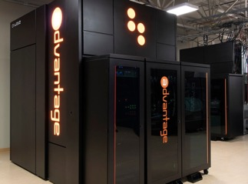
Quantum Computing
Quantum Computing (QC) is computing using quantum-mechanical phenomena, such as superposition and entanglement.
QC is potentially much faster than conventional computers.
QC will be able to break most common encryption schemes used today. Although this quantum supremacy has not been achieved yet. - https://medium.com/geekculture/quantum-computers-mirage-or-real-power-14241a01eb9a
Physicist Richard Feynman has mentioned potential power of quantum computers in 1982.
Physicist David Deutsch claimed that quantum computers will be able to solve problems that would take a traditional computer longer than the age of the universe.
Websites to read more: .. http://www.theory.caltech.edu/people/preskill/ - Prof. John Preskill .. https://www.scottaaronson.com/blog/?cat=4 - The Blog of Scott Aaronson
NASA, Google, IBM, CIA, etc. are working on quantum computers.
QuAIL - NASA’s Quantum AI Laboratory
D-Wave - up to 5,000 qubits (as of 2020) at costs of ~$10M. Users - Lockheed Martin, Google, NASA, USC, USRA and Los Alamos National Laboratory. D-Wave Systems is a private company (since 1999, Vancouver Canada, 160+ people) .. https://en.wikipedia.org/wiki/D-Wave_Systems .. https://www.dwavesys.com .. https://venturebeat.com/2020/09/29/d-wave-advantage-quantum-computing-5000-qubits-1-million-variables/
D-Wave 5,000 qubits

Slide 2
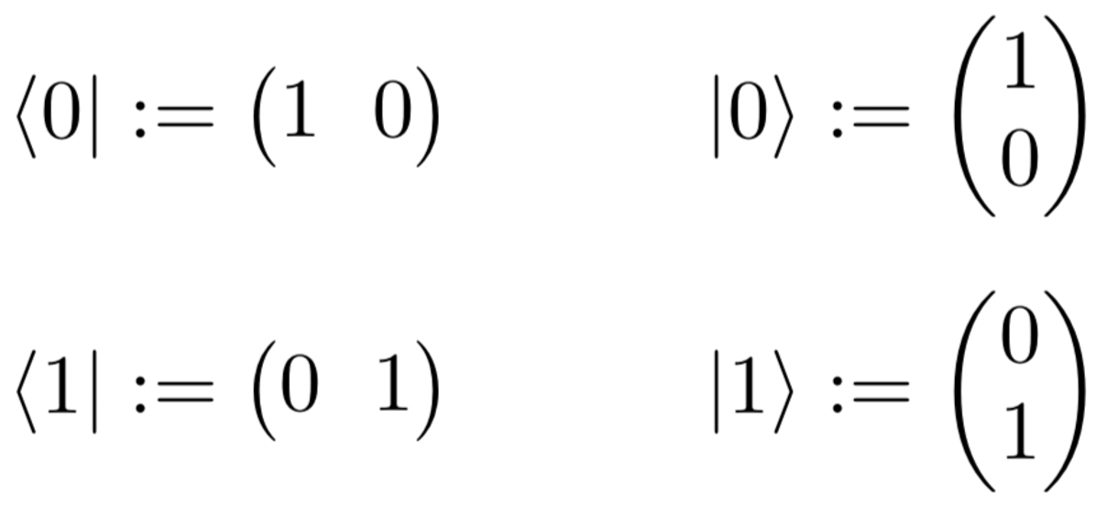
QuBit
A qubit (/ˈkjuːbɪt/) or quantum bit (sometimes qbit) is a unit of quantum information
A qubit is the quantum analogue of the classical binary bit.
Note how quantum states are represented by Dirac's "bra–ket" notation.
.. https://en.wikipedia.org/wiki/Bra%E2%80%93ket_notation
A pure qubit state is a linear superposition of the basis states |0⟩ and |1⟩.

Slide 3
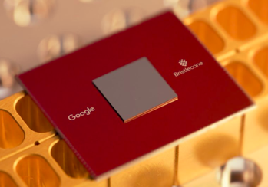
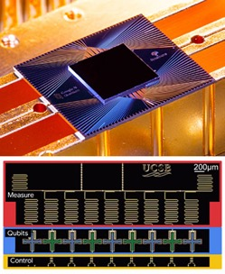
Google Quantum Computing
Google Quantum AI lab
Google’s Quantum Computer Is About 158 Million Times Faster Than the World’s Fastest Supercomputer .. https://medium.com/predict/googles-quantum-computer-is-about-158-million-times-faster-than-the-world-s-fastest-supercomputer-36df56747f7f -
Under the Hood of Google's Quantum Computer .. https://www.osa-opn.org/home/newsroom/2020/september/under_the_hood_of_google_s_quantum_computer/ -
Chemical Reaction Simulation .. https://www.scientificamerican.com/article/googles-quantum-computer-achieves-chemistry-milestone/ -
Google Bristlecone - 72 qubits
Google Sycamore chip – 53 circuits

Slide 4
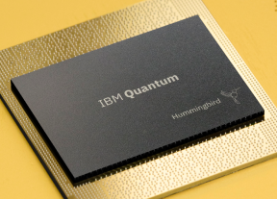
IBM Quantum Computing
IBM Quantum .. https://www.ibm.com/quantum -
Run projects on quantum machine .. https://quantum-computing.ibm.com –
https://arxiv.org/abs/1411.4028 - paper “A Quantum Approximate Optimization Algorithm”, 2014
Qiskit – open-source SDK for working with quantum computers. Originally from IBM. .. https://qiskit.org/ .. https://qiskit.org/documentation/finance/tutorials/

Slide 5
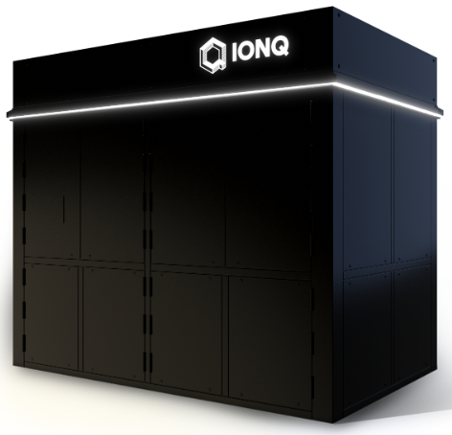
IonQ
IonQ is a quantum computing hardware and software company in Maryland, USA. They are developing a general-purpose trapped ion quantum computer and software to generate, optimize, and execute quantum circuits.
IonQ is claimed to be "The world’s most powerful quantum computer" .. https://ionq.com –
IonQ can be accessed from all 3 major clouds: .. AWS - https://aws.amazon.com/braket/ - .. Azure - https://azure.microsoft.com/en-us/services/quantum/ - .. Google - https://console.cloud.google.com/marketplace/product/ionq-public/ionq -
approx 450 algorithmic qubits
from qiskit_ionq import IonQProvider
from qiskit import QuantumCircuit
#hello many worlds
qc = QuantumCircuit(2, 2)
qc.h(0)
qc.cx(0, 1)
qc.measure([0, 1],[0, 1])
#run on IonQ hardware
ionq = provider.get_backend("ionq_simulator")
job = ionq.run(qc, shots=100)
print(job.get_counts())

Slide 6
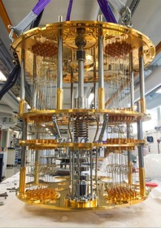
Microsoft Quantum Computing
Azure Quantum .. https://azure.microsoft.com/en-us/solutions/quantum-computing/ - .. https://azure.microsoft.com/en-us/services/quantum/
Search for quantum on Azure .. https://azure.microsoft.com/en-us/resources/whitepapers/search/?term=quantum –
QIO (Quantum Inspired Optimization) from Microsoft .. https://docs.microsoft.com/en-us/azure/quantum/optimization-overview-introduction

Slide 7

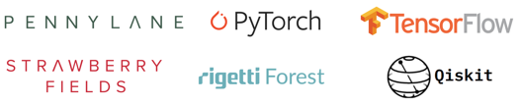
More Quantum Computing
There are some libraries, research, and toy projects, for example:
https://www.tensorflow.org/quantum -
https://qiskit.org/textbook/ch-machine-learning/machine-learning-qiskit-pytorch.html -
https://pypi.org/project/pytorch-quantum/ -

Slide 8
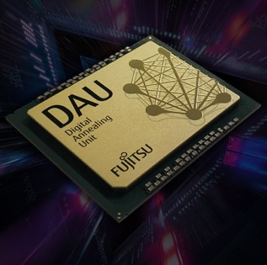
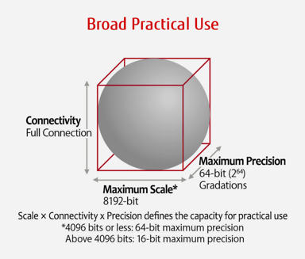
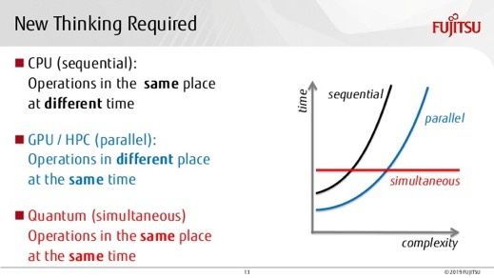
Fujitsu Digital Annealer
A specialized chip to solve massive combinatorial optimization problems.
Parallel, real-time optimization calculations.
Faster than GPUs.
https://www.fujitsu.com/us/services/business-services/digital-annealer/what-is-digital-annealer/
Fujitsu developed a “digital annealing unit” (DAU), a custom CMOS chip (similar to FPGA) with an architecture designed for efficient solving large-scale optimization problems.
It uses a version of classical simulated annealing method.
But for marketing purposes they say that it is “quantum-inspired”,
because “quantum annealing” is a variant of "simulated annealing".
But of course DAU is not "quantum".
Execution
time

Slide 9
Some Resources
Finovate conference in Sept in NY – 7 min demo - https://informaconnect.com/finovatefall/ -
Conference – 30 min presentation - https://www.re-work.co/events/ai-in-finance-summit-toronto-2022 -
QIO (Quantum Inspired Optimization) from Microsoft (Microsoft uses Topological while IBM uses NISQ Quantum paradigms, different around noisy and number of qubits) .. https://docs.microsoft.com/en-us/azure/quantum/optimization-overview-introduction
Three types of use cases – targeting & prediction, trading optimization, risk profiling .. Targeting and prediction includes use case like Recommendation, Fraud, AML (Anti-Money-Laundering) .. Risk profiling - stress tests, complying with regulations, Monte Carlo, Based III standards compliance, etc. .. https://www.ibm.com/thought-leadership/institute-business-value/report/exploring-quantum-financial
Case study of BBVA for use cases llike Currency arbitrage, Credit scoring, Portfolio optimization .. https://www.accenture.com/cr-en/case-studies/technology/quantum-computing-in-financial-services -
References different use cases including bank of me, sustainability etc. .. https://www.mastercard.com/news/perspectives/2022/quantum-computing-financial-services/ -
Use cases spanning trading, credit scoring, underwriting, risk management and cybersecurity; report includes case studies for Willis Towers, Project Natick .. https://azure.microsoft.com/en-us/resources/quantum-impact-financial-services/
Ally exploring use cases with Microsoft spanning knowing why a customer is likely to contact a call center to portfolio management and streamlining business process .. https://venturebeat.com/2021/04/22/ally-partners-with-microsoft-to-explore-quantum-computing-use-cases-in-fintech/ -
QIO algorithms references that were used by Toyota to optimize timing of traffic signals, used by Trimble to identify most efficient routes for fleets or vehicles etc. .. https://www.geekwire.com/2021/microsoft-and-kpmg-get-set-to-test-quantum-computing-with-real-world-problems/ -

