Slide 1


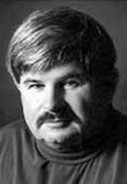

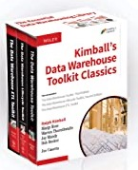
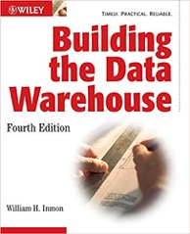

Kimball DW Framework
Inmon DW Framework
Kimball Group – closed in 2015
https://www.kimballgroup.com/
William H. Inmon
(1945 – present)
Ralph Kimball
(1944 – present)

Slide 2
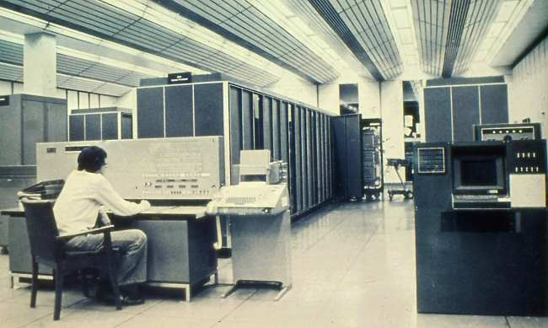
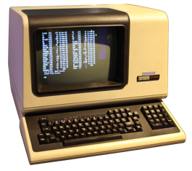
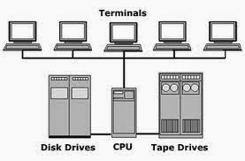

The Times of Inmon & Kimball
Imagine computers of 1970s.
A computer occupy the whole floor of a building
Computer have memory measured in 10s of Kilobytes
Punch cards slowly transition to magnetic tapes
IBM introduced VSAM files, relations, SQL
Usually just one computer in whole organization (IBM Mainframe or similar)
"Dumb terminals" connecting to the central computer. There are no personal computers
All company's information is typically stored in one central computer
In 1985 a "BIG" database would have 100 MBytes disk storage and 10-15 KB/sec data transfer speed
These are times when Inmon & Kimball were crafting their approaches.
As computers have become cheaper and more powerful, organization were able to buy several computers – one per department. Then people had to decide how to structure flows of information.
Inmon: from central main computer down to departments
Kimball: from departments to central
Now 30-40 years later any smart phone is more powerful than "huge" DW systems of Inmon & Kimball's era.
https://www.dataversity.net/a-short-history-of-data-warehousing/

Slide 3
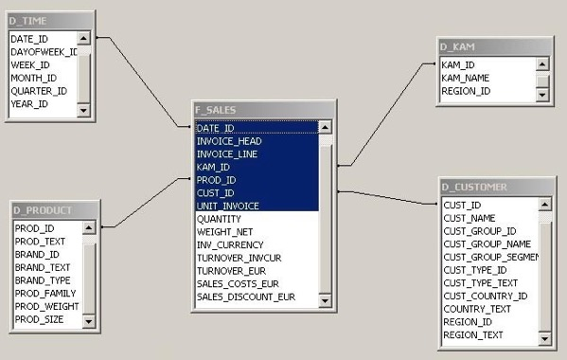
OLAP Cube – Rise and Fall
Old way of doing things:
Data >> Raw DB >> DW >> OLAP Cube >> Reporting
The above "old way" Includes a lot of ETL, Data modeling & Design:
Kimball Framework
Inmon Framework
Data Vault by Dan Linstedt (combines Kimball & Inmon).
But imagine that memory and compute power have become so cheap
that your regular SQL database can run any queries very fast
using in-memory columnar storage
and MPP = Massive Parallel Processing.
Then you don't need to hire data modelers.
You don't need all the OLAP infrastructure.
You can simply query your data as it is.
Data >> Reporting
Kimball "Star Schema"
Dimensional data Modeling
The Rise and Fall of the OLAP Cube - by Cedric Chin (2020) - https://www.holistics.io/blog/the-rise-and-fall-of-the-olap-cube/
OLAP Past, Present, and Future
- https://senturus.com/blog/olap-past-present-future/

Slide 4
Inmon vs Kimball
Ralph Kimball’s paradigm:
Each department in a company has its own Data Mart (DM). The company's DW (Data Warehouse) is the conglomerate of all DMs.
Information is always stored in the dimensional model.
Bill Inmon’s paradigm:
A company has one central DW (Data Warehous). Data Marts (DMs) source their data from the DW.
In the DW, information is stored in 3rd normal form. ( https://en.wikipedia.org/wiki/Third_normal_form )

Slide 5
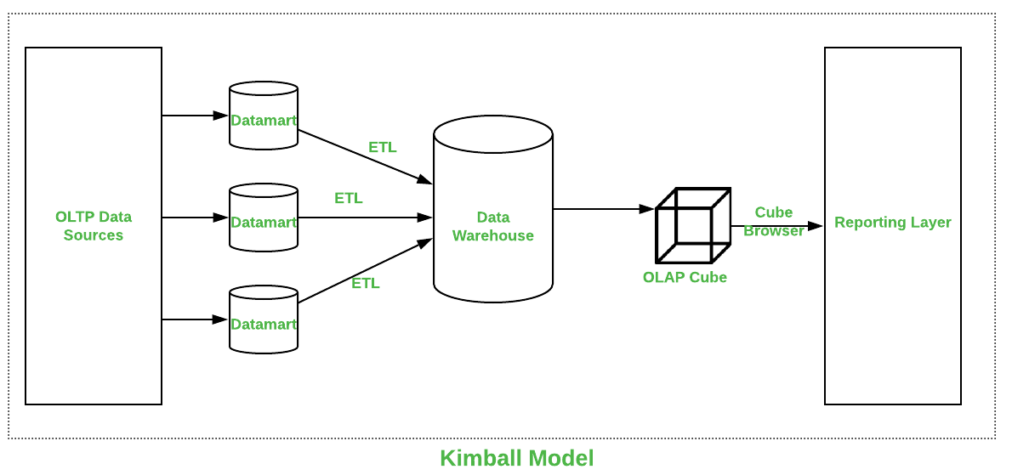
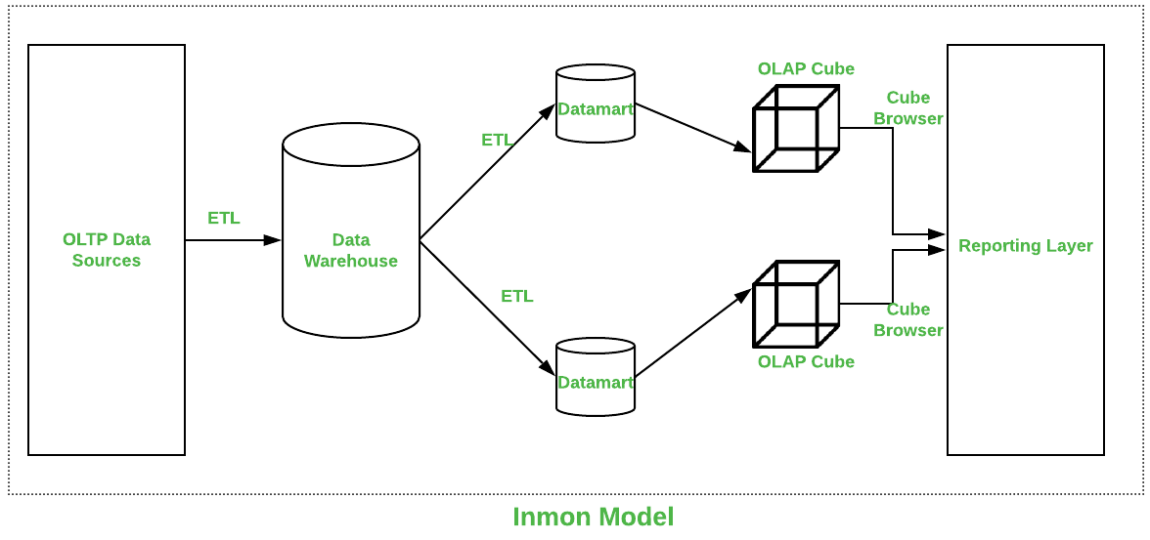
Kimball vs Inmon
This is no longer needed
Parameters | Kimball | Inmon
Introduced by | Introduced by Ralph Kimball. | Introduced by Bill Inmon.
Approach | It has Bottom-Up Approach for implementation. | It has Top-Down Approach for implementation.
Data Integration | It focuses Individual business areas. | It focuses Enterprise-wide areas.
Building Time | It is efficient and takes less time. | It is complex and consumes a lot of time.
Cost | It has iterative steps and is cost effective. | Initial cost is huge and development cost is low.
Skills Required | It does not need such skills but a generic team will do job. | It needs specialized skills to make work.
Maintenance | Here maintenance is difficult. | Here maintenance is easy.
Data Model | It prefers data to be in De-normalized model. | It prefers data to be in normalized model.
Data Store Systems | In this, source systems are highly stable. | In this, source systems have high rate of change.

Slide 6

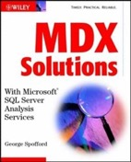


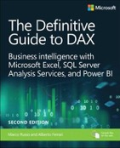
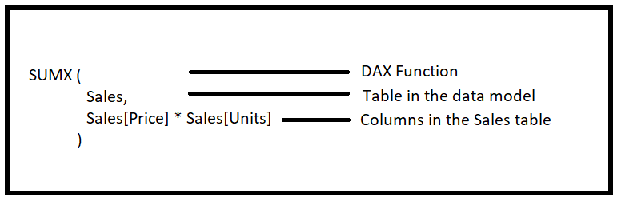
MOLAP, MDX, DAX
SSAS (Microsoft SQL Server Analysis Services).
1999 - MOLAP - multidimensional engine and MDX (pre-aggregated data)
2009 - tabular VertiPaq engine and DAX (vertically packed in-memory data)
MDX (MultiDimensional eXpressions) – by Mosha Pasumansky
https://en.wikipedia.org/wiki/Mosha_Pasumansky
https://www.linkedin.com/in/mosha/
https://www.youtube.com/watch?v=mX51gMNsT5M (Mosha sings)
DAX (Data Analysis eXpressions) by Amir Netz , Cristian Petculescu, and Microsoft team,
self-service, measure-based, visual, interactive, slice/dice.
https://en.wikipedia.org/wiki/Data_analysis_expressions
https://www.kasperonbi.com/the-rise-and-history-of-power-bi-with-amir-netz/
https://www.youtube.com/watch?v=izOppfQGanI
https://news.microsoft.com/stories/people/amir-netz.html
Amir Netz Microsoft since 1997
Mosha Pasumansky,
Microsoft 2005-2011,
Google 2011-Present
Cristian Petculescu Microsoft since 1997

Slide 7


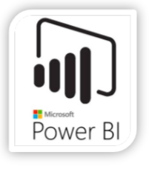
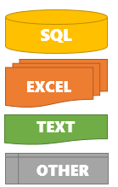






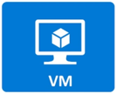

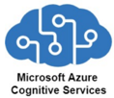

Azure - The Modern Data Warehouse Solution Pattern
Ingest, Store,
Prepare, Analyze,
Train, & Serve Data
Move from on-prem to cloud
Include all tools: data moving, storing, processing, analysis, and serving
All tools are interconnected and work together (Synapse)
Azure Data Lake Storage Gen2
Synapse
Integrate
Data Pipelines
Machine Learning
Web End-Points

Slide 8


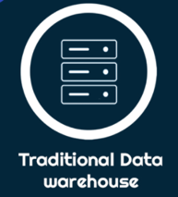
Much Better !
Modern Cloud-Based Data Warehouse
Traditional On-Prem Data Warehouse
Multi-component architecture allows for fast and flexible configuration to fit desired results
Data moving and preparation is fast and scalable
Speedy and efficient time-to-analytics
More manageable and customizable cost of ownership
Analytics-driven rise in productivity across the organization
Access is always available
Scalable from small to large amounts of data
Expensive/high-maintenance on-premise server setup
Rigid structure relying mostly on scheduled ETL processes
Limited speed potential
Expensive upgrades (hardware)
Limited scalability
Overall slower limited analytical processing

Slide 9
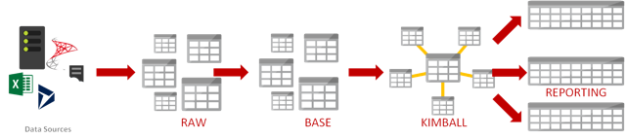
Should we still use a Kimball approach
on a modern data warehouse?
Kimball's "Star Schema"
facts table in the middle
surrounded by dimensions tables
Answer in most cases – yes.
Not for performance reason, but for better data maintenance.
Kimball's star schema always had three advantages:
takes less storage space – no longer relevant
performance – no longer relevant
data maintenance (loads, updates, restructuring)
Wide denormalized tables can have good performance,
but updating a "dimension" field in a denormalized table may require updating millions of records.
Also if we loading data from several different systems, a Kimball approach helps to identify and standardize common dimensions.
Also when implementing dashboards, fact table and dimension tables make queries easier to do.
Good discussions:
https://discourse.getdbt.com/t/is-kimball-dimensional-modeling-still-relevant-in-a-modern-data-warehouse/225
https://www.linkedin.com/pulse/kimball-still-relevant-modern-data-warehouse-simon-whiteley/

Slide 10

Who Invented Azure DW MPP Technology?
In 2008 Microsoft acquired DATAllegro.
DATAllegro was a company that specialized in data warehousing appliances. Similar to IBM Netezza, but running on top of commodity Dell Linux servers.
It was founded in 2003 by Stuart Frost.
SQL Server Parallel Data Warehouse was built using this technology and a version of the SQL Server database engine.
https://en.wikipedia.org/wiki/DATAllegro
https://www.linkedin.com/in/stu-frost/
https://www.crunchbase.com/person/stuart-frost
https://geminos.ai/
Stuart Frost

Slide 11
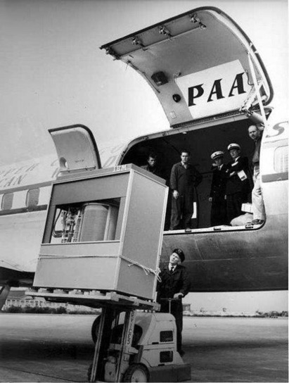
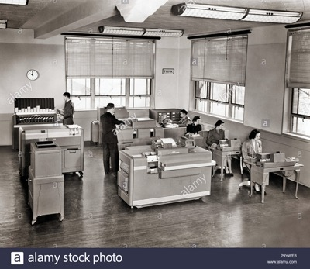
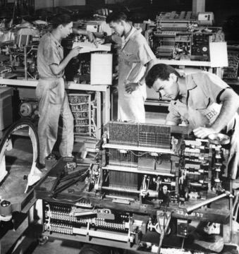
History
IBM – Punch-Cards in 1950s
1956 – loading 5 MB disk into a plane

Slide 12
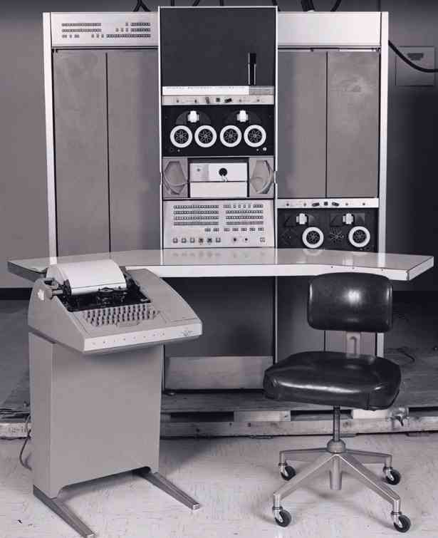
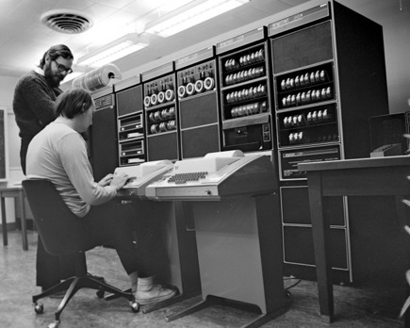
History - Unix
Ken Thompson (seated) and Dennis Ritchie (standing)
at a PDP-11 in 1972.
https://homepage.cs.uri.edu/~thenry/resources/unix_art/ch02s01.html
PDP-7 minicomputer (1969) on which Ken Thompson created the Space Travel game
and Unix OS

