Slide 1


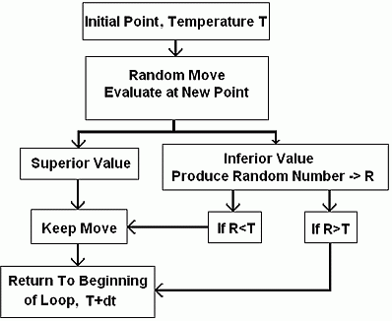
Simulated annealing (SA)
Need Picture
Svetlana V. Semenovskaya
Armen G. Khachaturyan
Boris K. Vainshtein
Annealing (metallurgy) - heating and controlled cooling of a material to increase the size of its crystals and reduce their defects.
Simulated Annealing (SA) - a probabilistic technique for approximating the global optimum of a given function in a large search space.
Slow cooling implemented in the Simulated Annealing algorithm is interpreted as a slow decrease in the probability of accepting worse solutions as the solution space is explored.
Note: accepting worse solutions is a fundamental property of metaheuristics because it allows for a more extensive search for the optimal solution.
The method is an adaptation of the Metropolis–Hastings algorithm, a Monte Carlo method to generate sample states of a thermodynamic system, invented by M.N. Rosenbluth and published by N. Metropolis et al. in 1953.

