Slide 1
James-Stein Estimator
Stein's Example (paradox, phenomenon) - https://en.wikipedia.org/wiki/Stein%27s_example
Suppose we have random m-dimensional vector Y, where m >= 3, all components are normally distributed with sigma=1 and mutually independent from each other. Suppose the vector θ is the unknown mean vector of mean values of components of Y.
Suppose we want to estimate θ based on a single observation of Y. As the components are independent, you would think that your best bet is to use values of Y for that estimation. But actually there is a combined JS estimate which is better (on average), mostly because it reduces the influence of individual outliers by combining (mixing-in) the values from other independent components of the same sample observation vector. This estimator is named after Charles Stein of Stanford University, who discovered the phenomenon in 1955, and further developed with Stein's graduate student Willard James).
"ESTIMATION WITH QUADRATIC LOSS", 1961:
- https://digitalassets.lib.berkeley.edu/math/ucb/text/math_s4_v1_article-19.pdf
- http://www.statslab.cam.ac.uk/~rjs57/SteinParadox.pdf - nice clear explanation
Important Note: It doesn't work for m=2 dimensions, it should be 3 dimensions, or more.
Charles M. Stein
( 1920-2016 )
Statistics,
Stanford
Maximum likelihood Estimation
(LS = Least Squares)
James-Stein Estimator (shrinked and biased)
sample vector
Note how the correction is different for each sample vector "y", it depends on squared normalized length of this vector.
A quirky example would be estimating the three unrelated values together (given a sample): speed of light, tea consumption in Taiwan, hog weight in Montana. Note that any particular component (such as the speed of light, for example) would improve for some parameter values, and deteriorate for others.

Slide 2
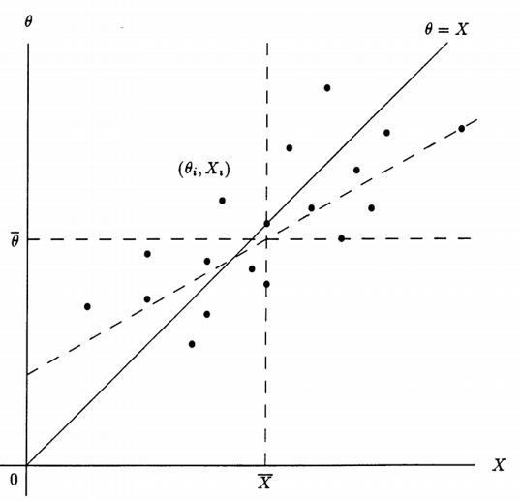
The 1988 Neyman Memorial Lecture: A Galtonian Perspective on Shrinkage Estimators
By Stephen M. Stigler
https://projecteuclid.org/download/pdf_1/euclid.ss/1177012274
also these slides:
https://maxkasy.github.io/home/files/teaching/TopicsEconometrics2019/NormalShrinkage-Slides.pdf
For each i in [1,..k], X_{i} is normally distributed with mean θ_{i} . We want to find estimate for each θ_{i} to minimize the sum of MSE. This is equivalent to standard linear regression with k-points (X_{i} , θ_{i}) – see the graph.
For number of dimensions k = 2 there are only two points, so you can draw only one line.
But for k >= 3 , E(X|θ) is generally not same as E(θ|X) .
X is distributed normally with mean θ, so E(X_{i}|θ_{i}) = θ_{i}
So If we estimate X from θ , we simply follow line θ = X.
But if we estimate θ from X - then we will generally get different estimate of θ. JS estimator shrinkage is derived by finding estimators of the form
θ_{i} = a+b·X_{i}
and finding values of a and b that minimize loss.

Slide 3
Visualizing the James-Stein Estimator
by Naftali Harris, 2013
read this
https://www.naftaliharris.com/blog/steinviz/
Naftali.Harris@gmail.com
https://www.sentilink.com/about/
https://www.naftaliharris.com/blog/ten-stat-ideas/
Here:
"y" – sample vector with "m" components
Note how the correction is different for each sample vector "y", it depends on squared normalized length of this vector.

Slide 4
James-Stein Estimator - continued
Why is the James-Stein estimator called a “shrinkage” estimator?
- https://en.wikipedia.org/wiki/James%E2%80%93Stein_estimator
- https://stats.stackexchange.com/questions/304308/why-is-the-james-stein-estimator-called-a-shrinkage-estimator
Why isn't the James Stein estimator the standard method for linear regression if it is strictly better than OLS when there are more than 2 covariates?
- https://www.quora.com/Why-isnt-the-James-Stein-estimator-the-standard-method-for-linear-regression-if-it-is-strictly-better-than-OLS-when-there-are-more-than-2-covariates
The picture above shows the shrinking of individual batting averages toward the overall "average of averages" by ~80% .
Stein's Paradox in Statistics – by Bradley Efron and Carl Morris (Scientific American, 1977)
- http://statweb.stanford.edu/~ckirby/brad/other/Article1977.pdf
In this "Scientific American" article, Efron explained the paradox with a baseball example: while most people would think the best prediction for the end-of-season batting averages of 10 players would be obtained by looking at each player's early average, the James-Stein theorem showed that including other players' averages leads to a better result. This is a paradox because players' individual performances shouldn't influence each other.

Slide 5
SURE = Stein’s Unbiased Risk Estimate (1981)
Note: the abbreviation "SURE" may also relate to "Seemingly Unrelated Regression Equations" describing the SUR model proposed by Arnold Zellner in 1962.
Estimation of the Mean of a Multivariate Normal Distribution
by Charles M. Stein, Stanford, 1981
- http://www.stat.cmu.edu/~larry/=sml/stein.pdf
- https://en.wikipedia.org/wiki/Stein%27s_unbiased_risk_estimate
- https://projecteuclid.org/download/pdf_1/euclid.aos/1176345632
Stein's unbiased risk estimate (SURE) is an unbiased estimator of the mean-squared error of "a nearly arbitrary, nonlinear biased estimator." In other words, it provides an indication of the accuracy of a given estimator.
A standard application of SURE is to minimize the risk estimate. For example, the technique has been used by Donoho and Johnstone to determine the optimal shrinkage factor in a wavelet denoising setting.
"Adapting to Unknown Smoothness via Wavelet Shrinkage", 1995

