Slide 1





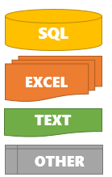








Azure Synapse
Azure Data Lake (Files in Blob Storage)
Synapse
Integrate
Streaming Data
SQL
Data Pipelines
Serverless
and Dedicated SQL Pools
Pre-aggregated Data
Distributed Parallel Data Processing, Machine Learning
Machine Learning
Web End-Points

