Slide 1

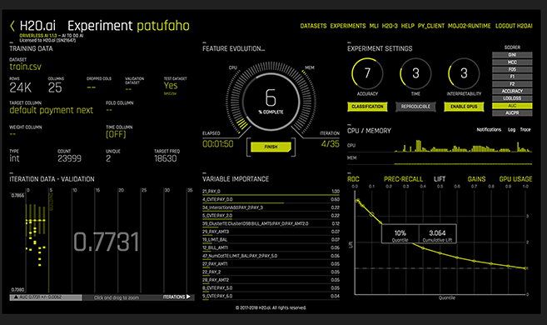
H₂O.ai
- https://www.h2o.ai/ - since 2011 as Oxdata, since 2014 as H₂O
- https://en.wikipedia.org/wiki/H2O_(software)
- https://www.linkedin.com/company/h2oai/ (~200 employees) - leading open source ML & AI platform
- https://github.com/h2oai
- estimated ~250K users, over 18K companies
- free open-source, free for academic use, collaboration with researches
(Java, Python, R – runs on Linux, macOS, MS Windows, Hadoop/Spark)
- integrates with python/Jupyter, provides in-browser graphical interface
conda install -c h2oai h2o=3.22.1.2
import h2o
h2o.init(max_mem_size = "2G")
from h2o.estimators.glm import H2OGeneralizedLinearEstimator
glm_multi_v1 = H2OGeneralizedLinearEstimator( ... )
glm_multi_v1.train( ... )
...
- paid option – "Driverless AI" – available on major clouds.
- http://docs.h2o.ai/driverless-ai/latest-stable/docs/userguide/index.html
- uses clusters of GPU-servers to run hundreds of models in parallel
- provides automatic feature engineering
- MLI (ML Interpretability)
SriSatish Ambati
CEO
Mountain View, CA
Cliff Click
CTO
San Jose, CA
Youtube videos:
- 6 min demo - https://www.youtube.com/watch?v=wcyMBRRLmqs
- Feature Enginering (Dmitry Larko) - https://www.youtube.com/watch?v=irkV4sYExX4
- Driverless AI MLI (Interpretability) - https://www.youtube.com/watch?v=5jSU3CUReXY

Slide 2

H2O.ai – Automatic Feature Engineering
Driverless AI .. https://h2o.ai/platform/ai-cloud/make/h2o-driverless-ai/
Automatic Feature Engineering .. https://docs.h2o.ai/driverless-ai/latest-stable/docs/userguide/feature-engineering.html
New features are created by doing transformations and/or interactions on the dataset columns.
Feature creation uses genetic algorithm to find the best set of feature transformations and model parameters for an experiment/dataset. Feature creation and selection is evolutionary (based on variable importance of previous iteration) .. https://docs.h2o.ai/driverless-ai/latest-stable/docs/userguide/ga.html#ga
Driverless AI Transformers (Numeric, Categorical, Time & Date, NLP (text), Image, etc.) See big list of transformers here: - https://docs.h2o.ai/driverless-ai/latest-stable/docs/userguide/transformations.html#transformations
Feature Interactions: - https://docs.h2o.ai/driverless-ai/latest-stable/docs/userguide/expert_settings/features_settings.html#max-feature-interaction-depth

