Slide 1

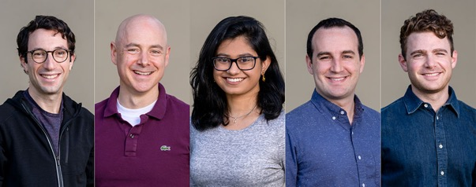
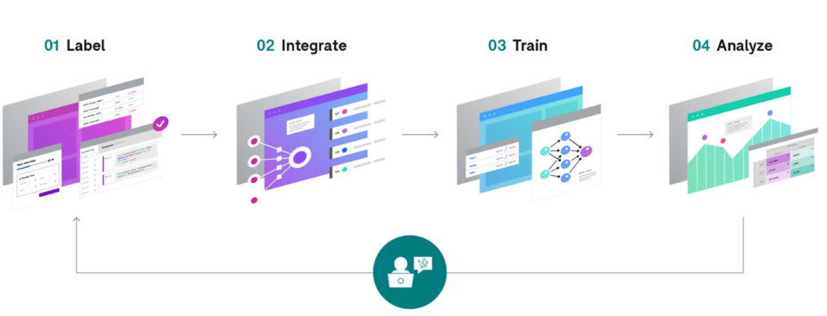
Snorkel.AI
• Snorkel AI, Inc. (https://snorkel.ai/)
• Project at Stanford in 2015, company in 2019
• Idea - Data-centric AI, feedback to auto-label data,
Labeling functions
• Fundraising: 3M (2019), 12M (2020), 120M(2021)
• Valuation $1B in August 2021
• https://github.com/snorkel-team
• https://greylock.com/portfolio-news/snorkel-making-ai-practical-investment/
• https://www.youtube.com/watch?v=pc2wzsXHbz4
• https://snorkel.ai/how-to-use-snorkel-to-build-ai-applications/
The Snorkel co-founders:
Alex Ratner, Chris Ré, Paroma Varma, Braden Hancock, and Henry Ehrenberg

Slide 2
From Andrew Ng lectures.
Notice feedbacks.

