Slide 1
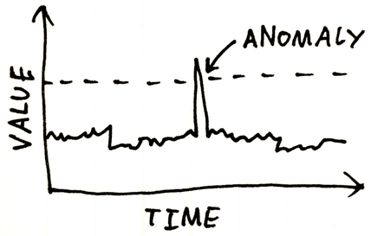
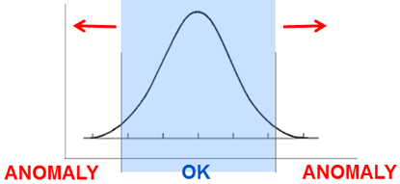
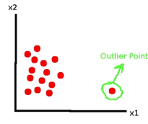
Anomaly Detection, Fraud Detection
Anomalies a.k.a. outliers, novelties, noise, deviations, exceptions.
Examples: fraud, a structural defect, medical problems or errors in a text.
Anomaly detection techniques:
1. Unsupervised 2. Supervised
3. Semi-supervised
Anomalies may be not rare, for example, bursts of intrusion activity.
Unsupervised methods may fail in these cases.
Examples of methods:
- clustering (SVM, etc.)
- represent state as image, use ConvoNet to detect anomaly "visually"

Slide 2
Outlier Detection methods:
Density-based techniques (k-nearest neighbor, local outlier factor, isolation forests, etc.).
Subspace- and correlation-based outlier detection for high-dimensional data.
One-class support vector machines.
Replicator neural networks.
Bayesian Networks.
Hidden Markov models (HMMs).
Cluster analysis-based outlier detection.
Deviations from association rules and frequent itemsets.
Fuzzy logic-based outlier detection.
Ensemble techniques, using feature bagging, score normalization, and different sources of diversity.
Benford's law - https://en.wikipedia.org/wiki/Benford%27s_law - first-digit law, is an observation about the frequency distribution of leading digits in many real-life sets of numerical data.
Application to data security:
intrusion detection systems using threshold statistics
based on profiles of users, workstations, networks,
remote hosts, groups of users, and programs based
on frequencies, means, variances & covariances.
The counterpart of anomaly detection in intrusion detection is misuse detection.

Slide 3
How to select features to train anomaly-detection model.
- remove features with a lot of missing data (we don't want to impute missing data)
- remove features which have no variance (no relation to events)
- look at collinearity of features
# find which columns' values change their distribution the most
# when we change from rows with Class=0 to Class==1.
# To compare two distributions we will use Kolmogorov-Smirnov test.
# - https://en.wikipedia.org/wiki/Kolmogorov%E2%80%93Smirnov_test
# Note - this is just one of many tests, for example, read this discussion:
# - https://stats.stackexchange.com/questions/1001/is-spearmans-correlation
#
# function ks_2samp(array1, array2)
# compares distributions of values in two arrays and returns p_value
# p_value > 0.4 - distributions are very similar (identical)
# p_value very small - distributions differ
Practical Machine Learning: New Look at Anomaly Detection - by Ted Dunning and Ellen Friedman (2014)
- https://mapr.com/practical-machine-learning-new-look-anomaly-detection/assets/practical-machine-learning-new-look-anomaly-detection.pdf
How to: Execute Anomaly Detection at Scale (Dataiku.com. 2020)
- https://pages.dataiku.com/hubfs/Guidebooks/Anomaly%20Detection/anomaly-detection-guidebook.pdf
How to prepare/construct features for anomaly detection (network security data)
- https://stats.stackexchange.com/questions/141017/how-to-prepare-construct-features-for-anomaly-detection-network-security-data
Kaggle Credit Card Fraud Data Set - https://www.kaggle.com/mlg-ulb/creditcardfraud -
Features for Credit Card Fraud Detection - https://towardsdatascience.com/how-to-create-good-features-in-fraud-detection-de6562f249ef
Feature Engineering for Fraud Detection - https://github.com/dachosen1/Feature-Engineering-for-Fraud-Detection
A Feature Extraction Method for Credit Card Fraud Detection - https://ieeexplore.ieee.org/document/8782457
etc.

