Slide 1
Today's topic:
How do we evaluate the quality
of a binary classifier or a medical test ?
Precision, Recall, ROC, AUC,
F1, Sensitivity, Specificity, etc.

Slide 2
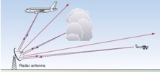

ROC Curve & Precision-Recall Curve
Receiver Operating Characteristic (ROC) curves for a binary classifier:
True Positive Rate (TPR) vs False Positive Rate (FPR)
at various threshold settings.
ROC curve was first developed by radar engineers during World War II
for quantifying the quality of detection of enemy airplanes.
TPR = REC = Recall or Sensitivity = TP/P = TP / (TP + FN)
( planes classified as planes / all planes' events)
FPR = False Positive Rate = fall-out = FP / N = FP / (FP + TN)
( noise classified as planes / all noise events )
PRE = Precision = TP/(TP+FP)
( planes classified as planes / all events classified as planes)
TNR = SPC = Specificity = TN/N = TN/(FP+TN)
(True Negative Rate)
--------------------------------------------------------------------------------
AUC = Area Under the Curve
Simply the area under the ROC curve (1 = very good, 0.5 = bad)
--------------------------------------------------------------------------------
F1 Score - a single number evaluation metric, harmonic average
of the precision and recall :
Radar detects planes.
It need to separate
"plane" signals from noise.
Planes
Noise
High Precision, Low Recall
Selecting Threshold
Low Precision, High Recall
Recall
Low Threshold
ROC
Curve
Precision-Recall
Curve
High Threshold
FPR

Slide 3


Noise
Planes
Noise
Planes
Precision – 100%
Recall – 15%
Good Precision = Sniper
Noise
Planes
Precision – 50%
Recall – 100%
Good Recall = Cover All
Good
Noise
Planes
Ideal:
Precision – 100%
Recall – 100%
+
Noise
Planes
Good:
Precision – 90%
Recall – 90%

Slide 4
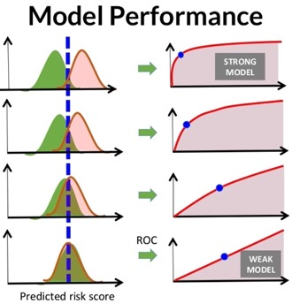
For measuring the performance of retrieval systems, several measures are used that depends on the following four major parameters:
True Positive (TP): True is identified True (correct identification)
True Negative (TN): False is identified False (correct identification)
False Positive (FP): True is identified False (wrong identification)
False Negative (FN): False is identified True (wrong identification)
P = TP + FN (number of correct identification cases)
N = FP + TN (number of wrong identification case) 25
Sensitivity = Recall = True Positive Rate (TPR) : TPR = (TP / P) = TP / (TP + FN)
Specificity (SPC) or True Negative Rate (TNR) : SPC = (TN / N) = TN / (FP + TN)
Precision or Positive Predictive Value (PPV) : PPV = TP / (TP + FP)
Negative Predictive Value (NPV) : NPV = TN / (TN + FN)
Fall-Out or False Positive Rate (FPR) : FPR = (FP / N) = FP / (FP + TN) = 1 – SPC
False Discovery Rate (FDR) : FDR = FP / (FP + TP) = 1 – PPV
Miss Rate or False Negative Rate (FNR) : FNR = FN / (FN + TP)
Accuracy (ACC) : ACC = (TP+TN) / (P+N)
F1 Score : F1 = 2*TP/(2*TP+FP+FN)
Mathews Correlation Coefficient (MCC):
MCC=(TP*TN-FP*FN)/sqrt((TP+FP)*(TP+FN)*(TN+FP) *(TN+FN))
Informedness = Sensitivity + Specificity -1
Markedness = Precision + NPV -1
From:
https://www.researchgate.net/post/How_do_I_calculate_the_false_alarm_rate_for_face_detection
From:
https://www.slideshare.net/KristenHunter/civitas-learning-understanding-roc-curves

Slide 5
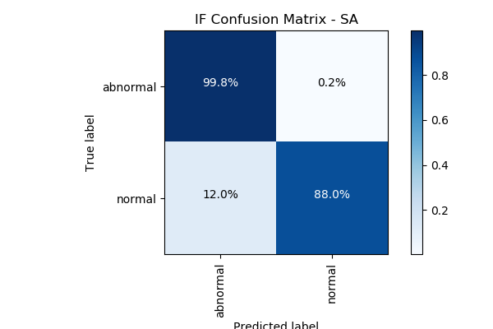
Confusion Matrix
For a simple binary classifier we are predicting one of two possibilities (Yes/No, Positive/Negative, Plane/No-Plane, Normal/Abnormal, etc.).
So we construct a 2x2 matrix to visualize True & False Positives and Negatives.
from sklearn import metrics
expected = target
predicted = model.predict(data)
metrics.precision_score(expected, predicted)
metrics.recall_score(expected, predicted)
metrics.roc_curve(expected, predicted)
metrics.roc_auc_score(expected, predicted)
metrics.confusion_matrix(expected, predicted)
[[194156 4864]
[ 23 321]]
Accuracy = sum(Diagonal) / sum(ALL) = sum(Correct) / sum(ALL)
Precision = TP / (TP+FP)
Recall = TP / (TP+FN) = TP / All_Actual_Positives

Slide 6
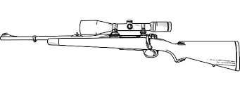

Accuracy = sum(Diagonal) / sum(ALL)
Precision = TP / (TP+FP) = TP / Predicted_Positives
Sniper
- high precision (zero FP)
- low recall (can't get everything)
Recall = TP / (TP+FN) = TP / Actual_Positives
Nuclear Bomb
- low precision (many FP)
- high recall (get everything)

Slide 7
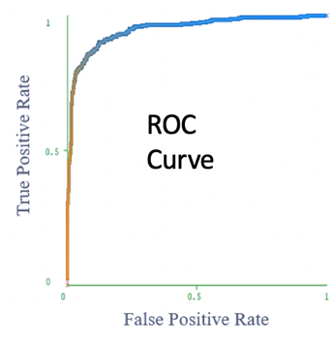
Good ROC curve is above diagonal
Optimal threshold – cut off most of noise, but catches most of planes
TP/P
Low Threshold – detect all events and all noise
Very high threshold.
Cut off all noise – and
most of "planes"
FP/N
ROC curve axes:
vertical = True Positives / All Actual Positives
horizontal = False Positives / All Actual Negatives

Slide 8
Medical Test Paradox – Predictive Power of Positive or Negative Test Result
from https://www.youtube.com/watch?v=lG4VkPoG3ko
Healthy
Sick
We have 1,000 people.
1% of them have a disease:
N_sick = 10
N_healthy = 990
We use a test with sensitivity SE = 90% and specificity SP = 91%.
This means that test shows results as following:
TP = True Positive = N_sick * SE/100 = 9 out of 10
TN = True Negative = N_healthy * SP/100 = 901 out of 990
FN = False Negative = 1 out of 10
FP = False Positive = 89 out of 990
What is the predictive power of this test?
Positive result : TP/(TP+FP) = 9/(9+89) = 0.092 (1 in 11 chance)
Negative result : TN/(TN+FN) = 901/(901+1) = 0.999 (very good)
Test Results:
Red = Positive
White = Negative
Specificity
Sensitivity
 | Positive | Negative
Disease | 9 | 1
Healthy | 89 | 901
Sensitivity = Recall = True Positive Rate (TPR) : TPR = (TP / P) = TP / (TP + FN)
Specificity (SPC) = True Negative Rate (TNR) : SPC = (TN / N) = TN / (FP + TN)

Slide 9
Example – Drug Test
Solution:
We have a drug test with the following characteristics:
false positives = 2%
false negatives = 1%
5% of population are drug positive.
If a person's test result is positive, what is the probability that this person is indeed drug positive?
FPR = 2% = FP/N
FP = 2% of 9,500 = 190
FNR = 1% = FN/P
FN = 1% of 500 = 5
TP = 500-5=495
95%
9,500 negative
10,000 people total
5%
500 positive
TN = 9,500-190 = 9310
TN = 9310
FN=5
If the person tests positive,
he is either TP or FP
Probability of being positive given the results of the test:
TP/(TP+FP) = 495/(495+190) = 0.72
FP
190
TP
495

Slide 10
Medical Tests
Merck Manuals:
https://www.merckmanuals.com/professional/special-subjects/clinical-decision-making/understanding-medical-tests-and-test-results
Healthy
Sick
Typical ROC Curves

