Slide 1
Probability & Statistics
If we throw 2 cubes, there are 6*6=36 possible combinations.
Probability of each combination is the same – 1/36.
If we define an outcome as a sum of numbers on top side of
cubes after the throw, then there are 11 possible outcomes:
---------------------------------------------------------
Sum Combinations Number of
combinations Probability
---------------------------------------------------------
2 1+1 1 1/36
3 1+2,2+1 2 2/36
4 1+3,2+2,3+1 3 3/36
5 1+4,2+3,3+2,4+1 4 4/36
6 1+5,2+4,3+3,4+2,5+1 5 5/36
7 1+6,2+5,3+4,4+3,5+2,6+1 6 6/36
8 2+6,3+5,4+4,5+3,6+2 5 5/36
9 3+6,4+5,5+4,6+3 4 4/36
10 4+6,5+5,6+4 3 3/36
11 5+6,6+5 2 2/36
12 6+6 1 1/36
---------------------------------------------------------
Total 36 1
From the table above you see how some outcomes can result
from more combinations, thus have higher probability of happening.
Note: Events can be mutually exclusive, or not.
Also, events may be independent, or dependent on each other.
Books on probability and statistics
https://www.quora.com/What-are-some-good-books-for-learning-probability-and-statistics
Introduction to Probability Theory
Probability Definitions
Probability of an event is the measure of the likelihood that
the event will occur (in some experiment).
Probability is a number between 0 and 1.
But sometimes people express probability using percents.
0 – event is impossible
0.5 – the event is just as likely to occur as it is to not occur
1 – event will certainly happen, 100%.
The sum of probabilities of all outcomes of an experiment
should always be 1.
Outcomes can be combinations of individual events.
For example, if we throw one dice cube – there are 6 possible
outcomes (1,2,3,4,5,6), each one has same probability – 1/6.

Slide 2
Marginal Probability = Simple Probability , a probability
of an independent event occurring.
The term “marginal variable” is used to refer to a subset
of variables in a table. They called “marginal” because they
used to be calculated by summing values in a table along
rows or columns , and writing the sum in the margins of the table.
Examples of assigning probability.
Example 1. Tossing a coin.
Possible outcomes : (tails or heads).
Events (tails of heads) are mutually exclusive.
Their probabilities should be equal.
P_{t} + P_{h} = 1
P_{t} = 0.5
P_{h} = 0.5
Example 2. Rolling a die.
Possible outcomes: (1,2,3,4,5,6).
They are mutually exclusive, probability equal, sum() = 1
So each probability = 1/6 = 0.167 3.
Example 3. Job Search.
I get 2 emails with job descriptions every day, 10 per week.
Two of them may be a fit: 2 of 10 (0.2).
So I send an email that I am interested.
I am invited to every third position I requested (0.2/3 = 0.067)
And I get 1 position out of 10 initial interviews (0.0067).
So the probability that an incoming email will result
in a job is 0.0067, or ~1%.
So, I need to consider 100 positions (this will take 10 weeks),
send 20 emails asking to invite, go to 6..7 interviews,
and eventually get a job.
So job search takes 2..3 months.

Slide 3
Rules (Or, And, etc.)
Lets A be an event.
P(A) – probabiltiy of event A
then: P(A) + P(not A) = 1
If A and B are events, then:
P(A or B) = P(A) + P(B) – P(A and B)
for mutually exclusive events P(A and B) = 0,
so P(A or B) = P(A) + P(B)
Venn Diagrams
Venn Diagrams = Graphical representation of events as circles.
See many examples – just google images for: Venn Diagram A or B.
For example, this image shows Intersection (A and B),
negation of intersection (A but not B, or B but not A),
union (A or B), and subtraction (A but not B) :
Conditional Probability
P(A|B) – probability of A given that B has occurred.
P(A|B) = P(A and B) / P(B) (if P(B) is not zero)
If A & B are independent form each other, then:
P(A|B) = P(A)
P(B|A) = P(B)

Slide 4
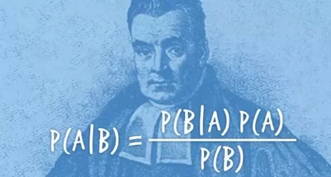
Bayes’ Theorem (Law, Rule)
– https://en.wikipedia.org/wiki/Thomas_Bayes - – https://en.wikipedia.org/wiki/Bayes%27_theorem –
– https://en.wikipedia.org/wiki/Bayesian_inference –
P(A|B) = P(B|A)*P(A)/P(B)
where A and B are events and P(B) not equal 0.
Frequentist interpretation of Bayes’ theorem.
Probability measures a proportion of outcomes.
Suppose an experiment is performed many times.
P(A) is the proportion of outcomes with property A,
and P(B) that with property B.
P(B|A) is the proportion of outcomes with property B
out of outcomes with property A,
and P(A|B) the proportion of those with A out of those with B.
Bayesian interpretation of Bayes’ theorem.
Probability measures a degree of belief.
Bayes’ theorem then links the degree of belief in a proposition before (A)
and after (B) accounting for evidence.
For example, suppose it is believed with 50% certainty
that a coin is twice as likely to land heads than tails.
If the coin is flipped a number of times and the outcomes observed,
then that degree of belief may rise, fall or
remain the same depending on the results.
Thomas_Bayes – (/’be?z/; 1701–1761)
For proposition A and evidence B,
P(A), the prior, is the initial degree of belief in A.
P(A|B), the posterior, is the degree of belief having accounted for B.
P(B|A)/P(B) – represents the support B provides for A.
See also Bayesian inference.
– https://en.wikipedia.org/wiki/Bayesian_inference
Bayesian inference is a method of statistical inference in which
Bayes’ theorem is used to update the probability for a hypothesis
as more evidence or information becomes available.

Slide 5
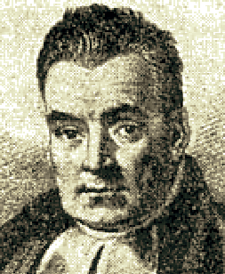

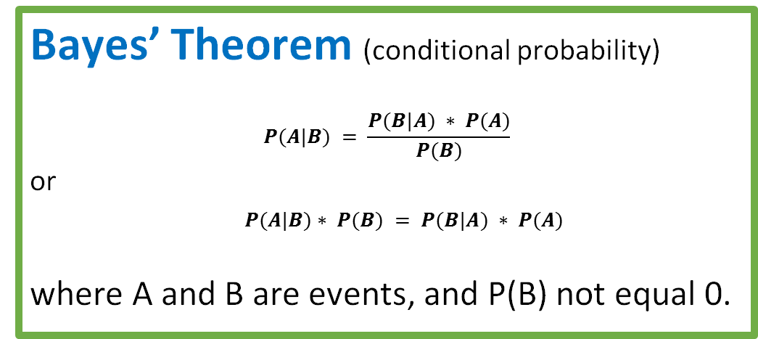
Bayesian inference - calculate probability
following chains of dependencies or correlations
Bayes’ Theorem (conditional probability)
$$P(A|B) = \frac{P(B|A) ∗ P(A)}{P(B)}$$
or
$P(A|B)∗ P(B) = P(B|A) ∗ P(A)$
where A and B are events, and P(B) not equal 0.
Thomas Bayes (1701–1761)
Intuitive explanation of Bayesian rule (on the left).
A = Happy, B = Rich
P(A) = 40% = probability of being happy (Yellow)
P(B) = 5% = probability of being rich (Blue)
P(A & B) = 4% = probability of rich & happy (Green)
P(B|A) = 10% = probability of being rich given that Happy
P(A|B) = 80% = probability of being happy given that rich
You can calculate green intersection using two methods:
P(A|B)*P(B) = 80%*5% = 4%
P(B|A)*P(A) = 10%*40% = 4%
All People
A
Happy
B
Rich

Slide 6
Random Variable. Probability Distribution
Random variable is a numerical variable taking different values.
Values may be discrete or continuous.
For example, think of variable “x” which may have any real value between -10 and +10.
Or think of a variable “z” which can have discrete values 0,0.1,0.2, … 0.9, 1.0
Discrete Case
Probability function P(x) of a discrete random variable “x”
is simply a function which gives probability of discrete values.
For example, if the random variable “x” may have two values: ( 0 or 1 ),
and if probabilities of those values are equal, then
P(0) = 0.5, f(1) = 0.5.
The sum of individual probabilities for all possible values should be 1.
Expected value is an weighted average of all values.
E(x) = sum(Xi*P(Xi)), where Xi goes through all allowed values of X.
Variance = sigma squared = sum( (Xi-E(x))**2 * P(Xi) )
Standard Deviation = sqrt(sigma squared)
Probability Density Function (PDF)
vs. Cumulative Probability Function ( CPF)
Continuous Case
Probability Density Function (PDF) f(x) is a continuous function.
f(x)*dx gives probability that value is between x and x+dx.
The total integral of f(x)*dx should be equal to 1.
Cumulative Probability Function (CPF)
This is simply a function F(x) which gives probability that value is less than x.
It monotonously grows from 0 to 1 as x grows (from small to large values).
The PDF is a first derivative of CPF.
CPF(x+dx) – CPF(x) = = [Prob. of value < (x+dx)] – [Prob. of value < x] = f(x)*dx
Mean value = Expected value
For discrete case we had:
E(x) = sum(Xi*P(Xi))
For continuous case this translates into
E(x) = Integral(xF(x)dx)

Slide 7
Binomial Distribution
– https://en.wikipedia.org/wiki/Binomial_distribution
if:
Experiment consists of N trials.
Each trial can have two outcomes (True of False).
The probabilities of these outcomes are the same
for all trials (p and q = 1-p).
The trials are independent from each other.
Then:
The probability of having “x” True values (out of N) is:
f(x) = C(N,x)*p^x*(1-p)^(N-x)
where C(N,x) = N!/(x!*(N-x)!) – a binomial coefficient
At large numbers the distribution f(x) has a bell-curve shape
Mean value = Expected value E(x) = N*p
Variance = N*p*(1-p).
Combinatorics
Factorial
N! = N*(N-1)*(N-2)*…*1
Reordering
Let’s say, we have N objects (N-element unordered set).
Question: In how many ways can we arrange them?
Answer: N!
Explanation:
N variants for the 1st element (N-1) variants for the 2nd element etc.
Example: How many ways are there to arrange the letters ABCDE in a row?
Answer: 5!=120
Subsets
Question: In how many ways can we select m-elements out of N-element set?
Answer: C(N,m) = N!/(m!*(N-m)!) – a binomial coefficient
Explanation:
N variants for the first element of subset
(N-1) for the 2nd etc.
(N-m+1) for the m-th element
The above can be written as N!/(N-m)!
Then we need to divide by the number of reordering permutations
within the subset, that is by m!

Slide 8
Poisson and Exponential Distributions
– https://en.wikipedia.org/wiki/Poisson_distribution
– https://en.wikipedia.org/wiki/Exponential_distribution
Suppose you are sitting near the road.
You notice that on average you see 10 cars passing by every minute
(we say: the rate lambda = 10/min).
Knowing the average rate, what would be the probability
of having only 5 cars in one minute?
Or 15 cars? Or any given number?
Poisson Probability P(k) is the probability of a given
number of events occurring in a fixed interval (of time)
if these events occur with a known average rate
and independently of each other
and of the time since the previous events.
Poisson Formula
P(x) = (lambda**x)*exp(-lambda)/x!
For example, for x=0 (probability of zero events in given interval):
P(0) = (lambda**0)*exp(-lambda)/0! = 1*exp(-lambda)/1 = exp(-lambda)
Poisson Distribution
Intervals between Poisson events distributed exponentially.
If we have events happening which follow Poisson Distribution,
we can measure the time intervals between these events.
Question: How these times will be distributed?
Answer: These times will have exponential distribution
with Probability Density Function (PDF) as:
f(t) = lambda*exp(-lambda*t)
The average time interval will be (1/lambda).
Standard deviation happens to be the same (1/lambda).

Slide 9
Uniform and Normal Distributions.
Uniform Distribution
If some value can change between some minimum and maximum
values a & b, and the probability of any value in interval [a,b]
is the same, then we say that we have uniform distribution.
The PDF (Probability Density Function) for Uniform Distribution
looks like a rectangle with the height (1/(b-a)),
so that the total area under the curve is exactly 1.
Central Limit Theorem (CLT).
The normal distribution is very common in nature.
Because when we have big number of sets of variables,
the distribution of parameters of these sets (for example, averages)
tend to converge to this bell form.
This fact is called Central Limit Theorem (CLT).
Here is a simple example of CLT:
Suppose we have N1 sets, each set has N2 values, all values drawn from the same distribution. The shape of distribution may be anything (uniform, bell-curve, triangular, exponential, etc.).
We calculate an average in each set – so we have N1 average values.
Question: How will these average values be distributed?
Answer: As N1 & N2 become big enough (30+), the distribution
will get close to the Normal Gaussian bell curve.
There are some nice animated demonstrations of CLT - just google for them.
De Moivre–Laplace theorem
De Moire-Laplace theorem is a simple demonstration how a symmetrical binomial distribution can be approximated by Gaussian bell curve (under certain conditions).
See video demonstration below.
https://en.wikipedia.org/wiki/De_Moivre–Laplace_theorem
Normal (Gaussian Bell-shaped) Distribution
The basic shape of the PDF is exp(-x*x/2)
You need to add a coefficient to normalize it to 1
(means – make area under the curve equal to exactly 1).
You can also have the curves have different position
(average value) and different width (sigma).

Slide 10
Introduction into Statistics
“Statistics is the study of the collection, analysis,
interpretation, presentation, and organization of data.”
Being a Statistician is the major part of being a Data Scientist.
And it is tricky, because there is easy to misuse statistics:
“There are three kinds of lies: lies, damned lies, and statistics.”
Statistics involves
Collecting (sampling) the data from different kind of observations
Visualizing the data, estimating the parameters (average/mean values, errors, etc.)
Testing validity of a hypothesis (null hypothesis) – or alternative hypothesis
Estimating intervals, estimating significance of observed differences, etc.
Here are some basic formulas:
Intuitive explanation for dividing by (n-1)
when calculating standard deviation:
– http://stats.stackexchange.com/questions/3931/intuitive-explanation-for-dividing-by-n-1-when-calculating-standard-deviation

Slide 11
When drawing a curve through experimental points,
it is very important to estimate how good this curve
fits the data, and if fitting the data with this curve makes sense.
For this you can use the Coefficient of Determination R²:
– https://en.wikipedia.org/wiki/Coefficient_of_determination
“R squared” is a number between 0 and 1. R² close to 1 – good model.
More advanced topics:
Linear Regression
– draw a line through experimental points.
– ( https://en.wikipedia.org/wiki/Linear_regression )
Simple Linear Regression
– ( https://en.wikipedia.org/wiki/Simple_linear_regression )
– the least squares estimator of a linear regression model.
Here is the simplest standard OLS method (OLS = Ordinary Least Squares).
ym = y_mean = sum(y)/N
xm = x_mean = sum(x)/N
var(x) = variance(x) = sum((x-xm)^2)
covar(x,y) = covariance(x,y) = sum((y-ym)*(x-xm))
slope b = covar(x,y) / var(x)
intercept a = ym - b*xm
We can simplify as following:
var(x) = sum((x-xm)^2) = sum(x^2) - sum(2*x*xm) + sum(xm^2) = sum(x^2) - N*xm^2
covar(x,y) = ... using similar logic = sum(y*x) - N*xm*ym
So:
slope b = (sum(y*x) - N*xm*ym) / (sum(x^2) - N*xm^2)
intercept a = ym - b*xm = (ym * sum(x^2) - ym*N*xm^2 -xm*sum(y*x)+xm*N*xm*ym) / (sum(x^2) - N*xm^2)
= (ym * sum(x^2) -xm*sum(y*x)) / (sum(x^2) - N*xm^2)

Slide 12
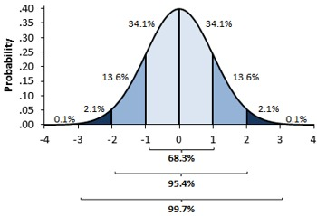
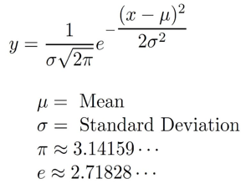
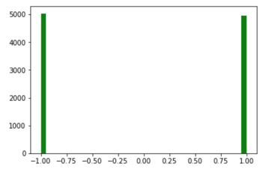
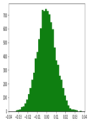
Central Limit Theorem (CLT)
We have all heard about Normal (Gaussian) distribution.
This distribution is very foundational in statistics. And it comes from CLT.
Classical CLT mathematically proves that if we calculate group averages in many groups, then the distribution of those averages converges to Normal distribution as long as we have large number of points in each group (30..100 or more) and large number of groups (30-100 or more).
Specifically, suppose we have our data points sampled from a distribution with finite average and finite variance. We subdivide this data into Ng groups, each containing Ns samples:
[...] [...] [...] [...] [...] [...] [...] [...] [...]
For each group we calculate average value of its Ns samples. Thus we have Ng averages values, and we plot them as a histogram.
If Ng and Ns are big enough, the histogram will converge to a normal distribution. This holds true regardless of the shape of the original distribution of data.
For example, suppose we have a million data points, each value is either 1 or -1 (random coin toss). We split data into Ng=10,000 groups, each sample group has Ns=10,000 data points. Then in each group we calculate the mean value (which will be close to zero).
Now we have 10,000 of mean values - and we make a histogram of those values. According to CLT it will be bell-shaped.

Slide 13
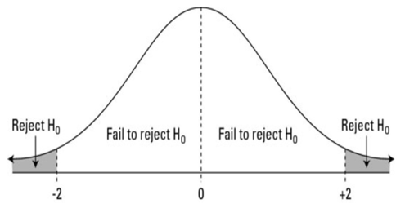
p-value & null hypothesis
A p-value is a probability of getting results at least as extreme as yours. If this probability is very small, this means that the result is unlikely to be explained by the null hypothesis. So we should reject the null hypothesis.
P-value probability of observed
-------------------------------
P < 0.05 5%
P < 0.01 1%
p < 0.001 0.1%
-------------------------------
A small p-value (typically ≤ 0.05) indicates strong evidence against the null hypothesis, so you reject the null hypothesis. People say that this evidence is "statistically significant".
Related term is Confidence Interval (CI). A 95% CI is the interval that you are 95% certain contains the true population value as it might be estimated from a much larger study.
z-score is the distance from the mean measured in the number of standard deviations.
Type I error - false rejection of the null hypothesis
Type II error - false acceptance of the null hypothesis
\ Decision Truth \ | Decision to Accept Ho | Decision to Reject Ho
Ho is True | Correct Decision | type I error
Ho is False | type II error | Correct Decision

Slide 14
Problem1:
Given: women's heights are normally distributed with the mean 65″ and standard deviation of 3.5″
Question: What is the probability of finding a random sample of 50 women with a mean height of 70″.
To answer, let's estimate the z-score:
z = (x – μ) / (σ / √n) = (70 – 65) / (3.5/√50) = 5 / 0.495 = 10.1
We know that 99% of values fall within 3σ (68, 95, 99.7 rule).
We have z-score = 10, which is much more than 3.
So the probability that any sample of 50 women will have a mean height of 70″ will be much-much less than 1%.
Problem 2:
Suppose you are testing a claim that the percentage of all women with varicose veins is 25%, and your sample of 100 women had 20% with varicose veins.
Then the sample proportion p=0.20.
The standard error for your sample percentage is the square root of p(1-p)/n which equals 0.04 or 4%.
You find the test statistic by taking the proportion in the sample with varicose veins, 0.20, subtracting the claimed proportion of all women with varicose veins, 0.25, and then dividing the result by the standard error, 0.04.
These calculations give you a test statistic (standard score) of –0.05 divided by 0.04 = –1.25.
This tells you that your sample results and the population claim in H0 are 1.25 standard errors apart; in particular, your sample results are 1.25 standard errors below the claim.
When testing H0: p = 0.25 versus Ha: p < 0.25, you find that the p-value of -1.25 by finding the probability that Z is less than -1.25. When you look this number up on the Z-table, you find a probability of 0.1056 of Z being less than this value.
Note: A Z-table is simply a table of values of the cumulative distribution function of the normal distribution.

Slide 15
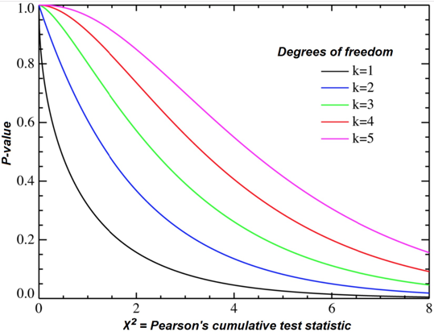
Chi-Square χ² Goodness of Fit Test
https://stattrek.com/chi-square-test/goodness-of-fit.aspx
Pearson, 1900
Suppose we have k mutually-exclusive classes
N - total number of all observations,
n_{i} (i=1,2,...k) - number of observations for each class
p_{i} - hypothetical probability of each class (null hypothesis). Then sum(p_{i}) = 1
Then for each class:
expected value of observations m_{i}=N*p_{i}
sum(m_{i}) = N*sum(p_{i}) = sum(n_{i})
Pearson has proposed that as N gets bigger
X² = sum((n_{i}-m_{i})²/m_{i}) --> χ² distribution
with (k − 1) degrees
of freedom
Chi-squared distribution, showing χ2 on the x-axis and p-value on the y-axis.
In practice we calculate value X² from our data, then use χ² distribution to estimate the P-value (the probability that a chi-square statistic is more extreme than X² value that we have.

Slide 16
Example of X2 calculation ( from https://stattrek.com/chi-square-test/goodness-of-fit.aspx )
Problem:
We have 3 types of cards (T1,T2,T3) with theoretical frequency of (30%, 60%, 10%).
We have a random sample of 100 cards with counts (50, 45, 5).
Is this sample consistent with theory? Use a 0.05 level of significance.
Solution:
Null hypothesis: The proportions are (30%, 60%, 10%)
Alternative hypothesis: At least one of the proportions in the null hypothesis is false.
Degrees of Freedom DF = k-1 = 3-1 = 2
Expected values:
E₁ = 100*0.3 = 30, E₂ = 100*0.6 = 60, E₃ = 100 * 0.10 = 10
Χ² = Σ [ (O_{i} - E_{i})² / E_{i} ] = [ (50 - 30)² / 30 ] + [ (45 - 60)² / 60 ] + [ (5 - 10)² / 10 ] = 19.58
The P-value is the probability that a chi-square statistic having 2 degrees of freedom is more extreme than 19.58.
Using Chi-Square Distribution we find P(Χ2 > 19.58) = 0.0001.
Since the P-value (0.0001) is less than the significance level (0.05), we cannot accept the null hypothesis.
Note: If you use this approach on an exam, you may also want to mention why this approach is appropriate.
Specifically, the approach is appropriate because the sampling method was simple random sampling, the variable under study was categorical, and each level of the categorical variable had an expected frequency count of at least 5.

Slide 17
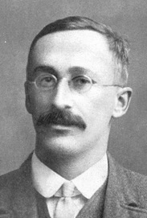
Student's t-distribution
https://en.wikipedia.org/wiki/Student%27s_t-distribution
Student's t-distribution (or simply the t-distribution)
is any member of a family of continuous probability distributions that arises when estimating the mean of a normally distributed population
in situations where the sample size is small
and the population standard deviation is unknown.
It was developed by William Sealy Gosset (1908)
under the pseudonym Student.
Let Xi be independently and identically drawn from the normal distribution with expected mean value μ and variance σ²
William Sealy Gosset (pseudonym "Student")
----- Sample mean
----- Sample variance
----- Random variable, Normal distribution
----- Random variable, t-distribution

Slide 18
More Statistics:
Confidence Interval
– ( https://en.wikipedia.org/wiki/Confidence_interval ) –
Cluster Analysis
– finding groups (clusters) in data.
– ( https://en.wikipedia.org/wiki/Cluster_analysis )
Student’s t-distribution
– estimating the mean of a normally distributed population
in situations where the sample size is small and
population standard deviation is unknown.
– ( https://en.wikipedia.org/wiki/Student%27s_t-distribution )
Chi-squared distribution
– distribution of a sum of the squares of k independent
standard normal random variables.
– ( https://en.wikipedia.org/wiki/Chi-squared_distribution )
F-distribution
– right-skewed distribution used most commonly in Analysis of
Variance.
– ( https://en.wikipedia.org/wiki/F-distribution )
Gamma distribution
– ( https://en.wikipedia.org/wiki/Gamma_distribution )
– a two-parameter family of continuous probability distributions.
The common exponential distribution and chi-squared
distribution are special cases of the gamma distribution.
Stochastic Processes, Time Series Analysis
- https://en.wikipedia.org/wiki/Stochastic_process –
- https://en.wikipedia.org/wiki/Time_series –
- https://en.wikipedia.org/wiki/Random_walk –
- https://en.wikipedia.org/wiki/Brownian_motion –
- https://en.wikipedia.org/wiki/Diffusion ,
- https://en.wikipedia.org/wiki/Diffusion_process –
- https://en.wikipedia.org/wiki/Stationary_process –
- https://en.wikipedia.org/wiki/Stable_process –
Poisson Process
– https://en.wikipedia.org/wiki/Poisson_point_process –
– https://en.wikipedia.org/wiki/Dirac_delta_function –
– https://en.wikipedia.org/wiki/Compound_Poisson_process –
White Noise, Gaussian Noise, Brownian Noise
– https://en.wikipedia.org/wiki/White_noise –
– https://en.wikipedia.org/wiki/Gaussian_noise –
– https://en.wikipedia.org/wiki/Brownian_noise –
Markov Process
– https://en.wikipedia.org/wiki/Markov_chain –
– https://en.wikipedia.org/wiki/Markov_process –
Correlation function:
– https://en.wikipedia.org/wiki/Correlation_function –
– https://en.wikipedia.org/wiki/Autocorrelation –
Spectral Density, Fourier Analysis
– https://en.wikipedia.org/wiki/Spectral_density –
– https://en.wikipedia.org/wiki/Fourier_analysis –
– https://en.wikipedia.org/wiki/Fast_Fourier_transform –

Slide 19
Convolution, Functional Analysis
– https://en.wikipedia.org/wiki/Convolution –
– https://en.wikipedia.org/wiki/Functional_analysis –
Extracting signal from Noise
– https://en.wikipedia.org/wiki/Signal-to-noise_ratio –
– https://en.wikipedia.org/wiki/Noise_reduction – (filtering, etc.)
If we add N samples “s” of noisy data, then the signal will add proportionally to N,
whereas noise will grow only as sqrt(N). So, if we add 100 samples, we will
improve out Signal/Noise ratio ~10 times.
Monte Carlo Method
– https://en.wikipedia.org/wiki/Monte_Carlo_method –
used to evaluate something by using randomly-generated samples.
The more samples – the more accurate the result.

