Slide 1
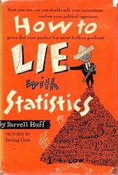
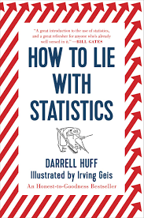
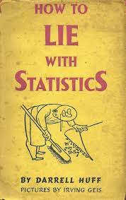
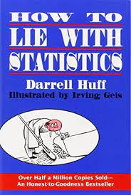
How to lie with statistics
How to lie with statistics

Slide 2
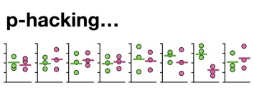
P-Hacking
Inflation bias
Inflation bias, also known as “p-hacking” or “selective reporting,” is the misreporting of true effect sizes in published studies.
It occurs when researchers try out several statistical analyses and/or data eligibility specifications and then selectively report those that produce significant results.
Data dredging (or data fishing, data snooping, data butchery), also known as significance chasing, significance questing, selective inference, and p-hacking[1] is the misuse of data analysis to find patterns in data that can be presented as statistically significant, thus dramatically increasing and understating the risk of false positives. This is done by performing many statistical tests on the data and only reporting those that come back with significant results.[2]
https://en.wikipedia.org/wiki/Data_dredging

Slide 3
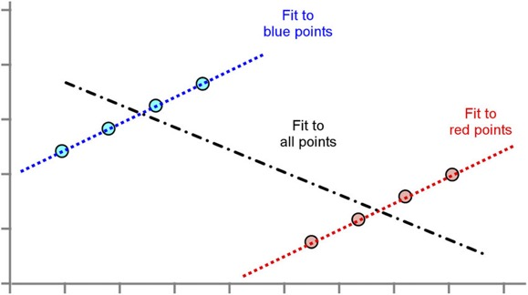
Simpson's paradox

