Slide 1
What Is AI

Slide 2

“AI is the New Electricity”
AI like electricity will also change our lives in many ways which is difficult to predict.
Electricity came into our life ~120 years ago:
- lamps and motors - telegraph, telephone, radio, TV, Internet
- computers, IT, Machine Learning, AI
- finance, trading
- science, education, medical diagnostics
- automation, robotics,
- etc. etc.
Andrew Ng
- co-founded and led Google Brain
- was the chief scientist at Baidu Research (~1,300 people)
for 3 years (2014-2017), resigned in March of 2017.
- adjunct professor at Stanford University
- co-founder and chairman of Coursera
- https://en.wikipedia.org/wiki/Andrew_Ng
- https://www.coursera.org/learn/machine-learning
Artificial Intelligence is the New Electricity
- https://www.facebook.com/andrew.ng.96/videos/1268821713173733/ - https://www.youtube.com/watch?v=21EiKfQYZXc

Slide 3
“AI is Life Extinction Event ?”
“AI - Tsunami ?”

Slide 4
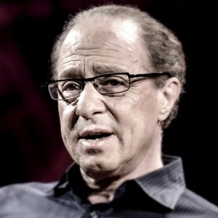
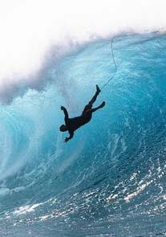
Ray Kurzweil, chief engineer for Google and famous futurist stated that "... ultimately, AI will benefit us in the same way that previous technologies have. ... My view is not that AI is going to displace us, ... (but) ... It’s going to enhance us. It does already.”
You need to get into AI asap to be able to surf the new wave, or this wave will drown you.
Ray Kurzweil
Millions of jobs will be "outsourced" to AI.
Also you will see new jobs, like "Chief AI Officer", AI departments.
We already see big shortage in AI specialists. Top AI talent is paid millions of $$.

Slide 5
Overview of Machine Learning Models
Machine Learning Systems = Prediction Machines
ML = "Cheap Predictions"
AI = "Cheap Predictions"
Ajay Agrawal
University of Toronto

Slide 6
OK, so what is Machine Learning?
- A computer program
- used to describe data in a compressed way
- to make predictions and take actions
- most common ML tasks - regression or classification
Neural Networks (Deep Learning)
Simple Analytics
Standard ML
Classification - learning to label examples based on their features. Model may have ~1-2 thousand of numbers
Logistic Regression
Linear Discriminant Analysis
Support Vector Machines
Decision trees (Random Forest, XGBoost)
KNN, K-Means, etc., etc.
Classification – dog or cat. Model is usually implemented as a Neural Network, and may use up to 1.5 Bln numbers. Text models up to 175 Bln.
Recognizing images, music, speech
NLP = Natural language Processing
Machine Translation
supervised, unsupervised, reinforcement learning
Generative Models (GANs)
Linear Regression y = f(x) = ax + b
Model uses only two numbers:
a = slope, b = intercept

Slide 7
Artificial General Intelligence (AGI)
AI that could successfully perform any intellectual task that a human can
(Turing test (1950), ...)
Artificial Intelligence (AI)
ML (DL) learning "human" abilities (speech and music recognition, conversation, visual recognition, video prediction, reasoning, self-driving cars, playing games, etc.)
Deep Learning (DL)
ML implemented as Neural Network
Machine Learning (ML)
DS where algorithm learns from data to make predictions
Data Science (DS)
computer skills + statistics
CSV files, SQL, PowerPoint

Slide 8
Recent breakthroughs in DL made it practical
(effective, affordable, and easy).
Instead of software engineers manually coding if/else logic,
DL algorithms can train networks equivalent to ~10s of million of if/else-s.
Distributed ML on Cloud (Google, Microsoft, Amazon, Intel, IBM, etc.)
allow to achieve ~100 Petaflops
(x1000 performance increase in last 3 years).
Prices dropping down precipitously: $6.50/hour per a Google TPU (180 TFlops).
You don't have to build your own infrastructure,
You don't have to code from scratch.
Nowadays you can use variety of pre-trained / pre-configured networks on the cloud.
Compare this with just few years ago: low-level C/CUDA coding, custom HPC clusters
(HPC = High-Performance Computing), etc.

Slide 9
Where and How ML & AI are used ?
ML = Machine Learning
AI = Artificial Intelligence
predictions (predictive analytics, forecasting, trends, investments, elections, sport & weather, news, etc.)
optimization of business processes, reducing costs
extracting information from text, fuzzy deduplication
image and face recognition
recommender systems
detection (anomaly, fraud, crime, terrorism, climate change, etc.)
self-driving cars (planes, boats, drones, construction/rescue machines, etc.)
robots (at home & at work), manufacturing robots
universal language translator, language understanding, concepts learning
music & literature composition, games and math.
medical diagnostics (using genomic, phenotypic, social, etc. data), surgery
intelligent secretary/helper, process management, traffic management
agriculture (pooling weeds, watering, etc.)
toys, military
combining AI with Virtual Reality and 3D printing
effective direct interface with human brain
etc. etc. etc.

Slide 10
AI in Context
Years
Artificial Intelligence (AI)
ML performing “human” functions
Deep Learning (DL)
ML implemented using multi-layered
structure (Neural Network)
Machine Learning (ML)
DS algorithm learns from data
Data Science (DS)
data + computer/statistics
Reinforcement Learning
alpha-Go
Unsupervised Learning
no labels, Google Translate
Supervised Learning
labeled data
Reasoning,
Inductive & Deductive Logic,
Knowledge Representation,
Ontology
2015
NLP,
Extracting Data from Text
2010
Chatbots,
Conversational
interfaces
Forecasting,
investments,
Resource Mgmnt
2005
Fraud Detection, Security,
Risk Mgmnt
2000
Recommender
Systems
Vision,
Robotics
Amount of data
Compute Speed

Slide 11
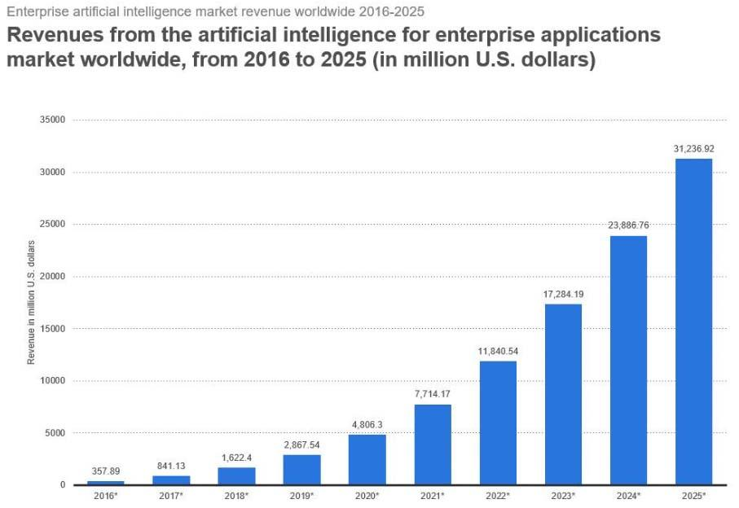
AI Growth Predictions
(Forbes, 2018)

Slide 12
Machine Learning & AI
How To Start
1. Are you a business owner or executive,
and want to start using ML & AI in your organization ?
2. Do you want to become a Data Scientist
and use existing ML technology?
3. Are you an enthusiast who wants to develop
new ML & AI methods?

Slide 13
If you are an Executive:
Create an AI department if you don't have one yet. Host AI conferences and training. Invite the best AI talent.
Get serious about collecting, cleaning, and labeling data.
Customize and fine-tune models instead of building "from scratch".
Use pre-trained tools.
Use multiple tools from external vendors (Google, AWS, Azure, etc.), make them work together, do not lock-in into a single vendor.
Accent on "explainability" of algorithms.

Slide 14
If you want to study to become a Data Scientist.
Things change fast - you need to learn constantly. Subscriptions, YouTube, Twitter. Get YouTube Premium.
Start following some famous people on YouTube, Facebook, Twitter: (Yann LeCun, Geoffrey Hinton, Ian Goodfellow, Yoshua Bengio, Jürgen Schmidhuber, Andrew Ng, etc.)
Learn (youtube, coursera, …) : .. Python programming (also Pandas, Numpy, Scikit-Learn) .. Unix commands (Linux or Mac) .. SQL, Excel .. Some Statistics (youtube, ...) - Normal distribution, CLT, Binomial Distribution, Hypothesis testing, P-value, t-test, Chi-square test, Linear Regression .. Logistic Regression .. Standard Machine Learning (Linear & Logistic Regression, Random Forest, XGBoost, etc.) .. Deep Learning ( deeplearning.ai or some other course )
Listen to podcast: Sam Charrington – “This Week in Machine Learning & AI”
Follow Siraj Raval on youtube,
Follow Chris Olah: colah.github.io , distill.pub
Learn 100-200 terms (dictionary) related to .. training and evaluating models (error / loss function, Precision and Recall, Accuracy, ROC curve, confusion matrix, regularization, cross-validation, folds, etc.) .. other terms related to Data Science, Machine Learning, and AI – google them, make your own dictionary
Look at AutoML (h2o.ai, Microsoft AutoML, etc.)

Slide 15
If you want to develop new ML & AI methods.
You first need to study to become a Data Scientist.
Then you need to find a place where people do research.
It is usually a university of one of just a handful of companies:
Google
Facebook
Open AI
Microsoft
Apple
Baidu
etc.

