Slide 1
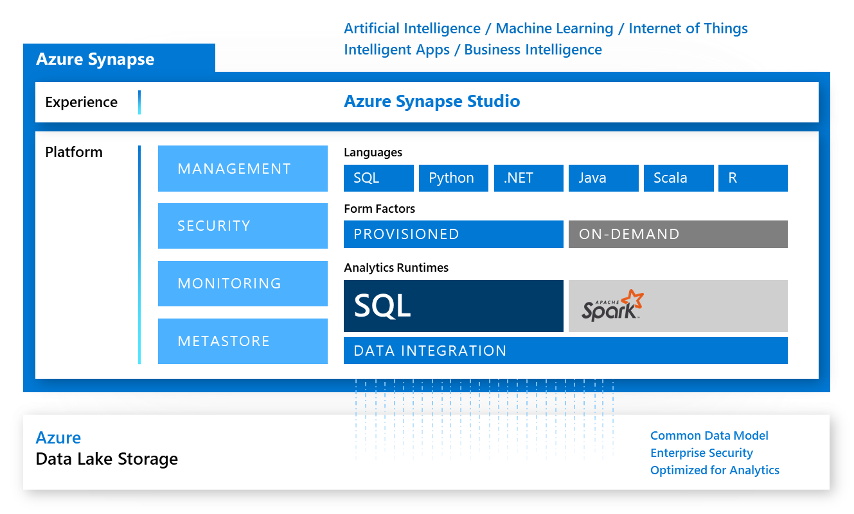
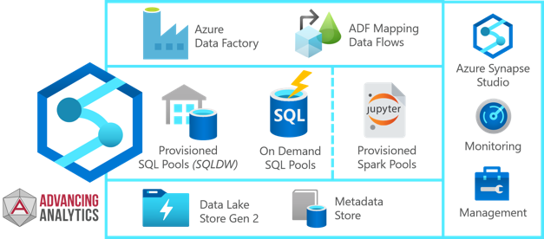
Azure
Machine Learning Workspace – set of tools for ML
Azure Machine Learning Studio - python scripts, jupyter notebook, ML Studio notebooks, data storage, Linux VMs (single or clusters), AutoML (regression, classification, forecasting), automating experiments and whole ML workflows.
Azure Synapse Workspace – newest collection of Azure tools for Analytics.
- https://azure.microsoft.com/en-us/services/synapse-analytics/
It is a big set of tools:
Azure Storage Gen 2 - substitutes for Storage Gen1 and Data Lake Gen 1. Gen 2 is more reliable, efficient, cheaper, support for “Big Data” technologies.
Data pools (serverless, dedicated, spark, databricks). Dedicated SQL Pool = SQL DataWarehouse You can query csv, jason, parquet files - serverless SQL pools
Compute clusters – including Spark & Databricks
Data Factory – to automate data flows
Azure Synapse Link for Azure Cosmos DB - https://docs.microsoft.com/en-us/azure/cosmos-db/synapse-link -
Cosmos DB Analytica Store - https://docs.microsoft.com/en-us/azure/cosmos-db/analytical-store-introduction
Power BI Integration

Slide 2
Machine Learning POC - High Level View
Export Client's data from their systems (usually in CSV format). Upload the CSV files into Azure ADLS Storage
Machine Learning: data visualization, preparation (nulls, outliers, imbalances, etc.), feature engineering, evaluating different models
Loading data and/or features into SQL DB
Visualize the prediction results (Power BI)
Prepare Data
Find, Select and/or Create Data
Train Model
Apply learning algorithm
Test Model
Test Candidate Model with unseen data
Deploy Model
Deploy Chosen Model
Apply preprocessing
Select Candidate model
Select good enough model
Application posts to API

Slide 3






Common ML Architectural Approach
Ingest
Store
Prep and train
Load and Serve
Analyze
Use Visual Studio SSAS project
or SSIS to retrieve the Cube(s)
Azure Synapse Analytics
Integrate
Prepare Data for ML
Pull from S3
Cube(s) in CSV
Azure Data Lake Store
shaped data
Predicted results
AWS S3 Bucket
Azure Data Factory
Azure Automate ML
Synapse SQL
Power BI

Slide 4
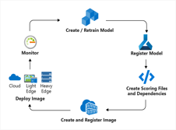

– Production: Financial ML Architectural Approach
Ingest
Store
Prep and train
Load and Serve
Analyze
Azure Synapse Analytics
Integrate
Prepare Data for ML
Create model and Deploy ML Image
Azure Data Factory
Azure Data Lake Store
Synapse SQL
Power BI
shaped data
Azure Synapse Analytics

Slide 5
Azure ML : https://ml.azure.com
Login into portal.azure.com ( https://portal.azure.com )
Move mouse to top-right and click on your icon (sign-in/sign-out) – and select a directory.
You may have several directories corresponding to your work with different clients.
Then select subscription
Then go to Machine learning (can search for it, or it is in the list)
- https://ml.azure.com/selectWorkspace
Go into workspace machine learning, then find and click the url to Azure Machine Learning Studio.
Here you can work with python notebooks,
create compute instances or clusters,
work with multiple data stores,
create datasets, pipelines, experiments,
run Automated ML,
create pickle model files,
use different open-source libraries (sklearn, TF, etc.),
register model endpoints, etc.
# ----------------------------------------------

Slide 6
Azure ML : Some Links
Here is a very good post on training using sklearn – and then register the model in ML Studio:
https://towardsdatascience.com/deploying-ml-models-on-azure-a948c106f7b5
or
https://ai.plainenglish.io/deploying-ml-models-on-azure-8daa9c10db5a
This above tutorial doesn't actually "deploy" the model.
The more appropriate title should be "Register your custom python model in ML Studio"
Note
The author uses specific library to store the model into pickle:
from sklearn.externals import joblib
joblib.dump(value=mymodel, filename="mymodel.pkl")
and then:
from azureml.core.model import Model
model = Model.register(
workspace=ws,
model_path="mymodel.pkl",
model_name="boston_housing_lr")
Then you can use the second tutorial:
https://docs.microsoft.com/en-us/azure/machine-learning/how-to-deploy-and-where?tabs=azcli#script
which shows how to deploy the model.
For this deployment you will need to write the "entry script"
which has to have two methods:
init() and run()
Once you have this script, you can go to your models (in ML Studio),
click on your model, then click on "Deploy" on top,
fill-in parameters (name, ... , entry script, ...) - and click the button to deploy it

Slide 7
Azure ML : Some Links
Good youtube video "Train and deploy ML models at scale using Azure Machine Learning | INT134C" -
- https://www.youtube.com/watch?v=2OgBxYCnVGk
And here is the link from this video to a good 10-hrs course: "Build AI solutions with Azure Machine Learning" - 10 hrs - - https://docs.microsoft.com/en-us/learn/paths/build-ai-solutions-with-azure-ml-service/
Yet another good tutorial - "Creating End-to-End MLOps pipelines: - https://benalexkeen.com/creating-end-to-end-mlops-pipelines-using-azure-ml-and-azure-pipelines-part-1/
Also:
https://docs.microsoft.com/en-us/azure/machine-learning/

Slide 8
Azure ML : More Links
Google-ing mount datastore azure ml notebook -
- https://github.com/microsoft/MLOpsPython
- https://docs.microsoft.com/en-us/python/api/azureml-core/azureml.core.datastore?view=azure-ml-py
Develop for Azure Files with Python -
- https://docs.microsoft.com/en-us/azure/storage/files/storage-python-how-to-use-file-storage
Azure for Python Developers -
- https://docs.microsoft.com/en-us/azure/developer/python/
Azure REST API Reference -
- https://docs.microsoft.com/en-us/rest/api/azure/
Azure SDK for Python -
- https://github.com/Azure/azure-sdk-for-python/tree/master/sdk/storage
- https://docs.microsoft.com/en-us/python/api/overview/azure/ml/?view=azure-ml-py –
Azure SDK – trigger published pipeline -
- https://docs.microsoft.com/en-us/azure/machine-learning/how-to-trigger-published-pipeline#trigger-pipelines-with-azure-machine-learning-sdk-for-python –
Automate ML Experiments
- https://docs.microsoft.com/en-us/azure/machine-learning/how-to-use-automlstep-in-pipelines -
- https://towardsdatascience.com/hidden-tricks-for-running-automl-experiment-from-azure-machine-learning-sdk-915d4e3f840e -
Understand AutoML
- https://docs.microsoft.com/en-us/azure/machine-learning/how-to-understand-automated-ml#regressionforecasting-metrics -
- https://docs.microsoft.com/en-us/azure/machine-learning/how-to-configure-auto-train#primary-metric -

Slide 9
Azure Synapse Analytics and AI
(MCW = Microsoft Cloud Workshop) - https://github.com/microsoft/MCW-Azure-Synapse-Analytics-and-AI
Log-in to the Azure portal https://portal.azure.com/ with provided credentials
Note - use incognito mode in Chrome, allow all cookies, stop all ad-blockers
Lab step-by-step here: https://github.com/microsoft/MCW-Azure-Synapse-Analytics-and-AI/blob/master/Hands-on%20lab/HOL%20step-by%20step%20-%20Azure%20Synapse%20Analytics%20and%20AI.md
Notes:
Three similar serverless solutions: Azure Serverless, Google BigQuery, AWS Athena. -
Best practices for serverless SQL pool: https://docs.microsoft.com/en-us/azure/synapse-analytics/sql/best-practices-sql-on-demand
Capacity limits for dedicated SQL pool in Azure Synapse Analytics: https://docs.microsoft.com/en-us/azure/synapse-analytics/sql-data-warehouse/sql-data-warehouse-service-capacity-limits
================================
REST APIs for dedicated SQL pool (formerly SQL DW) in Azure Synapse Analytics: https://docs.microsoft.com/en-us/azure/synapse-analytics/sql-data-warehouse/sql-data-warehouse-manage-compute-rest-api
What is Automated ML: https://docs.microsoft.com/en-us/azure/machine-learning/concept-automated-ml
Many Models Solution Accelerator: https://github.com/microsoft/solution-accelerator-many-models
Machine Learning Workshop: https://github.com/microsoft/MCW-Machine-Learning
ML Ops Workshop: https://github.com/microsoft/MCW-ML-Ops
Configure automated ML experiments in Python: https://docs.microsoft.com/en-us/azure/machine-learning/how-to-configure-auto-train
Trained Model can be registered in SQL as a function ! Recommended approach: pickle file of the model, convert to ONNX, use it from SQL server: https://docs.microsoft.com/en-us/azure/synapse-analytics/sql-data-warehouse/sql-data-warehouse-predict
Alternatively - create a stored procedure to get the data - and then invoke model via cursor
Also the model may be invoked via REST API endpoint.
Invoke model from PowerBI: https://github.com/alex-nogue/Machine_Learning_in_Power_BI#invoke-a-model-in-power-bi-using-azure-ml-service
3 Ways to Run ML on SQL Server (ML Service, native PREDICT, and Remote Compute Context): https://tsmatz.wordpress.com/2018/03/02/patterns-sql-server-machine-learning-services-r-and-python/
Azure Machine Learning Tutorials: https://github.com/Azure/MachineLearningNotebooks/tree/master/tutorials -
-
-
-
-

Slide 10
More Links:
Download Integration Runtime: https://www.microsoft.com/en-us/download/details.aspx?id=39717 -
Download AZCopy: https://docs.microsoft.com/en-us/azure/storage/common/storage-use-azcopy-v10 -
AZCopy Documentation: https://docs.microsoft.com/en-us/azure/storage/common/storage-ref-azcopy-copy -
Transfer S3 using AzCopy: https://docs.microsoft.com/en-us/azure/storage/common/storage-use-azcopy-s3 -
Differences between Standard and Premium storage: https://www.danielstocker.net/what-is-the-difference-between-azure-standard-storage-and-azure-premium-storage/ -
-
More links about deploying ML models & pipelines
https://azure.microsoft.com/en-us/blog/retraining-and-updating-azure-machine-learning-models-with-azure-data-factory/
https://azure.microsoft.com/en-us/blog/azure-data-factory-updates-integration-with-azure-machine-learning-2/
https://docs.microsoft.com/en-us/azure///data-factory/transform-data-machine-learning-service
https://docs.microsoft.com/en-us/azure/machine-learning/tutorial-pipeline-batch-scoring-classification
https://www.youtube.com/watch?v=lVP7ywRq8p4
https://www.youtube.com/watch?v=7k4XvM4wd0k
https://docs.microsoft.com/en-us/azure/machine-learning/
https://docs.microsoft.com/en-us/learn/paths/build-ai-solutions-with-azure-ml-service/
-

