Slide 1
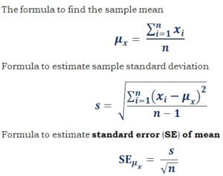
Error of the mean
Suppose we have two samples A and B,
each has "n" points, where n is relatively large (100+ points),
and distributions have "normal" shape
with same sample standard deviation "s".
The mean values are m_{A} and m_{B}
The standard error of the mean sem = s/sqrt(n)
Question – how big should be number of points so that we
can say that the means differ?
We can demand that δ = |m_{A} - m_{B}| >= 4*sem = 4s/sqrt(n)
Or
n >= 16s²/δ²
A B
Standard
Deviation
(blue)
Standard Error of the Mean
(orange)

