Slide 1
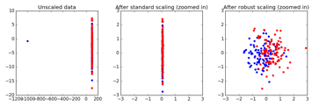

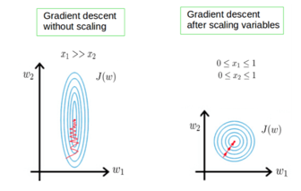
Do you need to Scale your Data?
Very good short video:
Should You Scale Your Data ??? : Data Science Concepts
https://www.youtube.com/watch?v=n9KeJLGwW0U
by ritvikmath ( Ritvik Kharkar, California)
http://ritvikmath.com/
https://github.com/ritvikmath
https://www.linkedin.com/in/ritvik-kharkar/
KNN Scaling
KNN in 2-dim (x1,x2) will work differently if x1 in meters, and x2 in centimeters
Decision Tree – each column is split the same regardless of the scale (m or cm)
Linear Regression – will work the same, but if you analyze feature sensitivity – it is easier to have all predictors having same scale.
Regularization term – need same (or similar) scaling
Gradient descent – works better with scaling
Generally, need scaling when features interact in same formula or being compared.
Linear Regression
Regularization
Gradient Descent

Slide 2
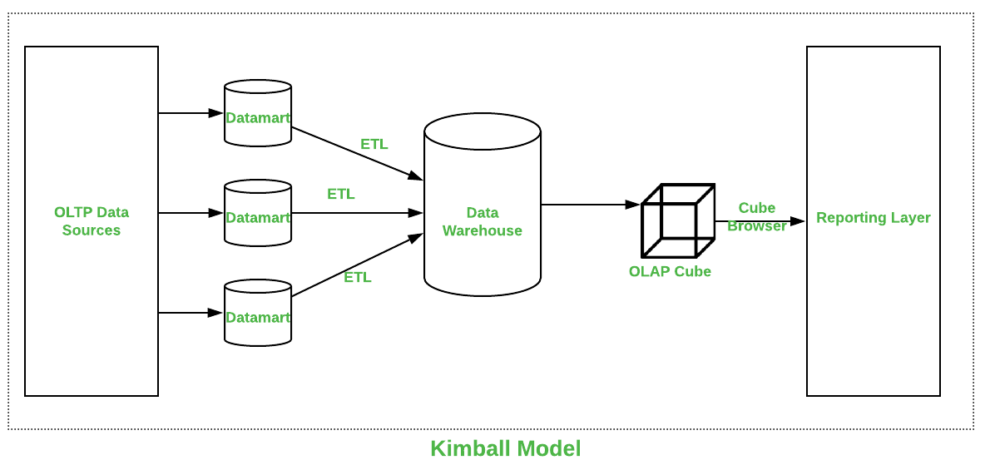
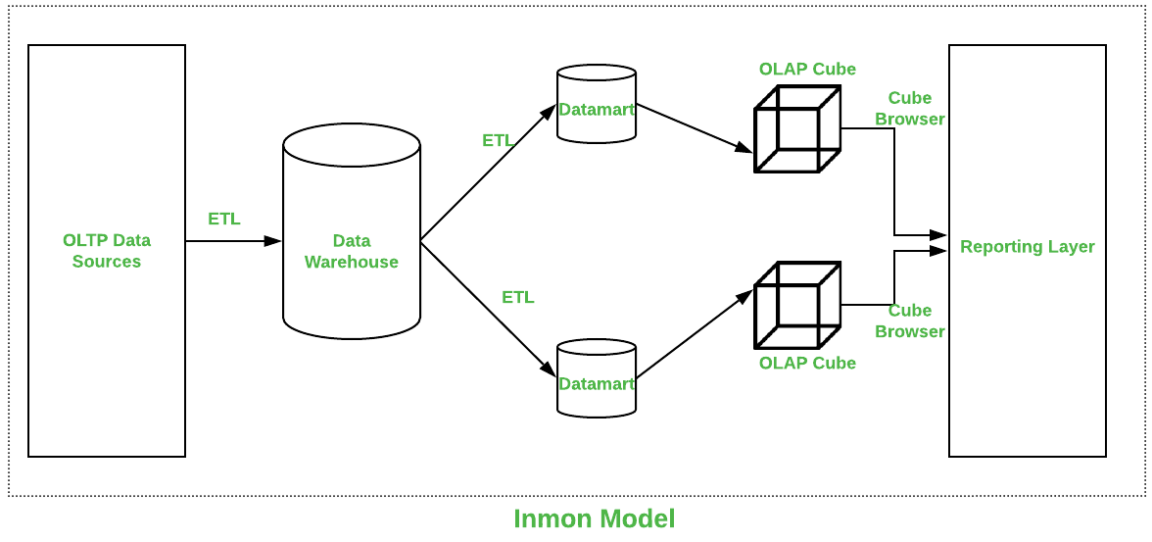
OLAP Cube – Complexity
This is no longer needed
Kimball vs Inmon vs Data Vault frameworks
Parameters | Kimball | Inmon
Introduced by | Introduced by Ralph Kimball. | Introduced by Bill Inmon.
Approach | It has Bottom-Up Approach for implementation. | It has Top-Down Approach for implementation.
Data Integration | It focuses Individual business areas. | It focuses Enterprise-wide areas.
Building Time | It is efficient and takes less time. | It is complex and consumes a lot of time.
Cost | It has iterative steps and is cost effective. | Initial cost is huge and development cost is low.
Skills Required | It does not need such skills but a generic team will do job. | It needs specialized skills to make work.
Maintenance | Here maintenance is difficult. | Here maintenance is easy.
Data Model | It prefers data to be in De-normalized model. | It prefers data to be in normalized model.
Data Store Systems | In this, source systems are highly stable. | In this, source systems have high rate of change.

