Slide 1
OLAP Cube – Rise and Fall
Very good article:
The Rise and Fall of the OLAP Cube - by Cedric Chin (2020)
https://www.holistics.io/blog/the-rise-and-fall-of-the-olap-cube/
Old way of doing things:
Data => ETL => Data WareHouse => ETL => OLAP Cube => Reporting
The above "old way" Includes a lot of ETL, Data modeling & Design:
Kimball Framework
Inmon Framework
Data Vault by Dan Linstedt (combines Kimball & Inmon).
But imagine that memory and compute power have become so cheap
that your regular SQL database can run any queries very fast using in-memory columnar storage and MPP = Massive Parallel Processing.
Then you don't need to hire data modelers.
You don't need all the OLAP infrastructure.
You can simply query your data as it is.
Data => Reporting

Slide 2
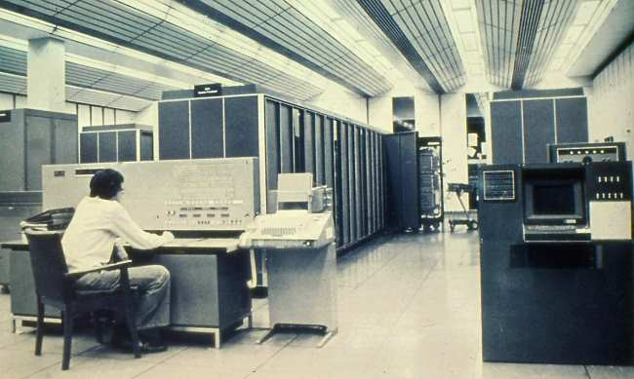
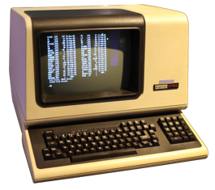
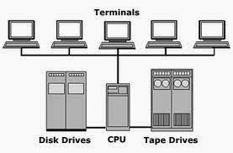
The Times of Inmon & Kimball
Imagine computers of 1970s.
A computer occupy the whole floor of a building
Computer have memory measured in 10s of Kilobytes
Punch cards slowly transition to magnetic tapes
IBM introduced VSAM files, relations, SQL
Usually just one computer in whole organization (IBM Mainframe or similar)
"Dumb terminals" connecting to the central computer. There are no personal computers
All company's information is typically stored in one central computer
These are times when Inmon & Kimball were crafting their approaches.
As computers have become cheaper and more powerful, organization were able to buy several computers – one per department. Then people had to decide how to structure flows of information.
Inmon: from central main computer down to departments
Kimball: from departments to central
Now 30-40 years later any smart phone is more powerful than "huge" DW systems of Inmon & Kimball's era.
https://www.dataversity.net/a-short-history-of-data-warehousing/

Slide 3
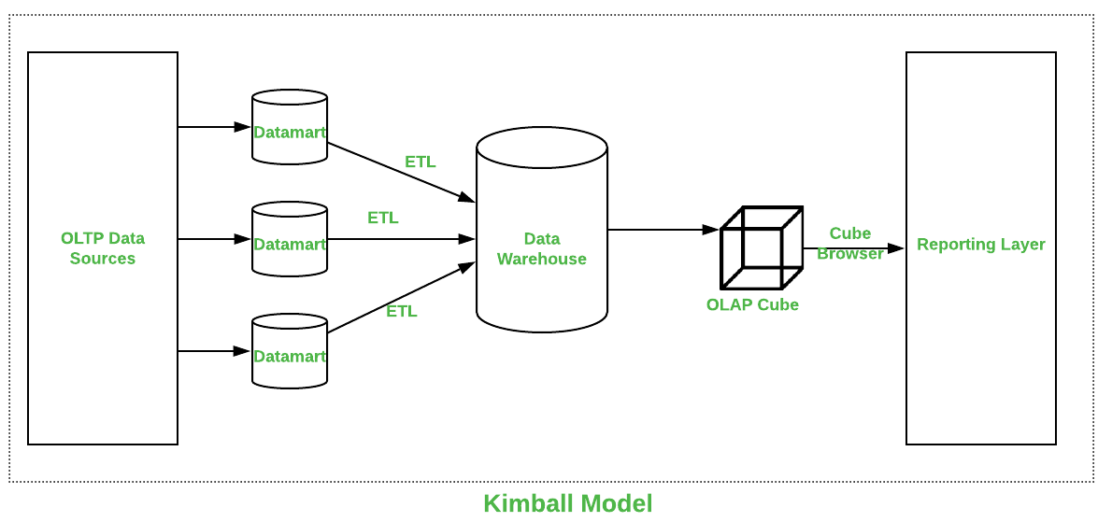
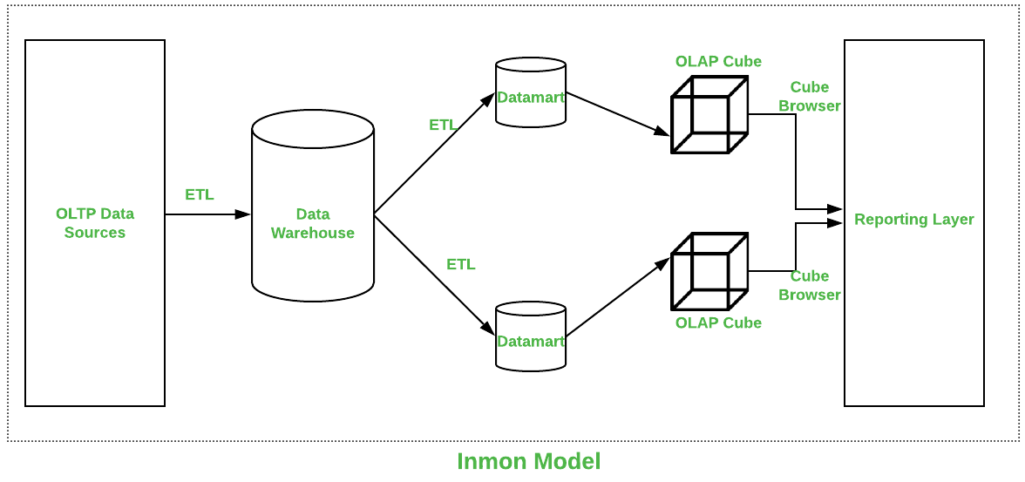
OLAP Cube – Complexity
This is no longer needed
Kimball vs Inmon vs Data Vault frameworks
Parameters | Kimball | Inmon
Introduced by | Introduced by Ralph Kimball. | Introduced by Bill Inmon.
Approach | It has Bottom-Up Approach for implementation. | It has Top-Down Approach for implementation.
Data Integration | It focuses Individual business areas. | It focuses Enterprise-wide areas.
Building Time | It is efficient and takes less time. | It is complex and consumes a lot of time.
Cost | It has iterative steps and is cost effective. | Initial cost is huge and development cost is low.
Skills Required | It does not need such skills but a generic team will do job. | It needs specialized skills to make work.
Maintenance | Here maintenance is difficult. | Here maintenance is easy.
Data Model | It prefers data to be in De-normalized model. | It prefers data to be in normalized model.
Data Store Systems | In this, source systems are highly stable. | In this, source systems have high rate of change.

Slide 4


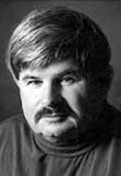
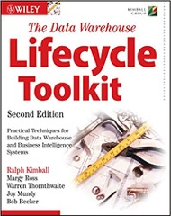
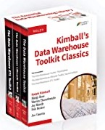
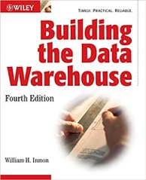
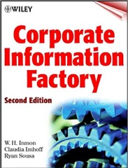
Kimball DW Framework
Inmon DW Framework
Kimball Group – closed in 2015
https://www.kimballgroup.com/
William H. Inmon
(1945 – present)
Ralph Kimball
(1944 – present)

Slide 5
Inmon vs Kimball
Ralph Kimball’s paradigm:
Each department in a company has its own Data Mart (DM). The company's DW (Data Warehouse) is the conglomerate of all DMs.
Information is always stored in the dimensional model.
Bill Inmon’s paradigm:
A company has one central DW (Data Warehous). Data Marts (DMs) source their data from the DW.
In the DW, information is stored in 3rd normal form. ( https://en.wikipedia.org/wiki/Third_normal_form )

