Slide 1
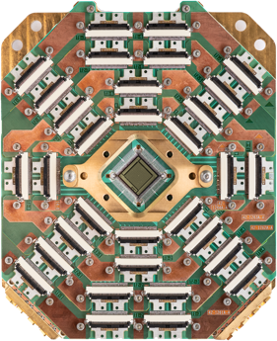
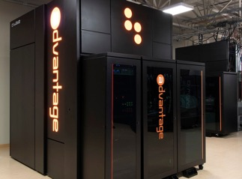
Quantum Computing
Quantum Computing (QC) is computing using quantum-mechanical phenomena, such as superposition and entanglement. Potentially much faster than conventional computers.
QC will be able to break most common encryption schemes used today. Although this quantum supremacy has not been achieved yet.
- https://medium.com/geekculture/quantum-computers-mirage-or-real-power-14241a01eb9a
Physicist Richard Feynman has mentioned potential power of quantum computers in 1982. Physicist David Deutsch claimed that quantum computers will be able to solve problems that would take a traditional computer longer than the age of the universe.
Websites to read more:
- http://www.theory.caltech.edu/people/preskill/ - Prof. John Preskill
- https://www.scottaaronson.com/blog/?cat=4 - The Blog of Scott Aaronson
NASA, Google, IBM, CIA, etc. are working on quantum computers. NASA’s Quantum Artificial Intelligence Laboratory (QuAIL) - assessing the potential quantum computers could have with regards to artificial intelligence.
D-Wave: D-Wave Systems (since 1999, private, Vancouver - Canada, 160+ people) – up to 5,000 qubits (as of 2020), at costs of ~$10M - Lockheed Martin, Google, NASA, USC, USRA and Los Alamos National Laboratory.
https://en.wikipedia.org/wiki/D-Wave_Systems
https://www.dwavesys.com
https://venturebeat.com/2020/09/29/d-wave-advantage-quantum-computing-5000-qubits-1-million-variables/
D-Wave 5,000 qubits

Slide 2

QuBit
a qubit (/ˈkjuːbɪt/) or quantum bit (sometimes qbit) is a unit of quantum information—the quantum analogue of the classical binary bit.
Note how quantum states are represented by Dirac—or "bra–ket"—notation.
A pure qubit state is a linear superposition of the basis states |0⟩ and |1⟩.

Slide 3
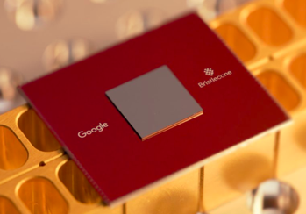
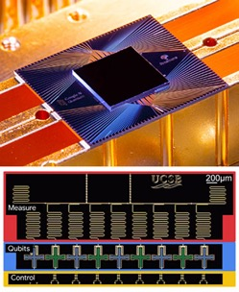
Google Quantum Computing
Google Quantum AI lab
https://www.osa-opn.org/home/newsroom/2020/september/under_the_hood_of_google_s_quantum_computer/ -
Chemical Reaction Simulation - https://www.scientificamerican.com/article/googles-quantum-computer-achieves-chemistry-milestone/ -
https://medium.com/predict/googles-quantum-computer-is-about-158-million-times-faster-than-the-world-s-fastest-supercomputer-36df56747f7f -
Google Bristlecone - 72 qubits
Google Sycamore chip – 53 circuits

Slide 4
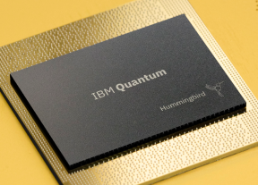
IBM Quantum Computing
IBM Quantum Experience:
https://www.ibm.com/quantum-computing/ -
https://quantumexperience.ng.bluemix.net/qx/experience - allows researches to run projects on Quantum machne.
https://ionq.co - Q.C. developers in MD.
https://arxiv.org/abs/1411.4028 - paper “A Quantum Approximate Optimization Algorithm”, 2014

Slide 5
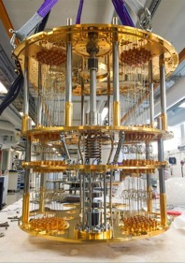
Microsoft Quantum Computing
Microsoft Quantum Computing ...
https://azure.microsoft.com/en-us/solutions/quantum-computing/ -
https://azure.microsoft.com/en-us/resources/whitepapers/search/?term=quantum –
https://azure.microsoft.com/en-us/services/quantum/ - Azure Quantum PREVIEW

Slide 6

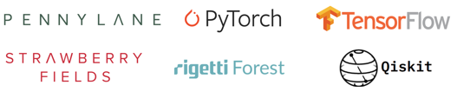
More Quantum Computing
There are some libraries, research, and toy projects, for example:
https://www.tensorflow.org/quantum -
https://qiskit.org/textbook/ch-machine-learning/machine-learning-qiskit-pytorch.html -
https://pypi.org/project/pytorch-quantum/ -

Slide 7
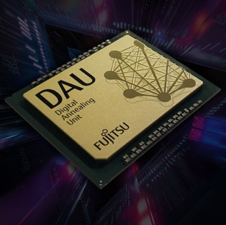
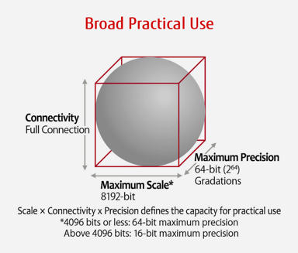
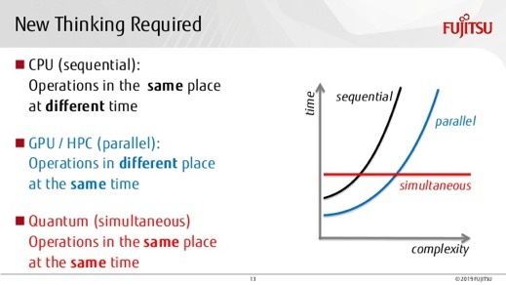
Fujitsu Digital Annealer
A specialized chip to solve massive combinatorial optimization problems.
Parallel, real-time optimization calculations.
Faster than GPUs.
https://www.fujitsu.com/us/services/business-services/digital-annealer/what-is-digital-annealer/
Fujitsu developed a “digital annealing unit” (DAU), a custom CMOS chip (similar to FPGA) with an architecture designed for efficient solving large-scale optimization problems.
It uses a version of classical simulated annealing method.
But for marketing purposes they say that it is “quantum-inspired”,
because “quantum annealing” is a variant of "simulated annealing".
But of course DAU is not "quantum".
Execution
time

