Slide 1
Today:
ROC Curve vs Precision-Recall Curve
Reinforcement Learning is the current frontline of AI research
youtube - Arxiv Insigts (Xander Steenbrugge)
youtube - Siraj Raval
amazon – many books
Sam Charrington – podcast “This Week in Machine Learning & AI”
Coursera - deeplearning.ai
Examples of Jupyter notebooks from deeplearning.ai

Slide 2
ROC Curve & Precision-Recall Curve
Receiver Operating Characteristic (ROC) curves for a binary classifier:
True Positive Rate (TPR) vs False Positive Rate (FPR)
at various threshold settings.
ROC curve was first developed by radar engineers during World War II
for detecting enemy objects.
TPR = REC = Recall or Sensitivity = TP / (TP + FN)
( planes classified as planes / all planes' events)
FPR = fall-out, probability of false alarm = FP / (FP + TN)
( noise classified as planes / all noise events )
PRE = Precision = TP/(TP+FP)
( planes classified as planes / all events classified as planes)
--------------------------------------------------------------------------------
AUC = Area Under the Curve
Simply the area under the ROC curve (from 0 to 1)
--------------------------------------------------------------------------------
F1 Score
F1 score is a single number evaluation metric:
F1 score = 2 * PRE * REC / (PRE + REC)
So the F1 score is the harmonic average of the precision and recall.
ROC
Curve
Precision-Recall
Curve

Slide 3
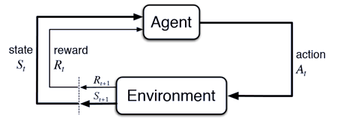
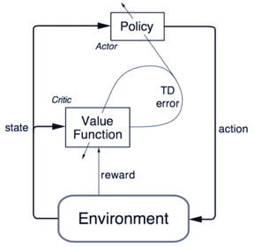
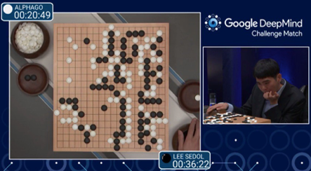
Reinforcement Learning (RL) "Good puppy ..." learning.
Feedback is not provided for every step, but only for final result.
Examples – learning to win in games (Atari, Alpha Go), robotics, etc.
Policy Gradients:
Learn policy map. A software agent selects actions using a map called “policy”. The policy map gives the probability of taking action “a” when in a certain state “s”.
Deep Q-Learning: (Watkins 1989, DeepMind 2014)
Learn Q-function to maximize the expected value of the total reward over all successive steps. The value function estimates how good it is to be in a given state. The goal is to find a policy with maximum expected cumulative return.
Actor-Critic Architecture: the actor - tunes the parameter 𝜽 for the policy function (decide the best action for a specific state). The critic is used for evaluating the policy function estimated by the actor according to the temporal difference (TD) error (TD = difference between estimated reward and actual reward received).
The exploration vs. exploitation trade-off. Multi-armed bandit problem in finite MDPs (Markov Decision Processes). One-armed bandit - a slot machine with some probability distribution of the reward. Multi-armed bandit - several slot machines available. So you have fixed limited set of resources (your moves), and you need to allocate this resource between competing (alternative) choices (slot-machines) to increase reward.

Slide 4
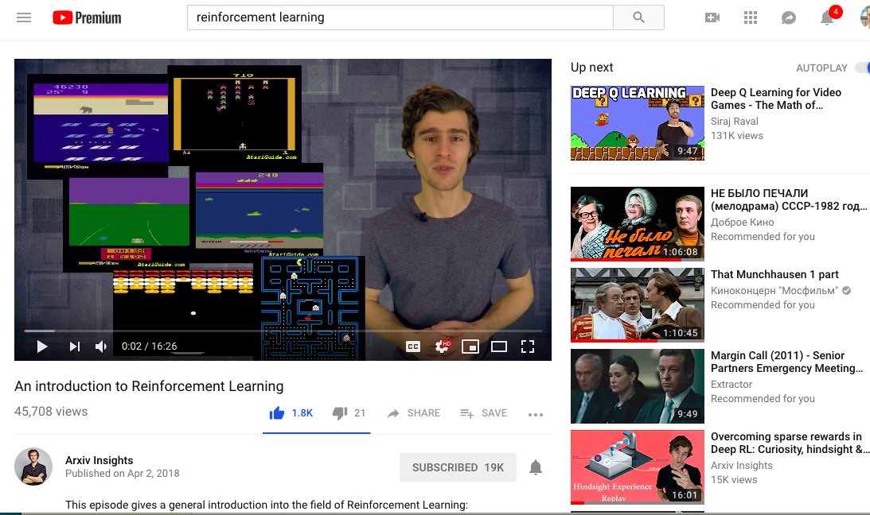
Xander Steenbrugge (Arxiv Insights on youtube)

Slide 5
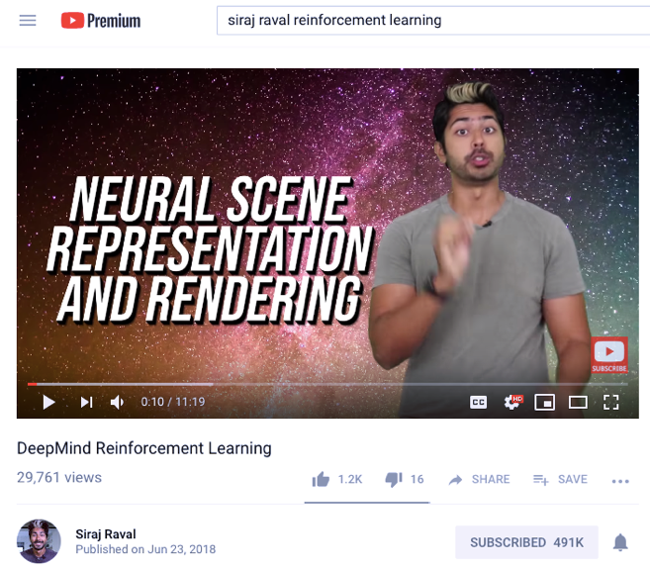
Siraj Raval on youtube - ~500K subscribers

Slide 6

Reinforcement Learning – books on Amazon

Slide 7
Sam Charrington
This Week in Machine Learning & AI (TWiML&AI) podcast
- https://twimlai.com -

Slide 8

DeepLearning.ai – Coursera course by Andrew Ng

