Slide 1
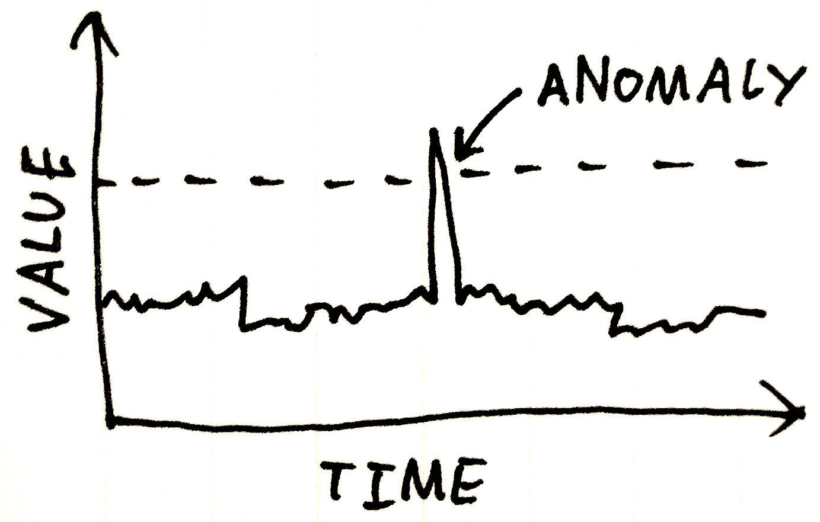
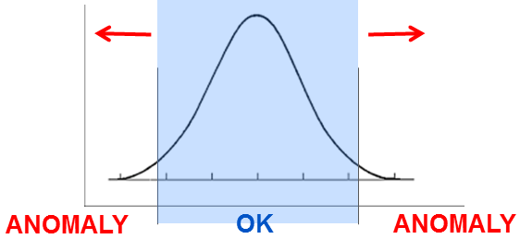
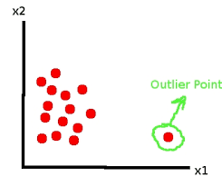
Anomaly Detection
Anomalies a.k.a. outliers, novelties, noise, deviations, exceptions.
Examples: fraud, a structural defect, medical problems or errors in a text.
Anomaly detection techniques:
1. Unsupervised 2. Supervised
3. Semi-supervised
Anomalies may be not rare, for example, bursts of intrusion activity.
Unsupervised methods may fail in these cases.
Examples of methods:
- clustering (SVM, etc.)
- represent state as image, use ConvoNet to detect anomaly "visually"

Slide 2
Outlier Detection methods:
Density-based techniques (k-nearest neighbor, local outlier factor, isolation forests, etc.).
Subspace- and correlation-based outlier detection for high-dimensional data.
One-class support vector machines.
Replicator neural networks.
Bayesian Networks.
Hidden Markov models (HMMs).
Cluster analysis-based outlier detection.
Deviations from association rules and frequent itemsets.
Fuzzy logic-based outlier detection.
Ensemble techniques, using feature bagging, score normalization, and different sources of diversity.
Application to data security:
intrusion detection systems using threshold statistics
based on profiles of users, workstations, networks,
remote hosts, groups of users, and programs based
on frequencies, means, variances & covariances.
The counterpart of anomaly detection in intrusion detection is misuse detection.

