Slide 1
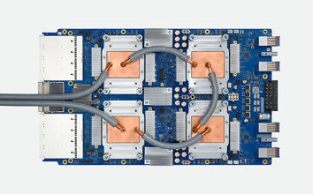
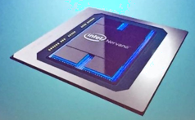


Specialized hardware.
Modern networks become big. Common practice today is to split network parallelly / sequentially to train separately (in parallel on multiple computers).
Inference can also be parallelized.
HPC = High-Performance Computing, InfiniBand = fast communication.
GPU (NVIDIA, CUDA)
Intel Nervana
Tesla & AMD
Google TPU v3
(Tensor Processing Unit)
- https://cloud.google.com/tpu/
Also many other vendors: QUALCOMM, AMD, APPLE, Xilinx, IBM, HiSilicon, Amazon (FPGAs), Microsoft (FPGAs), and many more.
FPGA = Field-Programmable Gate Array
Also in-memory and GPU-based databases like Kinetica.

Slide 2
Distributed ML on Cloud (Google, Amazon, Mocrosoft, Intel, IBM, etc.)
allow to achieve ~100 Petaflops
approx x1000 performance increase in last 3 years.
or ~ x10/year
This is MUCH faster than Moore's Laws (x2 every 12..18 months)
Prices dropping down precipitously: $6.50/hour per a Google TPU (180 TFlops).

Slide 3
GPU, OCP, etc.
Hardware and software for fast calculations.
GPU – Graphical Processing Unit (NVIDIA)
HPC – High Performance Computing
COTS HPC (Commodity Off-The-Shelf High Performance Computing): a cluster of GPU servers with InfiniBand interconnects and MPI.
- https://en.wikipedia.org/wiki/InfiniBand
- https://www.open-mpi.org
OCP – Open Compute Project
pyTorch – using “tiling” to solve “memory-to-CPU” bottleneck.

Slide 4
GPU-based databases.
For example, MapD ... allows you to query and visualize billions of rows in milliseconds using Amazon's GPU instances ...
- http://sqream.com/ - SQream DB, 10TB+
- http://www.mapd.com/ - open source
- http://www.kinetica.com/ - commercial, transactional
- http://www.brytlyt.com - commercial
- http://strom.kaigai.gr.jp/ - PG-Strom, open source
- https://www.blazegraph.com/ - for unstructured graph data
MapD on AWS:
- https://www.omnisci.com/demos/
- https://aws.amazon.com/marketplace/pp/B071H71L2Y
min price (on p2.xlarge) - $1.72/hr
Brytlyt on AWS:
- https://aws.amazon.com/marketplace/pp/B074JZNSWZ
min price (on p2.xlarge) - $2.17/hr
Kinetica on AWS:
- https://aws.amazon.com/marketplace/pp/B00PMNLW2K
min price (on p2.xlarge) - $5.90/hr

