Slide 1
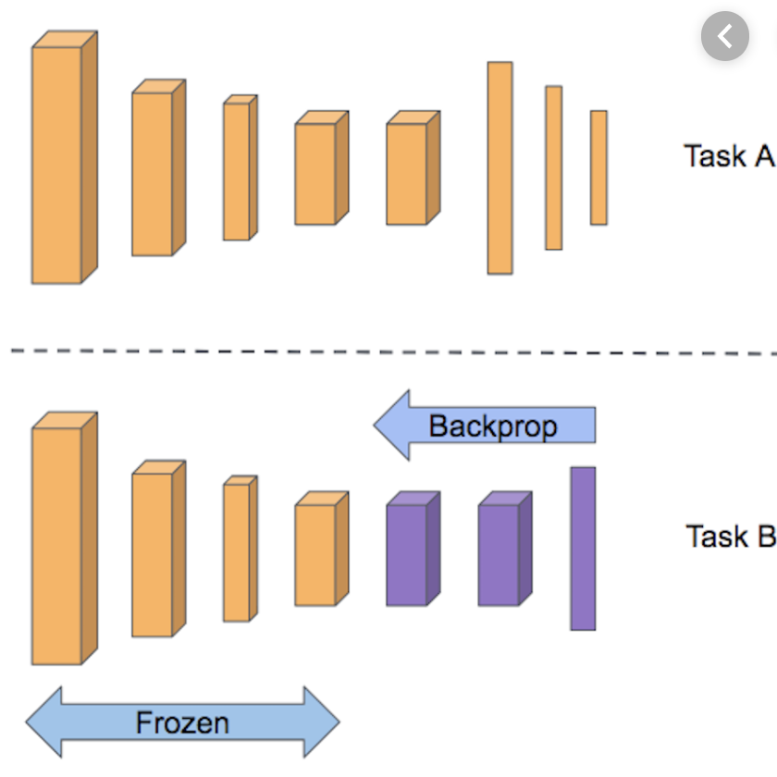
Transfer Learning
Transfer learning is a machine learning method
where a model developed for a task
is reused as the starting point for a model on a second task.

