Slide 1
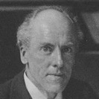
Correlation and Regression
Pearson Correlation r
https://en.wikipedia.org/wiki/Pearson_correlation_coefficient
Pearson correlation is also known under names:
Pearson correlation coefficient (PCC)
Pearson's r
Pearson product-moment correlation coefficient (PPMCC)
Bivariate correlation
Karl Pearson (1857 - 1936)
Famous English mathematician and biostatistician
r can vary from -1 to 1:
-1 – perfect negative correlation
+1 – perfect positive correlation
R² is the square of the Pearson's correlation coefficient r (for a single regressor, fitted by least squares)

Slide 2
Linear Regression
Linear Regression = draw a line through experimental points.
- https://en.wikipedia.org/wiki/Linear_regression
- https://en.wikipedia.org/wiki/Simple_linear_regression
- https://paternogbc.shinyapps.io/SS_regression/ - play with it
We derive linear model by minimization the mean square error (MSE):
When drawing a curve through experimental points,
it is very important to estimate how good this curve
fits the data, and if fitting the data with this curve makes sense.
For this you can use the Coefficient of Determination R²: – https://en.wikipedia.org/wiki/Coefficient_of_determination
“R squared” is a number between 0 and 1. R² close to 1 – good model.
R² = r² (the square of the Pearson's correlation coefficient r (for a single regressor, fitted by least squares)
We take partial derivatives by two coefficients - and solve system of 2 equations,
and after some algebraic transformations, we derive the standard OLS method
(OLS = Ordinary Least Squares).
y_{m} = y_mean = sum(y)/N
x_{m} = x_mean = sum(x)/N
var(x) = variance(x) = sum((x-x_{m})²)
covar(x,y) = covariance(x,y) = sum((y-y_{m})*(x-x_{m}))
slope b₁ = covar(x,y) / var(x)
intercept b₀ = y_{m} - b₁*x_{m}
Standard Error of regression slope:
where:
SS = Sum of Squared
RES – residual errors = diffs between model and points)
TOT – total, diffs between mean and points
y_bar – mean
y_hat – model
=
where sd(...) is standard deviation, and r – correlation coefficient

Slide 3
Linear Regression - assumptions
Linearity: The relationship between X and the mean of Y is linear.
Normality: For any fixed value of X, Y is normally distributed. We presume that deviations ϵ_{i} are picked from normal distribution. From this follows that the sampling distributions of slope and intercept (b₁ & b₀) are also normally distributed. Note: even if the ϵ_{i} are not Normally distributed, a general form of the central limit theorem tells us that the distributions of slope and intercept will be approximately normal if number "n" is big enough.
Independence: Observations are independent of each other. We assume that our sample is a SRS (simple random sample) of size "n". This means that it consists of "n" points chosen from the population in such a way that every set of n individuals has an equal chance to be the sample actually selected.
Homoscedasticity: The variance of residual is the same for any value of X.
Linearity, normality,
same deviation ( same σ ) - Homoscedasticity
Autocorrelation.
Observations are NOT independent
Heteroscedasticity
Variance changes
Four sets of points – fit by the same line.

Slide 4
Linear Regression – Slope Error
2σ_{ε}
We do not know real population σ, we use the estimated model standard deviation s.
When we do this, we move from the Normal distribution to t-distributions with degrees of freedom n – 2, the degrees of freedom of s.
ϵ_{i} are Normally distributed with standard error σ. "x" is distributed uniformly ?
The error of the slope is calculated as:
A confidence interval for the slope β1
is b1 ± t*SEb1
In this expression, t is the value for the t-distribution density curve with (n – 2) degrees of freedom with area between [ −t, t ].
To test the hypothesis H0: β1 = 0,
compute the test statistic :
Note: even if the ϵ_{i} are not Normally distributed, a general form of the central limit theorem tells us that the distributions of slope and intercept will be approximately Normal if number "n" is big enough.
Example: 42 points, df= n-2 = 40.
Looking for a critical value in t-test table for df=40, P=0.05, two-tails combined: cv = 2.021
Then if slope b1=35, error SEb1=10,
then t = 35/10 = 3.5 >> 2.021, so we reject the null hypothesis that slope = 0

Slide 5
Linear Regression – Slope Error via "r"
Standard Error of regression slope:
= ...
where sd(...) is standard deviation, and r – correlation coefficient.
https://stats.stackexchange.com/questions/342632/how-to-understand-se-of-regression-slope-equation/342672
https://www.slideserve.com/karis/introduction-to-linear-regression-and-correlation-analysis
df = degrees of freedom = n-2
If we have 2 points – we can draw only
one line, no freedom, df = 0. As we add points – we get more freedom.

Slide 6
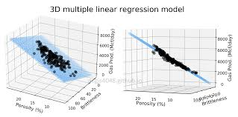
Multidimensional Linear Regression (MLR)
(a.k.a. Multiple Linear Regression)
Some people recommend to preprocess data as following:
- center variables to their mean values
- scale
Others argue that this doesn't improve the model.
- https://stats.stackexchange.com/questions/29781/when-conducting-multiple-regression-when-should-you-center-your-predictor-varia
Another problem - Multicollinearity
Multicollinearity - one predictor variable can be linearly predicted from the others with a substantial degree of accuracy.
In this situation, the coefficient estimates of the multiple regression may change erratically in response to small changes in the model or the data.
Multicollinearity does not reduce the predictive power or reliability of the model as a whole, at least within the sample data set; it only affects calculations regarding individual predictors.

Slide 7
Remedies to Multicollinearity problem.
Do not add dummy variables which could cause multicollinearity
Try subsets of training data – watch how stable the coefficients are
Leave the model as is, despite multicollinearity. It will still work well as a predictor
Try dropping one of the variables – see if coefficients for others will change
Get more data – thus get better estimates
Mean-center the predictor variables. Generating polynomial terms or interaction terms can cause some multicollinearity otherwise
Standardize your independent variables
It has also been suggested that using the Shapley value, a game theory tool, the model could account for the effects of multicollinearity
Ridge regression or principal component regression or partial least squares regression can be used
If the correlated explanators are different lagged values of the same underlying explanator, then a distributed lag technique can be used, imposing a general structure on the relative values of the coefficients to be estimated

Slide 8
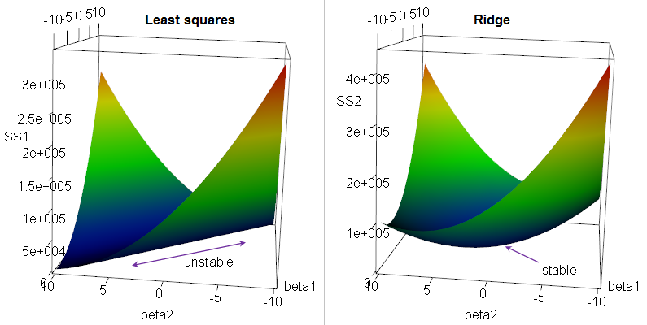

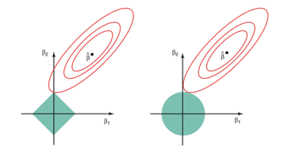
Regression: Ridge, LASSO, Elastic Net
Multivariate (multiple) Linear Regression Regularization.
Suppose we have a OLS (Ordinary Linear Squared) regression where two parameters x1 & x2
are not orthogonal, but in fact highly correlated.
Then there may be is infinite number of coefficients which will fit the model.
For example, (x1 - x2), (10*x1 - 10*x2), (100*x1 - 100*x2), etc.
If we are trying to minimize the cost function in the multidimensional
space of coefficients, we will get an infinite diagonal groove (ridge) for x1=x2.
Any place at the bottom of this ridge is equally good for us.
So we will get a big variability in possible values of coefficients for x1 & x2.
The solution will be unstable.
We can reduce this variability by adding additional regularization factor like this:
Why Ridge Regression is called Ridge ...
When we minimizing this expression, bigger "lambda" value will cause smaller "beta" values, thus keeping the coefficients "beta" from becoming too large.
This is called "Ridge Regression". It changes the infinitely long ridge into a local minimum.
In Ridge Regression we add a "regularization" term as sum of squares (L2 norm).
If instead we use L1 norm (sum of abs values) - it is called "LASSO Regression",
where LASSO = Least Absolute Shrinkage and Selection Operator.
LASSO favors solutions on the tips of the bounding surface for coefficients, where some of coefficients are zero. Thus it favors "sparse" solutions.
A combination of Ridge Regression and LASSO Regression is called "Elastic Net"
Why LASSO favors sparse solutions

