Slide 1
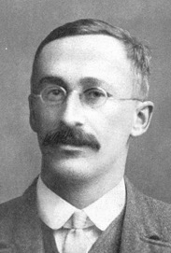
Student's t-distribution
https://en.wikipedia.org/wiki/Student%27s_t-distribution
Student's t-distribution (or simply the t-distribution)
is any member of a family of continuous probability distributions that arises when estimating the mean of a normally distributed population
in situations where the sample size is small
and the population standard deviation is unknown.
It was developed by William Sealy Gosset (1908)
under the pseudonym Student.
Let Xi be independently and identically drawn from the normal distribution with expected mean value μ and variance σ²
William Sealy Gosset used pseudonym "Student" because he was working for Guinness Beer Company in England as a "Head Experimental Brewer" (working on cultivating barley), and the company didn't allow him to publish under his own name.
----- Sample
mean
----- Sample
variance
In Excel: T.DIST(x,DF,FALSE)
where DF = Degrees of Freedom (Npoints-1)
----- Random variable,
Normal distribution
95% confidence interval
----- Random variable, t-distribution. It uses sample variance (because real sigma is unknown). This creates uncertainty – and leads to the "fat tails" in the t-distribution.

Slide 2
t-statistics vs z-statistics
t-statistics:
When sample size is small ( N < 30 ), then even if we know that the underlying distribution is gaussian, we still can not evaluate the distribution's sigma with enough precision. In this case we need to use t-distribution and t-statistics.
t = (x-μ)/s
Here s is a sample mean.
t-distribution has "fat tails", so to get 95% confidence interval we need to use t-score larger than 2. How much larger depends on how many data points we have in the sample. df = degrees of freedom = N-1
N-1 95% t-score
------------------
1 : 12.71
2 : 4.30
3 : 3.18
5 : 2.57
10 : 2.23
20 : 2.09
30 : 2.04
60 : 2.00
------------------
from scipy import stats
# Student, p<0.05, 2-tail, same as Excel TINV(0.05,n-1)
for df in [1,2,3,5,10,20,30,60]:
t_score = stats.t.ppf(1-0.025, df)
print(f"{df:2} : {t_score:5.2f}")
z-statistics:
When sample size is big ( > 30 ), then in many cases
sample distribution is close to gaussian. So we use gaussian distribution and z-statistics.
Suppose that variable x follows normal gaussian
distribution with mean value μ and standard deviation σ.
Then we can compose variable "z" which would follow
standard normalized distribution with zero mean
and standard deviation = 1 like this:
z = (x-μ)/σ
Z-score is simply the z-value which shows how far is
the value from the mean expressed in number of "sigmas".
For example, if z > 2, that means that the original
value is more than two sigmas away from the mean value.
For normal distribution this means that the probability
of this event is less than 0.05.
(to be precise, the exact z-score for 0.05 is 1.96)

Slide 3
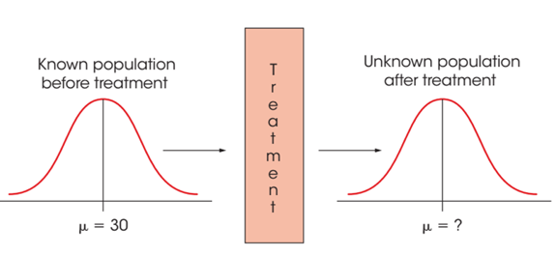
Hypothesis Tests with the t Statistic
The one-sample t test statistic (assuming the null hypothesis is true)
Four (4) Steps of Hypothesis Testing:
State the null hypotheses (H0) and alternative hypotheses, and select an alpha level
Locate the critical region using the t-distribution table and df
Calculate the t test statistic
Make a decision regarding H0 (null hypothesis)
For example:
H0: no effect (same mean), two-tailed test, alpha = 0.01
For sample size 100, critical t-values = +/-2.6264
t-statistics = (sample_mean – population_mean) / s , where s is an estimated standard error (calculated from sample)
if || t-statistics || > critical value, then we reject the H0
Basic Research Situation for t Statistic:
Assumed that μ is known for the population before treatment.
The purpose of the research study is to determine
whether the treatment has an effect.
Note that the population after treatment has unknown values
for the mean and the variance. So we will use a sample
to test a hypothesis about the population mean.

Slide 4
t-test – continued
Effect size.
In addition to rejecting/accepting a Hypothesis, you can also estimate the size of the effect:
      Cohen's d - for comparing two samples/groups with same sizes and similar SDs.
      Glass's delta - uses only the SD of the control group.
      Hedges' g - for two groups with different sample sizes.
Example: for two groups with mean M and standard deviations SD :
Cohen's d = (M₂ - M₁) ⁄ SD_{pooled}
where
SD_{pooled} = √((SD₁² + SD₂²) ⁄ 2)
Estimating m from sample
(use sample mean and sample deviation)
For any α we know that (1 – α) proportion of t values fall between ± t for the appropriate df.
Determining the amount of variability in scores explained by the treatment effect is an alternative method for measuring effect size.
r2 = 0.01 small effect
r2 = 0.09 medium effect
r2 = 0.25 large effect

Slide 5
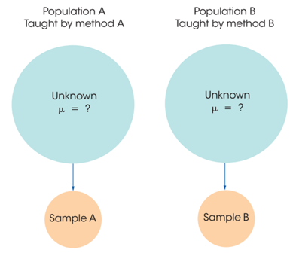
The t Test for Two Independent Samples
Data comes from two completely different, independent groups.
Observations within each sample must be independent.
The two populations must be normal.
The two populations must have equal variances (called homogeneity of variance).
Basic structure of the t statistic
where estimated standard error (unbiased if n1=n2)
unbiased estimate:
SS = Sum of Squares
Degrees of freedom df = df₁+df₂ = (n₁-1) + (n₂-1)
Null hypothesis for independent-measures test:
Test for homogeneity of variance:
Levene's test or Brown–Forsythe test
https://en.wikipedia.org/wiki/Levene%27s_test

Slide 6
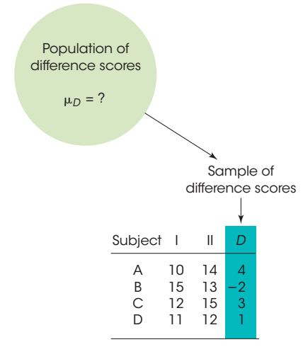
The t Test for Repeated-Measures
Difference score = D = X₂ − X₁
Mean Difference:
Repeated-measures design
(a.k.a. within-subjects design)
Two separate scores are obtained for each individual in the sample
Same subjects are used in both groups.
Observations within each treatment condition must be independent.
Population distribution of difference scores (D values) must be normally distributed.
Null Hypothesis H₀: μ_{D} = 0
Confidence Interval (C.I.):

Slide 7
t

