Slide 1
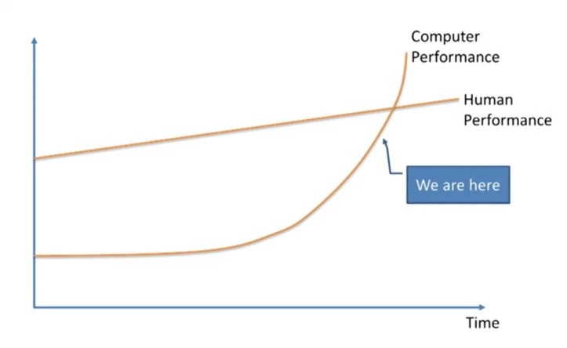
Artificial General Intelligence (AGI)
AGI - a machine that could perform any intellectual task that a human being can.
AGI is projected to be created by 2029 (Ray Kurzweil)
Various criteria for intelligence:
reason, use strategy, solve puzzles, and make judgments under uncertainty;
represent knowledge, including common-sense knowledge;
plan;
learn;
communicate in natural language;
use skills towards goals.
ability to see, hear, act (move, manipulate objects).

Slide 2
Tests for confirming human-level AGI:
The Turing Test (Turing) - A machine and a human both converse sight unseen with a second human, who must evaluate which of the two is the machine, which passes the test if it can fool the evaluator a significant fraction of the time. Note: Turing does not prescribe what should qualify as intelligence, only that knowing that it is a machine should not disqualify it.
The Coffee Test (Wozniak) - A machine is required to enter an average American home and figure out how to make coffee: find the coffee machine, find the coffee, add water, find a mug, and brew the coffee by pushing the proper buttons.
The Robot College Student Test (Goertzel) - A machine enrolls in a university, taking and passing the same classes that humans would, and obtaining a degree.
The Employment Test (Nilsson) - A machine works an economically important job, performing at least as well as humans in the same job.
The flat pack furniture test (Tony Severyns) - A machine is required to unpack and assemble an item of flat-packed furniture. It has to read the instructions and assemble the item as described, correctly installing all fixtures.

