Slide 1
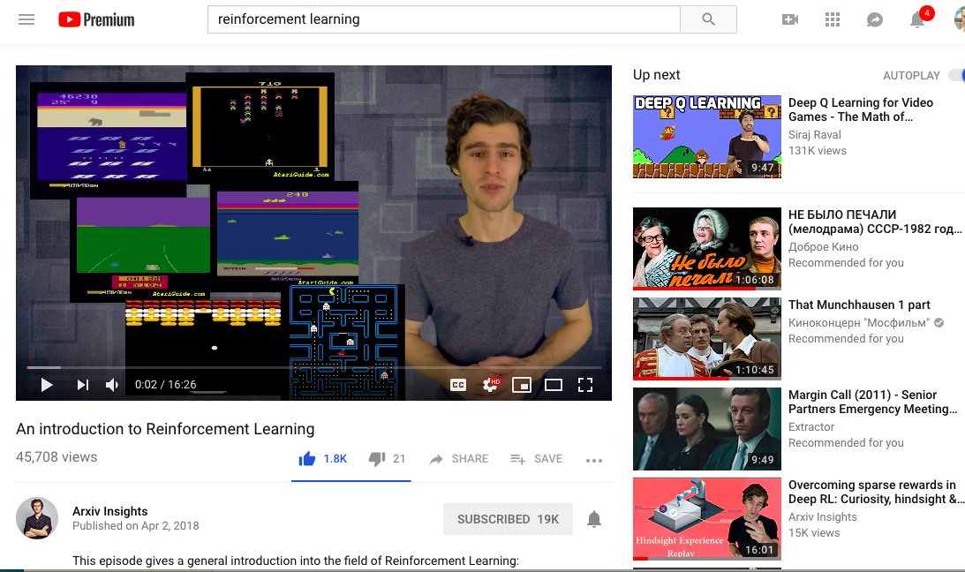
Xander Steenbrugge (Arxiv Insights on youtube)

Slide 2
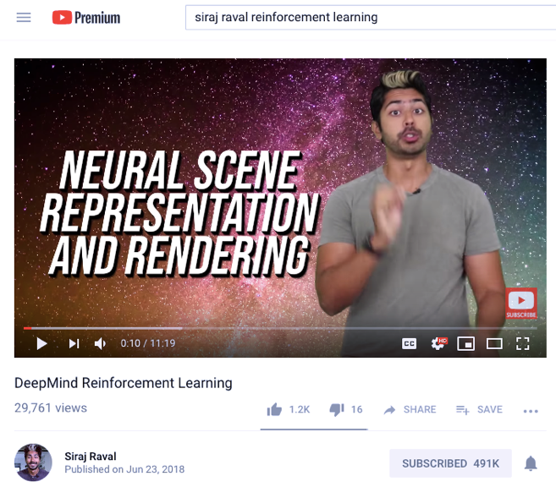
Siraj Raval on youtube - ~500K subscribers

Slide 3
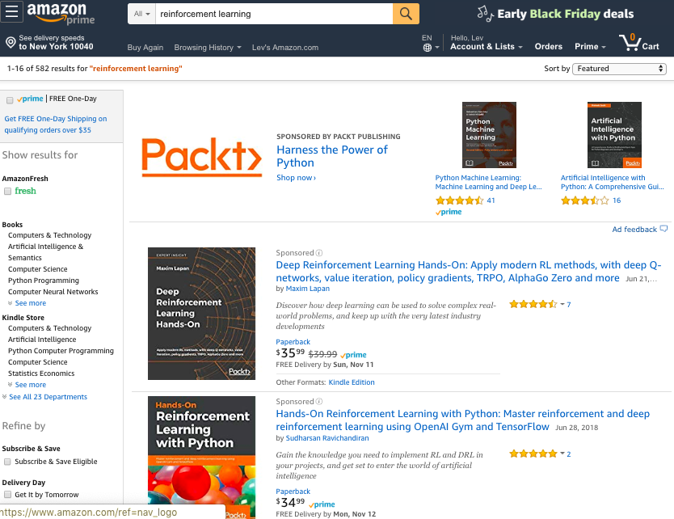
Reinforcement Learning – books on Amazon

Slide 4
Sam Charrington
This Week in Machine Learning & AI (TWiML&AI) podcast
- https://twimlai.com -

Slide 5
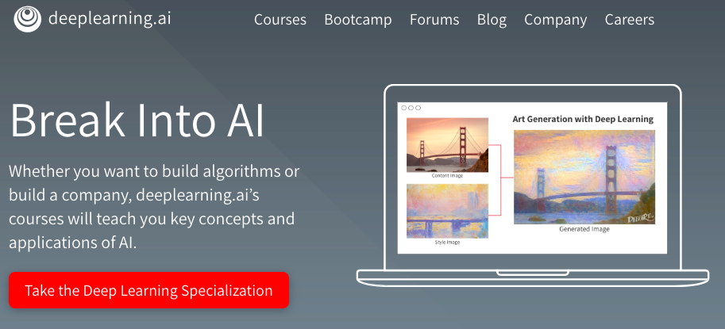
DeepLearning.ai – Coursera course by Andrew Ng

Slide 6
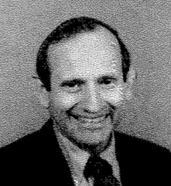
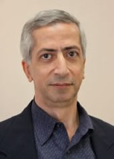
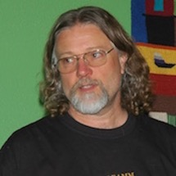

NIPS = NeurIPS
Ed Posner,
CalTech,
First conference
President, founded NIPS foundation.
Yaser Abu-Mostafa,
CalTech
James Bower
CalTech,
now Virtual Worlds, OR
NIPS Conference – held every December since 1987
NIPS = Neural Information Processing Systems
- https://nips.cc
- https://papers.nips.cc
- https://en.wikipedia.org/wiki/Conference_on_Neural_Information_Processing_Systems
-
2014 – 2,500 registered participants
2015 – 3,755 (growth 1,255, or 50%)
2016 – 5,680 (growth 1,925, or 51%)
2017 – 8,500 ?
2018 – 12K (2K tickets for main session sold in 12 minutes) 2019 ~ 13K, lottery was used to distribute tickets
1987-2000 – in Denver, USA
2001-2010 – in Vancouver, Canada
2011 – Granada, Spain
2012-2013 – Lake Tahoe, US
2014-2015 – Montreal, Canada
2016 - Barcelona, Spain
2017 - Long Beach, California, US
2018 - Montréal, Quebec, Canada Dec 3-8 (Mon-Sat)

