Slide 1
Probability & Statistics
If we throw 2 cubes, there are 6*6=36 possible combinations.
Probability of each combination is the same – 1/36.
If we define an outcome as a sum of numbers on top side of
cubes after the throw, then there are 11 possible outcomes:
---------------------------------------------------------
Sum Combinations Number of
combinations Probability
---------------------------------------------------------
2 1+1 1 1/36
3 1+2,2+1 2 2/36
4 1+3,2+2,3+1 3 3/36
5 1+4,2+3,3+2,4+1 4 4/36
6 1+5,2+4,3+3,4+2,5+1 5 5/36
7 1+6,2+5,3+4,4+3,5+2,6+1 6 6/36
8 2+6,3+5,4+4,5+3,6+2 5 5/36
9 3+6,4+5,5+4,6+3 4 4/36
10 4+6,5+5,6+4 3 3/36
11 5+6,6+5 2 2/36
12 6+6 1 1/36
---------------------------------------------------------
Total 36 1
From the table above you see how some outcomes can result
from more combinations, thus have higher probability of happening.
Note: Events can be mutually exclusive, or not.
Also, events may be independent, or dependent on each other.
Books on probability and statistics
https://www.quora.com/What-are-some-good-books-for-learning-probability-and-statistics
Introduction to Probability Theory
Probability Definitions
Probability of an event is the measure of the likelihood that
the event will occur (in some experiment).
Probability is a number between 0 and 1.
But sometimes people express probability using percents.
0 – event is impossible
0.5 – the event is just as likely to occur as it is to not occur
1 – event will certainly happen, 100%.
The sum of probabilities of all outcomes of an experiment
should always be 1.
Outcomes can be combinations of individual events.
For example, if we throw one dice cube – there are 6 possible
outcomes (1,2,3,4,5,6), each one has same probability – 1/6.

Slide 2
Marginal Probability = Simple Probability , a probability
of an independent event occurring.
The term “marginal variable” is used to refer to a subset
of variables in a table. They called “marginal” because they
used to be calculated by summing values in a table along
rows or columns , and writing the sum in the margins of the table.
Examples of assigning probability.
Example 1. Tossing a coin.
Possible outcomes : (tails or heads).
Events (tails of heads) are mutually exclusive.
Their probabilities should be equal.
P_{t} + P_{h} = 1
P_{t} = 0.5
P_{h} = 0.5
Example 2. Rolling a die.
Possible outcomes: (1,2,3,4,5,6).
They are mutually exclusive, probability equal, sum() = 1
So each probability = 1/6 = 0.167 3.
Example 3. Job Search.
I get 2 emails with job descriptions every day, 10 per week.
Two of them may be a fit: 2 of 10 (0.2).
So I send an email that I am interested.
I am invited to every third position I requested (0.2/3 = 0.067)
And I get 1 position out of 10 initial interviews (0.0067).
So the probability that an incoming email will result
in a job is 0.0067, or ~1%.
So, I need to consider 100 positions (this will take 10 weeks),
send 20 emails asking to invite, go to 6..7 interviews,
and eventually get a job.
So job search takes 2..3 months.

Slide 3
Rules (Or, And, etc.)
Lets A be an event.
P(A) – probabiltiy of event A
then: P(A) + P(not A) = 1
If A and B are events, then:
P(A or B) = P(A) + P(B) – P(A and B)
for mutually exclusive events P(A and B) = 0,
so P(A or B) = P(A) + P(B)
Venn Diagrams
Venn Diagrams = Graphical representation of events as circles.
See many examples – just google images for: Venn Diagram A or B.
For example, this image shows Intersection (A and B),
negation of intersection (A but not B, or B but not A),
union (A or B), and subtraction (A but not B) :
Conditional Probability
P(A|B) – probability of A given that B has occurred.
P(A|B) = P(A and B) / P(B) (if P(B) is not zero)
If A & B are independent form each other, then:
P(A|B) = P(A)
P(B|A) = P(B)

Slide 4

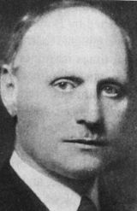
Union Bound Formula
P(A∪B) = P(A) + P(B) − P(A∩B) ≤ P(A) + P(B)
Bonferroni Inequality
A
A
P(A∩B) = P(A) + P(B) − P(A∪B) >= P(A) + P(B) – 1
A = smart, B = beautiful
If P(A) ~ 0.9, and P(B) ~ 0.9, then P(A & B) >= 0.8
If P(A) ~ 0.5, and P(B) ~ 0.5, then P(A & B) >= 0.0
A∩B
A∩B
B
B
Bonferroni Correction
Carlo Emilio Bonferroni
1892 – 1960
Florence, Italy
When conducting multiple tests, the chance of getting a significant (type 1) error increases by pure chance.
To correct for this, we proportionally "decrease" the "alpha" value of each test.
Example:
Suppose we have Ng = 5 treatment groups.
Hull hypothesis is that group members are "equal" in all groups.
Alpha = 0.05 ("family alpha rate") – chance of rejecting H0
We decided to make 10 comparisons:
1 to 2, 2 to 3, 3 to 4, 4 to 5, 1 to 3, 2 to 4, 3 to 5, 4 to 1,
(1 & 2) to (3 & 4), (1 & 2) to (4 & 5)
We will use new corrected alpha Alpha_new = Alpha/10 = 0.005 for each of those 10 tests.
If any of the 10 tests rejects the H0 (using this small Alpha_new value of 0.005),
then we reject H0 for the whole "family".

Slide 5
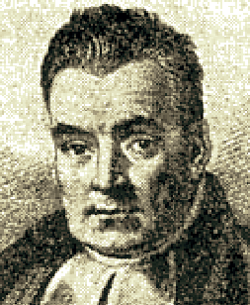

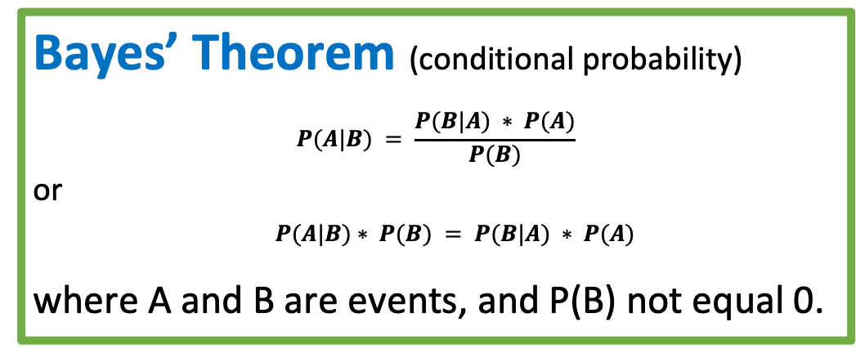
Bayesian inference - calculate probability
following chains of dependencies or correlations
Bayes’ Theorem (conditional probability)
$$P(A|B) = \frac{P(B|A) ∗ P(A)}{P(B)}$$
or
$P(A|B)∗ P(B) = P(B|A) ∗ P(A)$
where A and B are events, and P(B) not equal 0.
P(A|B)
P(A)
P(B|A)
Thomas Bayes (1701–1761)
P(B)
Bayes "solution" to a problem of inverse probability, was presented by Richard Price in 1763, two years after Bayes' death.
All People
A = Happy, B = Rich
P(A) = 40% = probability of being happy (Yellow)
P(B) = 5% = probability of being rich (Blue)
P(B|A) = 10% = probability of being rich given that Happy
P(A|B) = 80% = probability of being happy given that rich
Intersection:
P(A & B) = 4% = probability of rich & happy (Green)
P(A|B)*P(B) = 80%*5% = 4%
P(B|A)*P(A) = 10%*40% = 4%
+-----+--------+------+
| | Happy | |
+-----+--------+------+
|Rich | 4 | 1 |
| | 36 | 59 |
+-----+--------+------+
A
Happy
B
Rich

Slide 6
Bayesian vs Frequentist
Survivorship Bias in World War 2
During World War II the US military's concluded that the most-hit areas of the plane needed additional armor.
But statistician Abraham Wald (Statistical Research Group (SRG) at Columbia University) has recommended adding armor to the areas that showed the least damage. His reasoning was that the sample didn't include the planes which were shot down.
It is dangerous to use data "as is" to create a model, because the data may be biased to start with, and it can easily lead to creating a biased model Problem occur when we have: - under-represented features (missing data) - over-represented features, - "target leakage" effect. Survivorship bias: - https://www.youtube.com/watch?v=B3YQJ5DwTzM Gender Bias: - https://www.youtube.com/watch?v=p60-Jdq754A Bias in criminal justice: - https://www.youtube.com/watch?v=Gi4YeRqfb24 Target Leakage: - https://www.youtube.com/watch?v=y8qaI5mpJeA

Slide 7
Confidence vs Credibility
Bayesianism:
probabilistic statement about
model parameters
given a fixed credible region
Frequentism:
probabilistic statement about
a recipe for generating
confidence intervals
given a fixed model parameter
In general, a frequentist's
95% Confidence Interval
is not 95% likely to contain the true value!
A frequentist only states that:
if we repeat experiment multiple times
then 95% of such confidence intervals
will contain the true value.
Our Particular Interval
from Jake VanderPlas
https://www.youtube.com/watch?v=KhAUfqhLakw

Slide 8
Frequentist vs Bayesian
Frequentist interpretation of Bayes’ theorem.
Probability measures a proportion of outcomes.
P(A) - proportions of outcomes A
P(B) - proportions of outcomes B
P(B|A) is the proportion of outcomes B out of outcomes A
Bayesian interpretation of Bayes’ theorem.
Probability measures a degree of belief. P(A), the prior, is the initial degree of belief in A.
P(A|B), the posterior, is the degree of belief having accounted for B. P(B|A)/P(B) – represents the support B provides for A.

Slide 9
Random Variable. Probability Distribution
Random variable is a numerical variable taking different values.
Values may be discrete or continuous.
For example, think of variable “x” which may have any real value between -10 and +10.
Or think of a variable “z” which can have discrete values 0,0.1,0.2, … 0.9, 1.0
Discrete Case
Probability function P(x) of a discrete random variable “x”
is simply a function which gives probability of discrete values.
For example, if the random variable “x” may have two values: ( 0 or 1 ),
and if probabilities of those values are equal, then
P(0) = 0.5, f(1) = 0.5.
The sum of individual probabilities for all possible values should be 1.
Expected value is an weighted average of all values.
E(x) = sum(Xi*P(Xi)), where Xi goes through all allowed values of X.
Variance = sigma squared = sum( (Xi-E(x))**2 * P(Xi) )
Standard Deviation = sqrt(sigma squared)
Probability Density Function (PDF)
vs. Cumulative Probability Function ( CPF)
Continuous Case
Probability Density Function (PDF) f(x) is a continuous function.
f(x)*dx gives probability that value is between x and x+dx.
The total integral of f(x)*dx should be equal to 1.
Cumulative Probability Function (CPF)
This is simply a function F(x) which gives probability that value is less than x.
It monotonously grows from 0 to 1 as x grows (from small to large values).
The PDF is a first derivative of CPF.
CPF(x+dx) – CPF(x) = = [Prob. of value < (x+dx)] – [Prob. of value < x] = f(x)*dx
Mean value = Expected value
For discrete case we had:
E(x) = sum(Xi*P(Xi))
For continuous case this translates into
E(x) = Integral(xF(x)dx)

