Slide 1
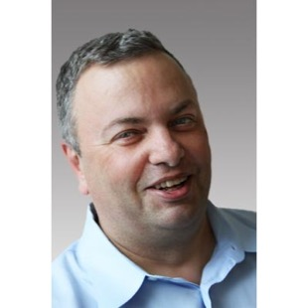
About me:
Lev Selector, Ph.D. – Mathematical Modeling
1977 - first programming project: Fortran, punch-cards
... - 1994 - math. modeling in biophysics
... - present – Data Science, Machine Learning & AI.

