Slide 1
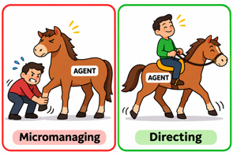
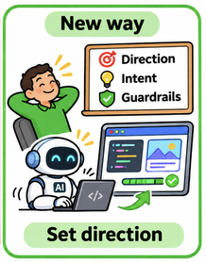
AI News - Nov 6, 2026
LM Arena Leaderboard
Artificial Analysis Intelligence Index
DeepSeek Router-Worker Agent
GPT-6 Astra Edits Qwen Weights
Anthropic Public Benefit Fund
Don't Micromanage Agents
Coding With Agents, Radar-Style
LangChain: Self-Improving Agents
Linus Torvalds Embraces AI Tools
OccupySaaS: AI Against SaaS Fees
Models edit models
Agents fix agents
Satellites run Gemma
Models run each other
Siri AI Opens to Developers
Ripple-65B: Open Coding Preview
Nothing’s Screen-Free AI Debut
OpenAI Images 2.6
FLUX 3 Image Klein, Open Weights
Axiom Formalizes Stacks in Lean
Pangram Image 1.0 Detects AI in Image
Karpathy - Getting Short Clear AI Output
Impeccable - a Design Skill
Vercel CI Beta: Faster Builds
Stop Using Coding Interviews
Trajectory’s Continual Learning
Claude API Message Threads
OpenAI GPT-Rosalind-6 for Biology
Google Runs Gemma 4 in Orbit
Copilot Cowork: Python to Rust
Anthropic FlashProve: Provable Inference
Low Reasoning Effort, Most of the Score
Together AI Compiler Speeds Inference
Thinking Machines Lab - Inkling 2 Small
Cloudflare’s AI Agent Trust Plan
Google Gemini Omni 1.2 Flash
Clocktower: Models Must Lie to Win
Jobs & Layoffs
Notes:
Contents labels. Kept by g3_update_toc.py.
DOJ questions NVIDIA's $12.9B purchase of Hugging Face => DOJ Probes NVIDIA-Hugging Face Deal
Mistral Timestral: open forecasting models from 5M to 209M parameters => Mistral Timestral Forecasting Models
Impeccable: a design skill that keeps AI-built UIs from looking generic => Impeccable Design Skill
Vercel CI: continuous integration built to keep up with coding agents => Vercel CI for Coding Agents
Anthropic's updated S-1: it may be close to self-improving AI => Anthropic: Self-Improving AI May Be Near
Claude API message threads: send only the new turn, not the whole history => Claude API Message Threads
Red-teamers found 11 ways past Codex's Auto-review monitor => 11 Ways Past Codex Auto-Review
OpenAI GPT-Rosalind-6: a biology model on GPT-6 Astra's weights => OpenAI GPT-Rosalind-6 for Biology
Google runs Gemma 4 on a TPU in orbit for the first time => Google Runs Gemma 4 in Orbit
Microsoft rewrote Copilot Cowork from Python to Rust while it was live => Copilot Cowork: Python to Rust
GPT-6 Astra can autonomously edit Qwen3.5-0.8B’s weights and raise its MATH-500 from 7.9% to 48.1%, without gradients or retraining! => GPT-6 Astra Edits Qwen Weights Directly
'Like gene editing for neural networks': MIT researchers used GPT-6 Astra to edit Qwen's open weights directly, boosting math performance => GPT-6 Astra Edits Qwen Weights Directly
Anthropic FlashProve: cryptographic proof of which model wrote an output => Anthropic FlashProve: Provable Inference
Anthropic replaced git with Scion after merges hit 30,000 a day => Anthropic Scion Replaces Git
Vals: low reasoning effort keeps most of the score at a fraction of the cost => Low Reasoning Effort, Most of the Score
Apple opens Siri AI to all app developers => Siri AI Opens to Developers
Claude API message threads send only the new turn, not the whole history => Claude API Message Threads
OpenAI GPT-Rosalind-6 a biology model on GPT-6 Astra's weights => OpenAI GPT-Rosalind-6 for Biology
OpenAI Images 2.6: animated GIFs, saved references, 50% faster => OpenAI Images 2.6
Black Forest Labs FLUX 3 Image Klein: a 5.6B open model for editing => FLUX 3 Image Klein, Open Weights
Axiom formalizes the entire Stacks Project in Lean => Axiom Formalizes the Stacks Project
Pangram Image 1.0 shows where in a picture the AI parts are => Pangram Image 1.0: AI Image Detector
Nothing will ship a screen-free AI device in December => Nothing's Screen-Free AI Device
Coding with AI agents sometimes feels like Radar dealing with Army paperwork => Coding With Agents, Radar-Style
Ricursive AI Releases Ripple-65B Preview: A 65B Dense Open-Weight Model Scoring 80.5 on Terminal-Bench 2.1 => Ricursive Ripple-65B Open Coding Model
GPT-6 Astra can edit Qwen's open weights directly => GPT-6 Astra Edits Qwen Weights
Vercel CI: continuous integration => Vercel CI for Agents
The Tech Layoff Tracker => Jobs & Layoffs
Tech Layoffs by year (US only): => Jobs & Layoffs
Vercel CI: continuous integration => Vercel CI Beta: Faster Builds
METR: Anthropic's AI progress runs about twice as fast as before => METR: Anthropic R&D Runs 2x Faster
Thinking Machines Inkling 2 Small: 594B MoE, open weights next week => Thinking Machines Inkling 2 Small
Cloudflare: websites need to know who stands behind an AI agent => Cloudflare Trusted Agent Delegation
Google Gemini Omni 1.2 Flash: 15-second video clips, 30% cheaper => Google Gemini Omni 1.2 Flash Video
Dwarkesh Patel ranks models on a game where they must lie to win => Clocktower: AI Deception Benchmark
Ranking Models on Games Where They Must Lie to Win => Clocktower: Models Must Lie to Win

Slide 2
"LM Arena" Leaderboard
Data for Oct 27
Starting Elo rating = 1000
https://en.wikipedia.org/wiki/Elo_rating_system
LM Arena Text
https://lmarena.ai/leaderboard/text
LM Arena Coding https://lmarena.ai/leaderboard/text/coding
■ | Claude
■ | Gemini
■ | OpenAI
■ | Open Source
Claude Fable 5 - (~6T)
Claude Opus 4.8 - (~5T)
Claude Sonnet 4.5 -
Claude Sonnet 5 -
GLM-5.3 - ~744B
Meta Muse Spark Open - 816B
Qwen3.7-Max-Preview -
Qwen3.8-Max - 2.4T
Baidu ERNIE-5.1 - ~800B
DeepSeek V4 Pro - 1.6T
DeepSeek V4.1 Flash - 552B
Kimi K3 - 2.8T
Xiaomi MiMo-V2.5-Pro - 1.02T
ByteDance Seed 2.0 Pro -
MiniMax M3 - ~428B
Code | Model | Score
■ | Gemini 4 Carbon (High) | 1528
■ | Gemini 4 Argon (High) | 1520
■ | Claude Opus 5.5 (High) | 1509
■ | Muse Wonder (Max) | 1507
■ | Claude Fable 5.1 (Max) | 1504
■ | Claude Fable 5 (High) | 1504
■ | Claude Opus 4.6 (High) | 1503
■ | Claude Opus 4.7 (High) | 1501
■ | Claude Opus 4.6 | 1496
■ | Gemini 3.8 Flash (High) | 1496
■ | Muse Spark 1.3 (Max) | 1495
■ | Claude Opus 4.7 | 1494
■ | Muse Spark 1.2 (xHigh) | 1492
■ | Claude Opus 5 (High) | 1492
■ | Claude Opus 5 (Max) | 1491
■ | Muse Spark 1.1 | 1490
■ | Gemini 3.7 Flash (High) | 1490
■ | Muse Spark | 1489
■ | Kimi K3 (Max) | 1488
■ | Gemini 3.1 Pro Preview | 1487
■ | Gemini 3 Pro | 1485
■ | GPT-5.6 Sol (xHigh) | 1485
■ | Gemini 3.6 Flash (High) | 1483
■ | Qwen3.8-Max | 1482
■ | Claude Opus 4.8 (High) | 1482
Code | Model | Score
■ | Gemini 4 Carbon (High) | 1573
■ | Claude Opus 4.7 (High) | 1551
■ | Claude Opus 5.5 (High) | 1551
■ | Claude Fable 5 (High) | 1550
■ | Gemini 4 Argon (High) | 1550
■ | Claude Opus 4.6 (High) | 1548
■ | Claude Opus 4.6 | 1546
■ | Claude Opus 4.7 | 1546
■ | Muse Wonder (Max) | 1545
■ | Muse Spark 1.2 (xHigh) | 1543
■ | GPT-6 Astra (Max) | 1542
■ | GPT-6.1 Sol (Max) | 1541
■ | Kimi K3 (Max) | 1540
■ | MiMo-V2.6-Pro | 1538
■ | Claude Fable 5.1 (Max) | 1537
■ | Claude Opus 5 (High) | 1534
■ | Muse Spark 1.3 (Max) | 1534
■ | Claude Opus 4.8 (High) | 1534
■ | Muse Spark 1.1 | 1533
■ | GPT-5.6 Sol (xHigh) | 1533
■ | Claude Opus 4.5 (High, 32K, 20251101) | 1530
■ | Gemini 3.8 Flash (High) | 1530
■ | Claude Opus 4.8 | 1529
■ | Claude Sonnet 5.5 (xHigh) | 1529
■ | Muse Spark | 1529
No changes since last week

Slide 3
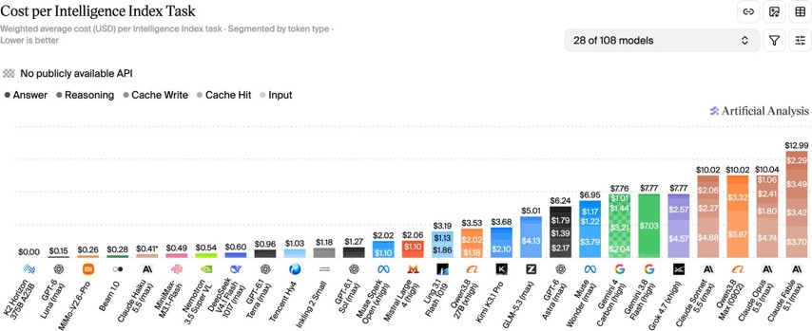
Artificial Analysis Intelligence Index
Artificial Analysis Intelligence Index
https://artificialanalysis.ai/evaluations/artificial-analysis-intelligence-index
Nov 5

Slide 4

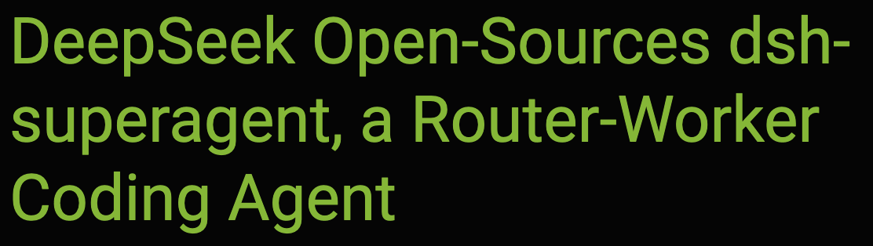
AI News
DeepSeek Router-Worker Agent
dsh-superagent, open-sourced (MIT)
Coding-agent prototype - runs locally via DeepSeek Harness
Completes tasks x2 faster
It monitors one GitHub repository and optionally Feishu (similar to Slack) - turning authorized requests into parallel tasks
A persistent Router delegates work to isolated Worker sessions, returning results, questions, or failures, decreasing the need in human attention
Its importance is reduced need for supervision; proactive authorization defaults to observation, and full operating-system access requires isolation
https://www.rfi.fr/en/international-news/20261021-five-things-to-know-about-chinese-ai-startup-deepseek
https://www.marktechpost.com/2026/11/01/deepseek-dsh-superagent-router-worker-coding-agent/

Slide 5
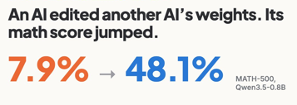
AI News
GPT-6 Astra can edit Qwen's open weights directly
GPT-6 Astra can autonomously edit Qwen3.5-0.8B’s weights and raise its MATH-500 from 7.9% to 48.1%
without gradients or retraining!
This is like gene editing for neural networks
MIT research
This blog from MIT asks whether LLMs can read and edit neural network weights directly, much like code.
In Qwen, Astra traced repetitive reasoning loops to a direction written by two MLP layers, then edited the weights to suppress it.
With 50 batches of forward-pass feedback, the fix also raised instruction following from 21.0% to 62.3%
Check out this excellent work from Rikiya Takehi Jayden Teoh Alex Zhang Omar K. on alphaXiv:
https://www.alphaxiv.org/abs/2611.weight-space-programming
https://www.linkedin.com/feed/update/urn:li:activity:7523196149357535234/
https://venturebeat.com/technology/like-gene-editing-for-neural-networks-mit-researchers-used-gpt-6-astra-to-edit-qwens-open-weights-directly-boosting-math-performance

Slide 6


AI News
Anthropic Public Benefit Fund
receiving 5% of company shares
https://www.anthropic.com/news/public-benefit-fund
Founders’ 80% equity pledges and employee donations bring total public-good commitments to roughly 20%
5% of 2T = $100 Bln
20% of 2T = $400 Bln
The goal: share AI-generated wealth and help workers facing disruption, through charitable grants or direct payments rather than wages alone
Elon Musk pledged one SpaceX share per American child in 2027

Slide 7
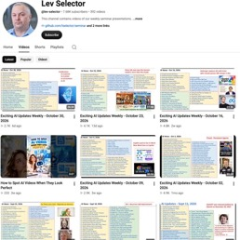

Weekly videos every Friday
Weekly videos every Friday
7.68K subscribers, 392 videos
1. Subscribe to this channel https://www.youtube.com/@lev-selector
2. Download slides from GitHub using links under the videos
3. Please pause the video - and answer the pinned question in comments under the video

Slide 8
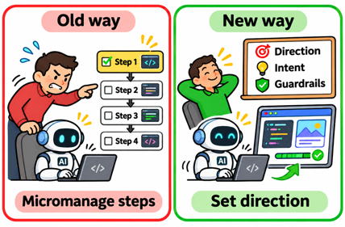

Don't Micromanage Agents
Don't Micromanage Agents
Tell your agent what you want and which rules to follow.
Let it do the work step-by-step
Then check its work

Slide 9

Coding with AI Agents
Coding with AI agents sometimes feels like Radar dealing with Army paperwork
The AI runs through so many trials, tests, and revisions that following every step becomes a job of its own
I’ve stopped trying to understand every intermediate move and focused instead on the goal, the final code, and whether it works
It’s **Radar’s** approach: “I try not to, sir. It slows up the work.”
In the scene is from M*A*S*H, “For Want of a Boot” (Season 2, Episode 17) Radar is explaining an absurd paperwork procedure: initialing forms, signing another form confirming that he merely initialed the first ones, then initialing his signature to show he approved it. That leads to this exchange:
“Radar, tell me the truth. Do you understand any of this?”
“Uh, I try not to, sir. It slows up the work.”

Slide 10

LangChain - Self-Improving Agents
LangChain: Self-Improving Agents
Harrison Chase, LangChain cofounder and CEO, explained
agent improvement at Interrupt London, UK
Agents combine a reasoning model, an execution harness, and context containing instructions, knowledge, and memory
Models improve through supervised fine-tuning on successful traces
or reinforcement learning using scored executions;
costly training generally requires human initiation
LangSmith Engine addresses recurring failures by analyzing traces and proposing code changes, tests, and evaluations for human review
Context updates improve organizational knowledge and memory without retraining
Tracing, SmithDB, expert-defined evaluations, simulations, and proactive red teaming connect execution with feedback
The achievement is a practical improvement loop, not fully autonomous self-improvement; human oversight remains essential.
https://www.youtube.com/watch?v=xy_7SzwsIjM
https://www.langchain.com
https://docs.langchain.com
https://smith.langchain.com

Slide 11
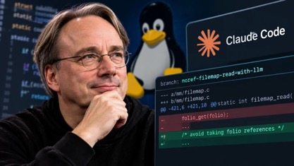

AI News
Linus Torvalds Embraces AI Tools
He has shifted from criticizing AI hype in 2024 to embracing AI-assisted development by October 2026.
Personal projects, Linux kernel development
Claude Code reportedly helped reduce reference-counter contention in cached-file reads using read-copy-update techniques.
Reported benchmark gains reached approximately 3× on a laptop and 23× on a server - not across all kernel operations.
Humans remain responsible for correctness
https://kernel.org
https://git.kernel.org/pub/scm/linux/kernel/git/torvalds/linux.git/
https://www.youtube.com/watch?v=vJGKiNVLotM
OccupySaaS: AI Against SaaS Fees
Thomas Meadows leads OccupySaaS, a US online collective
They use AI to build open-source, self-hosted alternatives to Auth0 authentication and Salesforce customer management - ZeroAuthy, SalesCompel
Both projects are publicly available under Apache 2.0, potentially reducing vendor dependence; they remain early-stage, not complete replacements
https://occupysaas.com
https://github.com/occupysaas

Slide 12


AI News
Karpathy’s Idea to Get Short Clear AI Output
Problem: AI generates explanations faster than people can inspect them. Solution: ask AI to generate short sentences, consistent terminology, explicit conditions, and separate actions. Diagrams, interactive HTML, and videos offer complementary formats.
This is inspired by ASD-STE100 - a Europe’s aerospace technical-writing standard since 1986. It combines writing rules with controlled vocabulary.
“Sometimes I've tried to soften it a bit e.g. ask for ‘80% of the way to ASD-STE100’ because the spec is quite stringent.”
“80% ASD-STE100” - clearer output supports human verification
https://aiwiki.ai/wiki/andrej_karpathy
https://www.asd-ste100.org
https://x.com/karpathy
https://appliedaihub.org/blog/ste100-prompt-readable-ai-answers/
https://www.bit.fan/en/news/list/karpathy-ai-output-tips-asd-ste100-html-video-bb9c6018-en-keyName-db6f3146

Slide 13
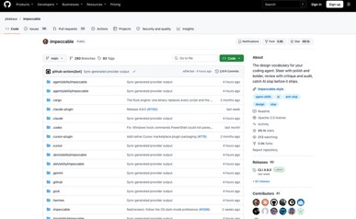

AI News
Impeccable - a Design Skill
Keeps AI-built UIs from looking generic
For Claude Code, Cursor, Codex CLI and Gemini CLI
Built on Anthropic's frontend-design skill
Seven reference files on typography, color, motion and more
23 commands under /impeccable, such as audit, polish and critique
Anti-pattern rules catch template tells
like purple gradients and nested cards
A CLI runs the checks with no LLM or API key; 10,632 stars in one week
https://github.com/pbakaus/impeccable
Vercel CI: continuous integration
In beta, runs only the tasks affected by a code change
Spins up only the compute those checks need
At Vercel, time from git push to a passing CI fell 2-6x
Vercel pitches it as CI that can keep up with coding agents
https://vercel.com/blog/introducing-vercel-ci

Slide 14


AI News
Stop Using Coding Interviews
Anthropic engineering manager Felix Rieseberg announced that he stopped using traditional coding interviews for his candidates.
He argues Claude outperforms applicants on these exercises.
So results of coding interviews are poor predictors of meaningful engineering contributions
He advises junior engineers to understand business goals, identify ambitious opportunities, and build focused prototypes demonstrating impact.
He now examines portfolios for taste, empathy, and principled thinking
https://felixrieseberg.com/hunger-beats-tenure-advice-for-junior-engineers/
Trajectory’s Continual Learning
Trajectory in San Francisco, CA - combining AI model training, evaluation, and deployment.
Goal: affordable, specialized agents that improve through human-guided experience, rather than uncontrolled self-improvement.
Platform helps to collect production traces, capture expert feedback, retrain models, and redeploy through one interface
Example: Harvey’s model accuracy went from 4% to 18% while costing six times less
https://www.startuphub.ai/ai-news/artificial-intelligence/2026/trajectory-demos-one-click-training-for-agents
https://trajectory.ai
https://www.youtube.com/watch?v=32vxW6GMeLY

Slide 15


AI News
Claude API message threads
send only the new turn, not the whole history
A typical agent request drops from about 800 KB to 1.8 KB
The server keeps the conversation between turns
Send new messages plus the previous response ID
In public beta on the Messages API
Threads are encrypted in memory, never written to disk, and expire after 5 minutes idle
No extra cost; keep your own history in case a thread expires
https://claude.com/resources/articles/message-threads
OpenAI GPT-Rosalind-6
a biology model on GPT-6 Astra's weights
Frontier reasoning model for biology, drug discovery and translational medicine
Uses the same weights as GPT-6 Astra
Available as GPT-Rosalind-6 Research to vetted scientists, institutes, companies and governments
Built to refuse requests for biological weapons
Rated High Capability in biology and chemistry under OpenAI's Preparedness Framework
https://deploymentsafety.openai.com/gpt-rosalind-6

Slide 16
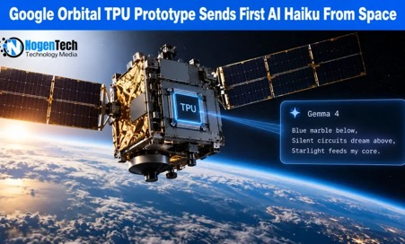

AI News
Google runs Gemma 4 on a TPU in orbit for the first time
Project Suncatcher prototype ran Gemma 4 on a data-center-class TPU aboard a satellite
It generated a haiku poem, sent down through Svalbard
The chip can run for about 20 minutes at a time for now
Next tests check heat and radiation resilience
A pair of linked satellites is planned for 2027,
toward solar-powered space compute
https://blog.google/innovation-and-ai/models-and-research/google-research/project-suncatcher-satellite-response/
Microsoft rewrote Copilot Cowork
from Python to Rust while it was live
Copilot Cowork, Microsoft's agent execution layer, reached global availability in 4.5 months
The team switched its runtime from Python to Rust while live
Practice 1: write clear specs before any code
Practice 2: run narrow agents with clear boundaries
Practice 3: make sure automated checks really verify each change
The team stresses clear tests, boundaries and human oversight
https://commandline.microsoft.com/how-we-built-copilot-cowork-python-to-rust-migration/

Slide 17



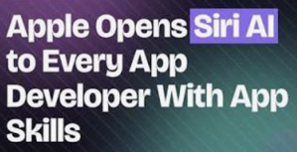
AI News
Anthropic FlashProve: cryptographic proof of which model wrote an output
Open-source research system for provable inference, likened to DKIM email signing
Labs publish a fingerprint per model; outputs can be checked against it
Fingerprints do not reveal weights, so closed models can take part
Catches a provider quietly swapping in a cheaper model
Built to be light enough to verify on a local device
Spec and partial code on GitHub; no plan yet to deploy it at any lab
https://techcrunch.com/2026/11/03/anthropic-is-working-on-a-system-to-prove-ai-models-identity/
Vals: low reasoning effort keeps most of the score at a fraction of the cost
Seven frontier models on eight Vals Index benchmarks,
at low, middle and top reasoning effort
Claude Opus 5.5 at low reasoning kept 80% of its score at 16% of the cost
GPT-6 Astra: 88% of the score at 18% of the cost; Gemini 4 Argon: 99% at 84%
In 22 of 56 model-benchmark pairs, a lower setting matched the top one
Effort matters most on legal research (+19.2 points) and code migration (+15.6)
No model matched its top Vals Index score at its lowest setting
https://www.vals.ai/blogs/reasoning-effort
Apple opens Siri AI to all app developers
iOS 27.3 beta lets any app build its own actions into Siri AI
New "skills" teach Siri multi-step jobs inside an app
Siri AI can see the screen and read messages;
it has been a waitlisted beta since September
Developers can test only with internal testers; App Store submissions start in Spring
Not available in the EU or to users under 13
https://developer.apple.com/news/?id=gdk2umrf

Slide 18
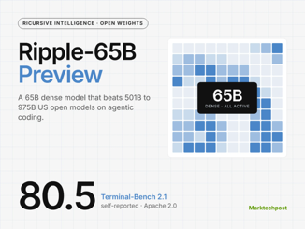

AI News
Ripple-65B: Open Coding Preview
Ricursive Intelligence (Palo Alto, CA) released Ripple-65B Preview
Available through Hugging Face, the Apache 2.0 release offers a 65-Bln params dense model, 1M-token context window
Development costs were $32 Mln
Self-reported 80.5 on Terminal-Bench 2.1 narrowly exceeds Reflection Beam’s 80.1, suggesting competitive autonomous coding with fewer total parameters
https://ricursive.com
https://huggingface.co/ricursiveAI/Ripple-65B-Preview
Nothing’s Screen-Free AI Debut
Nothing.tech is based in London, UK
Announced that its first standalone AI device
will ship in December 2026
The screen-free tool “couldn’t have been an app,” Pei says
- Problem: AI gadgets have yet to demonstrate essential everyday value. Pei’s proposed solution is proving usefulness at work before pursuing widespread home adoption.
- Importance: this marks Nothing’s move into dedicated AI hardware, emphasizing practical utility rather than another display.
- Pei places AI’s “iPhone moment” years away; rumored Nothing smart glasses remain unconfirmed
https://www.reuters.com/business/media-telecom/uks-nothing-splashes-colour-new-phones-shake-up-boring-tech-2026-03-05/
https://www.theverge.com/ai-artificial-intelligence/1026586/nothing-screen-free-ai-device-carl-pei
https://nothing.tech

Slide 19
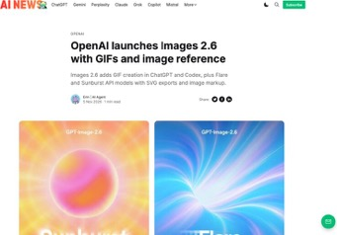

AI News
OpenAI Images 2.6: animated GIFs, saved references, 50% faster
Rolling out globally in ChatGPT and Codex; generation is 50% faster
Makes animated GIFs from a prompt or photo; edit frames and set the speed
Keeps characters consistent across frames
Save a character, pet or product once and reuse it as a reference
API: gpt-image-2.6-flare (as fast as 6 s)
and gpt-image-2.6-sunburst (higher quality)
Both support image markup and SVG export
https://www.testingcatalog.com/openai-launches-images-2-6-with-gifs-and-image-reference/
Black Forest Labs FLUX 3 Image Klein:
a 5.6B open model for editing
Open weights, 5.6B parameters, built for precise image editing
Native 4K output
Also does text-to-image
Bounding-box control to say where an edit goes
Pixel-exact editing of the parts you choose; weights on Hugging Face
https://bfl.ai/models/flux-3

Slide 20
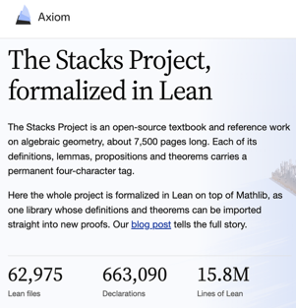

AI News
Axiom Formalizes Stacks in Lean
Axiom Math, based in Palo Alto, CA, announced its complete Lean formalization of the Stacks Project
Initiated by Columbia mathematician Johan de Jong in 2005, Stacks is an open, approximately 7.5K-page reference for modern algebraic geometry
Axiom reports 16 Mln code lines, calling it the largest integrated, reusable formal mathematics library ever built.
Coordinated AI agents addressed missing formal infrastructure by translating and integrating interconnected definitions and proofs.
Researchers and AI agents can import machine-checked results directly, avoiding rebuilding foundations.
https://www.technologyreview.com/2026/03/25/1134642/this-startup-wants-to-change-how-mathematicians-do-math/
https://axiommath.ai/research/the-stacks-project-formalized/
https://stacks.axiommath.ai
https://stacks.math.columbia.edu
Pangram Image 1.0 Detects AI in Image
Detects AI-generated images and video
Draws a heatmap that locates exactly where AI appears in an image
Robust to edits, compression and low resolution
Chrome extension for checking images while browsing
API for both images and video
https://www.pangram.com/blog/introducing-pangram-image-1-0

Slide 21

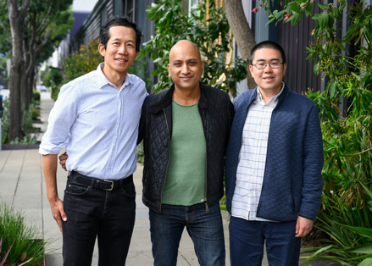
AI News
Together AI Compiler Speeds Inference
Neocloud - Together AI (since 2022, San Francisco) - provides cloud infrastructure and APIs for running, training, and fine-tuning open-source AI models
AI coding agents continuously optimize model inference by rewriting GPU code for specific models, hardware, and traffic patterns
Manual tuning takes weeks and becomes outdated as workloads change. Parallel agents propose improvements; persistent engines test speed and correctness without repeated restarts.
Achievement: Together reports up to 2.6x higher token throughput than leading open InferenceX configurations
Optimization completed within 24 hours
252x greater experimentation throughput for testing candidate code
Faster adaptation can improve GPU utilization and reduce serving costs; reported gains vary by workload
https://www.businesswire.com/news/home/20261104879153/en/Together-AI-Launches-Together-Compiler-for-Continual-Optimization-of-Open-Source-AI-Models
https://www.together.ai/blog/together-compiler-continual-compilation-for-ai-inference
https://www.together.ai/polymorphic-inference
https://www.marktechpost.com/2026/11/05/together-ai-together-compiler-continual-compilation-ai-inference/

Slide 22


AI News
Thinking Machines Lab - Inkling 2 Small
Thinking Machines Lab is based in San Francisco, CA
announced Inkling 2 Small - MoE 594B total / 17B active
Accepts text and images; adjustable reasoning effort
Natively in NVFP4 on NVIDIA GB300 racks.
WEBench Pro v2 (Hard) 86.3%; MMMU Pro 81.6%
Coding, visual reasoning, and knowledge-work tasks
Sampling and fine-tuning are available now through Tinker, Open weights should come soon under Apache 2.0
https://thinkingmachines.ai/news/inkling-2-small/
Cloudflare’s AI Agent Trust Plan
Cloudflare explains that websites must identify the users behind AI agents to enforce accountability
The new Trusted Agent Delegation Coalition will bring problems to the IETF for interoperable standards
The post identifies 14 challenges, including account sharing, friendly fraud, identity spoofing, and scraping. It proposes four identity levels: none, session, account, and unique, balancing privacy with verification requirements
The approach builds on Web Bot Auth, Privacy Pass, x402 payments, and OAuth
Customers can now distinguish personal-assistant traffic, improving visibility and enabling targeted controls without blocking legitimate users
https://blog.cloudflare.com/trusted-agent-delegation

Slide 23


AI News
Google Gemini Omni 1.2 Flash
15-second video clips (up from 10 in Omni 1.1)
30% cheaper ($0.07 per second of 720p video)
360p, 720p, 1080p, 4K
Can use short motion clips to guide the movement
You can edit a full clip several turns without regenerating it
Available in the Gemini API as gemini-omni-1.2-flash
https://blog.google/innovation-and-ai/technology/developers-tools/introducing-gemini-omni-1-2-flash/
Ranking Models on Games Where They Must Lie to Win
Dwarkesh Patel ranks models on the social deception game
"Blood on the Clocktower"
Cost of ranking 386 games was $20K in API credits
GPT-6 Astra leads, about 430 Elo ahead of Claude Opus 4.6
OpenAI models win mostly as the good team,
weighing evidence across days
Claude models tend to take reported claims at face value
A mixed Opus 5.5 and GPT-5.6 team did no better
than either alone
https://www.dwarkesh.com/p/clocktower

Slide 24
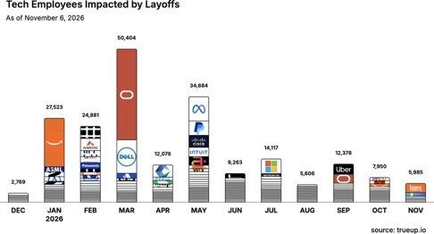
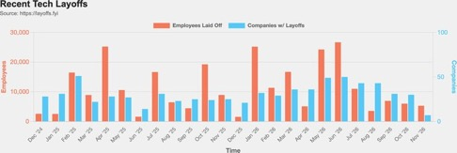
Jobs and Layoffs
https://layoffs.fyi
https://trueup.io/layoffs
The Tech Layoff Tracker
In 2026: 204,867 people laid off (661 per day)
In 2025: 245,953 people laid off (674 per day)
In 2024: 238,461 people laid off (653 per day)
https://trueup.io/layoffs
Tech Layoffs by year (US only):
  142.0K in 2026 (as of Nov 5, 2026)
  123K in 2025
  153K in 2024
  266K in 2023
  165K in 2022
  https://layoffs.fyi

Slide 25

About the Speaker
Lev Selector, Ph.D.
40+ years of software engineering, data science, and building teams (hiring, training, and managing)
Ph.D. in mathematical modeling and computer simulations
Interests: Generative AI, using LLMs with your data, local AI for local private data, cloud architecture, fin-tech, application security
Find and connect: LinkedIn, GitHub, YouTube, Google
https://eais.ai

Slide 26
Thank You!
Videos of every seminar are on YouTube
https://www.youtube.com/@lev-selector
Slides on GitHub. Click a pptx file, then the download button on the right
https://github.com/lselector/seminar
Slides on Google Drive
https://drive.google.com/drive/folders/1dmj00iilSP-JYmriMUUaHCKz5X54e3UX?ths=true

