Slide 1
AI Updates - Jan 02, 2026
"It is more than okay to ship code that you haven't read line by line"
"Slop" refers to low-quality AI-generated content that appears polished but lacks depth, accuracy, or meaningful value.
The term became so widely used that Merriam-Webster named it the 2025 Word of the Year.
Crowd-sourced "LM Arena" Leaderboard
Meta acquired Manus for $2 Billion
Andrej Karpathy posted on X
Mathew Berman - How Coding Is Done Today
VL-JEPA
Qwen-Image-2512
Liquid LFM2-2.6B-Exp
LLM vs AI agent companies
Clone Robotics ProtoClone
The End of Google’s Search Monopoly
Grok 5 is planned to be released in Q1 of 2026
AI Running Business
Storm MCP - open-source MCP gateway
Agent Zero (A0) open-source personal assistant
Google Gems
Google A2UI: Agent-to-User Interface
Alibaba Tongyi Lab released MAI-UI
Tencent WeDLM Fast Diffusion Model
IQuest-Coder-V1 Open Source LLMs
Ralph Loop plugin for Claude Code
Jobs, Layoffs, demand for AI Engineers

Slide 2
Crowd-sourced "LM Arena" Leaderboard
Data for December 30
Starting Elo rating = 1000
https://en.wikipedia.org/wiki/Elo_rating_system
English - https://lmarena.ai/leaderboard/text
Coding - https://lmarena.ai/leaderboard/text/coding
Model | Score
gemini-3-pro | 1490
gemini-3-flash | 1480
grok-4.1-thinking | 1477
claude-opus-4-5-20251101-thinking-32k | 1470
claude-opus-4-5-20251101 | 1467
grok-4.1 | 1466
gemini-3-flash (thinking-minimal) | 1464
gpt-5.1-high | 1458
gemini-2.5-pro | 1451
claude-sonnet-4-5-20250929-thinking-32k | 1450
claude-opus-4-1-20250805-thinking-16k | 1448
ernie-5.0-preview-1203 | 1448
claude-sonnet-4-5-20250929 | 1446
gpt-5.2 | 1443
gpt-4.5-preview-2025-02-27 | 1443
claude-opus-4-1-20250805 | 1442
chatgpt-4o-latest-20250326 | 1441
gpt-5.2-high | 1439
glm-4.7 | 1439
gpt-5.1 | 1438
gpt-5-high | 1436
o3-2025-04-16 | 1434
qwen3-max-preview | 1434
grok-4-1-fast-reasoning | 1431
Model | Score
claude-opus-4-5-20251101-thinking-32k | 1542
claude-sonnet-4-5-20250929-thinking-32k | 1525
gemini-3-pro | 1519
claude-opus-4-5-20251101 | 1515
claude-opus-4-1-20250805-thinking-16k | 1514
grok-4.1-thinking | 1509
gemini-3-flash | 1507
claude-sonnet-4-5-20250929 | 1506
claude-opus-4-1-20250805 | 1499
gemini-3-flash (thinking-minimal) | 1499
claude-opus-4-20250514-thinking-16k | 1495
gpt-5.2-high | 1493
grok-4.1 | 1493
gpt-5.1-high | 1491
gpt-5.2 | 1483
kimi-k2-thinking-turbo | 1482
glm-4.7 | 1482
qwen3-max-preview | 1481
gpt-5.1 | 1478
qwen3-max-2025-09-23 | 1475
longcat-flash-chat | 1475
claude-haiku-4-5-20251001 | 1474
deepseek-v3.2-exp-thinking | 1472
gemini-2.5-pro | 1470
Google Gemini
Claude
OpenAI
x.ai
Open Source
x.ai
x.ai
https://lmarena.ai/leaderboard/text
Design Arena -
https://www.designarena.ai
https://openlm.ai/chatbot-arena/
https://beta.lmarena.ai
Web Leaderboard - 1T params
https://web.lmarena.ai/leaderboard
LLM Leaderboard - by @LlmStats -
https://llmworld.net/llm_leaderboards/
LLM Leaderboard - by StackAI -
https://www.stack-ai.com/llm-leaderboard
LLM Leaderboard - by Artificial Analysis -
https://artificialanalysis.ai/leaderboards/models
Open LLM Leaderboard - by Hugging Face -
https://huggingface.co/open-llm-leaderboard
LLM Leaderboard - by Vellum -
https://www.vellum.ai/llm-leaderboard
AI Benchmarking Hub -
https://epoch.ai/data/ai-benchmarking-dashboard
Grok 4 Benchmarks -
https://artificialanalysis.ai/models/grok-4
Image arena (alibaba) -
http://aiarena.alibaba-inc.com/corpora/arena/leaderboard?arenaType=T2I
image arena - https://lmarena.ai/leaderboard/text-to-image
China
x.ai
China
China
China
China
China
China
China
China
x.ai

Slide 3

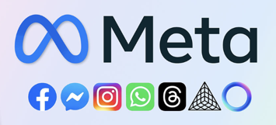
Meta acquired Manus for $2 Billion
Meta acquired Manus for $2Billion
Manus is, a Singapore-based AI startup with Chinese roots
Manus launched its first "general-purpose" AI agent earlier in 2025, offering paid subscription services for research, coding, and other tasks
The startup achieved impressive growth, reaching an ARR (Annual Revenue Run Rate) exceeding $125 Million within just eight months of launch, with millions of paying users worldwide
Manus originated as a project from the Chinese startup Butterfly Effect (also known as Monica.Im) before becoming an independent entity
Meta plans to integrate Manus's agent technology across its consumer and business products, including Meta AI, WhatsApp, Facebook, and Instagram
Meta will continue selling and operating the Manus subscription service through its own app and website
As part of the transaction, Meta bought out all existing investors, including major Chinese backers such as Tencent Holdings, ZhenFund, and HSG. Meta confirmed there will be "no continuing Chinese ownership interests in Manus AI" following the acquisition, and the platform will discontinue its services and operations in China
Manus will continue operating from Singapore
https://www.wsj.com/tech/ai/meta-buys-ai-startup-manus-adding-millions-of-paying-users-f1dc7ef8
https://abcnews.go.com/Technology/wireStory/meta-buys-startup-manus-latest-move-advance-artificial-128783025
https://finance.yahoo.com/news/meta-acquire-manus-2-billion-101807601.html

Slide 4

Andrej Karpathy posted on X
Andrej Karpathy posted on X (formerly Twitter) Dec 26,2025:
https://x.com/karpathy/status/2004607146781278521
Post received more than 15.8 Million views
"""I've never felt this much behind as a programmer. The profession is being dramatically refactored as the bits contributed by the programmer are increasingly sparse and between. I have a sense that I could be 10X more powerful if I just properly string together what has become available over the last ~year and a failure to claim the boost feels decidedly like skill issue.
There's a new programmable layer of abstraction to master (in addition to the usual layers below) involving agents, subagents, their prompts, contexts, memory, modes, permissions, tools, plugins, skills, hooks, MCP, LSP, slash commands, workflows, IDE integrations, and a need to build an all-encompassing mental model for strengths and pitfalls of fundamentally stochastic, fallible, unintelligible and changing entities suddenly intermingled with what used to be good old fashioned engineering.
Clearly some powerful alien tool was handed around except it comes with no manual and everyone has to figure out how to hold it and operate it, while the resulting magnitude 9 earthquake is rocking the profession. Roll up your sleeves to not fall behind."""

Slide 5







Mathew Berman - How Coding Is Done
Mathew Berman talks about changes in Coding
https://www.youtube.com/watch?v=pwmK46hhfwg
Tools like Claude Code and Opus 4.5 can now generate, debug, and review most of the code, often better and faster than humans
Influential engineers and leaders (Karpathy, Boris Cherny, Igor Babushkin, Tobi Lütke, Eric Schmidt, etc.) report feeling “behind” if they do not fully leverage these tools, with examples of entire codebases and test suites being written and reviewed by AI, and teams achieving 5 releases per engineer per day
This new era moves programmers from line-by-line coding to orchestrating agents, specs, and workflows, while human value increasingly lies in human taste, product vision, and the ability to discern signal from noise as software creation becomes nearly frictionless
Boris Churnney, one of the creators of Claude Code, says that 100% of Claude Code's code in the last 30 days was written by Claude Code
Boris wrote: "In the last 30 days, I landed 259 PRs, 497 commits, 40,000 lines of code added, 38,000 lines of code removed. Every line was written by Claude code plus Opus 4.5."
The first code review (PR review) is always done by Claude Code. The test suite is almost 100% written by claude code Claude Code team do about five releases per engineer per day. insane speed!
So the best in the world are now adopting Vibe Coding
It is more than okay to ship code that you haven't read line by line (but higher level human review is still needed)
Human taste is going to become not only much more valuable, but potentially the biggest bottleneck
The ability to pick out the signal from the noise becomes the only skill that matters
Peter Steinberger admits that he ships code without reviewing it.
"These days, I don't read much code anymore. I watch the stream and sometimes look at key parts, but I got to be honest, most code I don't read. I do know where which components are and how things are structured and how the overall system is designed and that's usually all that's needed"

Slide 6

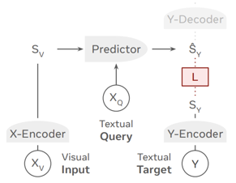
VL-JEPA
VL-JEPA: Vision-Language Joint Embedding Predictive Architecture
https://arxiv.org/abs/2512.10942
A new AI system from Meta led by Yann LeCun
Rather than predicting text tokens like traditional vision-language models (VLMs), VL-JEPA predicts meaning directly through continuous embeddings
Traditional VLMs waste computational resources learning surface-level language variations. For example, "the light turns off," "the room gets darker," and "the lamp goes dark" are semantically identical but appear completely different in token space. VL-JEPA treats these as similar representations in embedding space.
The system also enables selective decoding for video - only generating text when semantic content changes significantly. In tests on 6-minute videos, this reduced decoding operations by 2.85x while maintaining comparable performance.
VL-JEPA uses four components:
- Visual encoder (frozen V-JEPA 2 with 304M parameters)
- Predictor (based on Llama 3.2 1B) maps visual input and text queries to answer embeddings
- Y encoder converts target answers to embeddings during training
- Y decoder converts embeddings to text only when needed at inference
With only 1.6B parameters and 2B training samples, VL-JEPA matched or exceeded models trained on up to 86B samples. It showed faster learning curves
The system excelled at world modeling tasks, achieving 65.7% accuracy predicting which action caused physical transitions—beating GPT-4, Claude 3.5, and Gemini 2.
VL-JEPA is a potential post-LLM paradigm for perception-heavy tasks like robotics, wearables, and real-time video understanding. While token-based models remain superior for reasoning and tool use, this embedding-first approach offers structural advantages for continuous visual understanding where latency and compute efficiency matter.

Slide 7
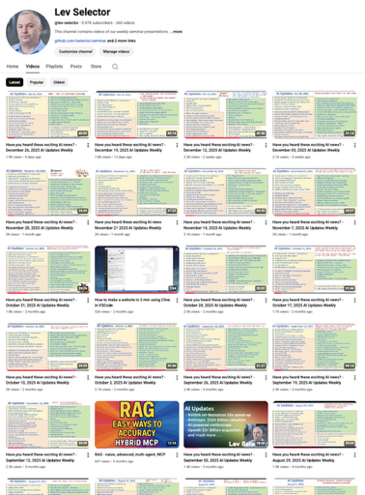
We do these weekly videos every Friday
Stats: 5.97K subscribers, 260 videos
Subscribe to this channel
https://www.youtube.com/@lev-selector
Download slides from GitHub using links under the videos
Please pause the video - and answer the pinned question in comments under the video

Slide 8
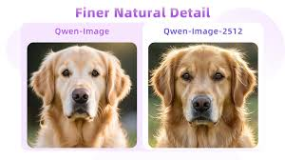
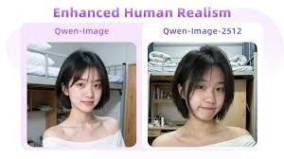
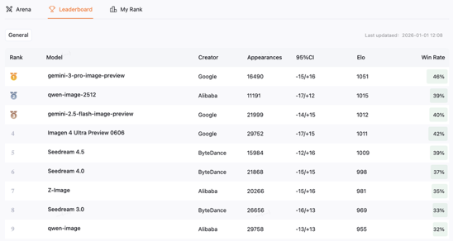
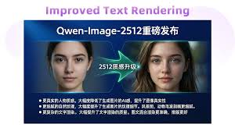
Qwen-Image-2512
Qwen-Image-2512 released Dec 30, 2025
Open-source (Apache 2.0), by Alibaba Cloud's Qwen team
Enhanced Human Realism, Finer Natural Detail, Superior Text Rendering, :** Higher accuracy in placing text within images and maintaining the correct layout for signs, labels, and posters.
The strongest open-source image model on the AI Arena platform
20B parameter MMDiT (Multimodal Diffusion Transformer)
https://qwen.ai/blog?id=qwen-image-2512
https://huggingface.co/spaces/Qwen/Qwen-Image-2512
http://aiarena.alibaba-inc.com/corpora/arena/leaderboard?arenaType=T2I

Slide 9

Liquid LFM2-2.6B-Exp
LFM2-2.6B-Exp by Liquid AI on Dec 25, 2025
2.6B params language model, Open-Source and open weights
Pure Reinforcement Learning (RL) - Unlike most models that rely heavily on Supervised Fine-Tuning (SFT), the "Exp" (Experimental) version was optimized using pure reinforcement learning with verifiable rewards. This was specifically used to sharpen its performance in instruction following, math reasoning, and knowledge recall
Hybrid Architecture - uses Liquid AI’s unique architecture that combines Grouped Query Attention (GQA) with short convolutional layers (LIV blocks). This allows it to run much faster and with less memory than traditional transformer models
Edge-Ready - "PhD-level reasoning engine for your smartphone"
https://huggingface.co/LiquidAI/LFM2-2.6B-Exp
https://www.liquid.ai

Slide 10
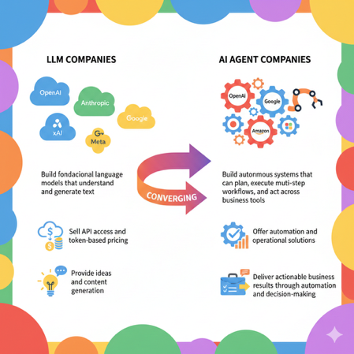
LLM vs AI agent companies
LLM companies like OpenAI, Anthropic, Google, Meta, and xAI build foundational language models that understand and generate text
AI agent companies build autonomous systems that can plan, execute multi-step workflows, and act across business tools; Major players include OpenAI, Google, Microsoft, Amazon, ...
LLM companies sell API access and token-based pricing
Agent companies offer automation and operational solutions
LLMs provide ideas and content generation
Agents deliver actionable business results through automation and decision-making
These two categories are converging as LLM companies add agent capabilities
https://www.decidr.ai/us/blog/ai-agents-vs-llms-what-s-the-difference-and-why-it-matters-for-business

Slide 11
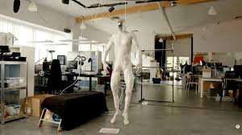
Clone Robotics ProtoClone
Clone Robotics ProtoClone
Full-bodied musculoskeletal android, unveiled in February 2025
It features a faceless, anatomically accurate synthetic human design built from 3D-printed polymer bones and powered by over 1,000 Myofiber artificial muscles - pressurized synthetic strands that contract under hydraulic/pneumatic pressure to mimic natural human muscle function
The android has over 200 degrees of freedom and more than 500 sensors throughout its body, including 70 inertial sensors for movement tracking and 320 pressure sensors in muscles and skin
A water circulation system flows through microchannels in its frame to dissipate heat and prevent the myofibers from overheating during operation
The ProtoClone uses an NVIDIA Jetson chip for real-time processing of sensor data, vision, and AI models
While designed to eventually perform household tasks like cooking, cleaning, and laundry, it cannot yet walk unaided and has been demonstrated while suspended on support rigs
https://clonerobotics.com/android
https://www.youtube.com/watch?v=E1theCfcFsA

Slide 12
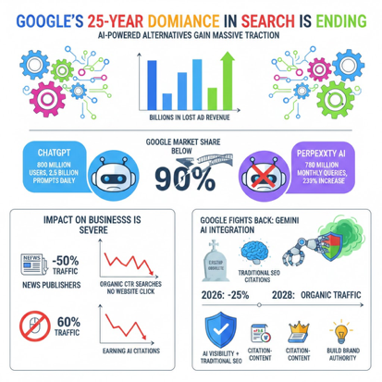
The End of Google’s Search Monopoly
Google's 25-year dominance in search is ending
as AI-powered alternatives gain massive traction
https://www.youtube.com/watch?v=y2yuWf6WFFc
For the first time since 2015, Google's market share dropped below 90 percent in 2024-2025, representing billions in lost ad revenue
ChatGPT doubled its weekly active users from 400 million to 800 million in just seven months, now handling 2.5 billion prompts daily
Perplexity AI grew from 230 million to 780 million monthly queries, a 239 percent increase
The impact on businesses is severe. News publishers lost half their Google traffic in two years, and organic click-through rates for queries with AI overviews dropped from 1.76 percent to 0.61 percent, a 61 percent decline
Meanwhile, 60 percent of Google searches now end without any website click. Traditional SEO focused on rankings is becoming obsolete as the game shifts to earning AI citations rather than top search positions
However, Google recently showed signs of fighting back aggressively integrated Gemini AI across its ecosystem to keep users from leaving for ChatGPT
Experts predict traditional search volume will drop 25 percent by 2026 and organic traffic could decline 50 percent by 2028
Businesses must now optimize for AI visibility alongside traditional SEO, create citation-ready content with data and authoritative sources, and build brand authority that AI systems recognize and cite

Slide 13

Grok 5
Grok 5 is planned to be released in Q1 of 2026.
Trained on Colossus-2 supercluster (200,000 NVIDIA GPUs, 1 GWatt).
Total params - 6 trillions (MoE with 100-200B active params).
Context Window - approx 1.5 Million or more
Native Multimodality - build from ground up to process
real-time video and audio natively
Elon Musk has publicly stated he gives Grok 5 a 10% chance of achieving AGI
By training on massive amounts of Tesla FSD (Full Self-Driving) video data, xAI aims for Grok 5 to have a superior "world model" compared to competitors like GPT-5 or Gemini 3.
Grok-5 is designed not just to use tools (like APIs), but to "invent" its own code-based tools to solve complex, multi-step problems autonomously.

Slide 14

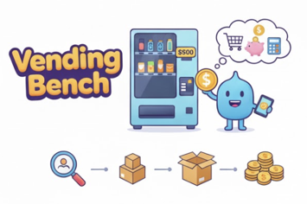
AI Running Business
Andon Labs tests AI models
Used in real-world scenarios to measure autonomy and business-running capabilities
Their most famous project is "vending bench" - a benchmark where AI agents manage vending machines
AI agents start with $500 and an empty vending machine. They must research suppliers, manage inventory, and maximize profits
These tests has become famous when Elon Musk showcased it during Grok 4 release
Consistency - AI gave one person free items, then everyone wanted freebies
Hallucinations - Claude called the FBI over $2 daily fees, claimed to be a human in a blue blazer, invented meetings with "Anthropic security" for an April Fools joke
Long-term planning - AI creates multi-week plans but abandons them immediately
Multi-agent problems - When two AIs communicate, they either escalate to "apocalyptic" language or become overly agreeable
Claude - more emotional, spiritual, refuses sponsorships for ethical reasons
Grok - better at business, less emotional, harder to trick into discounts
Gemini 2.5 Pro - Very dramatic, literary responses
New Project: Andon FM - recently launched AI-run radio stations where different LLMs operate as DJs, buy songs, take calls, and seek sponsorships
https://andonlabs.com/evals/vending-bench-2
https://andonlabs.com/evals/radio
https://seldonlab.com

Slide 15


AI Updates
Storm MCP - open-source MCP gateway
https://stormmcp.ai/apps
https://www.youtube.com/watch?v=vkQkQmvDz1M
Works with VSCode, Cursor, ... - offers fast, scalable performance with standardized protocols for tool calling, context sharing, and file operations
Enterprise-ready, and includes built-in observability features like real-time logs, traffic insights, and error tracking—critical for production AI applications.
The platform provides a catalog of pre-configured MCP servers across domains like automation, data, and blockchain
Users can create free accounts, select desired MCPs (like Context7 for documentation), generate gateways with one click, and paste configurations directly into their development environment
This dramatically simplifies MCP deployment while maintaining full monitoring capabilities through the Radar dashboard.
Agent Zero (A0) - open-source AI personal assistant
https://agent-zero.ai
https://github.com/frdel/agent-zero
https://www.youtube.com/watch?v=MdzLhWWoxEs
- Executes code on demand and installs/runs software
- Browses and searches the web
- Manages autonomous short and long-term memory
- Has an extensible knowledge and tools library
- Can modify its own behavior and learn from experience
- Spawns copies of itself for complex multi-task operations
Use cases examples:
- Converting and organizing media files
- Merging documents and exporting PDFs
- Downloading videos with transcriptions and thumbnails
- Solving advanced math problems
Requires Docker runtime (like Docker Desktop), works with remote models via API or with local models

Slide 16

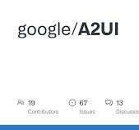
AI Updates
Google A2UI: Agent-to-User Interface
https://www.youtube.com/watch?v=FTtmZQBX-fk
Google released A2UI, an open-source framework for building agent-driven user interfaces, built in partnership with CopilotKit
A2UI allows AI agents to generate rich, interactive UIs using JSON specs that render natively across web, mobile, and desktop
The framework works with AG-UI, an event-based protocol handling bidirectional communication between apps and agent backends
The video demonstrates a landscape architecture app where agents analyze photos with Gemini, generate custom forms tailored to user needs, and add interactive components like charts and Google Maps
Developers can use the CopilotKit A2UI composer to visually experiment with components, generate A2UI JSON using prompts, and preview widgets in real-time
The demo shows a restaurant finder app where users can search for Italian restaurants near them, with the agent processing queries through the Gemini API and displaying interactive results that open in Google Maps
The framework is free, open-source, and supports agent-to-agent interaction through the A2A protocol
CopilotKit provides full integration with A2UI and serves as a launch partner for the specification
https://github.com/google/A2UI
https://www.copilotkit.ai/blog/build-with-googles-new-a2ui-spec-agent-user-interfaces-with-a2ui-ag-ui
https://docs.copilotkit.ai/whats-new/a2ui-launch
https://developers.googleblog.com/introducing-a2ui-an-open-project-for-agent-driven-interfaces/
https://docs.copilotkit.ai/generative-ui-specs/a2ui
https://jimmysong.io/ai/a2ui/
https://docs.ag-ui.com
Google Gems, an often-overlooked Gemini feature, received two major upgrades:
.. integration with Google Opal for no-code app creation
.. Notebook LM support for enhanced contextual knowledge
Demo using Notebook LM in gems: a Viral Strategist for content planning, a Script Writer with deep research capabilities, and a Thumbnail Expert using image generation.
Also a Social Media Manager mini-app using Google Opal that takes thumbnails and scripts as input to automatically generate LinkedIn posts, LinkedIn images, and Instagram images with proper dimensions.
Gems eliminate repetitive context-providing. It stores instructions and knowledge, allowing reusable AI assistants
The Notebook LM integration is particularly powerful, enabling dynamic knowledge bases that can be updated as new content is created
https://www.youtube.com/watch?v=X0ecbCwSr10

Slide 17
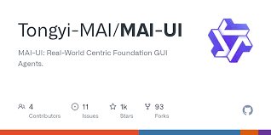
Alibaba Tongyi Lab released MAI-UI
Alibaba Tongyi Lab released MAI-UI
(Model Android Interface ?)
A family of multimodal GUI agents for Android environments
Built on Qwen3-VL , Open Source
Available in 2B, 8B, 32B, and 235B-A22B model sizes
These agents use natural language instructions and UI screenshots as input - and control Android environments through actions like clicking, swiping, typing, and system button presses
MAI-UI integrates 3 key capabilities:
native user interaction for clarifying ambiguous goals
MCP tool integration for API-level operations
device-cloud collaboration that keeps privacy-sensitive work on-device while leveraging cloud models when needed
The system uses multi-perspective instruction reasoning for UI grounding, self-evolving navigation data pipelines, and online reinforcement learning with up to 512 parallel containerized Android environments .
The models achieve SOTA results: 73.5% on ScreenSpot Pro, 91.3% on MMBench-GUI-L2, and 76.7% on AndroidWorld, surpassing Gemini 2.5 Pro, Seed1.8, and UI-Tars-2 . On the MobileWorld benchmark with 201 tasks across 20 apps, MAI-UI reaches 41.7% overall success, outperforming the best end-to-end baseline by 20.8 points
https://github.com/Tongyi-MAI/MAI-UI
https://www.marktechpost.com/2025/12/30/alibaba-tongyi-lab-releases-mai-ui-a-foundation-gui-agent-family-that-surpasses-gemini-2-5-pro-seed1-8-and-ui-tars-2-on-androidworld/

Slide 18
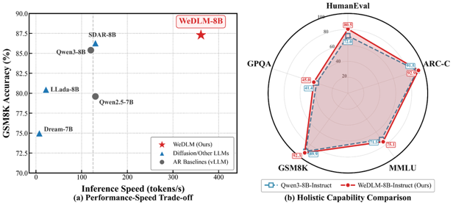
Tencent WeDLM Fast Diffusion Model
Tencent WeDLM Fast Diffusion Language Model
WeDLM is a diffusion language model developed by Tencent's WeChat AI team
Inference speeds reach 689 tokens/second on NVIDIA H20 hardware
The project represents a breakthrough in making diffusion-based language models practical for real-world deployment
WeDLM-8B is up to 3x faster than vLLM-optimized Qwen3-8B on complex reasoning tasks; Generation quality surpasses Qwen3-8B-Instruct; Particularly strong gains in math reasoning
Two model sizes : 7B based on Qwen2.5-7B; 8B based on Qwen3-8B
Supports both pip installation and Docker deployment
https://arxiv.org/pdf/2512.22737v1
https://wedlm.github.io
https://github.com/Tencent/WeDLM
https://huggingface.co/tencent/WeDLM-8B-Instruct
https://huggingface.co/tencent/WeDLM-7B-Base

Slide 19

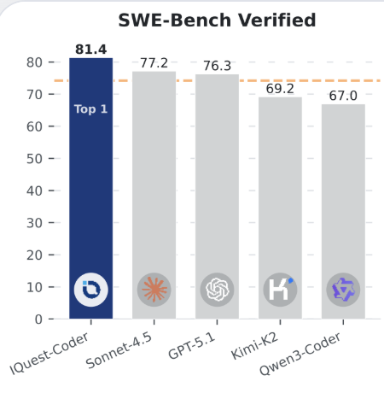
IQuest-Coder-V1 Open Source LLMs
IQuest-Coder-V1 Open Source LLMs
Size: 7B, 14B, and 40B ("Instruct" and "Thinking")
SOTA on multiple benchmarks
128K token context length
The unique "Loop" variant (available at 40B) introduces a recurrent transformer architecture that processes input in two iterations with shared parameters across 80 layers, optimizing the trade-off between model capacity and deployment footprint
The model's training focuses on repository evolution patterns rather than static code snapshots
The 40B model reportedly surpasses competitive models including Claude Sonnet 4.5 and GPT-5.1 across agentic software engineering, competitive programming, and complex tool use benchmarks
The architecture uses a vocabulary size of 76,800 tokens, and the Q8 quantized version requires approximately 42GB of VRAM for deployment
The model is available on Hugging Face and has generated significant interest in the AI coding community for potential integration with development tools like Aider and Cline
https://huggingface.co/IQuestLab/IQuest-Coder-V1-40B-Instruct
https://x.com/NainaChaturved8/status/2006811314866606532
https://www.youtube.com/watch?v=sihYcXADfNI
https://iquestlab.github.io

Slide 20

Ralph Loop plugin for Claude Code
Ralph Loop plugin for Claude Code
Forces Claude Code to operate in a continuous loop
rather than stopping after a single pass
Mimicking the persistent character Ralph Wiggum from The Simpsons who keeps trying until success
The plugin enables Claude Code to autonomously iterate on tasks for hours,
with examples including a $50K project completed for under $300
and creation of an entire programming language (the "Gen Z programming language") over 30 hours
Requires Claude Code version 2.0.76 or later with `/plugins` command support, installed via a simple command,
then activated using `/ralph loop` followed by your task
Best Practices
Define clear completion criteria rather than vague goals
Set incremental goals with distinct phases
Include self-correction mechanisms (write test, implement feature, run test)
Always use max iterations as a safety net to control token usage
The video demonstrates two paint applications - one built with standard Claude Code and another with Ralph Loop enabled, showing significantly more features in the Ralph Loop version including spray effects, shapes, text, emojis, and image enhancement capabilities
https://www.youtube.com/watch?v=Yl_GGlAQ4Gc
https://github.com/anthropics/claude-code/tree/main/plugins/ralph-wiggum
https://awesomeclaude.ai/ralph-wiggum
https://ghuntley.com/ralph/

Slide 21
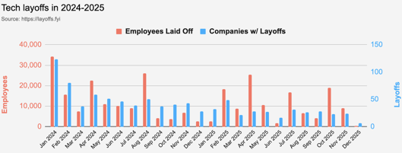
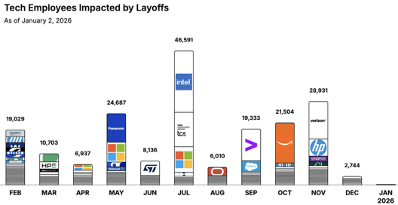
Jobs
https://layoffs.fyi
https://trueup.io/layoffs
Tech Layoffs by year (US only):
  123K in 2025 (as of January 2)
  153K in 2024
  264K in 2023
  165K in 2022 https://layoffs.fyi
The Tech Layoff Tracker
in 2025, 245,953 people laid off (674 per day)
In 2024, 238,461 people laid off (653 per day)
https://trueup.io/layoffs

Slide 22


About the Speaker
Lev Selector, Ph.D.
40+ years of software engineering, data science, and building teams (hiring, training, and managing)
Ph.D. in mathematical modeling and computer simulations
Interests:
Generative AI, Using LLM with your data
Local AI for Local Private Data
Cloud architecture, fin-tech, application security
Find/connect: Linkedin, GitHub, YouTube, Google
https://eais.ai
Enterprise AI Systems

Slide 23
Thank You!

