Slide 1
AI Updates - Jan 23, 2026
From manual coder to orchestrator of AI agent fleets
Crowd-sourced "LM Arena" Leaderboard
skills.sh - directory of skills
Cline vs Claude Code AI coding assistants
Block's open-source Goose vs Claude Code
Stack Overflow - Rapid Decline
GLM-4.7 Flash - Lightweight and Free
Baidu ERNIE 5.0 - 2.4T params
AI research workflow: Perplexity + NotebookLM
Microsoft OptiMind-SFT (a.k.a. OptiMind)
Google AI Edge
Taiwan invests $250 Bln into US
Thinking Machines Lab loses two co-founders
OpenAI Open Responses Standard
Cursor ran 100s of AI coding agents for weeks
OpenAI Updates
VIDIA Nemotron-Speech ASR
Deepseek Engram Conditional Memory
Nvidia personaplex-7b-v1
Emotion Computing
NousCoder-14B Trained with RL
Microsoft VibeVoice-ASR
Myrothinker 1.5 - 30B & 235B
Haystack, LangChain, LlamaIndex
Anti-gravity Update - Skill Builder capability
Gemini CLI Update: Session Persistence
Aion UI - open-source "Co-work" alternative
Manus AI (Meta) - develop mobile apps
Claude Code extension for VS Code
Moonshots podcast with Ray Kurzweil
Google AI Studio upgrades
Robotics muscles (actuators)
Google TranslateGemma
PixVerse AI Video Generation in Real Time
FLUX.2 Klein - generate AI Images in 0.5 sec
How to Rank #1 with NotebookLM AI SEO
Wikipedia deal: Microsoft, Meta, Amazon
Microsoft Research Job Market Predictions
Boris Cherny about career trajectory
Jobs, Layoffs, demand for AI Engineers

Slide 2
Crowd-sourced "LM Arena" Leaderboard
Data for January 16
Starting Elo rating = 1000
https://en.wikipedia.org/wiki/Elo_rating_system
English - https://lmarena.ai/leaderboard/text
Coding - https://lmarena.ai/leaderboard/text/coding
Model | Score
gemini-3-pro | 1490
grok-4.1-thinking | 1477
gemini-3-flash | 1472
claude-opus-4-5-20251101-thinking-32k | 1470
claude-opus-4-5-20251101 | 1467
grok-4.1 | 1465
gemini-3-flash (thinking-minimal) | 1462
ernie-5.0-0110 | 1459
gpt-5.1-high | 1458
gemini-2.5-pro | 1451
claude-sonnet-4-5-20250929-thinking-32k | 1451
ernie-5.0-preview-1203 | 1450
claude-sonnet-4-5-20250929 | 1450
claude-opus-4-1-20250805-thinking-16k | 1449
claude-opus-4-1-20250805 | 1445
gpt-5.2 | 1445
gpt-4.5-preview-2025-02-27 | 1444
chatgpt-4o-latest-20250326 | 1442
glm-4.7 | 1441
gpt-5.2-high | 1436
gpt-5.1 | 1435
gpt-5-high | 1435
qwen3-max-preview | 1434
o3-2025-04-16 | 1433
Model | Score
claude-opus-4-5-20251101-thinking-32k | 1537
claude-sonnet-4-5-20250929-thinking-32k | 1523
claude-opus-4-5-20251101 | 1519
gemini-3-pro | 1517
claude-opus-4-1-20250805-thinking-16k | 1512
claude-sonnet-4-5-20250929 | 1509
grok-4.1-thinking | 1509
gpt-5.2 | 1505
claude-opus-4-1-20250805 | 1504
gemini-3-flash | 1501
gemini-3-flash (thinking-minimal) | 1501
ernie-5.0-0110 | 1497
claude-opus-4-20250514-thinking-16k | 1497
grok-4.1 | 1496
gpt-5.1-high | 1495
gpt-5.2-high | 1494
glm-4.7 | 1485
kimi-k2-thinking-turbo | 1484
qwen3-max-preview | 1482
gpt-5.1 | 1478
claude-haiku-4-5-20251001 | 1478
qwen3-max-2025-09-23 | 1476
longcat-flash-chat | 1474
deepseek-v3.2-exp-thinking | 1473
deepseek-v3.2 - 671B
ernie-5.0 - 2.4T
glm-4.6 - 355B
kimi-k2-thinking - 1T
longcat-flash-chat - 560B
qwen3-max - 1T
qwen3-235b-a22b - 235B
Google Gemini
x.ai
Claude
OpenAI
Open Source
x.ai
x.ai
https://lmarena.ai/leaderboard/text
Design Arena -
https://www.designarena.ai
https://openlm.ai/chatbot-arena/
https://beta.lmarena.ai
Web Leaderboard - 1T params
https://web.lmarena.ai/leaderboard
LLM Leaderboard - by @LlmStats -
https://llmworld.net/llm_leaderboards/
LLM Leaderboard - by StackAI -
https://www.stack-ai.com/llm-leaderboard
LLM Leaderboard - by Artificial Analysis -
https://artificialanalysis.ai/leaderboards/models
Open LLM Leaderboard - by Hugging Face -
https://huggingface.co/open-llm-leaderboard
LLM Leaderboard - by Vellum -
https://www.vellum.ai/llm-leaderboard
AI Benchmarking Hub -
https://epoch.ai/data/ai-benchmarking-dashboard
Grok 4 Benchmarks -
https://artificialanalysis.ai/models/grok-4
Image arena (alibaba) -
http://aiarena.alibaba-inc.com/corpora/arena/leaderboard?arenaType=T2I
image arena - https://lmarena.ai/leaderboard/text-to-image
China
China
China
x.ai
China
China
China
China
China
China
China
China

Slide 3
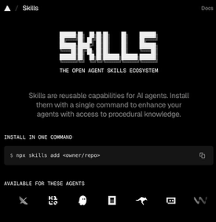
skills.sh - directory of skills
skills.sh - stores URLs/references to GitHub repositories
https://skills.sh
https://skills.sh/docs
A web directory, leaderboard, and finder for skills - I counted 6574 skills.
Each skill is essentially a Markdown file. It starts with two lines (name and description) followed by markdown text.
Each skill may also have optional bundled resources - scripts, references, assets, examples.
bigquery-skill/
├── SKILL.md
└── reference/
├── finance.md
├── sales.md
├── product.md
└── marketing.md
You can install using "npx skills add" command, for example:
npx skills add https://github.com/remotion-dev/skills --skill remotion-best-practices
npx skills add https://github.com/vercel-labs/agent-skills --skill web-design-guidelines
You need to provide the Github URL and the skill name
During installation it finds your agents (for example, Claude Code) and asks where to install (typically to ~/.claude/skills/)
Progressive loading (only 50 tokens per header) - allows developers to have hundreds of skills active without overwhelming the context window
This makes it significantly lighter than traditional MCP servers
The skills.sh has a leaderboard that ranks skills based on anonymous telemetry data from CLI installations

Slide 4


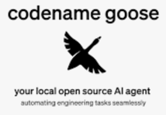
AI Updates
Cline vs Claude Code AI coding assistants
Cline is VS Code extension. Claude Code is primarily a terminal app, good for scripting actions and for team work
Cline was around for approx 1.5 year and has estimated 4 Mln users; it is free and open source
Claude Code user-base is MUCH bigger.
The 3 largest AI assistants are:
GitHub Copilot,
Cursor (by Anysphere),
Claude Code
Claude Code also has become available as a VS Code extension (Jan 20th) - and already has more than 3 Mln downloads - more than Cline.
Block's open-source Goose vs Claude Code
https://github.com/block/goose - more than 27K GitHub stars
https://block.github.io/goose/
https://block.github.io/goose/docs/quickstart/
https://block.github.io/goose/docs/getting-started/installation/
Goose is available as both a desktop application and CLI tool, supporting macOS, Linux, and Windows. Supports variety of models
You can install Goose via download script or Homebrew:
curl -fsSL https://github.com/block/goose/releases/download/stable/download_cli.sh | bash
brew install --cask block-goose
brew install block-goose-cli
No subscription fees, no cloud dependencies, no usage limits

Slide 5
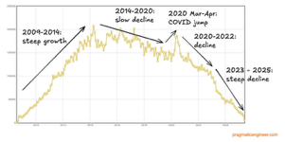

AI Updates
Stack Overflow - Rapid Decline
Its massive repository of public coding knowledge was used to train the very AI models that have now replaced it
Since late 2022, developers have pivoted from searching message boards to using AI agents and LLMs for instant, personalized debugging and code generation
The founders sold the platform for $1.8 Bln in 2021, just before the AI boom decimated its traffic and value
As developers use AI to generate code, compile, debug, and test it - this data is used by AI providers to train the models instead of human posts
GLM-4.7 Flash - Lightweight and Free
High-speed coding, agent building, and UI generation
Reasoning ("interleaved" and "preserved" thinking)
Impressive 59% on SWE-bench Verified (full version ~74%)
30B MoE architecture, lightning-fast responses, handles long-context tasks without losing accuracy
Practical Use Cases - coding, AI Agents, UI Generation
Can be accessed via the Z.ai API (with a free tier) or deploy it locally using weights from Hugging Face for complete privacy and zero latency
Baidu ERNIE 5.0
Native omni-modal large model
2.4T-parama MoE, under 3% active params
https://x.com/Baidu_Inc/status/2014252300018254054

Slide 6

We do these weekly videos every Friday
Stats: 6.06K subscribers, 263 videos
1. Subscribe to this channel https://www.youtube.com/@lev-selector
2. Download slides from GitHub using links under the videos
3. Please pause the video - and answer the pinned question in comments under the video

Slide 7
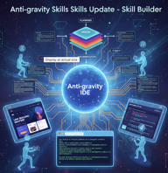

AI Updates
Anti-gravity Update - Skill Builder capability
Teach AI agents custom workflows using a single prompt
The agent observes a user’s actions once, captures the pattern, and saves it as a reusable skill
Zero Coding, Dynamic Learning (skills adapt to inputs), chaining multiple skills to create automated end-to-end business processes
Users can tag specific agents (e.g., @frontend-design) to generate superior, modern code compared to standard prompts
Notebook LM Integration: A new research skill that allows Anti-gravity to query Google Notebook LM URLs for specific data extraction.
Loki Mode: An autonomous system that dispatches parallel agents to handle planning, architecture, and verification.
Deployment: Easy integration with platforms like Vercel and Netlify via Model Context Protocol (MCP) tools.
https://www.youtube.com/watch?v=Nr4DuTI27CY
https://www.youtube.com/watch?v=tdzFX2u3dgA
Google Anti-gravity + Open Code
"conductor and lead engineer" workflow
Anti-gravity good at planning
Open Code is superior for surgical code changes and model flexibility
Demo: using Anti-gravity (powered by Opus 4.5) to generate a complex implementation plan; Using Open Code as attachment to execute the plan (do the coding)
https://www.youtube.com/watch?v=dzDVt3-MTRk
Gemini CLI Update: Session Persistence
Automatic background session saving - every prompt and response is stored locally
Use "gemini -res" to instantly resume the most recent conversation exactly where it left off
Use /resume command within the CLI to open a searchable list of all past conversations, allowing users to jump back into specific workflows from days prior
https://www.youtube.com/watch?v=-luEGxUCbTA

Slide 8
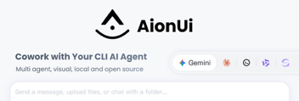

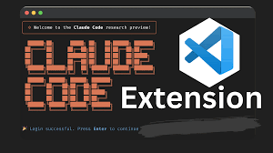
AI Updates
Aion UI - open-source "Co-work" alternative
Co-work is restricted to Anthropic Pro/Max users
Aion UI functions as a local AI Operating System (AIOS) that integrates multiple agents, including Gemini, Claude Code, and various open-source models
Automatically detects and manages various installed AI agents in one graphical dashboard
Agents can read, create, and organize local files directly on your machine
Supports 9+ visual formats (PDF, Excel, HTML, etc.), allowing users to view AI generations without switching apps
Users can configure local models via Ollama, add custom skills, and connect to different gateways like OpenRouter or the Gemini CLI for free usage
https://www.youtube.com/watch?v=yUU5E-U5B3M
https://github.com/iOfficeAI/AionUi
Manus AI (Meta) - develop mobile apps
Easy to use, packages files for iOS and Android
Overall preferred over Lovable - better reliability and real-world utility
Manus can also automate daily tasks (research, saving reports to GDrive)
https://www.youtube.com/watch?v=WSSs4WGImOQ
Claude Code extension for VS Code
Claude Code operates within VS Code sidebar, offers user-friendly UI than the terminal-based version
Supports planning modes, sub-agents, custom slash commands, and Model Context Protocol (MCP)
Auto-Compact Feature - solves context window limitations by automatically managing tokens, allowing for longer development sessions without performance drops
Real-Time Problem Solving - the tool can read error messages, fix bugs, use a "browser agent" for testing
https://www.youtube.com/watch?v=YZoxOVQT_RM
Claude Code Updates - Custom Planning Directory, Automated Plan Workflows (PostToolUse hooks), Context Management, MCP Tool Search, ...

Slide 9


AI Updates
Moonshots podcast with Ray Kurzweil
Discusses the accelerating timeline toward the Singularity
Singularity = we become 1,000 times more intelligent by merging with AI
Kurzweil reaffirms his long-standing predictions:
.. Human-level AI (AGI) by 2029
.. Singularity by 2045.
Longevity Escape Velocity: Predicted for 2032, where medical advances add more than one year to your life expectancy for every year that passes.
Brain-Computer Interfaces (BCI): High-bandwidth interfaces are expected by the mid-2030s, allowing human thoughts to merge seamlessly with the cloud.
The Future of Life: By 2086, Kurzweil suggests most intelligence will exist as software running on computronium - matter optimized for maximum processing power.
https://www.youtube.com/watch?v=8iWSNwIRazc
Google AI Studio upgrades
Integration of Veo 3.1, which allows for high-quality, 4K video generation, consistent character rendering, and native vertical video for social media.
AI Studio now supports advanced agent building - automate workflows and generate Python scripts
Data handling - ingest files directly from URLs (including AWS S3 and Azure) and increased file size limits
Future - GitHub integration, built-in authentication, and Stripe support
https://www.youtube.com/watch?v=rsHYx6IJmx0

Slide 10
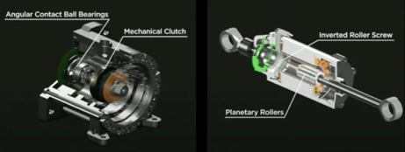
Robotics muscles (actuators)
A Deep Dive into Actuators for Humanoid Robotics
https://www.youtube.com/watch?v=FXC5ZFBefvs
Rotary or Linear
Modern humanoid robots primarily use rotating electric motors combined with gear reduction systems (like harmonic drives or planetary gears) as their main actuation mechanism for hands and feet
These joint motors serve as the "muscles" of humanoid robots and typically account for over 30% of the overall bill of materials cost in high-performance humanoid systems
https://www.roboticstomorrow.com/story/2025/06/joint-actuators-the-fundamental-component-for-humanoid-robots-power-and-dexterity/24924/
For legs, ankle joints typically have at least two actuators to control dorsiflexion/plantarflexion (pointing the foot up or down) and inversion/eversion (tilting the foot inward or outward)
Some designs use linkage mechanisms where actuators drive knee joints through four-bar linkages rather than direct rotation
The motors prioritize lightweight components with high torque density to minimize inertia and enhance agility while maintaining precise control
https://www.youtube.com/watch?v=fhRgwjEd3g8
Artificial muscle actuators research - soft actuators made from 3D-printed rubbers that can move and stiffen like biological muscle,
In 2025, South Korean researchers created magnetic composite actuators that can lift approximately 4,000 times their own weight and achieve 86.4% strain (over double human muscle performance) by using tunable stiffness polymers with magnetic microparticles
https://news.northwestern.edu/stories/2025/07/bone-ified-muscles-could-be-robots-next-flex
Upper limb joints have reached consensus around harmonic drive modules, while lower limb joints still vary between harmonic, planetary, RV rotary actuators, and linear actuators based on screws

Slide 11
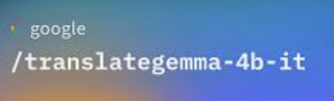


AI Updates
Google TranslateGemma
open-weight LLM, built on Gemma 3
4B, 12B, and 27B params
55 languages
Multimodal (text & images)
Image Translation - not very good, significant hallucinations
https://www.youtube.com/watch?v=JBr3cQph5hU
PixVerse AI Video Generation in Real Time
PixVerse is an Alibaba-backed Beijing startup that launched the first real-time interactive AI video generation tool on January 13, 2026
Founded in 2023, the company has raised over $60 million in funding and serves 16 million monthly active users with projected $40 million annual revenue
Users can control video generation in real-time at 1080P resolution, directing characters' emotions and actions like a film director
PixVerse V5 leads globally in image-to-video generation, surpassing Google's Veo 3, with V5.5 adding integrated audio and multi-shot capabilities
https://www.cnbc.com/2026/01/13/alibaba-backed-pixverse-real-time-ai-video-generation-tool-investors-startup-openai-sora.html
FLUX.2 Klein - generate AI Images in 0.5 sec
Extreme speed, high-quality images in less than a second
Image editing using AI
https://www.youtube.com/watch?v=672XOB_yD-A

Slide 12


AI Updates
How to Rank #1 with NotebookLM AI SEO
Deep Research - gather authoritative sources, analyze competitor blogs, and identify search intent
Structured SEO Analysis - generate a detailed outline (H1–H4) with suggested keyword placements and internal link opportunities
Refining Content Draft - expand the outline into a 2,000+ word article that sounds human and avoids repetition
Generating Infographics - visual summaries and alt-text descriptions to increase engagement and backlink potential
Build Data Tables - structured tables (e.g., keyword difficulty or competitor metrics) to increase authority and time-on-page
Final Assembly - Use NotebookLM to assemble the full post with meta tags and specific placement notes for visuals and tables
https://www.youtube.com/watch?v=KjUPBOCPBKg
AI research workflow: Perplexity + NotebookLM
1. Research and Vetting (Perplexity) - Deep Research, Source Selection, Verification
2. Synthesis and Creation (NotebookLM)
https://www.youtube.com/watch?v=MxFcCHz1e7A
Wikipedia signs AI training deals with Microsoft, Meta, and Amazon

Slide 13

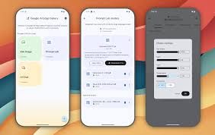
AI Updates
Microsoft OptiMind-SFT (a.k.a. OptiMind)
Open-source 20-B params MoE AI model, 128K context
Converting complex business problems into formal Mixed Integer Linear Programs (MILP) and executable Gurobi Python code
Optimization Expert-in-the-Loop: Microsoft trained the model using a "cleaned" dataset where human experts identified and corrected common mathematical modeling errors.
The system supports multi-stage inference, where it classifies problems, provides self-hints, and uses a "solver-in-the-loop" approach to execute code and self-correct based on error logs. While it requires significant hardware (at least 32GB VRAM) and human oversight for safety-critical tasks, Optim-SFT aims to make high-level decision science accessible to non-experts
https://www.youtube.com/watch?v=9ZseQ-hXcp4
Google AI Edge
Run AI models on mobile devices and microcontrollers without a cloud or internet connection
Uses TensorFlow and PyTorch
Fast performance, improved privacy, and offline functionality across Android, iOS, and the web
Low-code APIs for vision, text, and audio.
LiteRT - optimized runtime for CPU, GPU, and NPU execution
Model Explorer - visualizing and debugging model bottlenecks
AI Edge Portal - A private preview platform for benchmarking models on over 100 real physical devices to track latency, memory, and battery drain
Use Gemma LLM and multimodal apps, allowing businesses to ensure high performance on everything from budget phones to flagships before deployment
https://www.youtube.com/watch?v=-O-enNK6vYs

Slide 14




AI Updates
Taiwan invests $250 Bln into US
Into U.S. semiconductor, energy, and AI production, with another $250 billion in credit guarantees
In exchange, the U.S. will lower tariffs on Taiwanese goods and increase investment in Taiwan’s tech and defense sectors
The deal aims to reduce U.S. reliance on foreign chipmakers and deepen bilateral tech ties amid tensions with China.
Thinking Machines Lab loses two co-founders
Thinking Machines Lab, founded by former OpenAI CTO Mira Murati, is losing two co-founders as Barret Zoph and Luke Metz return to OpenAI.
Another early employee, Sam Schoenholz, is also rejoining the company.
Murati announced Zoph’s exit and named Soumith Chintala as the new CTO, without addressing the other departures. The moves follow a $2B seed round valuing the startup at $12B.
OpenAI Open Responses Standard
Specification for building interoperable, multi-provider LLM interfaces; It allows developers to switch between provider without rewriting their code.
Early adopters - Hugging Face contributors
The standard aiming to reduce lock-in while preserving advanced features across providers.
https://huggingface.co/blog/open-responses

Slide 15
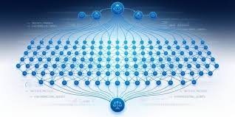


AI Updates
Cursor ran 100s of AI coding agents for weeks
In one experiment producing a 3M+ line web browser built entirely from the ground up using GPT 5.2
Cursor organized agents into planners, workers, and judges (similar to the viral Ralph Wiggum technique), allowing hundreds of agents to run and collaborate together
The browser was built in under a week by the agents from scratch, with the final output actually loading simple websites correctly
Other experiments included a Windows 7 emulator, an Excel clone, and an internal migration of Cursor's codebase, each spanning a Million+ lines of code
OpenAI Updates
$20 Bln in annual revenue
$8/mo "ChatGPT Go" plan - uses GPT-5.2 Instant - fast cheap model
Ads are being introduced to the Free and Go tiers
Flywheel: - more usage leads to more data, which trains better models, driving more revenue to buy more compute.
NVIDIA Nemotron-Speech ASR
ASR = Automatic Speech Recognition
Uses cache-aware streaming which only processes new audio "deltas" and stores past computations in an internal cache. 3x higher efficiency and zero latency drift under heavy loads; A 600M params model, outperforms larger models in both speed and word error rate
https://www.youtube.com/watch?v=83DSjiLgWI8

Slide 16
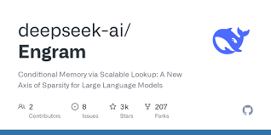


Deepseek Engram
Deepseek Engram - Conditional Memory via Scalable Lookup
Engram is a conditional memory module that adds a new type of sparsity to LLMs alongside existing Mixture-of-Experts (MoE) approaches
Unlike traditional Transformers that simulate knowledge retrieval through computation, Engram enables O(1) lookups using modernized N-gram embeddings, storing up to 27B parameters.
The researchers discovered a U-shaped scaling law that optimizes the balance between neural computation (MoE) and static memory (Engram)
Mechanistic analysis reveals Engram handles static reconstruction in early layers, effectively deepening the network for complex reasoning, while delegating local dependencies to lookups frees attention for global context, dramatically improving long-context retrieval (Multi-Query NIAH: 84.2→97.0)
https://github.com/deepseek-ai/Engram/tree/main
https://arxiv.org/abs/2601.07372
Microsoft VibeVoice-ASR
Speech-to-text model, 9B params, 64K-token context window
Transcribes up to 60 min of audio
https://huggingface.co/microsoft/VibeVoice-ASR
DeepSeek V4 Leak
Evidence on GitHub suggests DeepSeek is preparing its next flagship model for a mid-February 2026 release
Technical shifts in KV cache and FP8 support hint at a major architectural overhaul focused on efficiency and coding

Slide 17
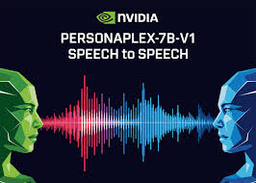


AI Updates
Nvidia personaplex-7b-v1
A full duplex speech to speech conversational model that targets natural voice interactions with precise persona control.
From ASR→LLM→TTS to a single full duplex model
Conventional voice assistants usually run a cascade. Automatic Speech Recognition (ASR) converts speech to text, a language model generates a text answer, and Text to Speech (TTS) converts back to audio
Each stage adds latency, and the pipeline cannot handle overlapping speech, natural interruptions, or dense backchannels
PersonaPlex replaces this stack with a single Transformer model that performs streaming speech understanding and speech generation in one network
https://huggingface.co/nvidia/personaplex-7b-v1
https://www.marktechpost.com/2026/01/17/nvidia-releases-personaplex-7b-v1-a-real-time-speech-to-speech-model-designed-for-natural-and-full-duplex-conversations/
Emotion Computing
Researchers in Japan published a framework that identifies human emotions with 75% accuracy using bodily signals (like heart rate) and visual data, rather than just text analysis.
https://arxiv.org/abs/2404.08295
NousCoder-14B - Open Source
Nous Research - programming model trained via RL by executing code in a sandbox and receiving rewards for success
https://huggingface.co/NousResearch/NousCoder-14B

Slide 18

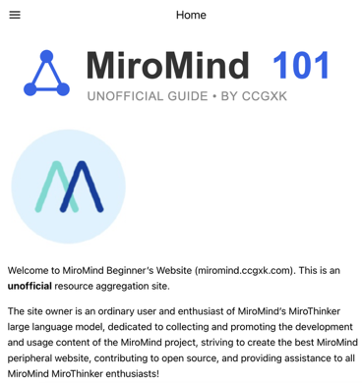
Myrothinker
Myrothinker v1.5 open-source web research agent
By Myromind AI - deep research and code execution
Direct competitor to OpenAI and Google Gemini Deep Research
Ranks at the top of benchmarks like HLE and GAIA for real-world agent tasks; 256K-token context window; 30B and 235B versions; can handle up to 400 tool calls per task; uses "interactive scaling" to think, act, and evaluate results in a continuous loop
You can download and run the model locally via GitHub, allowing for total data privacy and customization.
https://www.youtube.com/watch?v=YeJjr5-rVww
https://huggingface.co/miromind-ai/MiroThinker-v1.5-30B
https://huggingface.co/miromind-ai/MiroThinker-v1.5-235B
https://miromind.ccgxk.com/
https://github.com/MiroMindAI/MiroThinker

Slide 19
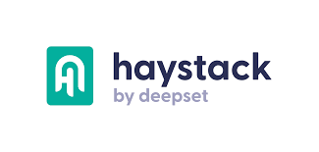


Haystack, LangChain, LlamaIndex
Haystack, LangChain, and LlamaIndex are three leading open-source frameworks for building LLM / RAG applications
Haystack - production-oriented and enterprise-ready
designed for large-scale deployments requiring robust document handling, stability, and compliance
It features a modular, component-based architecture with strong metadata filtering and hybrid retrieval capabilities
LangChain - orchestration and rapid prototyping
It offers maximum flexibility for building complex agent workflows, multi-modal applications, and dynamic systems requiring sophisticated context retention and real-time updates
LangChain has captured significant developer mindshare for experimentation
LlamaIndex - pecializes in fast information retrieval with dynamic chunking and flexible indexing strategies, though it's more limited in scope than the other frameworks
Recent benchmarks show minimal performance differences when using identical components
All three achieve 100% accuracy with variation mainly in token consumption (Haystack most efficient at ~1,570 tokens vs LangChain's ~2,400)
Framework choice depends on whether you prioritize production stability (Haystack), development flexibility (LangChain), or retrieval simplicity (LlamaIndex)

Slide 20
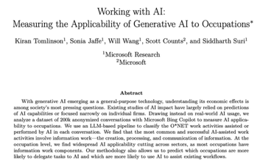
Microsoft Research Job Market Predictions
Microsoft Research Job Market Predictions.
Transformation vs. Elimination.
High-Risk jobs - White Collar (translation, writing, sales, customer service, coding)
Low Risk - Physical/Human-Centric (construction, electricians, nursing, personal services)
2025 - Entry-level "extinction" and the initial 85 Mln jobs outsourced to AI globally (but 97 Mln AI related jobs have emerged)
2026 - Industry transformation (jobs losses in manufacturing, transportation, healthcare), but growth in AI-related management roles
2027: The "Skill Revolution" where the divide between AI-literate workers and others becomes permanent. AI literacy becomes a mandatory requirement for high-paying roles; 70% of job skills globally are expected to change
By 2027, workers with AI skills will earn roughly 56% more than those without
Three strategies for workers:
1. Collaborate, don't compete: Use AI to handle routine tasks
and move "up the value chain"
2. Focus on Human Skills: Double down on ethics,
strategy, and emotional intelligence
3. Gain AI Literacy: Learn to prompt and manage AI systems
to remain employable and access higher wages
https://www.youtube.com/watch?v=x3QSOXgxp6I
https://arxiv.org/pdf/2507.07935
https://www.microsoft.com/en-us/research/publication/working-with-ai-measuring-the-occupational-implications-of-generative-ai/

Slide 21

Boris Cherny about career trajectory
Boris Cherny about career trajectory
Boris Cherny, creator of Claude Code, former Principal Engineer at Meta
He progressed from a mid-level engineer to a high-level IC
He emphasize the value of being a "generalist" and seeking "latent demand" - building products based on how users are already hacking existing tools
At Meta Boris rose through the levels by taking initiative on high-leverage "side quests," such as creating internal state management frameworks (Undux) and leading massive migrations like the rewrite of Facebook Groups onto the Comet platform
At Instagram - he moved to Tokyo to maintain his relationship, which inadvertently helped him avoid "meeting burnout" and return to deep coding, eventually leading the migration of Instagram's backend from Python to Hack
At Anthropic - driven by a mission-oriented culture and a love for sci-fi, he developed Claude Code
Boris argues that engineers should "build for the model six months from now," not the model of today.
He highlights that Claude Code has increased engineer productivity at Anthropic by nearly 70%, shifting the developer's role from manual coding to "orchestrating" fleets of AI agents
His ultimate advice for engineers is to maintain "common sense" and focus on solving real user problems rather than just following organizational processes

Slide 22
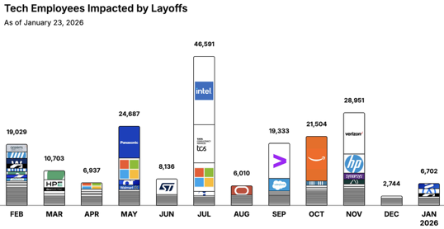
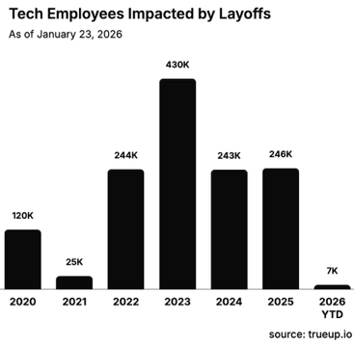
Jobs
https://layoffs.fyi
https://trueup.io/layoffs
The Tech Layoff Tracker
In 2026: 6,702 people laid off (291 per day)
In 2025: 245,953 people laid off (674 per day)
In 2024: 238,461 people laid off (653 per day)
https://trueup.io/layoffs
Amazon in process of laying off
~30K corporate jobs
https://www.reuters.com/business/world-at-work/amazon-plans-thousands-more-corporate-job-cuts-next-week-sources-say-2026-01-22/

Slide 23


About the Speaker
Lev Selector, Ph.D.
40+ years of software engineering, data science, and building teams (hiring, training, and managing)
Ph.D. in mathematical modeling and computer simulations
Interests:
Generative AI, Using LLM with your data
Local AI for Local Private Data
Cloud architecture, fin-tech, application security
Find/connect: Linkedin, GitHub, YouTube, Google
https://eais.ai
Enterprise AI Systems

Slide 24
Thank You!

