Slide 1



AI News - Oct 16, 2026
Anthropic replaces Git with Scion
after Claude passes 30K merges a day
Crowd-sourced LM Arena
Artificial Analysis Intelligence Index
Anthropic Replaces Git With Scion
Meta Muse Wonder
Meta Muse Spark Open
GLM-5.3 on Amazon Bedrock
Qwen Image 2.1 Turbo
ArtCraft and AI Reverse Engineering
Claude Code: Less Micromanagement
Local AI vs Cloud: True Costs
FLUX 3 Image
Microsoft Maia 300 Chip
GPT-6 becomes the ChatGPT default
Claude Managed Agents - 1,000 agents
Grok Bot Routes to Rival Models
Modal raises $750M at $15.75B Valuation
Fish Audio Drama 3 Open TTS
Liquid AI LFM2.5-24B-A2B LLM
MS Windows Hybrid AI
Decision Models
Deno Joins Cloudflare
Claude Motion
AstaBrief 8B Science Reports
TurboPuffer - RIP Vectors
Odyssey 3: Interactive AI Worlds
Step 5 Preview for Coding Agents
Laminar Flow-1: Detecting Agent Failures
Alibaba QwenGyre - Long-Horizon Agent RL
Character.AI files for Chapter 11
Grok Voice 3.0
Perplexity SPACE Agent Sandbox
JPMorgan Blocks Outside AI Agents
Google Deep Review
Jobs & Layoffs
Tech Hiring & Skills
Notes:
Contents labels. Kept by g3_update_toc.py.
Claude Haiku 5.5: Anthropic's cheapest, fastest small model => Claude Haiku 5.5
OpenAI publishes 722 math papers from an internal model => OpenAI's 722 Math Papers
Reflection AI launches Beam, a 501B open-weight model => Reflection Beam 501B Open Model
Mistral Large 4: a 1T-parameter open-weight model from Europe => Mistral Large 4
Google launches the Gemini agent for work => Google Gemini Agent
Decision models become a category: OpenAI, Microsoft, Cloudflare => Decision Models and Decisions API
OpenAI adds invisible watermarks to ChatGPT text in the EU => OpenAI textGrain Watermarks
Aleph Alpha releases Kolibri, an English-German open model => Aleph Alpha Kolibri
English - https://lmarena.ai/leaderboard/text => Crowd-sourced LM Arena
Coding - https://lmarena.ai/leaderboard/text/coding => Crowd-sourced LM Arena
Qwen Image 2.1 Turbo - text-to-image + editing => Qwen Image 2.1 Turbo
AstaBrief 8B - Generates Science Reports => AstaBrief 8B Science Reports
The Tech Layoff Tracker => Jobs & Layoffs
Tech Layoffs by year (US only): => Jobs & Layoffs
Top "In Demand" Skills and Qualifications => Tech Hiring & Skills
Software job postings on Indeed => Tech Hiring & Skills
Skills in demand => Tech Hiring & Skills
Anthropic cuts Claude's internet access in all internal evals => Claude Loses Internet in Evals
Gemini 4 Argon spotted in Google's Antigravity model picker => Gemini 4 Argon Leak
Epoch: chips shipped through 2027 could run 100M+ AI agents => Epoch: 100M+ Agents by 2027
Devin adds Memory and Dreaming to learn across sessions => Devin Memory and Dreaming
Perplexity releases multi-vector multimodal embeddings => Perplexity Multi-Vector Embeddings
Trump creates a "Super Intelligence Force" task force => Trump's Super Intelligence Force
Anthropic puts $100M into training 10,000 AI engineers => Claude Frontier Academy $100M
Meta releases Muse Wonder, its first frontier-class models => Meta Muse Wonder
Black Forest Labs releases FLUX 3 Image => FLUX 3 Image
Microsoft unveils Maia 300, its third in-house AI chip => Microsoft Maia 300 Chip
ArtCraft and AI Reverse Engineering => ArtCraft and AI Reverse Engineering
GPT-6 becomes the ChatGPT default, with Intelligent UI => GPT-6 in ChatGPT, Intelligent UI
Claude Managed Agents: dynamic workflows with 1,000 agents => Claude Swarms of 1,000 Agents
Anthropic replaces Git after Claude passes 30,000 merges a day => Anthropic Replaces Git with Scion
Anthropic tests AI self-replication on $55 TV boxes => AI Self-Replication on $55 Boxes
Agentic commerce gets standards and guardrails => Agentic Commerce Standards
Grok Bot will route tasks to Claude, Midjourney and Suno => Grok Bot Routes to Rival Models
Anthropic usage policy now bans abusing Claude => Anthropic Bans Abusing Claude
Anthropic replaces Git after Claude passes 30K merges a day => Anthropic Replaces Git with Scion
Anthropic reports Q3 revenue of $16.8 billion => Anthropic Q3 Revenue $16.8B
Modal raises $750M at $15.75B, passes $1B run rate => Modal Raises $750M, $1B Run Rate
Fish Audio Drama 3: open-weight 35B text-to-speech => Fish Audio Drama 3 Open TTS
Liquid AI LFM2.5-24B-A2B for on-device agents => Liquid AI LFM2.5-24B-A2B
Grok Voice 3.0 tops the speech-to-speech index => Grok Voice 3.0
Character.AI files for Chapter 11; Getty Images follows => Character.AI and Getty Bankruptcies
OpenAI engineer charged over hidden recorder at HQ => OpenAI Hidden Recorder Case
Fish Audio Drama 3 - open-weight 35B text-to-speech => Fish Audio Drama 3 Open TTS
Anthropic replaces Git with Scion after Claude passes 30K merges a day => Anthropic Replaces Git With Scion
Meta releases Muse Spark Open, an 816B open-weight model => Meta Muse Spark Open 816B
Microsoft details MAI-Base-2, a 2.8T model it will not open => Microsoft MAI-Base-2 2.8T
Goodfire: neural networks are already clean => Goodfire: Networks Are Already Clean
Perplexity open-sources SPACE, a sandbox for AI agents => Perplexity SPACE Agent Sandbox
JPMorgan blocks outside AI agents from customer accounts => JPMorgan Blocks Outside AI Agents
Claude agents now send OpenTelemetry traces => Claude Agent OpenTelemetry Traces
Google Deep Review checks technical documents => Google Deep Review
Meta releases Muse Spark Open => Meta Muse Spark Open

Slide 2
"LM Arena" Leaderboard
Data for Oct 15
Starting Elo rating = 1000
https://en.wikipedia.org/wiki/Elo_rating_system
English - https://lmarena.ai/leaderboard/text
Coding - https://lmarena.ai/leaderboard/text/coding
■ | Claude
■ | Gemini
■ | OpenAI
■ | Open Source
Claude Fable-5 - 6TB
Claude Opus-4.8 - 5TB
Claude Sonnet-4.5 - 1TB
Claude Sonnet-5 - ?
GLM-5.3 - 744B
Meta muse-spark - 16 x 70B
Qwen3.7-max-preview - 745B
Qwen3.8-max - 2.4TB
Baidu Ernie-5.1 - 800B
Deepseek-v4 - 1.6T
Deepseek-v4.1-Flash - 552B
Kimi-k3 - 2.8T
Xiaomi MiMo-V2.5-Pro - 1T+
ByteDance dola-seed-2.0-pro 400B
Minimax M3 - 456B
Code | Model | Score
■ | gemini-4-argon-high | 1524
■ | muse-wonder-max | 1509
■ | claude-opus-5.5-high | 1508
■ | claude-fable-5-high | 1504
■ | claude-opus-4-6-high | 1503
■ | claude-fable-5.1-max | 1502
■ | claude-opus-4-7-high | 1501
■ | claude-opus-4-6 | 1497
■ | gemini-3.8-flash-high | 1496
■ | muse-spark-1.3-max | 1494
■ | claude-opus-4-7 | 1494
■ | muse-spark-1.2 (xHigh) | 1493
■ | muse-spark-1.1 | 1490
■ | claude-opus-5-max | 1490
■ | claude-opus-5-high | 1490
■ | muse-spark | 1489
■ | gemini-3.7-flash-high | 1488
■ | kimi-k3-max | 1487
■ | gemini-3.1-pro-preview | 1487
■ | gemini-3-pro | 1485
■ | gpt-5.6-sol-xhigh | 1485
■ | gpt-6.1-sol-max | 1484
■ | gemini-3.6-flash-high | 1483
■ | qwen3.8-max | 1482
■ | claude-opus-4-8-high | 1481
Code | Model | Score
■ | gemini-4-argon-high | 1559
■ | claude-fable-5-high | 1551
■ | claude-opus-4-7-high | 1551
■ | claude-opus-4-6-high | 1548
■ | muse-wonder-max | 1548
■ | claude-opus-5.5-high | 1548
■ | claude-opus-4-6 | 1547
■ | claude-opus-4-7 | 1546
■ | gpt-6-astra-max | 1543
■ | gpt-6.1-sol-max | 1540
■ | muse-spark-1.2 (xHigh) | 1539
■ | kimi-k3-max | 1538
■ | mimo-v2.6-pro | 1538
■ | claude-fable-5.1-max | 1537
■ | muse-spark-1.3-max | 1535
■ | gpt-5.6-sol-xhigh | 1534
■ | claude-opus-4-8-high | 1534
■ | claude-opus-5-high | 1533
■ | muse-spark-1.1 | 1533
■ | claude-opus-4-5-20251101-high-32k | 1531
■ | claude-sonnet-5.5-xhigh | 1530
■ | claude-opus-5-max | 1529
■ | claude-opus-4-8 | 1529
■ | muse-spark | 1529
■ | claude-sonnet-4-6 | 1528

Slide 3
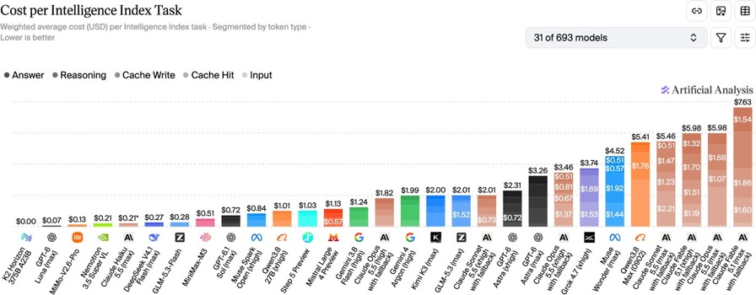
Artificial Analysis Intelligence Index
Artificial Analysis Intelligence Index
https://artificialanalysis.ai/evaluations/artificial-analysis-intelligence-index
Oct 15

Slide 4
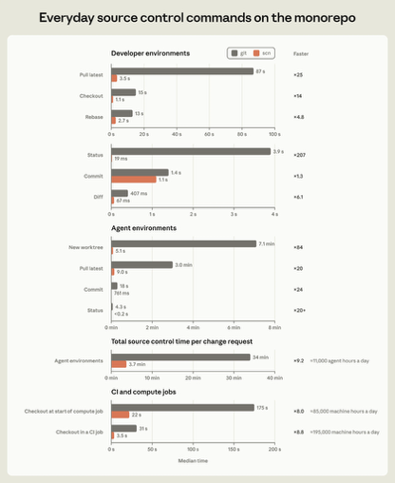

Anthropic Scion Replaces Git
Anthropic replaces Git with Scion
after Claude passes 30K merges a day
Git could not keep up with the speed of AI work done by Claude
Daily merges grew from about 2.5K in May to over 30K in Sept
A team of seven built Scion - a server-centric version control system
Plus Antique - an AI-assisted code review tool
CPU and memory use fell x200
Speed improved (from mins to secs)
Git: Client: “I want E; I have C.” Server determines the objects needed and constructs a custom transfer pack - then sends it
Scion: Client discovers E’s trees and checks its local object store. Client requests specific missing objects from caches. Cache streams the requested objects in ready-to-user format. No packing needed.
The main gains come from using cached objects
https://alphasignal.ai/email/1b36e75b14af56e6
https://www.anthropic.com/engineering/redesigning-source-control

Slide 5

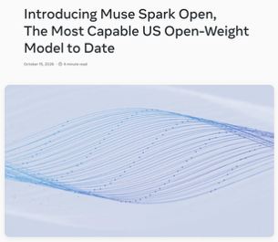
AI News
Meta releases Muse Wonder, its first frontier-class models
Two models: Muse Wonder and Muse Wonder Full
Wonder Full scores 56 on the Artificial Analysis Index,
second only to Claude Opus 5.5
Beats Opus 5.5 and GPT-6 Astra at legal work, long coding and memory
Active Memory keeps context across days, weeks and months
Leaked pricing: $4 input, $20 output per 1M tokens, 1M context
Closed weights;
Wonder Full only on Muse Code plans at $50 or $200 a month
https://research.meta.ai/blog/muse-wonder
Meta releases Muse Spark Open
816B open-weight model
Best Western open model so far
Multimodal MoE: 816B total, 42B active, 1M-token context
Built for coding and long-horizon agents
Runs locally on two M5 Ultra Mac Studios over Apple's MLX
Scores 39 on the AA Intelligence Index (Meta's closed Muse Wonder scores 52)
Compare: GLM 5.3 (45), Kimi K3 (44) and Qwen3.8 (40)
License: model-serving firms over $20M revenue need a separate deal
https://research.meta.ai/blog/muse-spark-open

Slide 6


AI News
GLM-5.3 on Amazon Bedrock
https://aws.amazon.com/about-aws/whats-new/2026/10/amazon-bedrock-glm-5-3/
open-weight, complex coding, repository-scale engineering, and autonomous agents performing extended, multi-step tasks
1M/128K in/out tokens
function calling, adjustable reasoning effort
OpenAI-compatible and native AWS APIs
https://aws.amazon.com/blogs/machine-learning/introducing-glm-5-3-on-amazon-bedrock/
US or global cross-Region inference
Qwen Image 2.1 Turbo - text-to-image + editing
https://github.com/QwenLM/Qwen-Image-2.1
7B params, 8 denoising steps, open-weight research license
https://huggingface.co/Qwen/Qwen-Image-2.1-Turbo
Developers can download weights from Hugging Face, run locally using Diffusers, or access hosted Turbo APIs through Alibaba Cloud

Slide 7

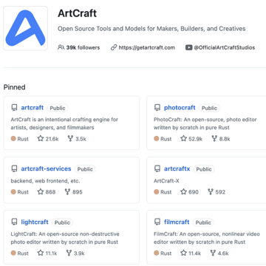
AI News
ArtCraft and AI Reverse Engineering
Developer Brandon Thomas released ArtCraft - a set of 7 free, open-source Adobe alternatives built with Rust and Claude for Windows, macOS, and Linux
https://getartcraft.com
https://github.com/storytold
https://www.linkedin.com/in/possibilistic/ - Brandon's Linkedin - Atlanta, Georgia
He describes these as clean-room re-implementations, not reconstructed Adobe source code
The Fireship's tests conclude that it is not a production-ready Adobe replacement yet
Reverse Engineer Anything (REA) - connects AI agents with binary-inspection tools such as Ghidra, helping developers analyze behavior and guide custom implementations - https://github.com/morluto/rea
The achievement is faster, accessible software experimentation - not making every proprietary application open source or rendering Adobe obsolete overnight
https://www.youtube.com/watch?v=wajoP_5Cpw8 -video

Slide 8
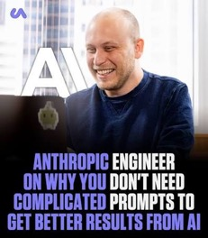
AI News
Claude Code: Less Micromanagement
Boris Cherny :
in January - planning advice
today - favoring autonomous execution
Define tasks, guardrails, and completion criteria
Review results instead of prescribing every step
Keep recommended effort settings
Provide executable checks that prove success
Use continuation loops to fix failures without repeated “continue”
Keep CLAUDE.md concise
Build skills from observed mistakes,
then compare performance with and without them
Enforce critical restrictions through hooks
Limit subagents and automate recurring workflows
The central achievement is reduced supervision
while retaining verifiable outputs
https://www.youtube.com/watch?v=J9NQTYUP6k0

Slide 9
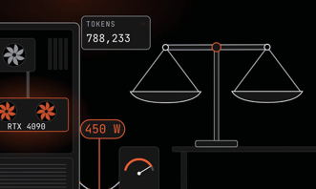
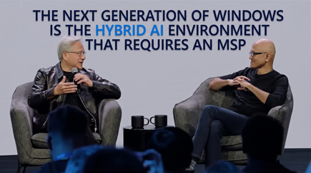
Local AI More Expensive Than Claude?
Local AI vs Cloud: True Costs
Haiku 5.5 $0.50 per 1M output tokens, plus input charges.
Compare with using local NVIDIA RTX 4090 - $0.47–$0.50
Hardware amortization makes lightly used GPUs substantially more expensive
Speed, quality, and context length also matter
Cloud providers use parallel batching - it dramatically lowers costs
https://www.youtube.com/watch?v=yaXgmGPZUOg
MS Windows Hybrid AI
Microsoft’s Satya Nadella and Nvidia’s Jensen Huang outlined Windows “hybrid intelligence.”
Windows would route AI tasks between local hardware and cloud models, addressing agent costs, privacy, latency, and offline access
Copilot would gain permission-based file access, local models, and PC actions; execution containers and separate agent identities would constrain access and enable monitoring.
Claimed advances include Nvidia RTX Spark hardware, Surface Laptop Ultra, compressed coding models, and Microsoft Decision 1, reportedly 35 times faster than GPT6.
The significance is a shift toward agent-operated PCs
https://www.youtube.com/watch?v=ApsNLVLRvu0

Slide 10

Decision Models
Decision Models
Mostly very short input context window
Some are not tunable
Fast, but accuracy may be limited
Model | Open | in-tokens | Based on | params | tunable
Laya — English | yes | 0.5K | ModernBERT-large with decision heads | 421M | yes
Laya — multilingual | yes | 8K | mmBERT-base with decision heads | 322M | yes
Laya — typed-decisions | yes | 1K | ModernBERT-large, further trained for typed decisions | 421M | yes
Kev | yes | 64K | Qwen3.5 / Qwen3.8 family, depending on checkpoint | 0.8B / 4B / 9B / 27B | yes
SemIf — formerly OpenJev | yes | — | Frozen open LLMs; extracts option probabilities from logits | — | no
CLM-v0.1-8B | yes | 2K | Frozen Qwen3-8B with state/action projection heads | 8B | yes
Von | yes | 8K | ModernBERT-large with decision scoring | 395M | yes
NanoJev — TianyuCodings | yes | — | Qwen3-0.6B with decision heads and dynamic candidate scoring | 0.6B | yes
Verdict — Daniel Ramos | yes | 16K | Qwen3.5-0.8B-Base with LoRA and bilinear/MLP decision heads | 0.8B | yes
Liquid d1-3B | yes | 32K | LFM2.5-VL-3B | 3.1B | no
Cloudflare Clef | yes | 64K | Fine-tuned Qwen with joint decision head | 27B | yes
Cloudflare Clef-Flash | yes | 24K | Fine-tuned Qwen with joint decision head | 9B | yes
Cloudflare Clef-Omni | yes | — | Multimodal Qwen-family model | 30B | no
TypeSafe Jev | no | 64K | Proprietary; backbone undisclosed | — | no
OpenAI Decisions API | no | — | GPT-6 Luna variant | — | no
Liquid d1 — hosted | no | 64K | Hosted Liquid decision model; exact backbone undisclosed | — | no
Microsoft-Decision-1 | no | 32K | Post-trained Qwen3.5-9B | 9B | no

Slide 11
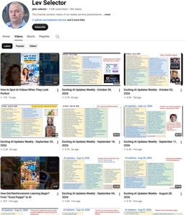

Weekly videos every Friday
Weekly videos every Friday
7.63K subscribers, 366 videos
1. Subscribe to this channel https://www.youtube.com/@lev-selector
2. Download slides from GitHub using links under the videos
3. Please pause the video - and answer the pinned question in comments under the video

Slide 12


AI News
Deno Joins Cloudflare
Deno is an open-source runtime for running JavaScript, TypeScript, and WebAssembly outside the browser
https://docs.deno.com/runtime/
Cloudflare acquires Deno's team and their celld technology
Cloudflare is not interested in Deno itself - Deno maintenance will discontinue in 1 year, its code remains open source
The team will merge celld with workerd
celld - an open-source system for running and coordinating Workers-compatible applications and persistent Durable Objects across your own servers
https://celld.dev
https://github.com/denoland/celld
workerd - Cloudflare’s open-source runtime for executing Workers applications on your own infrastructure
https://github.com/cloudflare/workerd
https://blog.cloudflare.com/workerd-open-source-workers-runtime/
This is a foundation for AI-agent infrastructure: it makes it easier to host many persistent, stateful agent sessions
Deno’s announcement explicitly identifies Durable Objects as useful for agent harnesses because they combine serverless execution, persistent state, WebSockets, and a JavaScript interface
One Durable Object per agent session, task, or user. Each object is an individually addressable, single-threaded execution unit with its own SQLite database; the platform handles distributing objects across machines.
https://blog.cloudflare.com/deno-joins-cloudflare/
https://deno.com/blog/cloudflare

Slide 13


AI News
Claude Motion
In Beta for Team and Enterprise
Turns supplied content and data into editable, code-based animated explainers, charts, product walkthroughs, and presentation visuals
Available inside Claude, with editing through conversation or an editor and export to MP4
Users describe their goals and ask Claude to generate and revise text, numbers, graphics, and timing
https://support.claude.com/en/articles/17454997-get-started-with-claude-motion
https://claude.com/resources/articles/dashboards-and-motion
AstaBrief 8B - Generates Science Reports
Ai2, the Allen Institute for AI, released AstaBrief 8B
on Hugging Face https://huggingface.co/blog/allenai/astabrief
Built on Qwen3-8B
It turns questions and supplied scientific excerpts into cited reports; the model itself does not search online
https://huggingface.co/allenai/AstaBrief_8B
Asta’s Fast pipeline averages 51.1 seconds, approximately 3.5 times faster than Thinking mode.
High precision and citation recall
Open weights and training data enable local deployment, customization, and greater privacy for sensitive research

Slide 14
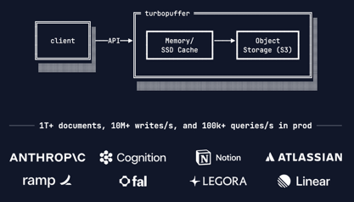
AI News
TurboPuffer - RIP Vectors
turbopuffer is a managed search AI - https://turbopuffer.com
The v3 redesign: document IDs replace vectors as primary storage keys
https://turbopuffer.com/blog/rip-vector-database
https://turbopuffer.com/v3
Serving AI applications including Cursor, Notion, and Anthropic, the company illustrates a shift: vector search becomes one tool, not the architecture’s center.
Three alternatives emerge: iterative agent search, live MCP connectors, and precompiled knowledge files
Agents are the best for complex questions, but higher costs and latency
Compiled wikis also show substantial overhead
Keyword search handles enterprise identifiers
Vectors help recover fuzzy meaning.
Choose retrieval by question complexity, permissions, latency, and budget
Simple, high-volume lookups still justify conventional RAG
https://www.youtube.com/watch?v=YLkSfz3EFGw

Slide 15
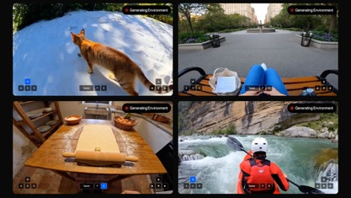
AI News
Odyssey 3: Interactive AI Worlds
Odyssey, a California AI company, launched Odyssey 3
In public research preview
It generates explorable worlds from prompts, responding continuously to movement and events.
Learned physics helps address the challenge of predicting how environments change
Potentially supporting robot control and AI-agent training
Odyssey 3 Pro reported 66.1 on Physics-IQ Verified using best-of-eight sampling; this is not its standard score
https://x.com/testingcatalog/status/2108246975883751665
Demonstrations include robot arms and driving in India, requiring additional control policies rather than the model alone.
Interactive simulation could expand training and creative applications
https://odyssey.systems
https://odyssey.systems/meet-odyssey-3

Slide 16
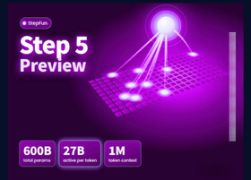
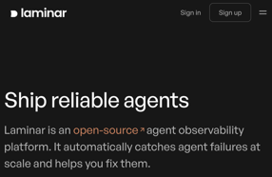
AI News
Step 5 Preview for Coding Agents
StepFun released Step 5 Preview for coding agents and professional workflows, including finance
600 Bln params, MoE
Supports text, images, video, tool calling
1M tokens input context window, 64K output
Agents can inspect projects, edit files, run tests, and iterate.
Available through OpenRouter and existing coding tools
https://www.stepfun.com/step-5-preview
https://openrouter.ai/stepfun/step-5-preview
https://www.youtube.com/watch?v=bqS3oZQgAhg
Laminar Flow-1: Detecting Agent Failures
Laminar launched flow-1 inside its Signals platform to investigate AI agent execution traces
Reinforcement-learning-trained flow-1 searches trace steps and returns structured explanations of errors
Affordable continuous monitoring helps businesses verify automation rather than trust completion claims.
https://laminar.sh/blog/flow-1
https://laminar.sh

Slide 17

AI News
Alibaba QwenGyre - Long-Horizon Agent RL
A training framework, not a model
Running on multi-node GPU clusters, it trains coding agents through unmodified harnesses on tasks lasting hours, with approximately 700,000 tokens per rollout
Dynamically moves GPUs between execution and training, then reconstructs, scores, and deduplicates histories into bounded training samples
On Qwen 3.8 2.4T, NL2RepoBench success increased from 52.5% to 58.5% in 48 steps
Training accelerated up to 1.85x, making lengthy repository-building agent training more computationally efficient
https://arxiv.org/abs/2609.33848

Slide 18



AI News
Black Forest Labs releases FLUX 3 Image
New image model with pixel-perfect editing over many turns
Bounding boxes control where things go in the picture
Generates natively at up to 4K
Combines up to 10 reference images in one picture
Accurate typography for text in images
Commercial weights available now; open weights come next
https://bfl.ai/models/flux-3-image
Microsoft unveils Maia 300, its third in-house AI chip
3rd generation of Microsoft's AI accelerator, built for inference
Claims 40% more tokens per megawatt than leading GPU systems
Large-scale deployment starts in 2027
Goal: depend less on NVIDIA and AMD chips
Joins Google TPUs and Amazon Trainium in the custom-chip race
https://news.microsoft.com/maia-2026/
GPT-6 becomes the ChatGPT default
GPT-6 Sol for paid tiers, GPT-6 Luna for Free and Go
Reaches ChatGPT's 1.2 Bln weekly users
Answers can include charts, forms, buttons and small tools
A compiler streams native components while the model writes
GPT-6 Instant web-search - answers 44% sooner
GPT-6.1 Sol Ultrafast: up to 8x faster, $12 / $60 per 1M tokens
https://links.tldrnewsletter.com/jzR1OT/1/010001a11bcb0cee-9ff72ec9-51ce-4456-9da7-54a384371a80-000000/KMPLg6QPwYc4tenSvqLS20N1U8oP0eU9p1-AUH0fidQ=452

Slide 19

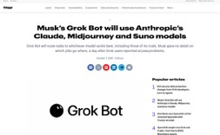
AI News
Claude Managed Agents - 1,000 agents
"Dynamic Workflows", in public beta
A lead agent writes a plan, then multiple agents work
Up to 1,000 worker agents per run
Results are merged at the end
No hand-written coordinator or subagent roster needed
Token use is high, the model does not see the spending limit
https://www.latent.space/p/claude-dynamic-workflows
Grok Bot will route tasks to Claude, Midjourney and Suno
Grok Bot becomes an orchestrator, not a single-model assistant
Claude Opus 5.5, Midjourney for images, Suno for music
Announced after reports of Grok access problems on mobile and web
https://thenextweb.com/news/grok-bot-claude-opus-midjourney-suno-musk

Slide 20



AI News
Modal raises $750M at $15.75B Valuation
Modal Labs is a startup founded in 2021 in New York City, with teams in San Francisco and Stockholm
It sells cloud computing for AI inference, model training, Python workloads, and isolated environments for AI agents
ARR is $1B+, Sandboxes alone are a $300M
https://modal.com
Fish Audio Drama 3 - open-weight 35B text-to-speech
83 languages, up to 16 speakers per request
Bracketed stage directions control tone word by word
First audio arrives in approximately 89 milliseconds for a single stream on one NVIDIA H200
It ranks 1st on Artificial Analysis’ Pronunciation Robustness benchmark at 93.2%, ahead of ElevenLabs, although not necessarily first in overall voice quality
https://www.eesel.ai/blog/fish-audio-drama-3
https://fish.audio/blog/fish-audio-drama-3/
https://huggingface.co/fishaudio/drama-3
Liquid AI LFM2.5-24B-A2B LLM
24 Bln params, open-weights, for on-device agents
131K context length; reasoning, tool use
Matches or beats Qwen3.6-35B-A3B, and 1.7x faster
Weights on Hugging Face
Liquid AI is a startup in Cambridge, MA
https://www.liquid.ai

Slide 21
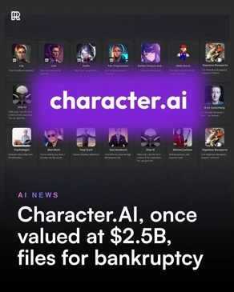
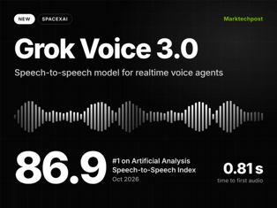
AI News
Character.AI files for Chapter 11
Character.AI was selling access to AI companions - chatbots with personalities that people could talk to for entertainment, role-playing, storytelling, or simulated companionship
The platform could close if no buyer emerges
https://www.cnbc.com/2026/10/13/character-ai-chapter-11-disney-bid.html
Grok Voice 3.0 tops the speech-to-speech index
Ahead of GPT-Live-1 and Gemini 3.8 Live
Sub-second latency, reasoning and tool calls mid-conversation
Already handles about 20K Starlink support calls a day
https://x.ai/news/grok-voice-3

Slide 22
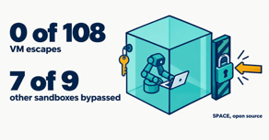

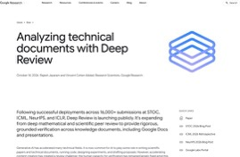
AI News
Perplexity open-sources SPACE, a sandbox for AI agents
Isolates each agent in a virtual machine
Blocks unauthorized access and data leaks
Top models made 118 breakout attempts; none escaped
https://www.perplexity.ai/hub/blog/open-sourcing-space
https://github.com/perplexityai/SPACE
JPMorgan blocks outside AI agents from customer accounts
Outside agents may not log in with customer credentials
They cannot move money or pay bills in retail accounts
Read-only data sharing through approved connectors still works
https://www.cnbc.com/2026/10/13/jpmorgan-ai-agents-account-access.html
Google Deep Review checks technical documents
An agent that gives rigorous feedback and verifies technical claims
Built first for computer science papers, now covers many domains
Takes PDF and plain text; multi-file input is coming
Google expects such tools to help both authors and peer reviewers
https://research.google/blog/analyzing-technical-documents-with-deep-review/

Slide 23
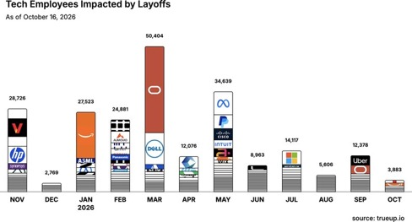
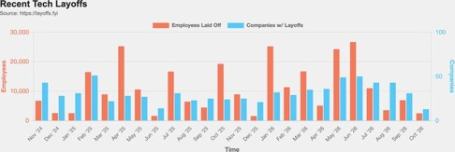
Jobs and Layoffs
https://layoffs.fyi
https://trueup.io/layoffs
The Tech Layoff Tracker
In 2026: 194,470 people laid off (673 per day)
In 2025: 245,953 people laid off (674 per day)
In 2024: 238,461 people laid off (653 per day)
https://trueup.io/layoffs
Tech Layoffs by year (US only):
  133.2K in 2026 (as of Oct 15, 2026)
  123K in 2025
  153K in 2024
  266K in 2023
  165K in 2022 https://layoffs.fyi

Slide 24
Tech Hiring
Software job postings on Indeed
Comparing to 2020 level, in Feb 2022 it was 234%, in 2025 it was 65%, now it is 77%
All US job postings: 103% (compared with 2020)
Postings that mention AI: 6.7% of all, up from 3.4% a year ago
https://fred.stlouisfed.org/series/IHLIDXUSTPSOFTDEVE
Top "In Demand" Skills and Qualifications
- Critical thinking and problem-solving
- Communication and stakeholder management
- Adaptability and continuous learning
- AI literacy and practical AI adoption
- AI/ML application development
- Data engineering and data management
- Cybersecurity and risk management
- Cloud and infrastructure engineering
- Software engineering
- Automation and workflow optimization
- DevOps, CI/CD, and platform engineering
- Governance, compliance, and responsible AI
- Analytical thinking and data analysis
- Product management and business alignment
- Project and program management
- Leadership and cross-functional collaboration
- Creativity and innovation
- Resilience and professionalism
- Technical troubleshooting and systems thinking
- Business growth and customer focus
Skills in demand
Dice, 7M+ US tech postings (Aug 2026): +18% year over year
AI and machine learning postings +101% year over year, five times the overall rate
Fastest-growing skills, each up 200%+: responsible AI, AI agents, agentic AI, AI infrastructure
Most requested overall: communication, computer science, troubleshooting
Indeed: 71% of the software postings rebound (May 2025 to May 2026) is senior roles; 37% has AI in the title
https://hiringlab.indeed.com/2026/07/08/ai-and-job-postings-from-destruction-to-creation/
https://www.dice.com/hiring/recruitment/reports/dice-tech-job-report

Slide 25
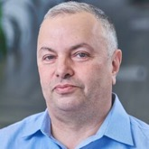
About the Speaker
Lev Selector, Ph.D.
40+ years of software engineering, data science, and building teams (hiring, training, and managing)
Ph.D. in mathematical modeling and computer simulations
Interests: Generative AI, using LLMs with your data, local AI for local private data, cloud architecture, fin-tech, application security
Find and connect: LinkedIn, GitHub, YouTube, Google
https://eais.ai

Slide 26
Thank You!
Videos of every seminar are on YouTube
https://www.youtube.com/@lev-selector
Slides on GitHub. Click a pptx file, then the download button on the right
https://github.com/lselector/seminar
Slides on Google Drive
https://drive.google.com/drive/folders/1dmj00iilSP-JYmriMUUaHCKz5X54e3UX?ths=true

