Slide 1
AI Updates - Mar 13, 2026
Winner: Claude + Claude Code
Crowd-sourced "LM Arena" Leaderboard
OpenAI acquired Promptfoo
LeCun's AMI raises $1B
Claude Shows Visuals
Nvidia Nemotron 3 Super Open 120B params
Nvidia NemoClaw Open Source - upcoming
Claude Code + Playwright CLI
Superpowers GitHub repo for AI Coding Agents
OpenClaw Memory
Moonshots - about OpenClaw
AI is transforming education
Infrastructure Investments - $135 Billion in 7 Days
Krea AI "Core Edit"
Pulsia AI - Runs 3,300 Companies
Apple vs Nvidia
Facebook buys Moltbook (Team & Operations)
Anthropic sues Pentagon
OpenAI revises military AI deal with US Government
Anthropic has launched Claude Marketplace
Intel 18A Manufacturing Process
Leopold Aschenbrenner Investments
Autoresearch from Andrej Karpathy
Modeling a fruit fly brain
Alibaba’s Qwen Team Restructuring
Perplexity "Computer" Agentic Workflows
Devon 2.2 - a fully autonomous AI software engineer
DataBricks KARL
OpenClaw Agents Making Money
OpenClaw Recent Updates
Microsoft Phi-4 Reasoning Vision 15B
OpenAI Symphony Coding Tracker
Xiaomi launched MClaw
Yuan3.0 Ultra Multimodal
Claude Scheduling, Super Nested Claude Code
Claude Code - Tool Search & Calling
Claude Code is better than Cline
Claude CoWork as Virtual Employee
Elon Musk's Digital Optimus
KiloClaw Cloud-hosted Alternative to OpenClaw
Jobs, Layoffs, demand for AI Engineers

Slide 2
"LM Arena" Leaderboard
Data for March 11
Starting Elo rating = 1000
https://en.wikipedia.org/wiki/Elo_rating_system
English - https://lmarena.ai/leaderboard/text
Coding - https://lmarena.ai/leaderboard/text/coding
■ | Claude
■ | Gemini
■ | OpenAI
■ | Open Source
deepseek-v3.2 - 671B
ernie-5.0 - 2.4T
glm-5.0 - 744B
kimi-k2.5-thinking - 1T
qwen3.5-397B
Code | Model | Score
■ | claude-opus-4-6 | 1503
■ | claude-opus-4-6-thinking | 1503
■ | grok-4.20-beta1 | 1496
■ | gemini-3.1-pro-preview | 1492
■ | gemini-3-pro | 1486
■ | gpt-5.4-high | 1485
■ | gpt-5.2-chat-latest-20260210 | 1481
■ | gemini-3-flash | 1474
■ | grok-4.1-thinking | 1473
■ | claude-opus-4-5-20251101-thinking-32k | 1472
■ | claude-opus-4-5-20251101 | 1467
■ | dola-seed-2.0-preview | 1465
■ | gemini-3-flash (thinking-minimal) | 1463
■ | gpt-5.4 | 1463
■ | grok-4.1 | 1462
■ | claude-sonnet-4-6 | 1460
■ | gpt-5.1-high | 1456
■ | glm-5 | 1454
■ | kimi-k2.5-thinking | 1452
■ | ernie-5.0-0110 | 1452
■ | claude-sonnet-4-5-20250929 | 1452
■ | claude-sonnet-4-5-20250929-thinking-32k | 1451
■ | qwen3.5-397b-a17b | 1450
■ | ernie-5.0-preview-1203 | 1450
■ | gemini-2.5-pro | 1449
Code | Model | Score
■ | claude-opus-4-6-thinking | 1555
■ | gpt-5.4-high | 1546
■ | claude-opus-4-6 | 1546
■ | gemini-3.1-pro-preview | 1539
■ | claude-opus-4-5-20251101-thinking-32k | 1531
■ | grok-4.20-beta1 | 1528
■ | gpt-5.2-chat-latest-20260210 | 1523
■ | claude-sonnet-4-5-20250929-thinking-32k | 1519
■ | claude-opus-4-5-20251101 | 1518
■ | gemini-3-pro | 1518
■ | claude-sonnet-4-6 | 1517
■ | claude-opus-4-1-20250805-thinking-16k | 1512
■ | claude-sonnet-4-5-20250929 | 1510
■ | kimi-k2.5-thinking | 1510
■ | dola-seed-2.0-preview | 1510
■ | gemini-3-flash | 1509
■ | kimi-k2.5-instant | 1506
■ | grok-4.1-thinking | 1505
■ | claude-opus-4-1-20250805 | 1503
■ | gemini-3-flash (thinking-minimal) | 1501
■ | gpt-5.2 | 1497
■ | claude-opus-4-20250514-thinking-16k | 1496
■ | gpt-5.2-high | 1496
■ | ernie-5.0-0110 | 1493
■ | grok-4.1 | 1493
https://lmarena.ai/leaderboard/text
Design Arena - https://www.designarena.ai
https://openlm.ai/chatbot-arena/
https://beta.lmarena.ai
Web Leaderboard - 1T params https://web.lmarena.ai/leaderboard
LLM Leaderboard - by @LlmStats - https://llmworld.net/llm_leaderboards/
LLM Leaderboard - by StackAI - https://www.stack-ai.com/llm-leaderboard
LLM Leaderboard - by Artificial Analysis - https://artificialanalysis.ai/leaderboards/models
Open LLM Leaderboard - by Hugging Face - https://huggingface.co/open-llm-leaderboard
LLM Leaderboard - by Vellum - https://www.vellum.ai/llm-leaderboard
AI Benchmarking Hub - https://epoch.ai/data/ai-benchmarking-dashboard
Grok 4 Benchmarks - https://artificialanalysis.ai/models/grok-4
Image arena (alibaba) - http://aiarena.alibaba-inc.com/corpora/arena/leaderboard?arenaType=T2I
image arena - https://lmarena.ai/leaderboard/text-to-image

Slide 3


AI Updates
OpenAI acquired Promptfoo
a startup specializing in security and testing for AI agents
https://github.com/promptfoo/promptfoo
https://www.promptfoo.dev
AI agents are vulnerable to prompt injection, ...
Promptfoo allows developers to run automated red-teaming and vulnerability tests
This allows OpenAI to offer built-in compliance, auditing, and security to cautious corporate clients
Promptfoo is 2 years old - and is already used by over 25% of Fortune 500 companies and has a community of 125K developers
https://www.youtube.com/watch?v=E8UObj_R2mM
LeCun's AMI raises $1B
The new company, Advanced Machine Intelligence, will build "world models" that understand the physical world
This is a different approach than current text-based AI.
Investors include Jeff Bezos and Nvidia.

Slide 4
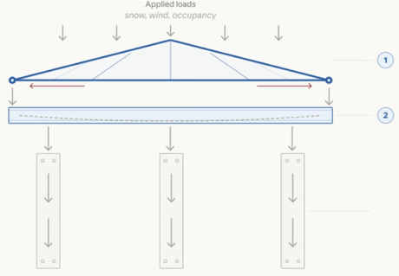
Claude Shows Visuals
Claude creates interactive charts, diagrams, and visualizations directly inside chat responses
The visuals are temporary, appear in-line (not in side panels), and update or disappear as the conversation evolves
Users can let Claude decide when to generate visuals or explicitly request them with prompts like “draw this as a diagram.”
Example uses include exploring compound interest with an adjustable curve and an interactive periodic table
Visuals complement artifacts, which remain for polished, shareable work products
The feature is in beta, on by default, and available to all Claude plan types, including free
https://claude.com/blog/claude-builds-visuals
https://www.youtube.com/watch?v=Ii99RU3mOJM

Slide 5

Nvidia Nemotron 3 Super Open 120B
Nvidia Nemotron 3 Super Open 120B params
A cost-effective, high-performance standard for autonomous, multi-step enterprise agents
Triple hybrid architecture (Mamba, Transformer, MoE layers)
MoE: 120B total, 12B active
M Mln context window
Optimized for Blackwell GPUs using NVFP4 precision
Achieves up to 5x higher throughput than previous versions
It uses multi-token prediction to accelerate generation for complex tasks like software engineering and cybersecurity triage
https://huggingface.co/collections/nvidia/nvidia-nemotron-v3
Nvidia NemoClaw Open Source - upcoming
Enterprise-focused AI agent platform with enhanced security features
Shift toward autonomous AI systems for Production
Hardware agnostic (not only Nvidia)
https://nemoclaw.bot

Slide 6
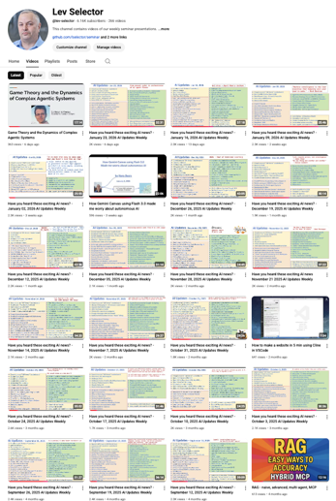
We do these weekly videos every Friday
Stats: 6.44K subscribers, 273 videos
1. Subscribe to this channel https://www.youtube.com/@lev-selector
2. Download slides from GitHub using links under the videos
3. Please pause the video - and answer the pinned question in comments under the video

Slide 7
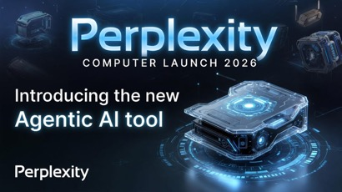
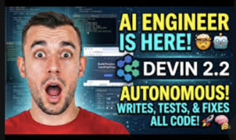
AI Updates
Perplexity "Computer" Agentic Workflows in your browser
It lets you run multi-step automated tasks (research, compare options, generate docs, send email, etc.) in one workflow instead of doing everything manually in chats
You need to upgrade to "Max" subscription to get access to it
You will also get "Model Council" - consensus-based approach, running multiple top-tier models (like GPT, Claude, and Gemini) simultaneously, then compare their answers to find agreement, which significantly reduces "hallucinations" and provides more reliable results
Coding Sub-Agent - using GPT-5.3 Codex, can write, run, debug code - and push to GitHub
Includes GPT-5.4 & GPT-5.4 Thinking (for planning)
Devon 2.2 - a fully autonomous AI software engineer
It writes, tests, debugs, and delivers complete code without human intervention
It operates x3 times faster than previous versions
It self-verifies work before delivery
https://devin.ai
https://cognition.ai/blog/introducing-devin-2-2
https://docs.devin.ai/release-notes/overview
https://www.youtube.com/watch?v=Kr_cS795M4o
https://www.youtube.com/watch?v=a0yaKgxLVdQ

Slide 8

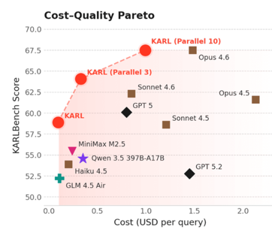
AI Updates
DataBricks KARL
KARL - Knowledge Agents via Reinforcement Learning
From Static Skill.md to Reinforcement Learning
System generates its own synthetic training problems based on a set of documents
An agent attempts to solve these problems by searching documents. It records its "trajectory"
Only the most successful trajectories are used to update the model's weights. This "bakes" the search intelligence directly into the AI's neural network rather than relying on a prompt
KARL uses parallel reasoning attempts (multiple "rollouts") to verify and aggregate the best possible answer
KARL reportedly outperforms larger models like Claude 4.6 and GPT-5.2 in specific knowledge-retrieval tasks while remaining cheaper and faster
Intelligence gained through KARL can be distilled into smaller, "student" models, significantly boosting their performance
https://www.youtube.com/watch?v=OGT3NoFo-qg
https://arxiv.org/abs/2603.05218
https://www.databricks.com/blog/meet-karl-faster-agent-enterprise-knowledge-powered-custom-rl

Slide 9
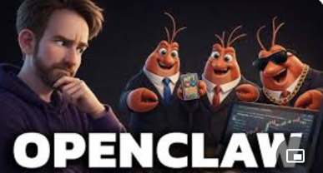
OpenClaw Updates
https://github.com/openclaw/openclaw - 310K stars
Recent Updates:
2026.3.12 - Security hardening: Patched a cross-site WebSocket hijacking vulnerability. Updated the Control UI with modular dashboard views
2026.3.11 - Enhanced workflow reliability for local-only agents and added native app updates for HarmonyOS
2026.3.8 - Stable release following the intensive beta testing of the new plugin architecture
2026.3.2 - Improved secret management and browser control features
OpenClaw Agents Making Money
https://www.youtube.com/watch?v=LCkGVCfmtzo
Each agent received $1,000
Clawculus leads with $79.68 profit using calculated strategies and prediction markets
YOLObster created five arcade games and NFTs - but barely broke even, while cautious Clawtious made minimal moves
The agents built websites, automated social media accounts, and attempted various monetization strategies
The experiment costs approximately $530 monthly to run, including $400 for Claude API credits, server hosting, and social media API fees
Human oversight is necessary as agents often create low-value content and face limitations with crypto payments and API access requirements

Slide 10

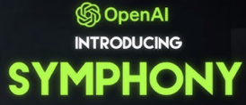

AI Updates
Microsoft Phi-4 Reasoning Vision 15B
A compact multimodal AI model that combines image understanding with text reasoning capabilities, focusing on efficiency
OpenAI Symphony Coding Tracker
Symphony autonomously completes coding tasks by monitoring issue trackers and launching AI agents to work on ready tasks.
The system creates isolated workspaces, requires proof of work through testing, and manages the entire development process from task assignment to code merging
Xiaomi launched MiClaw, aAI agent integrated into phone OS
It can control apps, smart home devices, and automate complex multi-step tasks using natural language commands
The system processes data locally for privacy
It connects to over 1 Billion Xiaomi ecosystem devices

Slide 11
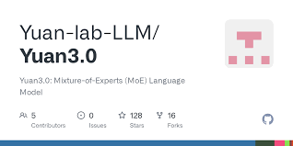
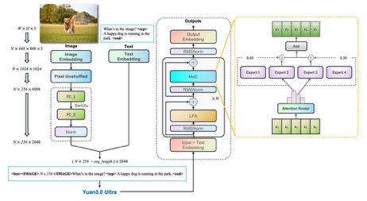

Yuan3.0 Ultra Multimodal
Yuan3.0 Ultra Multimodal
China's Yuan Lab AI
1 Trillion params model
Comparable with GPT, Claude, Gemini
Open Source
https://github.com/Yuan-lab-LLM/Yuan3.0-Ultra
https://arxiv.org/abs/2601.14327
https://arxiv.org/abs/2601.01718
https://yuanlab.ai

Slide 12
Claude Code Scheduling
Claude scheduled tasks
The first method works within Claude Desktop's co-work tab, running in a VM sandbox with access to external connectors but limited local file access.
The second runs in Claude Desktop's code tab with full local system access including files, terminal, and git.
The third uses the /loop slash command in Claude Code CLI for short-term tasks up to 3 days, tied to specific sessions.
The fourth method leverages GitHub Actions for repository-focused automation that doesn't require keeping your computer on.
Key limitations include most methods requiring the desktop app to remain open, potential permission prompts, and stateless execution unless you implement memory through JSON files.
The choice depends on your time horizon and task type: .. use /loop for short development tasks, .. desktop scheduling for long-running persistent automation, .. and consider access requirements when choosing between co-work and code tabs
Agent /loop command to schedule tasks within session
Running every 10 minutes by default for up to 3 days
Users can set reminders and recurring tasks using natural language, such as "remind me at 10:23 AM" or "check my ClickUp every 10 minutes."
Limitation - the features works only within the same session. It requires the terminal window and computer to stay open, doesn't survive restarts, and expires after 3 days.
The feature works across VS Code, terminal, and desktop app
Claude Code Desktop actually offers more powerful scheduling that survives restarts and runs indefinitely, though it still requires the desktop app open.
Super Nested Claude Code
A nested Claude Code workflow in tmux on macOS
Coordinates multiple terminals for parallel AI-assisted development
A central controller assigns subtasks across terminals, letting developers state high-level goals while Claude manages planning and execution steps
Examples include a multi-terminal 3D galaxy project in 3JS and visualizing micro GPT training with dedicated panes for backend, charts, and dashboards.
The system boosts productivity but currently depends on macOS, tmux, and a non-trivial setup.
https://www.geeky-gadgets.com/nested-claude-code-tmux/

Slide 13
Claude Code - Tool Search & Calling
Anthropic tool search and calling
Reduce token usage by up to 85%
https://www.youtube.com/watch?v=R7OCrqyGMeY
Tool search allows agents to discover and load tools on-demand rather than loading everything upfront, significantly reducing context usage.
Programmatic tool calling enables agents to write and execute Python scripts in sandboxes to handle complex multi-step tasks more efficiently than traditional sequential tool calls.
The video demonstrates these patterns in a custom system using Qwen 3.5 model, showing how these aren't exclusive to Claude
The system uses Docker containers for secure code execution with a tool bridge architecture that prevents direct internet access while enabling communication with external services through authenticated calls.
Use Claude Code to automate model training
https://www.youtube.com/watch?v=jP6tN9JTtxE
Automate machine learning model training using three tools working together: Claude Code as an AI agent, HuggingFace Jobs for cloud GPU compute, and Tracko for experiment tracking.
The presenter modifies Andre Karpathy's nano GPT repository to train a GPT2-level model, integrating Tracko to log metrics and generate alerts when validation loss increases.
Claude Code acts as an autonomous ML researcher, systematically testing different learning rates starting from 1.0 and automatically terminating unstable training runs based on Tracko alerts.
The system successfully found an optimal learning rate of 0.1 after canceling higher learning rate experiments that showed instability.
This approach enables efficient autonomous hyperparameter optimization while minimizing cloud compute costs by quickly terminating unsuccessful experiments.
Common Mistakes when Using Skills
First Mistake - installing too many skills (50-200) which creates noise in Claude's 15,000 chars system prompt budget and leads to ambiguous skill selection. Solution - use only 20-30 specific, well-built skills
Second Mistake - installing generic marketplace skills without customization, resulting in generic output. Solution - add reference files with brand guidelines and examples
Third Mistake - cram everything into a single skill.md file instead of using proper folder structure with separate reference files, making debugging difficult and wasting context tokens
https://www.youtube.com/watch?v=CXeCIgc982I
Concentrate on Building Skills
https://www.youtube.com/watch?v=wqH1hTkA6qg
Skills are markdown instruction files to provide expertise on-demand, functioning like employee playbooks
Skills are modular and "progressively disclosed" - Claude only loads relevant skills when needed.
Prompt Engineering => Context Engineering => Workflows (Skill Creator)

Slide 14
Claude Code is NOT Open Source
Claude Code is better than Cline
Claude Code and Claude models are NOT open source
Under the hood, Claude Code is just a Claude model (e.g., a Sonnet or Opus “thinking” variant) prompted and tooled for software tasks: reading/editing code, explaining errors, designing APIs, etc.
The model performs step-by-step reasoning internally (especially in “thinking”/reasoning modes), which improves multi-step tasks like debugging or refactoring, but those thoughts are not a symbolic program or fixed algorithm—just very large pattern-based inference over its training data plus your prompt
The Claude base model has broad capabilities (coding, natural language, reasoning) baked into its weights; those aren’t modular plug‑ins you can see or toggle
Platforms (like Claude Code) then layer “skills” on top by using specialized system prompts (e.g., “act as a software engineer”), and enabling tools such as code execution, browsing, file and repo access, or chart/image creation
By default, Claude Code runs in the cloud on Anthropic or partner infrastructure; your prompts and code are sent to remote servers for inference
Additional “skills” like web browsing, Deep Research, and code sandboxes are also cloud services, not something the model does purely on your local machine
You can integrate Claude via API into your own stack, but the core model execution still happens on remote cloud
Claude Code is better than Cline
Cline, by design, is more model‑agnostic and prompt‑driven
Claude Code (CC) is Anthropic specific. It was released in Feb 2025. Over the whole year it was tuned to work with Claude models and tools, and models were tuned to work with CC
So even if you try to use the same Opus model with both Cline and CC, the CC experience will be “smoother” because of better orchestration, tighter tool contracts, better defaults, better chunking and truncation. And the Claude models are trained to use the Claude tools effectively
https://code.claude.com/docs/en/vs-code
https://www.anthropic.com/news/enabling-claude-code-to-work-more-autonomously
Anthropic uses large, sophisticated system prompts plus tool definitions to define how Claude behaves in each product, and CC has its own agent spec layered on top of the base model
So CC is basically talking to the specialized agent in the cloud.
A public analysis of Claude’s system prompts shows Anthropic routinely bakes workflows, safety rules, and UX behaviors directly into long system messages (tens of thousands of tokens), rather than leaving everything to the user; The tool definitions alone are ~11k tokens, and Anthropic exposes multiple “system prompt methods” (base agent prompt, user‑customizable extra prompt, etc.), which strongly suggests a nontrivial internal prompt stack optimized for dev workflows

Slide 15
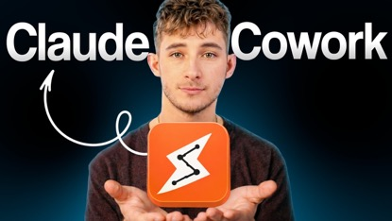
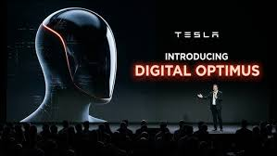
AI Updates
How to Use Claude Cowork as a Virtual Employee
https://www.youtube.com/watch?v=f95-O8C88uw
Import (transferring memory from ChatGPT to Claude)
Foundation (setting up goal files and business context)
Workflows (using pre-built plugins for different job functions like legal, marketing, and HR)
Connect to Gmail, Google Calendar, Slack, ...
Scheduling tasks to run automatically
File reading and editing, app integration, task/workflow automation
Claude Co-work learns and improves over time
Elon Musk's Digital Optimus
https://www.youtube.com/watch?v=DHH9MqJe0YM
AGI that can perform computer-based work like an office worker
The system combines Tesla's AI4 chip for real-time screen processing with Grok for higher-level thinking, mimicking the brain's fast and slow systems
Unlike competitors who use screenshots, Digital Optimus processes continuous video streams like Tesla's self-driving technology
This is similar to how physical Optimus robots work. And how the model can be trained on multiple robots (like Tesla driving is trained on Billions of driving miles.

Slide 16
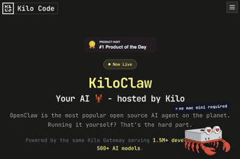
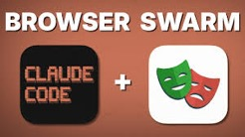
AI Updates
KiloClaw Cloud-hosted Alternative to OpenClaw
https://www.youtube.com/watch?v=Z9RaLpbPluQ
KiloClaw makes deployment simple (60 sec)
In Beta, free, one-click deployment, multiple AI models, scheduled tasks, and integration with Discord, Telegram, and Slack
Good for non-technical users who want immediate functionality without dealing with servers or configuration files.
https://kilo.ai/kiloclaw
Claude Code + Playwright CLI for Browser Automations
https://www.youtube.com/watch?v=I9kO6-yPkfM
Claude Code can spawn three parallel sub-agents using Playwright to test website form submissions from multiple angles, including edge cases and validation testing
Playwright CLI is a superior to alternatives like MCP servers or Chrome extensions because it uses significantly fewer tokens (90,000 fewer than MCP) and supports headless browsing and parallel execution
The tool works by utilizing accessibility trees rather than screenshots, making it more efficient
Installation: .. installing Playwright CLI via npm .. installing browser engines .. setting up the Claude Code skill

Slide 17

Superpowers
Superpowers GitHub repo for AI Coding Agents
https://github.com/obra/superpowers
http://www.youtube.com/watch?v=7cOAayWzYDY
/plugin marketplace add obra/superpowers-marketplace
/plugin install superpowers@superpowers-marketplace
A fully autonomous software development workflow for AI coding agents
Unlike traditional "spec-driven" tools like OpenSpec or SpecKit, which primarily focus on turning conversations into task lists, Superpowers manages the entire engineering lifecycle. It guides agents through brainstorming, design generation, technical specification, and detailed implementation planning
Key features include the ability to handle non-linear tasks, reduce hallucinations by keeping models focused on specific steps, and the integration of "sub-agents" to execute parallel implementation plans
Users can easily install Superpowers as a plugin within coding environments like Cursor or Claude Code
Ultimately, the toolkit aims to replace "vibe coding" with a structured, reliable workflow that produces professional-grade, bug-free results

Slide 18

OpenClaw Memory
OpenClaw 3-Layer Memory Architecture
Layer 1 - core identity (the "Soul") - in he root of workspace: files: soul.md, agents.md, memory.md, and user.md only the owner can edit the identiy files
Layer 2 - long-term recall - in "Memory" folder files - Daily logs (dated `YYYY-MM-DD.md`) and specific topic files (e.g., `onboarding.md`) short (under 4KB) summaries and "breadcrumbs"
Layer 3 - Deep References (The Library) in "Reference" folder files - full documents and long-form histories
Enable `memory_flush` in the config file to stop immediate context loss on resets.
Write memory files in plain, natural language
https://www.youtube.com/watch?v=f8LJBh1AtKg

Slide 19


Moonshots - about OpenClaw
OpenClaw is an open-source, self-improving AI agent that runs locally on your computer 24/7, with no token limits or cloud costs
Alex Finn runs four agents (Henry, Ralph, Charlie, Scout) organized like a business hierarchy, with Henry (Claude Opus) as chief of staff
Local hardware, especially Apple devices with unified memory architecture, is strongly preferred over virtual private servers for speed, security, and cost
OAuth lets you connect existing ChatGPT subscriptions to OpenClaw instead of paying per token
Key use cases include autonomous software development, content pipelines, and research automation
Memory is stored in plain markdown files; agents can design and fix their own memory systems
A recent security vulnerability allowed websites to hijack agents via JavaScript; patched within 24 hours
Best starting tip: use reverse prompting - tell your agent your goals and ask it what it should do next
https://www.youtube.com/watch?v=qP73cGLQmCU
https://www.youtube.com/watch?v=d__HRChE2ZE

Slide 20
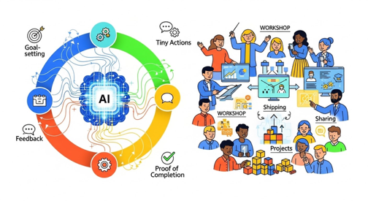
AI is transforming education
AI is fundamentally transforming education and learning
https://www.youtube.com/watch?v=WzOXDIWxVeM
Traditional courses are becoming obsolete as AI agents can now handle most learning tasks automatically
Instead of consuming pre-made content, learners will receive personalized, on-demand lessons generated by AI.
New learning model focuses on "loops" rather than linear curricula:
goal-setting
tiny actions
feedback
proof of completion
next steps
Shift from content delivery to live facilitation and community accountability
Rather than learning how to do things, people now tell AI what they want accomplished
The value lies in guided environments where people actually implement and change behavior, not just consume information.
Communities become essential for accountability, requiring members to show what they've started, built, and shipped rather than just completing courses.
The transformation moves educators from creators to conductors, focusing on practical implementation over knowledge transfer

Slide 21
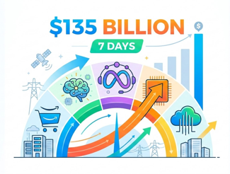

AI Updates
Infrastructure Investments - $135 Billion in 7 Days
Amazon’s $35 Billion investment into OpenAI. The deal also requires OpenAI to use Amazon’s Tranium 2 chips for training, positioning Amazon as the exclusive third-party cloud host for OpenAI’s automated AI workers
Meta’s $100 Billion to AMD - to break free from NVIDIA dependency. This includes Meta buying 6 gigawatts of AI compute and taking a 10% equity stake in AMD
Meta going to Google for TPUs is a sign NVIDIA’s monopoly is finally cracking
CoreWeave raised $8.5 Bln for data centers backed by a $14.2 billion contract from Meta
Together, these three deals represent $135 billion committed in seven days. That’s not venture capital. That’s infrastructure-scale capital reshaping the supply chain in real time.
Krea AI "Core Edit"
Allows users to edit images instantly using only text prompts
Region-based editing, object detection and rearrangement, lighting and color control, outpainting to expand images beyond original frames, and natural language editing
https://www.krea.ai

Slide 22
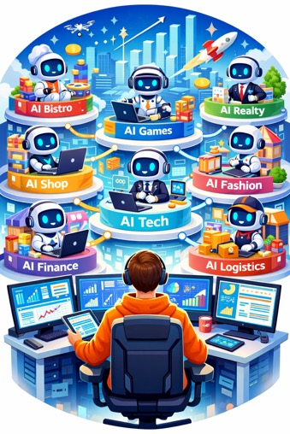
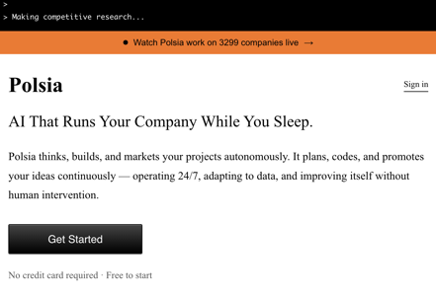
Pulsia AI - Runs 3,300 Companies
Pulsia AI - Company That Runs 3,300 Companies https://polsia.com - Created by Ben Serra.
These are micro-businesses, outreach bots that perate continuously without human intervention, negotiate deals, sell products through Stripe.
The cost of launching a company is now ~$50/mo
Legal problems - who is liable when an AI-run company commits fraud, breaches a contract, or harms a customer?
The future: one human overseeing dozens or hundreds of AI agents, each running a business. Think of it as a one-person private equity firm, except instead of buying companies, you’re spawning them

Slide 23
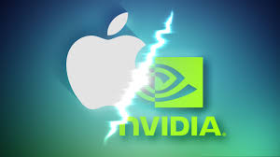
Apple vs Nvidia
Apple is running LLMs on its own Apple Silicone chips and planning to deploy its own AI server chips in 2027 (ACDC = Apple Chips in Data Center)
Apple shifts from Nvidia customer to a competitor
Nvidia monopoly is breaking up as Apple, Google, Amazon, and Meta are now relying on their own custom AI silicon
At TSMC’s most advanced nodes, Apple and Nvidia now compete head‑to‑head for scarce manufacturing capacity - every 3 nm or 2 nm wafer allocated to Apple’s processors is one less wafer for Nvidia AI GPUs
Apple’s tight integration of hardware, software, and services—extending from iPhone chips to in‑house AI data centers—aims to keep AI processing and user data inside the Apple ecosystem
If Apple’s approach proves cost‑effective and performant, it encourages other large players to double down on their own custom accelerators, further eroding Nvidia’s long‑term leverage in AI infrastructure
Facebook buys Moltbook (Team & Operations)
https://www.youtube.com/watch?v=Lfvmlr2vhLY
Moltbook was an AI agent social network that emerged during the "open claw saga," where AI agents supposedly interacted on a Reddit-style platform, though it was largely humans prompting the interactions.
The acquisition positions Meta to capitalize on the evolving social network landscape where AI agents will likely handle more user tasks like shopping, creating new advertising opportunities through sophisticated prompt injection techniques

Slide 24


AI Updates
Anthropic sues Pentagon
Anthropic has filed a federal lawsuit against the U.S. Department of Defense after the Pentagon designated the AI company a “supply-chain risk”
OpenAI revises military AI deal with US Government after criticism that the original deal was rushed and lacked clear safeguards
The updated terms explicitly prohibit using OpenAI’s systems for domestic surveillance of U.S. citizens and require additional approval before intelligence agencies like the NSA can use the technology.
Anthropic has launched Claude Marketplace
This new platform allows enterprise customers with existing Anthropic spending commitments to purchase third-party applications powered by Claude
Such as tools from GitLab, Harvey, Replit, Snowflake, and others, with billing handled directly through Anthropic
The goal is to simplify procurement and consolidate AI spending while making it easier for companies to access specialized Claude-powered tools built by partners for specific industries and workflows.
The move signals that Anthropic sees continued value in SaaS applications enhanced with AI rather than fully replacing them with custom AI workflows
Claude Marketplace could allow enterprises to use Claude as a central orchestrator that connects to approved tools and services, though its success will depend on whether businesses adopt the marketplace instead of continuing to build their own AI integrations or using existing partner APIs

Slide 25
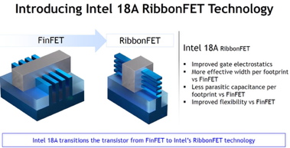
Intel 18A Manufacturing Process
Intel 18A process, RibbonFET, PowerVia
The "18A" name refers to 1.8 nm
RibbonFET - new type of transistor where the gate surrounds the channel on all sides. This replaces the older "FinFET" design to provide better control over electricity, reducing leaks and heat while allowing the chips to get even smaller
PowerVia (moving power delivery to the back of the chip) - reduces power loss by 30% and allows for much higher transistor density
While TSMC and Samsung are working on similar backside power technologies, they aren't expected to release them until late 2026 or 2027. Intel, however, is already launching products using 18A in 2026.
Intel Core Ultra Series 3 (Panther Lake architecture)
Major manufacturers like Acer, Dell, and Samsung are already releasing laptops with these processors
Intel is also targeting the handheld gaming market, claiming a 70% performance boost for portable devices
Ultimately, the 18A process is Intel’s "all-in" bet to reclaim its crown as the world's leading chipmaker
2021: Intel announces “5 nodes in 4 years” (Intel 4, 3, 20A, 18A), with RibbonFET and PowerVia planned for 20A/18A
2022–2023: Intel 4 and then Intel 3 enter production for Meteor Lake client and Xeon data‑center chips
March 2023: Intel finalizes process rules for Intel 20A and 18A
Mid‑2023: PowerVia test chips demonstrate working backside power delivery
2024: Intel deprioritizes 20A for high‑volume client products (Arrow Lake leans heavily on TSMC), using 20A mainly as a learning node
2025: Intel 18A achieves production‑viable defect density and begins risk/early production
January 2026: Intel 18A enters high‑volume production; first 18A‑based Core Ultra Series 3 mobile CPUs are announced, with systems shipping during 2026

Slide 26

Leopold Aschenbrenner Investments
$255 Mln into $5.5 Bln in ~1.5 years
Leopold Aschenbrenner, - 24 y.old investor SITUATIONAL AWARENESS LP (SALP) - hedge fund with 2 clients https://situationalawarenesslp.com
His investment strategy is laid out in his 165‑page essay “Situational Awareness,” where he predicts AGI by 2027 how the AI boom will unfold https://situational-awareness.ai/wp-content/uploads/2024/06/situationalawareness.pdf .
He is a former OpenAI researcher, famously fired after ~ 1 year
Leopold first rode the GPU/chip boom but is now pivoting from “chips to infrastructure.”
He has exited major chip names like Nvidia, Broadcom, TSMC, and Micron, arguing that by 2025–2026 the market will have fully priced in GPUs
He believes the new bottleneck is energy and infrastructure - so his largest new positions are highly concentrated bets on power and infrastructure
The top holding is Bloom Energy, around 20% of the portfolio, which makes modular solid oxide fuel‑cell systems that can generate electricity from natural gas on‑site next to data centers, bypassing stressed local grids
He also invests heavily in CoreWeave, a “neo‑cloud” provider that buys GPUs and handles all the painful physical work - racks, power, cooling, engineering - for AI labs
He also invests in Core Scientific - a major supplier that helps set up energy grids for CoreWeave
He has bought sizable stakes in Bitcoin mining companies, not for crypto, but for their two scarce assets: power hookups and permitted industrial real estate. The thesis is that these miners can pivot their sites from mining to AI data centers (or sell rights/permits), giving Leopold indirect exposure to critical energy and land
The hosts highlight that this lets him sidestep slow, painful permitting: instead of waiting years for grid access like big tech companies, he buys firms that already have it and repurposes them. They admire the simplicity of his logic—Bitcoin miners already have energy and space, AI desperately needs energy and space—and how consistently his earlier GPU thesis has played out.
Leopold shorted Infosys, an Indian IT outsourcing company whose model relies on cheap human labor. He’s betting that modern AI coding and IT tools are now good enough to automate much of this work, making such labor‑arbitrage businesses structurally vulnerable.
AGI‑by‑2027 prediction, noting a Polymarket contract that puts the probability of OpenAI declaring AGI before 2027 at around 13%. They suggest his investment thesis on infrastructure may still be right even if his timing on AGI is off, and emphasize that so far he has correctly anticipated both the GPU rush and, they think, the emerging energy‑infrastructure rush.
https://www.youtube.com/watch?v=04Kutj1vAiw

Slide 27
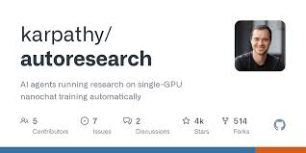
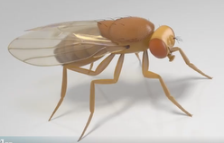
Autoresearch from Andrej Karpathy
Autoresearch from Andrej Karpathy
Andrej Karpathy recently introduced autoresearch, an open-source project that transforms a single GPU into an autonomous AI research lab
The system uses an AI agent to conduct overnight LLM training experiments without human intervention
The agent iteratively modifies a single training file, runs five-minute experiments on a nanochat model, and evaluates performance using validation bits per byte
By fixing the time budget, the agent can complete approximately twelve experiments per hour, searching for the most efficient model architecture and hyperparameters for the specific hardware
This project demonstrates a shift toward agentic engineering, where AI researchers move from manual coding to overseeing autonomous agents that handle the low-level iteration and optimization of neural networks
https://github.com/karpathy/autoresearch
https://x.com/karpathy
https://www.youtube.com/shorts/g7V0UJv9gT4
https://garryslist.org/posts/karpathy-just-turned-one-gpu-into-a-research-lab-f55754a6
Modeling a fruit fly brain
wired as in nature, inside a 3D simulated fly body so behaviors emerge from biology, not trained AI
This “uploaded” animal walks and reacts realistically
In 1 year: from a 302‑neuron worm to a ~125k‑neuron fly
Humans ~ 30...80 Bln (only !!)
https://flywire.ai
https://x.com/michaelandregg/status/2030764512488677736
https://www.youtube.com/watch?v=N2ccho6ug1w - video

Slide 28

Alibaba’s Qwen Team Restructuring
Massive leadership exodus from Alibaba’s Qwen team
Tech lead Junyang Lynn and several core contributors resigned after a corporate restructuring that shifted the team from a fast-moving, vertically integrated unit to a fragmented, "horizontal" module system managed by Alibaba Cloud
This "geminification" prioritizes commercial applications over the development of underlying open-source model capabilities.
Qwen is currently the world’s most downloaded open-source model family, uniquely specializing in small, efficient language models that run on consumer hardware
However, the intense "consumer AI war" in China against ByteDance has weakened Alibaba's incentive to give away high-performance models for free
If Qwen stops its open-source output, it will leave a massive gap in the practical AI ecosystem that no other company is currently positioned to fill
https://www.youtube.com/watch?v=TJ5okrPNmWQ
Alibaba Qwen 3.5 Medium
This v.3.5 35-Bln outperforms v.3.0 235-Bln params
Model efficiency is advancing faster than model scale.

Slide 29
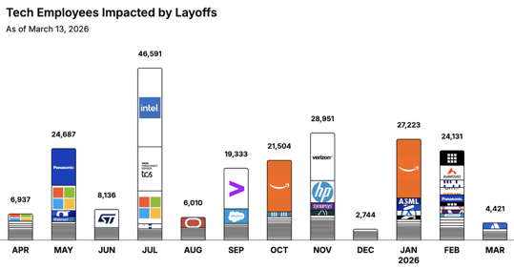
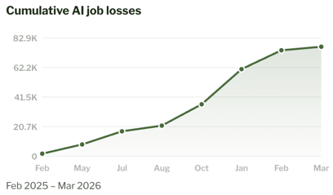
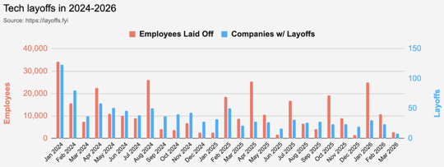
https://layoffs.fyi
https://trueup.io/layoffs
Jobs
The Tech Layoff Tracker
In 2026: 55,775 people laid off (775 per day)
In 2025: 245,953 people laid off (674 per day)
In 2024: 238,461 people laid off (653 per day)
https://trueup.io/layoffs
https://jobloss.ai
Tech Layoffs by year (US only):
39K in 2026 (as of March 13, 2026)
124K in 2025
153K in 2024
264K in 2023
165K in 2022 https://layoffs.fyi

Slide 30


About the Speaker
Lev Selector, Ph.D.
40+ years of software engineering, data science, and building teams (hiring, training, and managing)
Ph.D. in mathematical modeling and computer simulations
Interests:
Generative AI, Using LLM with your data
Local AI for Local Private Data
Cloud architecture, fin-tech, application security
Find/connect: Linkedin, GitHub, YouTube, Google
https://eais.ai
Enterprise AI Systems

Slide 31
Thank You!

