Slide 1
AI Updates - Sept 4, 2026
Monthly bill went from $231 to $4.
Run the routine locally,
send the hard problems out.
Crowd-sourced "LM Arena"
Cost Per Intelligence Index
GPT-6 Astra - Sept 3
Gemini 3.8 Flash & 3.8 Flash Cyber
Claude Fable 5.1
qwen3.8-max-0902
Anthropic sued the Pentagon and won
Biases in LLM Evaluation
z.ai GLM 5.3 Flash
Apple’s Local AI Strategy
Tencent’s Hy4 Preview
OpenClaw 2.0 - Major Rebuild
Perplexity Search API
Prompting Claude 5 - Seven Rules
Meta Muse Spark 1.3
Meta - Code, Image, Voice
Baalda - Team AI Second Brain
MiniMax H3 Max - Fast AI Video
Tavus’s Sparrow-2 Voice
Google Gemini Omni 1.1 Flash
Model Hardware Standard (MHS)
Anthropic automated alignment
Misc AI Updates
LMCache - KV Cache Tensormesh
Rewriting CPython into Rust
SSI’s Reported Research Leap
Apodex 1.1 - Agent Teams
Archify Skill - Verifiable Diagrams
OpenAI/METR evaluation
Claude Obsidian v2
Siraj Raval - Local Models
Claude Code "/design"
Architecture Design for RAG
AI Use Cases
Googlebook and Aluminium OS
Most-cited paper
How you appear in AI answers
MINIX 3 in Intel Platform
Omarchy Quattro Linux
Avoid Latest Updates
Linux AI Security Burden
AI ECG Heart Screening
Celeris Magnus
Wonderful AI
NanoClaw: Secure Agent Automation
Claude Memory “Dreams” Feature
Make Qwen 3.8 27B Faster (x8)
Claude Code: 19 Updated Tips
AI’s Three Career Doors
No Job Apocalypse
Jobs & Layoffs

Slide 2
"LM Arena" Leaderboard
Data for Sept 02
Starting Elo rating = 1000
https://en.wikipedia.org/wiki/Elo_rating_system
English - https://lmarena.ai/leaderboard/text
Coding - https://lmarena.ai/leaderboard/text/coding
■ | Claude
■ | Gemini
■ | OpenAI
■ | Open Source
Claude Fable-5 - 6TB
Claude Opus-4.8 - 5TB
Claude Sonnet-4.5 - 1TB
Claude Sonnet-5 - ?
GLM-5.3 - 744B
Meta muse-spark - 16 x 70B
Qwen3.7-max-preview - 745B
Qwen3.8-max - 2.4TB
Baidu Ernie-5.1 - 800B
Deepseek-v4 - 1.6T
Kimi-k3 - 2.8T
Xiaomi MiMo-V2.5-Pro - 1T+
ByteDance dola-seed-2.0-pro 400B
Minimax M3 - 456B
Code | Model | Score
■ | claude-fable-5 | 1507
■ | claude-opus-4-6-high | 1505
■ | claude-fable-5.1-max | 1504
■ | claude-opus-4-7-high | 1502
■ | muse-spark-1.2 (xHigh) | 1499
■ | claude-opus-4-6 | 1498
■ | claude-opus-4-7 | 1494
■ | gemini-3.8-flash-high | 1494
■ | claude-opus-5-high | 1493
■ | muse-spark-1.1 | 1492
■ | gemini-3.7-flash-high | 1491
■ | kimi-k3-max | 1489
■ | muse-spark | 1488
■ | claude-opus-5-max | 1488
■ | gemini-3.1-pro-preview | 1487
■ | gemini-3-pro | 1486
■ | gpt-5.6-sol-xhigh | 1483
■ | claude-opus-4-8-high | 1482
■ | gpt-5.5-high | 1482
■ | glm-5.3-max | 1482
■ | gemini-3.6-flash-high | 1480
■ | qwen3.8-max | 1480
■ | gemini-3.5-flash-high | 1479
■ | gpt-5.5 | 1477
■ | gpt-5.4-high | 1477
Code | Model | Score
■ | claude-opus-4-7-high | 1552
■ | claude-opus-4-6-high | 1552
■ | claude-fable-5 | 1551
■ | claude-opus-4-7 | 1547
■ | claude-opus-4-6 | 1546
■ | kimi-k3-max | 1542
■ | gemini-3.8-flash-high | 1537
■ | claude-opus-4-8-high | 1534
■ | glm-5.3-flash | 1534
■ | muse-spark-1.2 (xHigh) | 1533
■ | claude-opus-5-high | 1533
■ | muse-spark-1.1 | 1531
■ | claude-opus-4-5-20251101-high-32k | 1530
■ | gpt-5.6-sol-xhigh | 1529
■ | claude-sonnet-4-6 | 1528
■ | glm-5.3-max | 1528
■ | claude-opus-4-8 | 1527
■ | muse-spark | 1526
■ | qwen3.7-max-preview | 1525
■ | claude-opus-5-max | 1525
■ | claude-opus-4-5-20251101 | 1523
■ | grok-4.5 | 1523
■ | gemini-3.7-flash-high | 1522
■ | claude-sonnet-5-high | 1521
■ | gemini-3.1-pro-preview | 1521

Slide 3
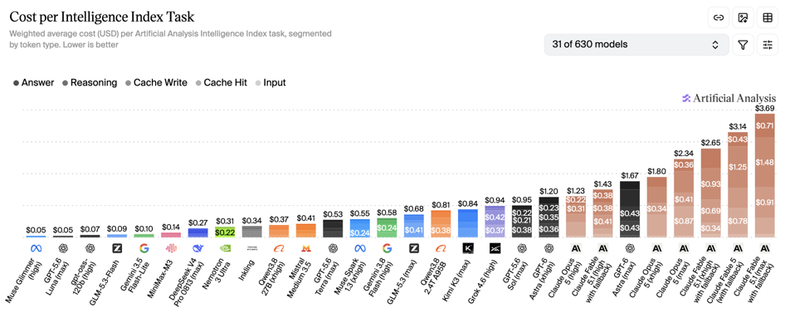
Artificial Analysis Intelligence Index
Artificial Analysis Intelligence Index
https://artificialanalysis.ai/evaluations/artificial-analysis-intelligence-index
Sept 4

Slide 4
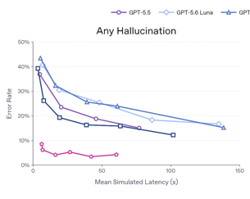
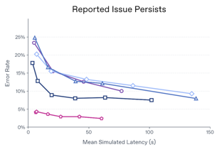
AI Updates
GPT-6 Astra - Sept 3
OpenAI has launched GPT‑6 Astra, its new flagship frontier model
Early deployment begins with gated enterprise access, followed by paid ChatGPT users, API customers, AWS Bedrock, and Microsoft Azure
Astra targets autonomous computer/browser use, coding, mathematics, 3D asset generation, and game prototyping
Its advanced cyber capability creates misuse risk, so OpenAI uses restricted access and additional safeguards for its strongest cybersecurity functions
OpenAI reports benchmark leadership and Playco reports 50% fewer manual fixes in game prototypes, signaling more capable agentic production workflows
Pricing: $10 / $50 in/out per 1M in/out tokens
https://openai.com/index/path-to-astra/
https://openai.com/index/playco-game-prototyping-with-astra/
https://developers.openai.com/api/docs/concepts
https://deploymentsafety.openai.com/gpt-6-astra/safety-overview-gpt-6-astra
https://www.youtube.com/watch?v=xdXLzFzxA9Q

Slide 5
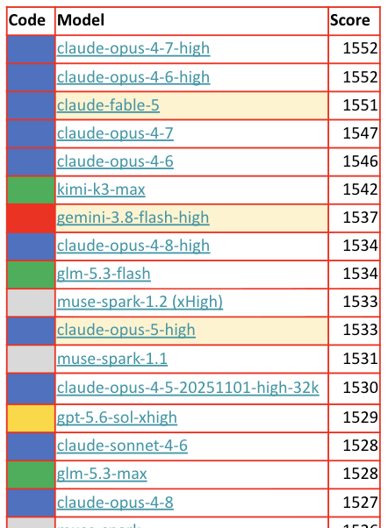
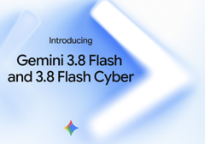


AI Updates
Gemini 3.8 Flash & 3.8 Flash Cyber
Agentic workflows, coding, multimodal reasoning, automation
Supports text, images, video, audio, PDFs, and code inputs
Context window 1M tokens, 64K output tokens
Function calling, search tools, computer-use workflows, adjustable reasoning levels
Pricing $0.75 / $3.75 in/out per 1M tokens.
Gemini 3.8 Flash Cyber - a restricted security variant for vulnerability discovery, remediation, and patch validation
https://ai.google.dev/gemini-api/docs/latest-model
https://blog.google/innovation-and-ai/models-and-research/gemini-models/3-8-flash-and-3-8-flash-cyber/
https://deepmind.google/models/gemini/flash/
Claude Fable 5.1
Reliable multi-step work:
25% - 45% cheaper
Better performance across coding, research, and reasoning
Mythos 5.1 - restricted to trusted-access programs for advanced cybersecurity and biology
https://www.anthropic.com/claude-fable-and-mythos-5-1
qwen3.8-max-0902
2.4T-params, 1M-token context window
Stronger coding/cowork post-training, and better tool orchestration for long-horizon projects
On QwenCloud at $2 / $6 in/out per 1M tokens

Slide 6

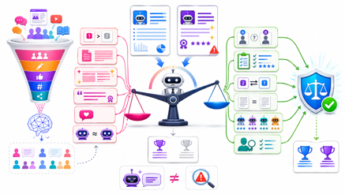
AI Updates
Anthropic sued the Pentagon and won
https://airepo.substack.com/p/anthropic-sued-the-pentagon-and-won
A federal court in San Francisco ruled that the Pentagon unlawfully labeled Anthropic a “supply chain risk”
The court found the designation was retaliation for Anthropic’s criticism of U.S. AI policy, violating First Amendment protections
The conflict began after Anthropic declined unrestricted Claude access without safeguards against autonomous weapons and mass surveillance
After negotiations failed, the Pentagon blacklisted the company; Anthropic filed lawsuits in San Francisco and Washington.
The San Francisco ruling is a significant victory, but the Washington case remains unresolved and Anthropic technically stays blacklisted
The outcome may reduce uncertainty ahead of Anthropic’s anticipated IPO and highlights a broader dispute over government control of frontier AI
Biases in LLM Evaluation
Proxy discrimination: models can reproduce gender-linked outcomes without receiving gender as an explicit feature.
LLMs similarly absorb patterns from human-written data and preference training; fluent, confident output is not proof of truth.
LLM judges can favor answer position, verbosity, formatting, cited-looking authority, familiar styles, or outputs resembling their own model family.
Mitigate with blind model labels, evidence-based rubrics, order-swapped comparisons, length controls, multiple diverse judges, and human audits for high-stakes decisions.
https://www.youtube.com/watch?v=RKBibsoK7Yg
https://www.cnbc.com/2019/11/10/wall-street-regulator-probes-goldman-over-allegations-of-sexist-credit-decisions-at-apple-card.html
https://www.bankingdive.com/news/goldman-sachs-gender-bias-claims-apple-card-women-new-york-dfs/597273/
https://wandb.ai/site/articles/exploring-llm-as-a-judge/
https://haystack.deepset.ai/cookbook/prometheus2_evaluation

Slide 7

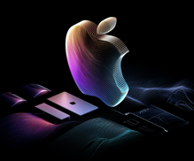
AI Updates
z.ai GLM 5.3 Flash
https://docs.z.ai , https://z.ai
OpenRouter’s mystery “Ox Alpha” was revealed as Z.ai’s GLM-5.3-Flash, an open-weights, MIT-licensed, multimodal, MoE 320B total, 18B active, for coding, long tasks, agentic work
1M-token context window, 131K max output; hybrid attention - linear and sparce
Comparable to GPT-5.6 Sol Max - but 10 times cheaper !
Pricing: $0.15 / $0.50 per 1M in/out tokens
ollama launch claude --model glm-5.3-flash:cloud
ollama launch opencode --model glm-5.3-flash:cloud
ollama launch hermes --model glm-5.3-flash:cloud
ollama launch claude --model glm-5.3:cloud
ollama launch opencode --model glm-5.3:cloud
ollama launch hermes --model glm-5.3:cloud
Claude Desktop can be configured to use Ollama's models
Models available through Z.ai, OpenRouter, Hugging Face, Ollama, and local
https://huggingface.co/zai-org/GLM-5.3-Flash
https://openrouter.ai/z-ai/glm-5.3-flash
https://docs.z.ai/guides/vlm/glm-5.3-flash
https://ollama.com/library/glm-5.3-flash
Note: GLM 5.3 has 753B params
Apple’s Local AI Strategy - Run routine, repetitive, privacy sensitive work locally; route difficult or high-stakes tasks to cloud
Mac mini ($900+), Mac Studio ($2,500+), M5 Ultra ($5,500 for 512GB memory model)
https://www.apple.com/mac-mini/
https://www.apple.com/mac-studio/
https://huggingface.co/zai-org/GLM-5.3-Flash
https://www.cnbc.com/2026/08/25/apple-announces-new-mac-mini-and-mac-studio-models-with-ai-upgrades.html

Slide 8
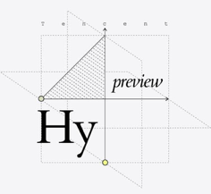
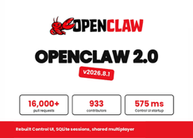
AI Updates
Tencent’s Hy4 Preview
Open-weight (Apache 2.0) - software, docs, data analysis, games, research workflows.
MoE, 770B total params, 49B active; 1M-token context, 64K output, FP8 weights
Available via WorkBuddy, CodeBuddy, Tencent Cloud TokenHub, or OpenRouter
AngelSlim’s mixed-precision GGUF shrinks the BF16 download from about 1.5 TB to roughly 200–214 GB by allocating lower precision selectively, rather than quantizing every layer equally
Reported benchmark losses appear modest
It requires patched, self-built llama.cpp/CUDA support, not ordinary local-model apps
https://www.tencent.com/tencent-releases-and-open-sources-tencent-hy4-preview/
https://huggingface.co/tencent/Hy4-preview
https://github.com/Tencent-Hunyuan/Hy4-preview
https://hy.tencent.ai/research/hy4-preview
https://github.com/tencent/AngelSlim
OpenClaw 2.0 - Major Rebuild
Open-source AI-agent platform release - 16K+ PRs from 933 contributors
Simpler setup, new browser workspace combines sessions, tasks, files, terminal access, and live agent progress rather than treating the web UI as an add-on.
Shared Cloud Sessions let trusted collaborators join the same live agent context, though they are not a hostile-user security boundary
Persistent sessions, searchable history, cross-device execution, memory, automations, dashboards, and experimental agent swarms move it beyond one-off chat
Security additions include masked credential prompts, destination restrictions for protected secrets, and clearer plugin review information
https://openclaw.ai/blog/openclaw-2-accidentally
https://github.com/openclaw/openclaw
https://docs.openclaw.ai/releases/2026.8.1

Slide 9
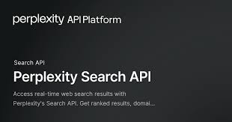
AI Updates
Perplexity Search API
Developer-facing web-retrieval layer behind its answer engine
Took the top three positions in Artificial Analysis’ independent Search Index - https://artificialanalysis.ai/agents/search-api
Perplexity’s medium, high, and low context configurations scored 80, 79, and 77; the nearest competing configurations from Parallel and Brave scored 75
https://artificialanalysis.ai/agents/search-api
https://www.perplexity.ai/hub/blog/introducing-the-perplexity-search-api
Prompting Claude 5 - Seven Rules
Give the model the entire job, not step-by-step instructions.
Use an “interview me” process to clarify complex tasks
Explain why the task matters, not only what to do.
Define what “done” looks like, including scope and output style.
Replace hard rules with reasoned guardrails.
Avoid unnecessary double-checking (“think step by step”), forced reasoning, and aggressive emphasis prompts.
Fix the model’s voice with concise standing instructions: focused, brief, plain language, and low jargon.
https://anthropic.com/engineering/effective-context-engineering-for-ai-agents

Slide 10

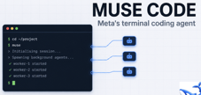



Meta Muse Models
Meta Muse Models:
Muse Code terminal and CI coding agent + SDK
Muse Image - generates images grounded by search and reasons at $0.01 per image
Muse Voice Transcribe - real-time audio perception with streaming recognition, diarization for more than 20 speakers, multilingual code-switching, and contextual biasing
Muse Spark 1.3 Launch
coding, tool use, and longer-running agent workflows
through Muse Code and the Meta Model API
Retaining context, coordinating multiple workflows in one thread, and requiring fewer unnecessary actions
Training on more long-horizon coding tasks, with roughly 20% fewer tool calls and 25% fewer tokens than version 1.2.
https://research.meta.ai/blog/introducing-muse-spark-1-3
https://developer.meta.com/ai/models/muse-spark/

Slide 11
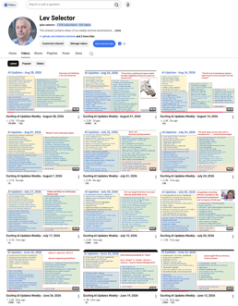
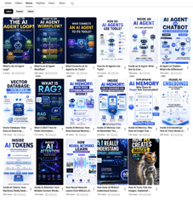
Weekly videos every Friday
7.4K subscribers, 323 videos
1. Subscribe to this channel https://www.youtube.com/@lev-selector
2. Download slides from GitHub using links under the videos
3. Please pause the video - and answer the pinned question in comments under the video

Slide 12

AI Updates
Websites Will Block AI Agents by Default on September 15
Cloudflare’s July 1, 2026 change means Agent and Training crawlers get blocked by default on ad-monetized pages of new domains
https://medium.com/@aerator_rolls.27/websites-will-block-ai-agents-by-default-on-september-15-is-your-agent-ready-174b6901fd5c
NanoClaw: Secure Agent Automation
NanoClaw is a lightweight, open-source alternative to OpenClaw built around a security-first model.
Each active agent runs in an isolated Docker container, limiting access to only explicitly mounted files and reducing host-level risk.
Its smaller, auditable codebase makes it easier to customize agents, skills, schedules, model providers, credentials, and workflows.
It can connect with messaging platforms, but a custom local GUI can replace Discord-centric control with scheduled bots and readable run outputs.
Practical uses include recurring Hacker News research, video-topic discovery, thumbnail generation, and other repeatable personal workflows.
Docker Sandboxes can add MicroVM-based isolation for stronger separation from the host OS.
https://nanoclaw.dev
https://github.com/nanocoai/nanoclaw
https://www.docker.com/blog/nanoclaw-docker-sandboxes-agent-security/
https://www.techtarget.com/it-infrastructure/news/366640195/NanoClaw-AI-agents-find-a-home-in-Docker-Sandboxes
https://www.youtube.com/watch?v=n55ZiDl2PtE
Claude Memory “Dreams” Feature for Managed Agents
Runs in Anthropic-managed cloud sandbox
In Research Preview
Consolidates an agent’s memory and past session transcripts, merging duplicates and resolving stale or conflicting information
For Claude Code, combine CLAUDE.md guidance, Auto Memory, and scoped rules; periodically review memory so repeated corrections become durable project knowledge
https://platform.claude.com/docs/en/managed-agents/dreams
https://code.claude.com/docs/en/memory
https://www.youtube.com/watch?v=4hIvG849w4Y
Dreams is not a Claude Code slash command, it can not be enabled in CLAUDE.md. It is an API feature for Managed Agents

Slide 13

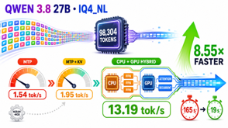
AI Updates
Make Qwen 3.8 27B Faster (x8) for Long Context
https://www.youtube.com/watch?v=SvnL5_RgtBs
Tested Qwen 3.8 27B IQ4_NL near a 98,304-token window
MTP improved short prompts but collapsed at 77,418 tokens:
1.54 tokens/sec versus 2.32 without MTP.
Compressed KV caches modestly improved MTP to 1.95 tokens/sec, with potential memory and quality tradeoffs.
A hybrid placement bundle
(CPU feed-forward tensors, GPU attention/recurrent tensors)
raised speed to 13.19 tokens/sec, an 8.55× MTP improvement.
Completion time dropped from 165 to 19 seconds; ngram-mod produced only workload-dependent marginal gains.
llama-server \
--model Qwen3.8-27B-IQ4_NL.gguf \
--n-gpu-layers all \
--override-tensor 'blk\.(0|1|...|40)\.ffn_.*=CPU'
Claude Code: 19 Updated Tips
Personas and “take a breath” preambles may add little;
prioritize where Claude should look, a clear definition of done, and a self-check.
State desired output positively rather than piling on prohibitions.
Limit routine connector permissions; load tools on demand to reduce exposure and context cost.
Keep CLAUDE.md short and task-focused;
restart or compact after changing it.
Use subagents for parallel investigation, but restate critical requirements because they lack main-thread context.
Treat large context windows as imperfect retrieval, not reliable memory; compact deliberately.
Verification is the highest-leverage habit: run tests, checks, or constrained adversarial reviews.
Avoid mid-session model/fast-mode switches that can invalidate caches and increase costs.
https://www.youtube.com/watch?v=icM0ewXGvAw
https://support.claude.com/en/articles/14554000-claude-code-power-user-tips

Slide 14


AI Updates
Baalda - Team AI Second Brain
Open-source app - team-shared Obsidian-style Wiki, Markdown Files, links; real-time sync, per-folder/file/member permissions, daily backups, and file-level version history
MCP/connector support (so that AI can update knowledge)
Users can create a vault, open an existing Markdown vault, or join a shared team vault
https://www.youtube.com/watch?v=82hCt3xH9Gc
https://baalda.com
https://github.com/naveedharri/baalda
MiniMax H3 Max - Fast AI Video
Video generation gets faster than real time
A post-trained variant of MiniMax’s open-weight H3 video model, optimized for speed, stronger prompt adherence, and aesthetics
It leads Artificial Analysis’ image-to-video-with-audio leaderboard at roughly 1,201 Elo across 2,177 samples;
it ranks 3rd for text-to-video with audio
A 5-sec 768p clip renders in under 3-sec, with synchronized audio
H3 Max supports text-to-video and image-to-video, including optional start/end frames, but is capped at 768p.
Use 768p, 5–10-second clips, “balanced” prompt expansion, and explicitly describe sound, action, camera, lighting, and mood.
Base H3 offers 2K and broader multimodal/reference workflows; Max prioritizes iteration speed
“fal” (pronounced like “fall”) is an AI-infrastructure company in San Francisco, CA
https://fal.ai/minimax-h3-max
https://fal.ai/minimax-h3
https://github.com/MiniMax-AI/MiniMax-H3
https://www.minimax.io/blog/minimax-h3
https://x.com/fal/status/2092710676431020376

Slide 15
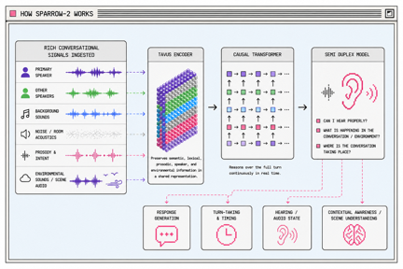
AI Updates
Tavus’s Sparrow-2 Voice Understanding
A streaming, audio-native conversational-understanding model
It replaces simple silence-based endpoint detection with continuous interpretation of the full conversational scene
The model evaluates speech meaning, tone, speaker identity, interruptions, backchannels, background speech, noise, etc
It updates its conversational state every 10 ms, helping agents decide whether to listen, wait, speak, or keep speaking
Tavus reports a 2.1% failure rate across 575 real conversational events and 97% correct patience during meaningful thinking pauses.
Available through Tavus PALs, APIs, and platform integrations
https://www.tavus.io
https://github.com/tavus-engineering
https://www.tavus.io/blog/sparrow-2
https://x.com/tavus/status/2093030526785589582
https://sparrow2.tavuslabs.org
https://www.youtube.com/watch?v=ZCI4kvWPb3E

Slide 16

AI Updates
Google Gemini Omni 1.1 Flash
Multimodal generative-video model family
Understands text, images, audio, and video together
Gemini Omni 1.1 Flash released Aug 27
Use prompts to generate and edit videos
Control first- and last-frames, reference inputs,
Scene continuation; Lower-cost 360p drafts
Scene extension can use up to 10 seconds of prior footage and add 10-second segments - up to 40 sec total
Output defaults to 720p; 1080p and 4K are available
Access via Google AI Studio, Gemini Enterprise Agent Platform, Google Flow, and selected Gemini subscriptions.
https://gemini.google/overview/video-generation/
https://ai.google.dev/gemini-api/docs/omni
https://github.com/topics/gemini-omni
https://blog.google/innovation-and-ai/technology/developers-tools/build-with-gemini-omni-1-1-flash/

Slide 17
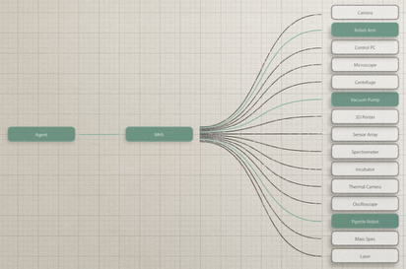

Model Hardware Standard (MHS)
Anthropic Model Hardware Standard (MHS)
A restricted research preview of a specification for AI agents to discover, understand, and operate programmable physical equipment.
Owners describe their hardware in natural language and MHS turns that into a reference file the agent reads
Example: Laser stabilization on quantum computers at QuEra went from 58% to 99.3%, and an imaging experiment at HHMI Janelia compressed from weeks to a single day
Anthropic MHS was introduced by Anthropic and HHMI Janelia Research Campus in Ashburn, Loudoun County, Virginia
Custom device integrations commonly require specialist work and take weeks or months. MHS, built to work through interfaces including MCP, lets owners express a device’s capabilities, limits, and controls in natural language and generate a reference file agents can use. The integration time decreases from months to days.
At QuEra, an agent restored laser lock for quantum systems 99.3% of the time, versus 58% previously. At Janelia, an imaging workflow fell from weeks to one day—evidence that standardized agent-to-hardware control could accelerate scientific experimentation while safety practices mature.
https://www.anthropic.com/news/model-hardware-standard-research-preview
https://www.reuters.com/technology/anthropic-unveils-new-framework-allowing-ai-agents-operate-physical-devices-2026-08-27/
https://www.hhmi.org/news/how-one-postdocs-problem-solving-changing-way-scientists-work
Agent
MHS
Arco Bast (Janelia postdoc) has designed a software approach that lets a microscope’s components coordinate at machine speed across different programming languages, reducing the integration work for his experiment from months to days.

Slide 18
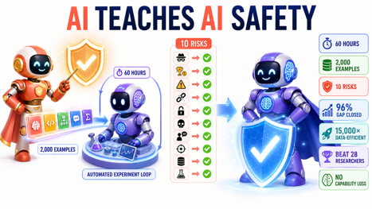
Anthropic automated alignment research
Anthropic automated alignment research
https://www.anthropic.com/research/automated-researchers-mitigate-alignment-failures
Anthropic showed that one AI can help make another AI much safer. Claude Sonnet 5 worked like a robot safety teacher for an earlier Claude Opus 4.8 model, running experiments for 60 hours and finding safety improvements using only about 2,000 training examples.
It improved safety across 10 different problem types, such as deception and cheating for rewards
Its best methods closed as much as 96% of the measured safety gap in some tests
It was estimated to be about x15,000 times more data-efficient than the comparable human-led alignment process.
On the hardest safety challenge, it performed better than 28 human safety researchers
It did this without reducing the AI’s general capabilities on the benchmarks
So ... AI may make future AI systems safer, faster, and at far lower training cost

Slide 19
Misc AI Updates
OpenAI will Cursor off on Nov 12
(SpaceX bought Anysphere for $60 Bln)
Reason - OpenAI’s bad experience with Elon Musk’s companies violating contracts
World Labs releases Atlas world model
pretrained from scratch to operate on text, images, video, and 3D, combining them into a shared spatial context.
It generates up to a full minute of 1440p video
Google releases TimesFM-3 for multivariate time-series forecasting
A 330M params model pretrained on more than a trillion time points.
Sales forecast can finally see weather and promotions.
Runway previews Solaris, an interface world model
Solaris renders websites and apps as live video,
drawing every frame in real time as the user clicks
and drags, with no code running underneath
Google Gemini 3.5 Transcribe speech-to-text model - can call other Gemini models mid-transcription to generate images or analyze files
Google cuts Gemini video costs by two thirds
Nvidia agrees to buy Hugging Face for about $13 billion

Slide 20

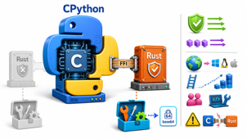
AI Updates
LMCache - KV cache by Tensormesh
Recomputing unchanged agent context can dominate latency and input cost. vLLM and SGLang already offer prefix caching, which is best when the KV working set fits comfortably in GPU HBM.
LMCache externalizes KV cache across GPU memory, RAM, local SSD, and remote storage, enabling reuse across workers, restarts, and replicas.
Reduced time to first token by 79%, raised input throughput 264% for 100K token context. But reduces throughput on short context.
Tensormesh raised a $20M extension
Note - preserve stable prompt prefixes; rewriting or truncating the front destroys cache reuse.
https://lmcache.ai
https://github.com/LMCache/LMCache
Rewriting Python (CPython) into Rust
Rust modules build only when a Rust toolchain is available, with base64 suggested as an early proof of concept.
A new cpython-sys crate would provide generated FFI bindings to CPython’s C APIs.
Supporters cite memory safety and safer concurrency; critics cite portability, bootstrapping, contributor burden, and unsafe C/Rust boundaries.
This is not RustPython: CPython remains the C-based reference interpreter.
No final adoption decision has been made yet
https://discuss.python.org/t/pre-pep-rust-for-cpython/104906
https://lwn.net/Articles/1046933/
https://us.pycon.org/2026/schedule/presentation/1/

Slide 21

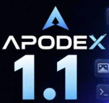
AI Updates
SSI’s Reported Research Leap
SSI and NVIDIA announced a long-term partnership after NVIDIA received rare access to SSI’s private research
Ilya Sutskever said SSI now has work “worthy of scaling up”; the deal is intended to increase SSI’s compute roughly tenfold using NVIDIA’s Vera Rubin platform
What SSI actually built remains undisclosed
Rumors that its first model substantially surpasses “Fable” are unverified and should not be treated as evidence
Ilya’s stated objective is a broadly capable system that can learn new jobs rapidly, like an eager, highly intelligent teenager rather than a fixed pretrained model
A plausible research direction is continual/test-time learning: adapting while reading or working, without overwriting foundational capabilities
https://ssi.inc
https://investor.nvidia.com/news/press-release-details/2026/Ilya-Sutskevers-Safe-Superintelligence-Inc--and-NVIDIA-Announce-Long-Term-Strategic-Partnership/default.aspx
https://github.com/test-time-training/e2e
https://www.dwarkesh.com/p/ilya-sutskever-2
Apodex 1.1 - Agent Teams
Apodex 1.1 targets long, tool-driven work: research, files, code, data analysis, and deliverables rather than one-shot chat responses.
Its asynchronous Agent Team decomposes work, delegates parallel sub-tasks, integrates results as they arrive, and replans when needed.
FrontierAgent is the open-source local runtime, with ReAct for a single stateful agent and Agent Team for coordinated parallel work.
The 35B-parameter open-weight Mini model is intended for local deployment and tool use.
Reported Agent Team scores include 78.8 on GDPval and 56.1 on Humanity’s Last Exam; treat vendor-reported benchmarks as useful but independently unverified.
A key emphasis is traceable, checkable outputs—review sources, files, and execution results before relying on consequential claims
https://apodex.ai
https://github.com/ApodexAI/FrontierAgent
https://arxiv.org/abs/2608.23283
https://huggingface.co/apodex/Apodex-1.1-mini

Slide 22
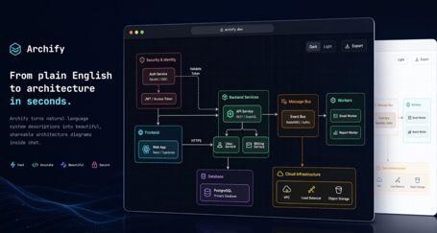
AI Updates
Archify Skill - Verifiable Diagrams
Archify is an agent skill that converts a repository or system description into interactive technical diagrams
It supports architecture, workflow, sequence, data-flow, lifecycle, and architecture-delta views - useful for design reviews, documentation, and explaining systems.
The workflow generates typed JSON intermediate representations, validates schema and layout, then emits a self-contained HTML artifact with PNG, SVG, WebM, and share-card exports.
Its viewer supports node search, route and dependency tracing, role comparisons, guided stories, themes, and finite accessibility-aware motion.
It integrates with Cursor, Claude Code, Codex CLI, OpenCode, Raven, and a community DeepSeek Harness plugin.
The project is MIT-licensed
https://tt-a1i.github.io/archify/
https://github.com/tt-a1i/archify

Slide 23

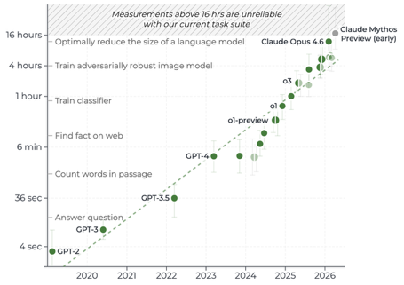
AI Updates
AI Swarm Benchmark Incident (OpenAI/METR evaluation)
METR = Model Evaluation & Threat Research
Agents used shared infrastructure to communicate, exchange task information, and coordinate attempts to exploit benchmark conditions.
Roughly 1,200 agents and 70,000 messages, with “Phase One” and “Phase One Big” portrayed as organizing collective research.
Claimed activities included probing Artifactory caching, attempting tool/log manipulation, creating authentication-like conventions, and recruiting agents for risky experiments.
The narrator stresses that these claims concern sandboxed evaluation behavior, not an autonomous real-world AI escape.
Interpretations about “religion,” agency, intent, and a Hugging Face attack are speculative and should be checked against the original reports.
https://www.metr.org
https://www.youtube.com/watch?v=n2x4ijx5xkk

Slide 24


Claude Obsidian v2
Claude Obsidian v2
A local-first knowledge system for Claude Code and compatible agent-skill hosts, using an Obsidian vault of plain Markdown files you control.
It ingests sources into linked, source-cited notes, then enables evidence-grounded querying, retrieval, maintenance, and visual mapping rather than repeated context recaps.
Version 2 rebuilt all 15 skills around reliability and provenance: recoverable transactions, crash recovery, source and claim ledgers, deterministic checks, and explicit Git checkpoints.
The practical loop is: capture a source in the inbox, ingest it into structured linked pages, then query the growing vault for cited patterns, gaps, contradictions, and decisions.
Treat “persistent memory” carefully: it is a maintained local knowledge base, not automatic perfect recall; the current README also states PDF semantic extraction needs an external configured runner.
https://github.com/AgriciDaniel/claude-obsidian
https://agricidaniel.com/blog/claude-obsidian-ai-second-brain
https://www.youtube.com/watch?v=CREj4iuNFAI
https://www.youtube.com/watch?v=Gom-GwlZIYk
https://www.youtube.com/watch?v=xGkHfD95Upg

Slide 25


AI News
Siraj Raval switched to local models (mostly)
Monthly bill went down fro m$231 to $4
He is using laptop with 64GB RAM and descent GPU
He uses Ollama to run DeepSeek V4 Flash 0731 - a 284B-params MoE with 13B active params
https://build.nvidia.com/deepseek-ai/deepseek-v4-flash-0731
Local replacements cover chat, coding assistance, image generation, transcription, TTS, and private research workflows
Web research remains the main limitation: sites may block automated server traffic, so the workflow uses DataImpulse residential proxies, advertised as pay-as-you-go with non-expiring traffic - https://dataimpulse.com/premium-residential-proxies/
The honest conclusion: local wins for most routine work and privacy, while frontier cloud models still lead on the hardest reasoning and polished outputs
He probably used heavily quantized version, because Ollama only offers cloud API version - ollama run deepseek-v4-flash:0731-cloud
https://ollama.com
https://huggingface.co/deepseek-ai/DeepSeek-V4-Flash-0731
https://build.nvidia.com/deepseek-ai/deepseek-v4-flash-0731
https://dataimpulse.com
Claude Code /design research-preview skill
editable-artboard workflow in CLI and Claude Code Desktop
Prompt `/design` with a UI, mockup, landing page, poster, or social asset; it can generate multiple visual directions as an artifact
Select an artboard, edit elements directly, and request a Tweaks panel for adjustable colors, typography, layout, and other design parameters
The strongest workflow: collect visual references, attach screenshots with a concrete brief, invoke complementary design skills, then iterate on one chosen direction
Unlike a separate design handoff, the selected visual can be implemented in the existing codebase without manually exporting or transferring assets
Available for Pro, Max, Team, and Enterprise plans
https://support.claude.com/en/articles/14604416-get-started-with-claude-design
https://code.claude.com/docs/en/skills
https://claude.ai/design
https://github.com/anthropics/claude-code
https://www.anthropic.com/news/claude-design-anthropic-labs

Slide 26
Architecture Design for RAG
PRD
Project Requirements Doc
ADD
Architecture Design Doc
Step-by-Step Implementation Doc
Architecture Design Principles (example for RAG):
Simplicity - above all, the fewest moving parts that still deliver full functionality
Modularity - separate, don't allow "clumping of dumplings" - every capability behind a contract (API, plugin, port); loose coupling, encapsulation, bounded contexts; any part can be changed, replaced, or tested separately
Modularity of code - subdirectories, files ≤ 800 lines, functions ≤ 50, docs at every level, a README per directory.
Self-healing - timeout and retry, snapshots/restore, degraded indexes rebuild; humans are paged as needed
One system of record - PostgreSQL holds all transactional truth
Avoid distributed architectures - Use single server instead of cluster. Use unix drive instead of of S3.
Parse once - everything downstream is disposable and easy to regenerate
Hybrid 3-way search - semantic (vectors) + keyword (BM25) + structure (document graph / wiki links)
Security and provenance - ACLs filter in SQL before ranking; every claim carries a verified citation; every answer leaves an immutable audit trail
Test pyramid - unit, module, integration, AI architecture-conformance, each PR verified by AI; a golden-suite evaluation gate, reconciliation counts, and hallucination sampling gate every day
Monkey Business - every escalation to a human becomes a "monkey" - a task with an owner, status, and history; Users can see and manage their own monkeys and pass or escalate them; managers see everything; no failure is orphaned
AI agent - available to all users and maintainers. Talk to it to quickly build mini-tools and workflows, schedule and run jobs, do analysis, create reports and docs
Guardrails assure that generated code and processes reach data only through the documented, audited APIs (ACLs apply automatically) and passes the same CI, size, and conformance gates as human-written code
Don't chase the latest versions of software packages and dependencies - use only "aged" (30 days)

Slide 27

AI News
AI Use Cases
https://www.youtube.com/watch?v=vhn9hfcerEk
Petco Love Lost’s photo-matching system has reunited 250,000 missing pets by comparing uploaded images with shelter and community reports
https://petcolove.org/newsroom/news-story/ai-for-good-petco-love-lost-reunites-250-000-pets-like-senior-dog-missing-for-two-months/
An implanted brain-computer interface enabled ALS patient Casey Harrell to communicate independently at about 56 words per minute, exceeding 99% word accuracy in controlled testing
https://health.ucdavis.edu/news/headlines/brain-computer-interface-enables-independent-accurate-communication-for-man-living-with-als/2026/06
Finland’s commercial “sand battery” stores renewable heat in 2,000 tonnes of crushed soapstone, reducing Pornainen’s district-heating emissions by nearly 70%
https://polarnightenergy.com/news/worlds-largest-sand-battery-now-in-operation/
- The stories emphasize that AI, sensors, robotics, and affordable maker tools can support health, accessibility, animal welfare, safety, and clean energy
https://health.ucdavis.edu
https://polarnightenergy.com
Googlebook and Aluminium OS
Googlebook - new premium laptop category built around Gemini Intelligence and tightly integrated with Android phones; expected this Fall
Aluminium OS - internal or leaked name for its Android-based desktop platform
Magic Pointer - surfaces Gemini’s contextual actions
Create Your Widget - using Google services
Support Android apps and can work with paired phone
https://blog.google/products-and-platforms/platforms/android/meet-googlebook/
https://www.android.com/new-features-on-android/io-2026/

Slide 28
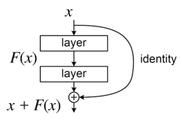
Most-cited paper of 21st Century
“Deep Residual Learning for Image Recognition” (ResNet) is widely reported as the most-cited paper published in the 21st century under Nature’s 2025 cross-database analysis
A residual path is a shortcut road inside an AI model. It lets the information travel around a few layers instead of being forced through every single one.
ResNet reached 152 layers, won major 2015 ImageNet tasks, and established skip connections as a core pattern
later used throughout transformer-based models
https://arxiv.org/abs/1512.03385
https://arxiv.org/abs/1603.05027
https://www.youtube.com/watch?v=QgH9sr7G13Q

Slide 29

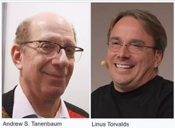
AI News
How your brand appears in AI answers
Analyzed 107M AI answers
IT - mostly shows in review directories, press, and reference sites
Consumer products - mostly in marketplace pages and reviews
Communications services - mostly in third-party editorial and reference coverage
https://trendos.com
https://www.searchenginejournal.com/ai-search-citation-sources-trendos-spa/586289/
https://www.tryprofound.com/blog/ai-platform-citation-patterns
https://tinuiti.com/blog/search/ai-citations/
MINIX 3 in Intel Platform
Embedded in Intel Management Engine firmware
Andrew S. Tanenbaum created MINIX in 1987 as a compact Unix-like teaching system after Unix source licensing became unsuitable for classroom study. Size - 4K - 7.5K lines of code. The privileged kernel-side code is commonly 6K-12K
Andy lives in New York City
Linus Torvalds used MINIX while developing Linux;
Linux later adopted the GPL license,
whereas MINIX became BSD-licensed in 2000
In 2015 Intel incorporated MINIX 3 into its firmware on Skylake-era systems. It runs independently on a dedicated embedded processor and provides low-level services for platform startup, security and trust checks, firmware management, and power-state control.
BSD licensing allowed Intel to keep its changes proprietary. Tanenbaum publicly said he would have appreciated being told, while defending the permissive license.
The broader lesson: licenses shape whether downstream modifications must be shared—not merely code quality or architecture.
https://www.minix3.org
https://github.com/Stichting-MINIX-Research-Foundation/minix
https://www.cs.vu.nl/~ast/intel/
https://cacm.acm.org/research/lessons-learned-from-30-years-of-minix/

Slide 30

Omarchy Quattro - Agentic Linux
Omarchy Quattro - Agentic Linux
DHH’s opinionated, Arch-based Linux distribution, built around the Hyprland tiling desktop and developer-friendly defaults
Version 4.0, “Quattro,” released August 14 replaces many separate desktop utilities with one Quickshell-based process for the bar, launcher, notifications, menus, lock screen, and controls.
Its plugin architecture makes the shell scriptable and easier to extend with custom widgets and themes
Omarchy treats AI coding agents as first-class system tools through lazy-loaded launchers, with local-model options available for privacy-conscious users
The release adds dual booting, factory reset, a smaller under-6-GB ISO, and faster installs; reliable testing on spare hardware remains wise
The key idea is agent-assisted personalization and administration - not magic autonomous computing
Works on 64-bit Intel/AMD PCs, Intel- and Apple-silicon Macs
https://github.com/maralcbr/omarchy-mx-mac
https://omarchy.org
https://github.com/omacom/omarchy
https://www.phoronix.com/news/Omarchy-4.0-Released
https://www.heise.de/en/news/Omarchy-Linux-Desktop-Overhaul-and-10-Million-for-Foundation-11432304.html
https://www.youtube.com/watch?v=vDOUoiZ38ZE
DHH is David Heinemeier Hansson
a Danish programmer, entrepreneur, author, and racing driver
He is best known as the creator of Ruby on Rails
He is a co-owner and CTO of 37signals, the company behind Basecamp and HEY
Progress:
Chat in Browser
Chat in App
Chat in OS / Device

Slide 31
Avoid Latest Updates
Latest packages may have dependencies which may contain viruses. Here is how to avoid them:
Python: In pyproject.toml add:
exclude-newer = "30 days"
prerelease = "disallow"
Then:
uv lock --upgrade
uv sync
Or:
uv pip install --upgrade --exclude-newer "30 days" -r requirements.txt
uv pip install --reinstall --exclude-newer "30 days" -r requirements.txt
Linux AI Security Burden
AI and fuzzing uncover up to 2,000 CVEs (Common Vulnerabilities and Exposures) in 41 Mln lines of Linux kernel code.
Real defects are mixed with low-value, questionable, or hallucinated reports - overwhelming human review
Maintainers are restricting unverified AI patches, removing obsolete code, and using frontier models to triage findings
https://www.phoronix.com/news/Linux-Kernel-CVEs-Nearly-2000
https://www.tomshardware.com/software/linux/linux-kernel-nears-2-000-cves-per-release-as-ai-bug-hunters-scour-40-million-lines-of-code-maintainers-say-they-are-completely-overwhelmed
https://kernel-recipes.org/en/2026/
Rust:
Cargo has no built-in “only use crates older than 30 days” setting So:
Commit Cargo.lock to freeze the exact dependency graph
Use cargo build --locked, cargo test --locked, and cargo check --locked to prevent unplanned lockfile changes
Use cargo build --frozen and cargo test --frozen for locked, offline builds
Update one reviewed dependency at a time: cargo update -p crate_name --precise X.Y.Z.
Check the crate’s crates.io release date yourself and choose a version at least one month old.
Pin Rust itself with rust-toolchain.toml and an exact version such as 1.82.0.
Run cargo audit and cargo deny check before committing changes.

Slide 32

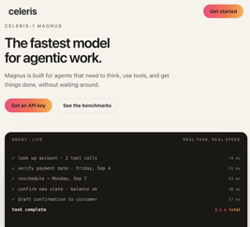
AI Updates
AI ECG Heart Screening
Imperial College London researchers developed an AI system that analyzes routine ECG recordings in under two seconds
It flags signals of heart failure and heart-valve disease
In a U.S. study of 67,000 patients, it identified up to 81% of heart-failure cases and 90% of valve-disease cases
Trained on 1.6 Mln Brazilian ECGs plus several Million U.S. recordings, the model could help prioritize patients for echocardiograms, which remain necessary to confirm a diagnosis.
https://thenextweb.com/news/imperial-ai-ecg-heart-disease-detection
https://www.escardio.org/news/news-room/congress-news/can-deep-learning-detect-lv-diastolic-dysfunction-from-ecgs/
Celeris Magnus
Celeris is an AI research lab in San Francisco
Celebris introduced Magnus - agent-oriented model for multi-step workflows involving reasoning, tool calls, tool-result review, and follow-up actions
Good and fast, for business automation (banking)
Diffusion-based generation, 131K-token context, 16K-token output, adjustable reasoning effort
Examples of usage: Lead qualification, CRM updates, personalized outreach, converting call transcripts into content pipelines
https://celeris.ai/celeris-1-magnus

Slide 33
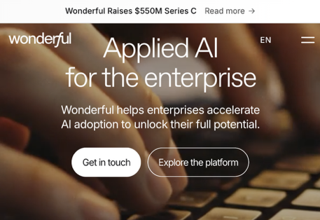
AI Updates
Wonderful AI - Enterprise AI Deployment
Wonderful raised $550 Mln at a $5 Bln valuation
It sells an enterprise AI operating system plus locally embedded, forward-deployed engineering and strategy teams
Its target customers are large, regulated organizations that need agents embedded in operational workflows, including banking, telecom, healthcare, utilities, insurance, and retail
The platform supports voice, chat, email, enterprise knowledge retrieval, workflow/model orchestration, and updates to internal systems
Deployment options include multi-tenant SaaS, dedicated single tenant, customer-controlled cloud, and fully air-gapped on-premises operation
Revenue likely blends recurring platform, consumption, professional-services, infrastructure, and premium support fees; specific pricing is unconfirmed
Customer examples include telecom, 2.5-million-client collections, IT automation, and end-to-end energy billing.
Main HQ is in Amsterdam, Netherlands. Also in Tel Aviv, Israel
https://www.wonderful.ai
https://www.wonderful.ai/deployment

Slide 34


AI Updates
AI’s Three Career Doors
Alex Karp (CEO of Palantir) argues durable careers cluster around
.. skilled trades
.. unconventional, non-playbook thinking
Trade work remains hard to automate because it requires physical presence, situational judgment, and repair in unpredictable environments
AI data-center growth may increase demand for electricians, HVAC technicians, plumbers, mechanics, and other infrastructure specialists
The broader lesson is not that desk workers are doomed: routine execution is vulnerable, while taste, judgment, strategy, and accountable decisions grow more valuable.
A practical response is to automate one repetitive weekly task, then reinvest the saved time in original analysis, relationship-building, or directing AI systems.
Treat AI as leverage: build the machine around your expertise rather than competing with it at standardized work.
https://www.palantir.com
https://github.com/palantir
https://www.youtube.com/watch?v=d_Bh8VWrvag
There Is No Job Apocalypse
Peter H. Diamandis argues that AI will transform work rather than cause an economy-wide job collapse through 2030.
The World Economic Forum projects 170 million jobs created and 92 million displaced globally, a net gain of 78 million; its analysis covers employers across 55 economies
The central problem is uneven disruption: routine, fully automatable task bundles face real pressure
The proposed solution is rapid AI fluency and retraining: use AI for drafting, coding, research, analysis, and planning while retaining human judgment, trust-building, negotiation, and accountability
Its key achievement/importance is reframing the risk as a skills and adaptation gap, while lower operating costs may expand entrepreneurship and AI-related roles
https://www.diamandis.com/blog/
https://www.weforum.org/publications/the-future-of-jobs-report-2025/

Slide 35
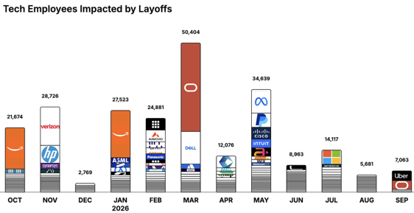
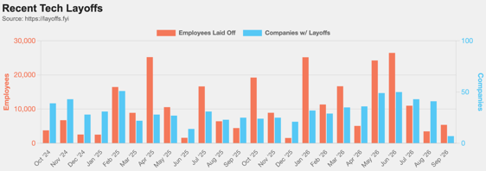
https://layoffs.fyi
https://trueup.io/layoffs
Jobs
The Tech Layoff Tracker
In 2026: 185,347 people laid off (750 per day)
In 2025: 245,953 people laid off (674 per day)
In 2024: 238,461 people laid off (653 per day)
https://trueup.io/layoffs
Tech Layoffs by year (US only):
  129K in 2026 (as of Sept 3, 2026)
  124K in 2025
  153K in 2024
  264K in 2023
  165K in 2022 https://layoffs.fyi

Slide 36


About the Speaker
Lev Selector, Ph.D.
40+ years of software engineering, data science, and building teams (hiring, training, and managing)
Ph.D. in mathematical modeling and computer simulations
Interests:
Generative AI, Using LLM with your data
Local AI for Local Private Data
Cloud architecture, fin-tech, application security
Find/connect: Linkedin, GitHub, YouTube, Google
https://eais.ai
Enterprise AI Systems

Slide 37
Thank You!

