Slide 1
AI Updates - Aug 28, 2026
Reviewing and Validating is the New Bottleneck
Crowd-sourced "LM Arena"
Cost Per Intelligence Index
Open Models Overtake Closed Models
NVIDIA’s AVO - 100% on ARC-AGI-3
DeepSeek Flash Gets Vision
Time to 100K Stars on GitHub
OpenAI Open-Sourced Codex Harness
Jalapeño: OpenAI’s AI Chip
52 Open Harnesses
2026 World Humanoid Robot Games
Ox Alpha on OpenRouter
Unsloth - Efficient LLM Training
4x more Context from the same GPU
Ornith 1.5 by by DeepReinforce - Self-Teaching AI
Qwen3.8-27B on 24GB RTX 3090
TurboFieldfare: SSD-streamed LLM
SST - Solid State Transformers
AI Evals: Human Taste at Scale
Task - Build a RAG service for millions of docs
Alibaba Wan 3.0: Document-to-Video AI
Claudex Loop Skill for Dual Model Work
Anthropic silicon team for custom Claude chips
Xiaomi Aluminum AI Cube
Podman vs Docker
Kimi Linear: cheaper long context
Google’s Gemini Enterprise for Legal
OpenAI Apple Messages for ChatGPT
Perplexity + Nvidia - Local AI Agent
Habit-Hooks - Avoid Agent Slop
FreeToken - Open Local Inference Engine
Mixedbread’s Toast 1 - AI Search
OpenBot: Self-Hosted AI Coworkers
Jobs & Layoffs

Slide 2
"LM Arena" Leaderboard
Data for Aug 21
Starting Elo rating = 1000
https://en.wikipedia.org/wiki/Elo_rating_system
English - https://lmarena.ai/leaderboard/text
Coding - https://lmarena.ai/leaderboard/text/coding
■ | Claude
■ | Gemini
■ | OpenAI
■ | Open Source
Claude Fable-5 - 6TB
Claude Opus-4.8 - 5TB
Claude Sonnet-4.5 - 1TB
Claude Sonnet-5 - ?
GLM-5.3 - 744B
Meta muse-spark - 16 x 70B
Qwen3.7-max-preview - 745B
Qwen3.8-max-preview - 2.4TB
Baidu Ernie-5.1 - 800B
Deepseek-v4 - 1.6T
Kimi-k3 - 2.8T
Xiaomi MiMo-V2.5-Pro - 1T+
ByteDance dola-seed-2.0-pro 400B
Minimax M3 - 456B
Code | Model | Score
■ | claude-fable-5 | 1508
■ | claude-opus-4-6-high | 1504
■ | claude-opus-4-7-high | 1502
■ | muse-spark-1.2 (xHigh) | 1498
■ | claude-opus-4-6 | 1497
■ | claude-opus-4-7 | 1494
■ | claude-opus-5-high | 1493
■ | muse-spark-1.1 | 1491
■ | gemini-3.7-flash-high | 1490
■ | kimi-k3-max | 1489
■ | muse-spark | 1488
■ | claude-opus-5-max | 1487
■ | glm-5.3-max | 1487
■ | gemini-3.1-pro-preview | 1486
■ | gemini-3-pro | 1485
■ | gpt-5.6-sol-xhigh | 1482
■ | gpt-5.5-high | 1482
■ | claude-opus-4-8-high | 1482
■ | qwen3.8-max | 1481
■ | gemini-3.6-flash-high | 1481
■ | gemini-3.5-flash-high | 1478
■ | gpt-5.4-high | 1476
■ | gpt-5.5 | 1476
■ | gpt-5.2-chat-latest-20260210 | 1476
■ | grok-4.20-beta1 | 1475
Code | Model | Score
■ | claude-opus-4-7-high | 1552
■ | claude-opus-4-6-high | 1551
■ | claude-fable-5 | 1551
■ | claude-opus-4-7 | 1547
■ | claude-opus-4-6 | 1546
■ | kimi-k3-max | 1542
■ | claude-opus-5-high | 1533
■ | claude-opus-4-8-high | 1533
■ | muse-spark-1.2 (xHigh) | 1531
■ | glm-5.3-max | 1531
■ | gpt-5.6-sol-xhigh | 1530
■ | claude-opus-4-5-20251101-high-32k | 1530
■ | muse-spark-1.1 | 1530
■ | claude-sonnet-4-6 | 1528
■ | claude-opus-4-8 | 1527
■ | muse-spark | 1526
■ | qwen3.7-max-preview | 1524
■ | claude-opus-5-max | 1524
■ | claude-opus-4-5-20251101 | 1523
■ | grok-4.5 | 1523
■ | gemini-3.7-flash-high | 1521
■ | gemini-3.1-pro-preview | 1521
■ | claude-sonnet-5-high | 1521
■ | gpt-5.4-high | 1520
■ | qwen3.8-max | 1520

Slide 3
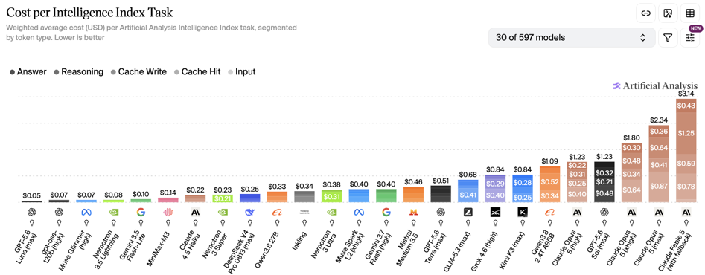
Artificial Analysis Intelligence Index
Artificial Analysis Intelligence Index
https://artificialanalysis.ai
https://artificialanalysis.ai/evaluations/artificial-analysis-intelligence-index
https://www.youtube.com/watch?v=nxr20lcqagg - Anthropic vs OpenAI
August 19

Slide 4
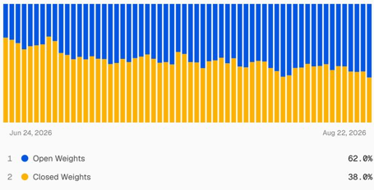
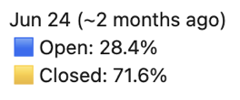
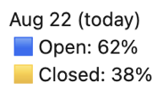
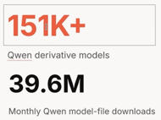
Open Models Overtake Closed Models
Open Weight Models Overtake Closed Models
Vercel AI Gateway data shows open-weight models overtaking closed models in token volume: 62% versus 38% on August 22, up from 28.4% open in late June.
The shift reflects rapidly improving, low-cost open-weight models, notably from Chinese labs.
Token volume is not revenue: Anthropic reportedly retains disproportionate spend through premium frontier workloads.
The likely market split is cheap open models for broad workloads and closed frontier models for high-value, accuracy-critical tasks.
Open weights offer deployment control, privacy options, fine-tuning, vendor leverage, and less platform dependency.
Strategic concern: US companies increasingly depend on Chinese-origin model ecosystems, potentially creating future chip and supply-chain exposure.
https://vercel.com/ai
https://github.com/vercel/ai
https://www.youtube.com/watch?v=2w7ZdceZT-g - Matthew Berman Review
https://www.linkedin.com/posts/rauchg_todays-a-record-day-for-open-weight-share-share-7497028233108860928-omcG/

Slide 5
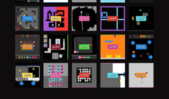
AI Updates
NVIDIA’s AVO agent improves Claude Opus 5 performance on ARC-AGI-3 from a 30% baseline to 100%
The agent completes all 183 levels across the benchmark’s 25 public environments
AVO uses persistent memory, external tools and supervision to sustain progress across unfamiliar tasks, building on a seven-day GPU-kernel optimization run
Note that the official base-model leaderboard evaluates individual models under its specified evaluation setup:
1 Claude Opus-5 - 30.2%
2 GPT-5.6 Sol - 7.8%
3 Claude Opus-4.8 - 3.6%
NVIDIA AVO Agent
AVO - Agentic Variation Operators
It is NVIDIA’s research architecture for long-horizon autonomous agents.
Works as evolutionary optimizer rather than relying on fixed mutation and crossover rules
The agent inspects code, proposes changes, executes tests and benchmarks, reads profiler feedback, and iterates over many attempts
Persistent memory retains prior experiments, failures, performance data, and successful approaches across the optimization process.
NVIDIA first used AVO for autonomous GPU-kernel optimization, where real compilation and hardware measurements guide decisions.
NVIDIA later applied the architecture to ARC-AGI-3 interactive reasoning tasks, reporting a perfect public-environment score.
AVO is an agent system design, not a standalone foundation model
https://developer.nvidia.com/blog/nvidia-avo-reaches-100-on-arc-agi-3-demonstrating-a-frontier-level-general-purpose-architecture-for-long-horizon-autonomous-agents/
https://arxiv.org/abs/2603.24517
ARC-AGI-3 Interactive Benchmark
Evaluates learning through interaction and adaptation from limited experience (similar to learning a computer game)
ARC Prize runs a competition around ARC-AGI-3 with more than $2M in total prizes
https://arcprize.org/arc-agi/3
https://arcprize.org/competitions/2026/arc-agi-3
https://arxiv.org/html/2603.24621v1
https://www.kaggle.com/competitions/arc-prize-2026-arc-agi-3

Slide 6
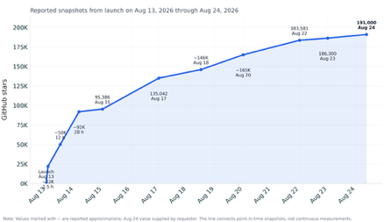

AI Updates
DeepSeek Flash Gets Vision
DeepSeek released experimental V4 Flash Vision Exp
Adds image understanding to text, reasoning, coding, and agent capabilities
Agents can now inspect screenshots, extract text, interpret charts, and compare visual UI output—not just operate from text context
Model name: deepseek-v4-flash-vision-exp
Supply JPEG, PNG, GIF, or WebP through base64, a public URL, or reusable Files API file IDs
Files API avoids repeat uploads
Pricing: up to 384 tokens per image
https://api-docs.deepseek.com/news/news260821/
https://api-docs.deepseek.com/guides/vision/
https://x.com/deepseek_ai/status/2090730032574631962
DeepSeek Harness (dsh) - Early Dev Preview
Open-source (MIT) agent runtime, launched Aug 13, 191K stars
Operates model, tools, workspace, state, policies, and agent loop
“everything is a plugin”
Supports local web and headless profiles, with configurable bundles and patches rather than a monolithic application
Four baseline configs: Standard, Code, Minimal, and Creator.
Append-only session log - replay, forking, persistence, and traceability of model-visible context
https://github.com/deepseek-ai/deepseek-harness
https://api-docs.deepseek.com/news/
https://www.infoq.com/news/2026/08/deep-seek-harness/
https://www.datacamp.com/tutorial/deepseek-harness
https://www.youtube.com/watch?v=qHMxtIuuKso

Slide 7
Time to 100K Stars on GitHub
Rank | Project | GitHub URL | Launched | Time to 100K stars | Current stars | Project age on Aug 24 | Notes
1 | Claw Code | https://github.com/ultraworkers/claw-code | 2026-03-31 | ~1 day | ~195.1K | 146 days | open-source AI coding-agent harness inspired by the architecture of Anthropic’s Claude Code (created on the day when Claude Code was leaked on March 31)
2 | DeepSeek Harness | https://github.com/deepseek-ai/deepseek-harness | 2026-08-13 | <48 hours | 191K | 11 days | Crossed 100K in under two days.
3 | OpenClaw | https://github.com/openclaw/openclaw | 2025-11-24 | ~2 days | ~387.3K | 273 days | Timing is not cleanly comparable because of predecessor names/rebrands; public claims conflict.
4 | Hermes Agent | https://github.com/NousResearch/hermes-agent | 2026-02-25 | ~7–10 weeks | >100K | 180 days | open-source, self-hosted autonomous AI assistant built by Nous Research
5 | AutoGPT | https://github.com/Significant-Gravitas/AutoGPT | 2023-03-30 | ~3–4 weeks | 176K | 1,243 days | AutoGPT is an open-source agent platform that lets you build, deploy, and run AI agents for multi-step digital workflows
6 | LangChain | https://github.com/langchain-ai/langchain | 2022-10-17 | ~3.5 years | 140K | 1,407 days | Open-source Python and JavaScript framework for building AI applications - assistants, RAG systems, tool-using agents, and multi-step AI workflows
7 | Dify | https://github.com/langgenius/dify | 2023-05-15 | ~2.1 years | 153.2K | 1,197 days | open-source LLM app development platform
8 | n8n | https://github.com/n8n-io/n8n | 2019-06-04 | ~6 years | 200K+ | 2,638 days | Platform for AI Agents and Workflow Automation
9 | Ollama | https://github.com/ollama/ollama | 2023-06-26 | Not established | 173K | 1,155 days | Local AI-model runtime and developer platform
10 | llama.cpp | https://github.com/ggml-org/llama.cpp | 2023-03-10 | ~3 years | 100K+ | 1,263 days | open-source, low-level C/C++ inference engine for running LLMs and VLMs locally

Slide 8
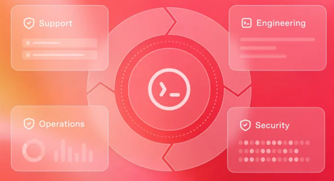
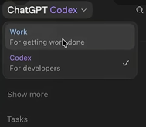
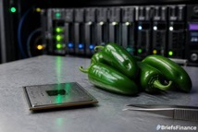
AI Updates
OpenAI Open-Sourced Codex Harness - Aug 19
Codex Harness powers the ChatGPT desktop app, CLI, and VS Code extension
This includes Codex CLI, app-server, and official SDK
https://github.com/openai/codex
https://developers.openai.com/blog/codex-as-a-platform
https://aidisruption.ai/p/deepseek-harness-vs-codex-harness
OpenAI Merges ChatGPT and Codex into the ChatGPT app
Phasing out the standalone Codex branding
The updated interface emphasizes coding and developer tasks, relegating standard chat to a minimized secondary window.
eading AI companies are shifting their focus heavily toward practical knowledge work rather than basic question-and-answer use cases.
http://www.youtube.com/watch?v=mlc9JSTQoxc
Jalapeño: OpenAI’s AI Chip - deployment by the end of 2026
OpenAI and Broadcom’s Jalapeño is a custom ASIC for serving LLM inference, not a general-purpose GPU or training chip
SemiAnalysis reports 1.5–1.9× higher throughput per watt than Nvidia Blackwell, with lower end-to-end latency in tested scenarios
https://www.youtube.com/watch?v=Im2c-7jvKz8
https://openai.com/index/openai-broadcom-jalapeno-inference-chip/
https://newsletter.semianalysis.com/p/openai-jalapeno-better-than-nvidia

Slide 9

52 Open Harnesses
Codex CLI — Rust terminal coding-agent harness from OpenAI with tools and sandboxing
Pi — Minimal TypeScript terminal harness with extensible tools, skills, and prompts
OpenCode — TypeScript coding harness for terminal, desktop, IDE, tools, and providers
Claw Code — Rust CLI implementation of the Claw coding-agent harness architecture
Grok Build — xAI Rust TUI coding agent with shell access, web search, and subagents
DeepSeek Harness (dsh) — Plugin-first Node.js coding and general agent runtime
Aider — Git-aware Python terminal coding agent for controlled repository edits
Cline — TypeScript coding agent for VS Code, CLI, and SDK with approvals
Roo Code — VS Code coding agent with task modes, tools, and multi-provider support
Kilo Code — Coding agent for VS Code, JetBrains, CLI, and cloud with BYOK access
Goose — Rust local agent for coding, research, analysis, writing, and automation
OpenHands — Python autonomous coding agent for sandboxed self-hosted tasks
SWE-agent — Python agent that resolves repository issues by generating patches
mini-SWE-agent — Compact Python harness for reproducible issue-solving and coding runs
Continue — TypeScript IDE and CLI coding assistant with agent and local-model support
Qwen Code — Qwen-first TypeScript terminal coding agent with configurable providers
Qwen Agent — Qwen-first Python framework for tools, planning, memory, and GUI use
Crush — Charm’s Go terminal/TUI coding agent with multi-provider support
Plandex — Go plan-driven coding agent for controlled multi-step changes
Open Interpreter — Python local computer-use agent for terminal commands
Hermes Agent — Self-hosted Python agent with persistent memory, skills, and subagents
OpenClaw — Autonomous agent runtime with memory, messaging, tools, and automation
LangGraph — Python/TypeScript framework for stateful, human-supervised agents
AutoGen — Microsoft multi-agent framework for conversations, tools, and workflows
PydanticAI — Typed Python framework for structured, testable, tool-using agents
smolagents — Lightweight Hugging Face Python framework for code-first agents
Semantic Kernel — Microsoft SDK for agent applications, plugins, and workflows
OpenAI Agents SDK — OpenAI-first Python/TypeScript framework with tools and guardrails
Mastra — TypeScript framework for agents, workflows, memory, RAG, and observability
AutoGPT — Python platform for autonomous, continuous task-oriented agents
BabyAGI — Lightweight Python task-planning autonomous-agent reference framework
CrewAI — Python framework for role-based multi-agent crews and automated flows
Letta — Stateful agent platform centered on persistent managed memory
Microsoft Agent Framework — for multi-agent systems and workflows
Dify — Platform for building, deploying, and operating LLM apps and agents
Flowise — Visual low-code platform for LLM flows, tools, and agent applications
Langflow — Visual builder for LangChain-oriented agents, flows, and deployment
n8n — Workflow-automation platform with AI-agent nodes and tool integrations
Haystack — Python framework for RAG pipelines, tools, and agent workflows
Agno — Python framework for multi-agent systems, memory, knowledge, and tools
CAMEL — Research-oriented Python framework for communicative multi-agent systems
MetaGPT — Python framework for role-specialized software-development agents
SuperAGI — Platform for deploying and managing autonomous agent systems
OpenDevin — Autonomous software-engineering agent and predecessor to OpenHands
OpenManus — Python autonomous agent inspired by Manus-style workflows
Browser Use — Python framework for LLM-driven browser automation
Skyvern — Browser automation agent for website navigation and task completion
Stagehand — TypeScript framework for AI-driven Playwright browser automation
Composio — Open-core integration layer supplying external application tools to agents
MCP Servers — Ecosystem of reusable tool servers, rather than a standalone harness
Agent Zero — Personal autonomous-agent framework with tools and long-running tasks
TaskWeaver — Microsoft Python framework for code-first planning and data workflows

Slide 10
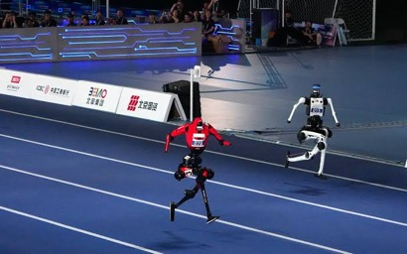

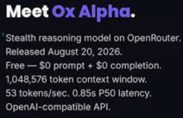

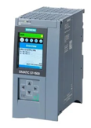
AI Updates
Chinese humanoid robots broke records set by humans
2026 World Humanoid Robot Games
100-meter sprint: 9.39 sec vs 9.58 sec set by Usain Bolt in 2009.
Beijing’s 2026 World Humanoid Robot Games began August 22 at the National Speed Skating Oval and runs for five days.
More than 2,000 humanoid robots, 16 countries, 51 sports, arts, and practical-work events, including sprints, football, boxing, table tennis, factory tasks, rescue, and household activities.
Chinese teams dominate, reflecting China’s large state-backed robotics push and commercialization focus.
Rumors
Google has confirmed Gemini 4 pre-training
Ox Alpha on OpenRouter - for coding and agentic workloads, with text, image, video, 1M-token context
SSI (Ilya Sutskever) promised their release in August
US agencies warn of an active campaign targeting
exposed industrial controllers (Siemens S7 PLCs)
https://openrouter.ai/stealth
https://cisa.gov/news-events/cybersecurity-advisories/aa26-231a
https://www.youtube.com/@WesRothAI

Slide 11
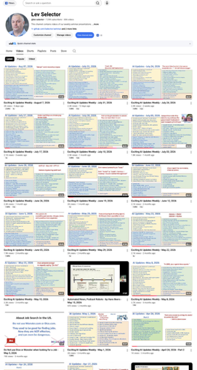
Weekly videos every Friday
7.32K subscribers, 310 videos
1. Subscribe to this channel https://www.youtube.com/@lev-selector
2. Download slides from GitHub using links under the videos
3. Please pause the video - and answer the pinned question in comments under the video

Slide 12
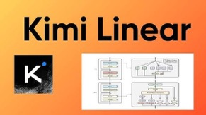

AI Updates
Kimi Linear: cheaper long context
Moonshot AI’s Kimi Linear is a hybrid transformer architecture intended to reduce the cost of long-context inference
Its Kimi Delta Attention (KDA) layers use recurrent, linear-style attention
Design combines three KDA layers with one conventional full-attention layer, retaining periodic global token interactions
Much smaller KV cache, lower VRAM pressure, better decoding throughput at very long contexts
It does not automatically mean a large model needs fewer GPUs for weights, MoE routing, training, or peak compute.
https://arxiv.org/abs/2510.26692
https://github.com/MoonshotAI
https://www.digitalocean.com/community/tutorials/kimi-linear-moonshot-ai
Google’s Gemini Enterprise for Legal
A suite of AI skills and agents for legal teams
Supports contract review and negotiation, regulatory tracking, and search across case files and internal documents.
The product integrates with legal-data platforms including Everlaw, Relativity, iManage, NetDocuments, DocuSign, Thomson Reuters, Harvey, and Legora.
Google says customer data and model outputs will not train its foundation models.
The launch intensifies competition with Anthropic, OpenAI, and Microsoft as legal organizations seek faster work and lower costs.
https://www.businessinsider.com/google-unveils-gemini-enterprise-for-legal-law-tech-push-2026-8

Slide 13

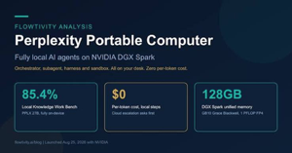
AI Updates
OpenAI launched an Apple Messages plugin for ChatGPT
It lets users connect their inbox to the chatbot for sorting, editing, deleting, and drafting or sending messages on their behalf
Promo clip shows ChatGPT suggesting follow-ups based on yesterday's inbound texts
Privacy questions came immediately: OpenAI told Bloomberg the plugin runs locally and "doesn't create an index of all someone's messages."
https://techcrunch.com/2026/08/20/chatgpt-can-now-send-texts-for-you-with-new-apple-messages-plugin/
Perplexity + Nvidia - Local AI Agent
Perplexity and Nvidia launched Portable Computer, a local-first version of Perplexity Computer for running agent workflows on compatible Nvidia GPU systems.
It packages models, inference, tools, connectors, security sandboxing, and the agent harness into one application rather than requiring a DIY local-AI stack.
Work begins locally, keeping files and inference on-device with no cloud-token charges; users can explicitly permit escalation to cloud frontier models.
Initial models include Qwen 3.8 27B and Perplexity’s post-trained PPLX 27B; Nemotron 3.5 Lightning is planned.
Linux support targets RTX GPUs with at least 24 GB VRAM, including RTX 3090-class hardware; Windows is planned next.
It supports Gmail, Google Drive, GitHub, and Slack.
https://venturebeat.com/infrastructure/perplexity-partners-with-nvidia-to-launch-portable-computer-a-fully-local-ai-agent-with-zero-token-costs

Slide 14


AI Updates
Habit-Hooks - Avoid Agent Slop
Coding agents can rapidly produce code, but unchecked output can compound technical debt into “slop”
Habit Hooks - turns linter JSON findings into targeted refactoring guidance, pairing a detected smell with advice on resolving its underlying design problem
https://github.com/habit-hooks/habit-hooks
This steers agents away from gaming metrics, such as merely splitting functions to satisfy line-count limits.
The goal is cohesive modules, clear naming, separation of concerns, and code that remains understandable for humans and agents.
A small independent evaluation reported that smell-specific guidance properly fixed issues in over 80% of cases, outperforming generic or metric-only prompts
FreeToken - Open Local Inference Engine
GLM-5.2, a 753B-parameter MoE, at 15 tok/sec on 96GB RTX PRO 6000
Qwen3.6-35B reaches 39 tok/sec on 8GB RTX 4060 laptop
Routing-aware caching and dynamically choosing CPU computation versus PCIe transfers for unavailable experts, rather than llama.cpp’s fixed layer split
FreeToken currently targets NVIDIA CUDA/Linux and remains beta; llama.cpp is far broader and more mature.
Best fit: recent NVIDIA hardware, ample RAM, and sustained MoE/agent workloads where tail latency matters
https://github.com/FlashML-org/FreeToken
https://arxiv.org/pdf/2608.16157
https://www.latent.space/p/ainews-10-worse-100x-cheaper-10000x
https://www.youtube.com/watch?v=Mlo16hrA5wQ

Slide 15

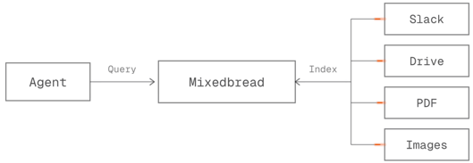
AI Updates
Mixedbread’s Toast 1 - AI Search Subagent
Retrieval-focused AI subagent for iterative search, reading, filtering, and evidence curation
It decomposes questions, runs multi-step searches, inspects sources, and returns a compact evidence package for a downstream model to reason over
Up to 12× lower latency and 10× lower cost
Prime Intellect reports Toast 1 plus GPT-5.6 Sol outperformed Claude Fable 5 by roughly 10 points on OfficeQA Pro V2 at 27% of the cost
It supports Mixedbread Search and other search backends via API, fitting document, Slack, PDF, legal, finance, and enterprise-RAG workflows
Pricing:
Toast 1 - $0.30 / $0.72 in/out per 1M tokens
Semantic search - $4 per 1K queries
($7.50 with re-ranking)
https://www.mixedbread.com
https://github.com/mixedbread-ai/toast-harness
https://www.mixedbread.com/blog/toast-1
https://www.primeintellect.ai/case-study/mixedbread

Slide 16


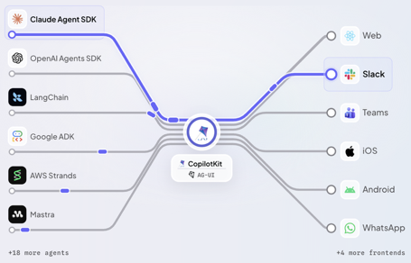
AI Updates
OpenBot: Self-Hosted AI Coworkers
OpenBot is an MIT-licensed, alpha-stage platform for running isolated AI coworkers
Each coworker can receive a separate browser, files, tools, credentials, and human-handoff workflow
A central policy gateway evaluates and records actions before allowing browser, file, or MCP activity
It supports AG-UI-compatible agent harnesses rather than bundling a specific model; bring your own model key
Deployment uses Docker and requires Bun plus a CopilotKit Intelligence project/license
Treat it as experimental: review policies carefully and avoid granting production credentials until security behavior is validated.
https://www.copilotkit.ai/openbot
https://www.copilotkit.ai
https://github.com/CopilotKit/openbot
https://x.com/ataiiam/status/2090125716767773120
https://www.youtube.com/watch?v=qJQzYj9Pw2k

Slide 17


Unsloth
Unsloth - Efficient LLM Training
"sloth" - slow (slow animal)
Unsloth is an open-source toolkit that speeds up and reduces GPU-memory use for training and running language models locally
(mostly used for single-GPU fine-tuning)
Founded in late 2023 by brothers Daniel and Michael Han, it focuses on efficient LoRA and QLoRA fine-tuning
Unsloth builds on PyTorch, adding specialized Triton kernels, hand-optimized gradient calculations, memory-efficient loss computation, and activation checkpointing.
Training math with less temporary GPU memory, allowing longer contexts or larger models on the same card.
https://unsloth.ai
https://github.com/unslothai/unsloth
https://unsloth.ai/blog/reintroducing
https://unsloth.ai/docs/basics/unsloth-benchmarks
https://unsloth.ai/docs/desktop
https://pytorch.org/blog/pytorch-ecosystem-landscape-q126/
https://www.youtube.com/@unslothai
https://www.youtube.com/watch?v=nWbZmJMWg6E
claims “same accuracy”, cut Cross-Entropy avoids materializing full vocabulary logits; “2× faster” and “70% less VRAM”.
sloth animal—a slow-moving, tree-dwelling mammal from Central and South America. Sloths spend much of their lives hanging in trees and mainly eat leaves.

Slide 18
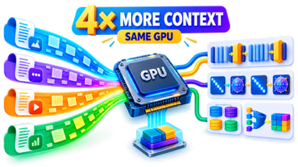

AI Updates
4x more Context from the same GPU
Modern models use less KV cache
Standard: 2 × layers × KV heads × head dim × bytes × tokens
Modern models have hybrid architectures. For example, Qwen uses 48 Gated DeltaNet layers and 16 full-attention layers; only the latter have token-growing KV state, potentially cutting that component by roughly 4×
Gemma 3 interleaves five 1,024-token sliding-attention layers with one global layer, so cache growth becomes lower
gpt-oss alternates 128-token sliding and full attention, uses 8 KV heads of dimension 64, and stores MoE projections in MXFP4
https://huggingface.co/Qwen/Qwen3.8-27B
https://github.com/ggml-org/llama.cpp
https://arxiv.org/html/2508.10925v1
https://developers.googleblog.com/gemma-explained-whats-new-in-gemma-3
https://www.youtube.com/watch?v=629J4G3aek4
Ornith 1.5 by by DeepReinforce - Self-Teaching AI
Open-weight agentic-coding models - 9B dense, 35B & 397B MoE
The 397B model is close to Claude Opus 4.8 on benchmarks
The 35B model prioritizes efficient inference
The 9B is a mobile variant
https://huggingface.co/ornith-ai/Ornith-1.5-397B
https://github.com/ornith-ai/Ornith-1
https://www.mindstudio.ai/blog/ornith-1-5-35b-a3b-benchmarks

Slide 19
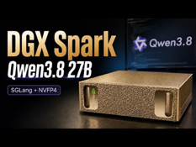

AI Updates
Qwen3.8-27B on 24GB RTX 3090
vLLM stack, power-capped at 250 W
Software tuning raises single-user throughput from roughly 46 to 133 tokens/s
Optimized batching reaches about 1,000 tokens/s across 64 requests
Key changes include W4A8 tensor-core compute, FP16 DeltaNet state, quantized embeddings, improved speculative decoding, and prompt-based copying
Quantization serves two roles: 4-bit weights make the model fit; 8-bit activations accelerate compute
Quality validation matters: an early INT8 kernel produced garbage despite excellent benchmark throughput
Trade-offs include version-specific patches, reduced multi-user latency, and weaker performance when every request has unique long context
https://github.com/syv-ai/qwen38-27b-rtx3090
https://syv.ai
https://www.youtube.com/watch?v=Nu0TsGmreRk
TurboFieldfare: SSD-streamed LLM
Runs Gemma 4 26B-A4B on Apple Silicon with roughly 2 GB resident memory by retaining its 1.35 GB shared core and KV cache, while streaming routed MoE experts from SSD.
- It reports 5.1–6.3 tokens/sec on an 8 GB M2 MacBook Air, demonstrating feasibility rather than conventional performance.
- Explicit parallel reads and a small expert cache beat memory-mapped page faults; the project’s key advantage is controlling I/O around expert routing.
- The “2 GB” figure is process footprint, not total system memory cost: macOS file cache can consume spare RAM.
- MLX remains much faster where RAM permits; TurboFieldfare’s value is enabling otherwise impractical models on fixed-memory Macs. [github](https://github.com/drumih/turbo-fieldfare)
https://turbo-fieldfare.dev
https://github.com/drumih/turbo-fieldfare
https://news.ycombinator.com/item?id=49098510
https://www.youtube.com/watch?v=TAUgUdWb51s

Slide 20




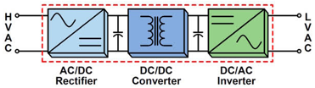
SST - Solid State Transformers
SST - High-Freq Solid State Transformers
Conventional transformers used in electric grids to convert 100-600 kV of 60Hz AC to lower levels
These massive transformers can be substituted by x100 times smaller SSTs operating at tens or hundreds of kilohertz
SSTS ALSO enable fast voltage regulation, bidirectional power flow, battery and solar integration, and direct DC connections for EV chargers, microgrids, and data centers
They remain more complex and expensive than traditional transformers, requiring power electronics, cooling, control software, filtering, and robust protection
Adoption is most likely first in specialized medium-voltage applications, rather than universal residential replacement.
https://www.mdpi.com/2079-9292/15/13/2839
https://www.powermag.com/the-solid-state-shift-reinventing-the-transformer-for-modern-grids/
https://www.epri.com/research/products/000000003002034220
High
Frequency
High Voltage
Low Voltage

Slide 21
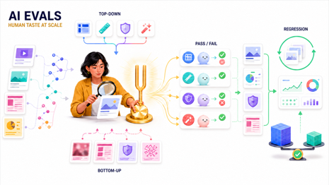
AI Evals
AI Evals: Human Taste at Scale
AI evals (short for evaluations) are systematic tests used to measure the quality, accuracy, safety, and performance of artificial intelligence models and applications.
Start evals from real outputs and traces, not an abstract checklist. Review failures before writing criteria
Split criteria into Top-down and Bottom-up:
Top-down: known task requirements, such as format, length, actionability, or policy compliance
Bottom-up: recurring flaws discovered by comparing generated outputs with human-approved results
AI can help cluster examples, build a review interface, identify repeated patterns, and draft rubric items - but humans supply the taste and product judgment
Prefer specific pass/fail checks over vague scores.
Examples: “uses sentence fragments,” “answers a sales objection,” or “contains required structure.”
Use separate LLM-judge passes or subagents for many criteria; one large prompt can overlook requirements.
Annotate outputs in context. For writing, flag issues directly in the draft; for agents, review end-to-end traces.
Turn validated patterns into regression tests, dashboards, CI checks, and production monitoring.
Automated eval tools find obvious problems but often miss domain-specific judgment calls and may produce false positives. Review their findings.
For podcast takeaways, compare generated drafts against your final human edits across many past episodes to discover high-value bottom-up evals.
Evals enable safe cost optimization: benchmark cheaper models, prompts, and workflows against the same rubric.
https://github.com/hamelsmu/error-discovery-skill
https://hamel.dev
https://evals.work
https://www.youtube.com/@peter_yang
https://www.youtube.com/watch?v=bdMHQLvtVaQ

Slide 22
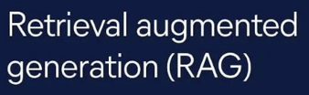
Modern RAG System Architecture
Task - Build a RAG service for millions of docs
Internal financial and legal documents, including PDFs, Office files, email archives, spreadsheets, web content, and scanned records.
RAG Architecture:
Store original files and immutable Docling JSON/Markdown derivatives in S3-compatible object storage. Content hashes enable byte-level deduplication; normalized derivatives allow re-chunking and re-embedding without reparsing originals.
Use PostgreSQL as the transactional system of record for document lineage, versions, ACLs (Access Control Lists), ingestion jobs, search indices, evaluations, and immutable query audit logs.
Enforce source-system permissions before retrieval ranking through SQL ACL filters and collection partitions. This prevents unauthorized chunks from entering candidate results and supports ethical-wall segregation.
Process born-digital documents through a fast extraction path;
route scans and complex layouts to Docling OCR/layout workers. Preserve headings, pages, slides, tables, notes, footnotes, and OCR confidence.
- Apply structure-aware chunks: 400–800-token narrative sections, one slide per presentation chunk, and header-preserving table or spreadsheet regions.
Combine BM25 lexical search with HNSW vector search using reciprocal-rank fusion, then optionally rerank candidates on internal GPUs. Broad questions first search document summaries; identifier and clause queries search chunks directly.
Require page-, slide-, section-, or table-level citations tied to an exact document version. The agent abstains when evidence is insufficient or contradictory.
Target 20–25 million indexed chunks, retrieval p95 below 1.5 seconds, Recall@20 of at least 88%, citation faithfulness above 92%, and zero permission leaks.
Begin with a 500,000-document pilot, then scale through staged backfill and governance reviews. Introduce external search infrastructure only above 50 million chunks or after measured latency/write-churn failures.
https://www.postgresql.org
https://github.com/pgvector/pgvecto
https://github.com/docling-project/docling
https://docling.ai

Slide 23
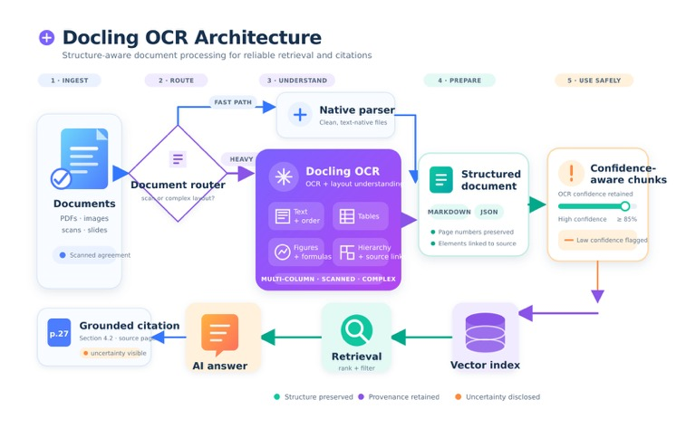
Modern RAG System Architecture

Slide 24
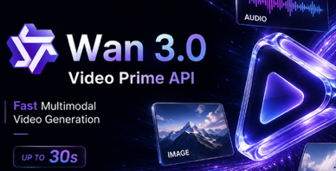
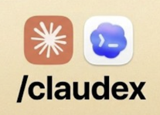
AI Updates
Alibaba Wan 3.0: Document-to-Video AI
A closed, API-hosted video model in public beta, available through Qwen Cloud and Alibaba Cloud Model Studio.
It can generate up to 30-second videos with native audio in a single pass, at 480p, 720p, or 1080p—not native 4K.
Its Omni Reference workflow accepts mixed source material, including PDFs, presentations, spreadsheets, web pages, images, video, audio, and text.
This enables a practical “document-to-video” workflow: upload a deck or report, specify the desired tone, then review and refine the result.
Claims of universally open access, open weights, or high production throughput need caution: reported beta access and rate limits have varied.
https://www.qwencloud.com/models/wan3.0-video
https://www.alibabacloud.com/help/en/model-studio/models
https://github.com/Wan-Video
https://www.atlascloud.ai/blog/tips/wan-3-0-preview
Claudex Loop Skill for Dual Model Work
Claudex Loop is a Claude Code skill that separates planning, implementation, and evaluation across Claude and Codex
It uses four phases: reconnaissance/research, structured interrogation, adversarial plan review, and cross-model building with code verification.
Codex reviews Claude’s plan in a read-only sandbox, returns specific issues, and the models iterate until approval or a configurable loop limit.
A fresh reviewer session checks the finished implementation against the approved specification, reducing self-review bias and catching edge cases.
It supports new projects and major features, with tunable review limits and optional model-role reversal
https://github.com/chaseai-yt/claudex-loop
https://github.com/promptadvisers/claudex
https://onexiang.cc/en/skills/claudex-loop
https://www.youtube.com/watch?v=rZQDZWayzNo

Slide 25
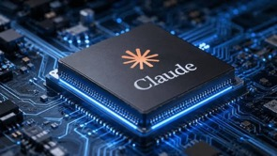
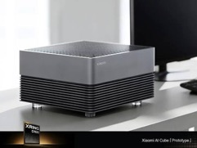
AI Updates
Anthropic in-house silicon team for custom Claude chips
Hiring experienced “shipped silicon” engineers at $320,000–$485,000
Custom chips are likely a long-term efficiency and inference-cost strategy, not an imminent replacement for rented accelerators.
https://www.youtube.com/watch?v=PgJ2i7TtnkY
Xiaomi Aluminum AI Cube
A prototype, not a released DGX Spark rival
Uses wafer-on-wafer stacking to achieve dramatically wider memory-to-compute path
https://www.guru3d.com/story/xiaomi-ai-cube-uses-three-xring-chips-and-lpddr6-memory/
https://www.mi.com
https://github.com/XiaomiMiMo
https://www.reuters.com/world/china/xiaomi-launches-new-xring-chip-partners-with-tsmc-production-sources-say-2026-08-24/
https://www.youtube.com/watch?v=H0CJAlVjhDo

Slide 26
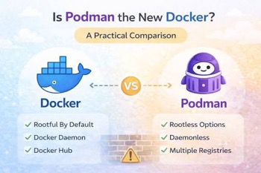
AI Updates
Podman vs Docker
Both build and run containers using familiar Dockerfile workflows
Docker offers the broadest ecosystem, polished Docker Desktop experience, and widespread Compose/tooling compatibility
Podman is daemonless - does not require one long-running central background service - such as Docker’s dockerd. Podman starts and manages container-related processes directly. A running container can continue independently of the podman CLI invocation
Podman supports rootless containers - run under an ordinary, unprivileged Linux user account instead of requiring host root access or sudo
Podman’s CLI is largely Docker-compatible
https://podman.io , https://www.docker.com
https://github.com/containers/podman
https://github.com/moby/moby
https://oneuptime.com/blog/post/2026-03-18-choose-between-podman-and-docker/view

Slide 27
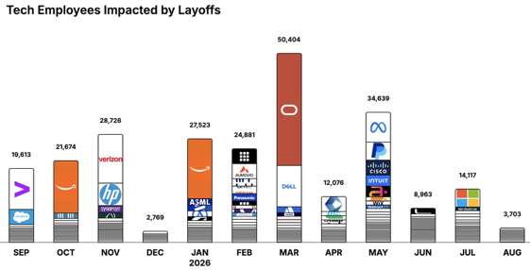
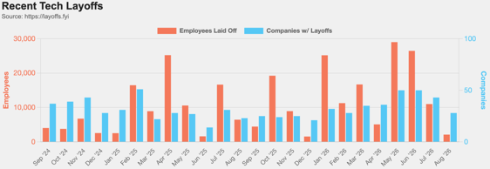
https://layoffs.fyi
https://trueup.io/layoffs
Jobs
The Tech Layoff Tracker
In 2026: 176,306 people laid off (757 per day)
In 2025: 245,953 people laid off (674 per day)
In 2024: 238,461 people laid off (653 per day)
https://trueup.io/layoffs
Tech Layoffs by year (US only):
  127K in 2026 (as of August 20, 2026)
  124K in 2025
  153K in 2024
  264K in 2023
  165K in 2022 https://layoffs.fyi

Slide 28


About the Speaker
Lev Selector, Ph.D.
40+ years of software engineering, data science, and building teams (hiring, training, and managing)
Ph.D. in mathematical modeling and computer simulations
Interests:
Generative AI, Using LLM with your data
Local AI for Local Private Data
Cloud architecture, fin-tech, application security
Find/connect: Linkedin, GitHub, YouTube, Google
https://eais.ai
Enterprise AI Systems

Slide 29
Thank You!

