Slide 1
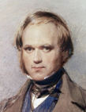
AI Updates - Mar 27, 2026
"It is not the strongest of the species that survives, nor the most intelligent, but the one most responsive to change." — Charles Darwin
Crowd-sourced "LM Arena" Leaderboard
Andrej Karpathy Interview
Anthropic Claude Code Channels
Claude Cowork Projects
Claude now covers 90% of OpenClaw Use Cases
Claude Code "Auto-Mode" setting
Claude Remote Control & Dispatch
Claude Desktop Computer Use & Min Browser
Boston Dynamics Robots for Manufacturing
Siraj Raval - Build Your Personal Agent
BlinkClaw cloud agent (digital employees) platform
Perplexity Health
OpenAI $110B funding at a $840B valuation
DeepSeek's Engram
Anthropic AutoDream feature for Claude
Meta's Hyperagents - Self-modification
OpenClaw Nerve Dashboard
Claude AI + Obsidian = Your Own JARVIS
Hermes Agent by News Research - Self-improving
Claude + Collaborator
I Made Claude My Co-Founder
Claude Chrome Extension
LightLLM Compromize
Anthropic vs US Government
Xiaomi MiMo-V2-Pro - Foundation Model
Google Gemini 3.1 Ultra - 2M window, multimodal
OpenClaw Updates
Manus's "My Computer" Feature
Microsoft MAI-Image-2 text-to-image AI model
CLI tools
AI Tokens as a New Employee Bonus
OpenAI Shuts Down Sora AI video generation app
Tesla TeraFab
TradingAgents
AI on Databricks platform
Google Stitch - Free AI UI Vibe Design
Jobs, Layoffs, demand for AI Engineers

Slide 2
"LM Arena" Leaderboard
Data for March 26
Starting Elo rating = 1000
https://en.wikipedia.org/wiki/Elo_rating_system
English - https://lmarena.ai/leaderboard/text
Coding - https://lmarena.ai/leaderboard/text/coding
■ | Claude
■ | Gemini
■ | OpenAI
■ | Open Source
deepseek-v3.2 - 671B
ernie-5.0 - 2.4T
glm-5.0 - 744B
kimi-k2.5-thinking - 1T
qwen3.5-397B
Xiaomi MiMo-V2-Pro - 1T+
Code | Model | Score
■ | claude-opus-4-6-thinking | 1504
■ | claude-opus-4-6 | 1500
■ | gemini-3.1-pro-preview | 1493
■ | grok-4.20-beta1 | 1491
■ | gemini-3-pro | 1486
■ | gpt-5.4-high | 1484
■ | grok-4.20-beta-0309-reasoning | 1483
■ | gpt-5.2-chat-latest-20260210 | 1480
■ | gemini-3-flash | 1474
■ | claude-opus-4-5-20251101-thinking-32k | 1474
■ | grok-4.1-thinking | 1471
■ | claude-opus-4-5-20251101 | 1468
■ | gpt-5.4 | 1466
■ | qwen3.5-max-preview | 1465
■ | gpt-5.3-chat-latest | 1464
■ | gemini-3-flash (thinking-minimal) | 1463
■ | claude-sonnet-4-6 | 1463
■ | dola-seed-2.0-preview (ByteDance) | 1463
■ | grok-4.1 | 1461
■ | glm-5 | 1456
■ | gpt-5.1-high | 1455
■ | gpt-5.4-mini-high | 1454
■ | kimi-k2.5-thinking | 1454
■ | claude-sonnet-4-5-20250929-thinking-32k | 1453
■ | claude-sonnet-4-5-20250929 | 1453
Code | Model | Score
■ | claude-opus-4-6-thinking | 1557
■ | claude-opus-4-6 | 1548
■ | gemini-3.1-pro-preview | 1537
■ | gpt-5.4-high | 1533
■ | claude-opus-4-5-20251101-thinking-32k | 1531
■ | grok-4.20-beta1 | 1526
■ | grok-4.20-beta-0309-reasoning | 1525
■ | gpt-5.2-chat-latest-20260210 | 1522
■ | claude-sonnet-4-6 | 1522
■ | claude-sonnet-4-5-20250929-thinking-32k | 1520
■ | gemini-3-pro | 1519
■ | claude-opus-4-5-20251101 | 1517
■ | gpt-5.3-chat-latest | 1515
■ | claude-opus-4-1-20250805-thinking-16k | 1513
■ | claude-sonnet-4-5-20250929 | 1510
■ | qwen3.5-max-preview | 1510
■ | mimo-v2-pro (Xiaomi) | 1510
■ | dola-seed-2.0-preview (ByteDance) | 1510
■ | gemini-3-flash | 1510
■ | gpt-5.4 | 1510
■ | kimi-k2.5-thinking | 1509
■ | claude-opus-4-1-20250805 | 1506
■ | kimi-k2.5-instant | 1506
■ | gpt-5.4-mini-high | 1504
■ | grok-4.1-thinking | 1504
https://lmarena.ai/leaderboard/text
Design Arena - https://www.designarena.ai
https://openlm.ai/chatbot-arena/
https://beta.lmarena.ai
Web Leaderboard - 1T params https://web.lmarena.ai/leaderboard
LLM Leaderboard - by @LlmStats - https://llmworld.net/llm_leaderboards/
LLM Leaderboard - by StackAI - https://www.stack-ai.com/llm-leaderboard
LLM Leaderboard - by Artificial Analysis - https://artificialanalysis.ai/leaderboards/models
Open LLM Leaderboard - by Hugging Face - https://huggingface.co/open-llm-leaderboard
LLM Leaderboard - by Vellum - https://www.vellum.ai/llm-leaderboard
AI Benchmarking Hub - https://epoch.ai/data/ai-benchmarking-dashboard
Grok 4 Benchmarks - https://artificialanalysis.ai/models/grok-4
Image arena (alibaba) - http://aiarena.alibaba-inc.com/corpora/arena/leaderboard?arenaType=T2I
image arena - https://lmarena.ai/leaderboard/text-to-image

Slide 3
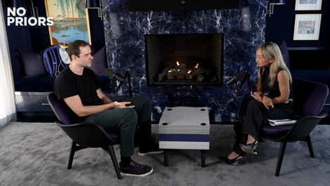
Andrej Karpathy Interview
Code Agents, AutoResearch, and the Loopy Era of AI
https://www.youtube.com/watch?v=kwSVtQ7dziU
In this episode of the No Priors podcast, Andrej Karpathy discusses the transition from manual coding to the "agentic era."
He describes a state of "AI psychosis," where he now spends his time delegating high-level intent to autonomous agents rather than writing lines of code.
AutoResearch: Karpathy introduces his project where agents autonomously design and run AI experiments, finding optimizations that human researchers - overlook.
The "Claw" Concept: He describes persistent, looping agent harnesses that manage complex tasks, such as his "Dobby" agent that hacked and unified his entire smart home system.
Future of Work: Karpathy envisions a "swarm" of untrusted global compute collaborating on research, suggesting that while the digital world will transform at light speed, physical robotics will lag due to the complexity of "atoms."
Education: He predicts a shift where humans explain concepts to agents, which then provide personalized, infinitely patient tutoring to students.

Slide 4
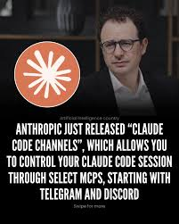
Anthropic Claude Code Channels
Anthropic Claude Code Channels (in "Research")
Use Telegram or Discord to interact with Claude Code AI agent
This mirrors how OpenClaw works
You can send text messages to Claude from your phone - and receive back notifications
It turns your terminal-based AI agent (Claude Code) into an "always-on" assistant that you can "text" with
A "Channel" is technically a specialized Model Context Protocol (MCP) server. It acts as a two-way bridge between an external service and your active Claude Code session
Inbound: When you send a message via Telegram or Discord, it is pushed into the active Claude Code session as an event.Outbound: Claude can use its internal tools to execute commands, fix bugs, or run tests, and then reply back to you through that same message thread
/plugin install telegram@claude-plugins-official
/telegram:configure <your_bot_token>
claude --channels plugin:telegram@claude-plugins-official
Pairing: Send a message to your bot; it will give you a code to enter in the terminal to verify your identity

Slide 5
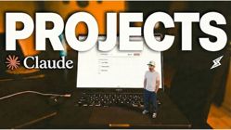
Anthropic Claude Cowork Projects
Claude Cowork Projects
https://www.youtube.com/watch?v=4CiCwvAA5FI
Projects function as dedicated workspaces with their own files, persistent memory, instructions, skills, and scheduled tasks
Example - using projects for specific business areas like YouTube content creation, where Claude remembers brand voice, upload schedules, and performs automated competitor analysis
Projects can be enhanced with memory features, web connectors, and integration with other apps.
Claude Code "Auto-Mode" setting
A built-in "classifier" robot checks every action before Claude executes it - and blocks only "unsafe" operations. Thus user doesn't have to "approve" dozens of times. And it is safer than the old "skip permissions" mode
Toggle "Allow auto permissions mode" in settings, and run the command claude enable auto mode in the terminal
Currently available for Claude Team Plan users, with Enterprise and API access rolling out shortly after
Claude vs OpenClaw
Anthropic recently added Claude features which closely mirror OpenClaw - persistent desktop automation, computer use (navigating apps and browsers like a human), mobile task delegation via the Claude app, and integrations with Slack, Google Workspace, and Notion - all without complex setup. This covers 90% of his OpenClaw use cases with far less security risk
OpenClaw remains relevant: it's free, open-source, works with any LLM, runs on Linux/Mac/Windows, and builds deep personalized memory
Claude's version is sandboxed, beginner-friendly, and Mac-only for now - a safer but less flexible alternative
3 Claude Code Hacks:
https://www.youtube.com/shorts/tQuinn9FpMA
/hook I want you to create a sound when you finish a task
/statusline create status line to include ...
/skill-creator create a skill that humanizes AI-generated text
Remote Control - for Claude Code
Dispatch - for Claude Cowork Desktop app

Slide 6
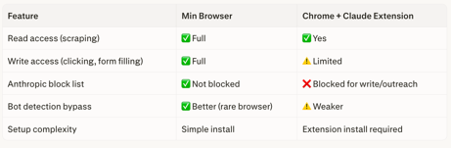
Claude Desktop Computer Use
Min Browser
Anthropic's computer use feature
It makes screen snapshots - and controls keyboard and mouse to take over browser and applications
Anthropic has a "block list" for certain actions in the browser implemented for major browsers (Chrome, Firefox, Safari, Edge). The workaround is to use a less popular light weight open source browser (like "Min Browser" - minbrowser.org) which is not on Anthropic's block list
Once Claude's computer use is enabled in Claude Desktop's settings (under General → Browser Use + Computer Use), you direct it via the Co-work tab by prepending requests with "computer use."
Claude then opens Min Browser, where a yellow outline visually confirms it has taken control.
It operates by taking rapid screenshots and then physically moving your mouse and typing via your keyboard — mimicking genuine human interaction
You can intervene at any time to make minor adjustments without breaking the workflow
This human-like behavior is exactly what bypasses bot-detection on platforms like LinkedIn, Instagram, and Facebook, which normally block traditional browser automation scripts.
Min Browser - open source, not blocked by Claude
https://minbrowser.org
https://github.com/minbrowser/min
https://www.youtube.com/watch?v=2u93VTYvG5U
The core difference is that Anthropic intentionally restricts Chrome (and Safari, Firefox, Edge) from performing outreach-style write actions - like sending LinkedIn connection requests or filling out forms. The Claude Chrome extension enables some browser control, but it won't let you do the automation tasks shown in the video.
Min Browser bypasses that restriction entirely, giving Claude unrestricted read and write access

Slide 7
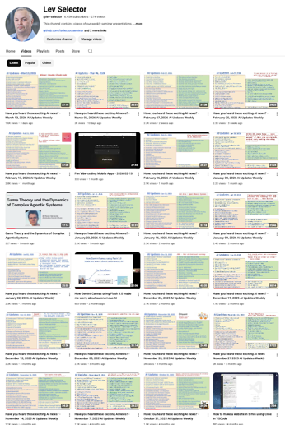
We do these weekly videos every Friday
Stats: 6.49K subscribers, 276 videos
1. Subscribe to this channel https://www.youtube.com/@lev-selector
2. Download slides from GitHub using links under the videos
3. Please pause the video - and answer the pinned question in comments under the video

Slide 8


Anthropic vs US Government
On March 24, 2026, a federal judge in San Francisco heard Anthropic's request to block the Pentagon's "supply chain risk" blacklisting of the company
On March 25 Judge Rita Lin issued a 43-page preliminary injunction ruling in Anthropic's favor. She blocked the Trump administration from enforcing the presidential directive banning federal agencies from using Claude, and halted the Pentagon's "supply chain risk" designation.
She wrote that "there is nothing in the relevant statute that supports the dystopian idea that a U.S. company can be labeled as a potential enemy and saboteur for dissenting with the government"
The ruling is not yet in full effect - Judge Lin put it on hold for one week to give the Justice Department time to appeal
Claude Mythos - Anthropic's most powerful AI model yet, accidentally leaked on March 26, 2026 due to a misconfigured data cache
It introduces a new top-tier model tier called Capybara, surpassing Opus
It dramatically outperforms previous Claude models in coding, reasoning, and cybersecurity benchmarks
It's currently in limited early access, restricted to cyber defense organizations, with no public release date announced
https://fortune.com/2026/03/27/anthropic-data-leak-reveals-powerful-secret-mythos-ai-model/

Slide 9
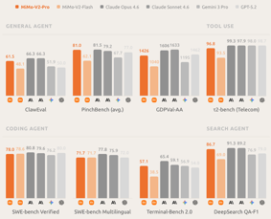
AI Updates
Xiaomi MiMo-V2-Pro - Foundation Model
https://mimo.xiaomi.com/mimo-v2-pro
Released March 18, via API
MoE: 1T+ total, 42B active
Context window 1M tokens
API Pricing $1/$3 per 1M in/out (≤256K); $2/$6 (256K–1M)
The smaller MiMo-V2-Flash was released with open weights (MIT)
Scores high on benchmarks, (between Kimi K2.5 and GLM-5)
Coding performance reportedly surpasses Claude 4.6 Sonnet
Google Gemini 3.1 Ultra with native multimodal reasoning and a 2M token context window
Gemini hit 750 million active users
Users can import chat history from ChatGPT into Gemini
Google TV + Gemini (visual help, deep dives, sports briefs)
Google confirmed it's exploring ads inside the Gemini interface as AI responses reduce traditional search traffic

Slide 10

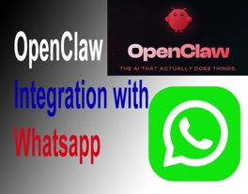
OpenClaw Updates
https://github.com/openclaw/openclaw - 338K
https://github.com/openclaw/openclaw/releases
3.22 - major release with many breaking changes: removed legacy Chrome extension relay, "nano-banana-pro" skill, old clawdbot / moltbot related names, Added ClawHub native install flows, new plugin SDK (`openclaw/plugin-sdk/*`), SSH/OpenShell sandbox backends, bundled Exa/Tavily/Firecrawl web-search plugins, Anthropic Vertex support, and new Matrix plugin
3.23 - Patch release. Added Qwen/DashScope pay-as-you-go endpoints and UI/accessibility improvements (Knot theme). Fixed plugin runtime bundling, ClawHub auth on macOS, OpenAI token credential reversion, Mistral 422 errors, agent web_search provider selection, and Chrome MCP stability issues
3.24 - adds Microsoft Teams SDK migration with streaming, Docker/Podman container support, a redesigned Skills panel UI, overhauled Slack interactive replies, a new agent /tools page, and multi-platform messaging reliability improvements across Teams, Slack, Discord, Telegram, and WhatsApp.
Using WhatsApp with OpenClaw for multiple threads
You can create multiple WhatsApp group chats — one per project — since each group gets its own isolated session
Alternatively, you can configure multiple OpenClaw agents, each tied to a different WhatsApp number, for stricter separation with distinct tools and workspaces
For quick task switching within a single chat, commands like /new or /reset start a fresh context on demand
It is also recommended to use a dedicated WhatsApp number for OpenClaw rather than your personal one
ClawFlows, a free workflow system for OpenClaw
https://www.youtube.com/watch?v=BeeKm5x3UMU
Provides 111 pre-built automations for productivity, health, home automation, meal planning, and business tasks
The system personalizes recommendations based on OpenClaw's memory of user preferences and creates scheduled tasks like morning briefings, habit tracking, and social media posting

Slide 11


AI
Manus's "My Computer" Feature
This AI agent runs local LLM on your machine (no cloud needed)
It can read, edit, and organize your local files, open applications, and execute terminal commands
Manus has full operating system access, allowing it to perform tasks like building a Mac app from scratch via the terminal
You can send tasks from your mobile phone
Security & Control - it requires manual approval for every command before it is executed
Examples - organizing thousands of messy files, renaming them, and tagging them; Building applications, running CLI commands
Setting up workflows that run on your machine even when you aren't actively using it
Trend - local AI agents, moving from the cloud to the OS
https://www.youtube.com/watch?v=Pysh7jiZ0h8
Microsoft MAI-Image-2 text-to-image AI model
https://microsoft.ai/news/introducing-mai-image-2/
Ranking #3 on the Arena.ai leaderboard, behind Google and OpenAI
Enhanced photorealism, reliable in-image text rendering, rich cinematic scene generation
Available now on MAI Playground and rolling out to Copilot and Bing Image Creator; API access open to select enterprise partners, with broader Microsoft Foundry availability coming soon.

Slide 12



AI
CLI tools
1. CLI Anything - https://github.com/HKUDS/CLI-Anything
2. NotebookLM CLI - https://github.com/teng-lin/notebooklm-py
3. Stripe CLI - https://github.com/stripe/stripe-cli
4. FFmpeg - https://github.com/FFmpeg/FFmpeg
5. gh (GitHub CLI) - https://github.com/cli/cli
6. Supabase CLI - https://github.com/supabase/cli
7. Vercel CLI - https://github.com/vercel/vercel
8. Playwright CLI - https://github.com/microsoft/playwright-cli
9. LLMFit - https://github.com/AlexsJones/llmfit
10. Google Workspace - https://github.com/googleworkspace/cli
AI Tokens as a New Employee Bonus
Tech firms (like Nvidia) now offer engineers not just salary, benefits, and bonuses - but also tokens ($100K+ in tokens)
https://techcrunch.com/2026/03/21/are-ai-tokens-the-new-signing-bonus-or-just-a-cost-of-doing-business/
OpenAI Shuts Down Sora AI video generation app
Reasons: Cost and resource strain; Narrowing focus toward capital investment, chips, and enterprise solutions; Weak user interest; Criticism for hosting harmful content
OpenAI has shutdown Sora iOS app and Sora.com, API, and video generation in ChatGPT, and has disovled teir deal with Disney

Slide 13
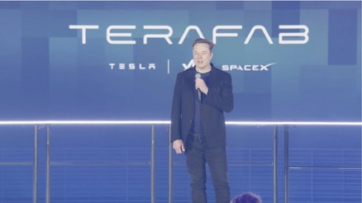
Tesla TeraFab
Tesla TeraFab
Tesla has been designing its own AI inference chips for Full Self-Driving (FSD) since 2019, when it transitioned away from NVIDIA hardware
The FSD Chip are custom-built to run Tesla's neural networks for autonomous driving
Tesla has historically relied on TSMC and Samsung to manufacture them - but this will change with the new TeraFab
TeraFab will be built at Tesla's facility in Austin, Texas. Planned investment $20-25 Bln. The facility will do logic, packaging, testing, lithography mask production, and chip evaluation all under one roof.
TeraFab will produce two chip variants:
Edge inference chips - for cars and robots
Space-hardened chips - for SpaceX satellites
Musk targets a staggering output of 100–200 GW of terrestrial AI compute per year, with up to 1 terawatt** destined for space-based AI on solar-powered satellites. For context, the entire global AI compute output today is roughly 20 gigawatts.
https://www.investors.com/news/tesla-stock-elon-musk-tesla-spacex-terafab-project/

Slide 14
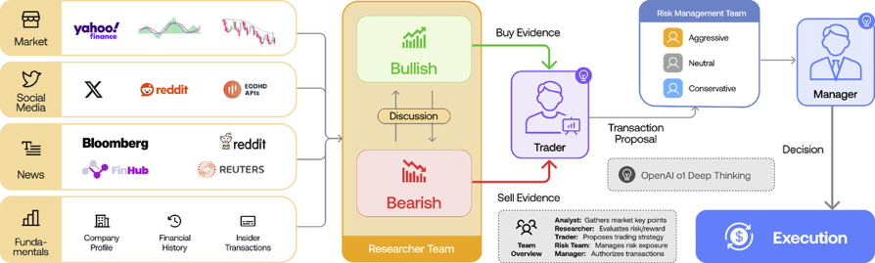
TradingAgents
TradingAgents: Multi-Agents LLM Financial Trading Framework
Open Source, from US (UCLA/Los Angeles project)
https://tradingagents-ai.github.io/
https://arxiv.org/abs/2412.20138
https://github.com/TauricResearch/TradingAgents
https://x.com/heynavtoor/status/2035199111872618555
TradingAgents is utilizing multiple LLM-powered agents with specialized roles such as fundamental, sentiment, and technical analysts, as well as traders with diverse risk profiles
The system features Bull and Bear researchers evaluating market conditions, a risk management team overseeing exposure, and traders integrating insights from debates and historical data to make informed decisions
This collaborative, dynamic environment enhances trading performance, as demonstrated by our comprehensive experiments showing significant improvements in cumulative returns, Sharpe ratio, and maximum drawdown compared to baseline models
Our results highlight the effectiveness of multi-agent LLM frameworks in financial trading.

Slide 15
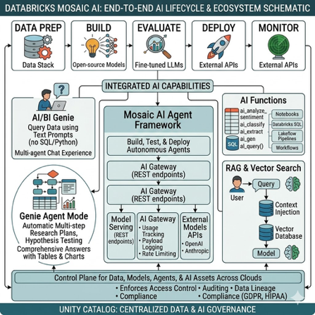
AI on Databricks platform
Mosaic AI - full AI lifecycle - from data prep to model deployment
Building, evaluating, deploying, and monitoring AI applications, whether you're using open-source models, fine-tuned LLMs, or external APIs
https://docs.databricks.com/aws/en/machine-learning/
AI/BI Genie - query data using text prompts (no SQL or Python)
Genie Agent Mode - automatically generates and executes multi-step research plans, tests hypotheses, and delivers comprehensive answers with tables and charts
Databricks One - UI for multi-agent chat experience powered by Genie
AI Functions - built-in SQL functions that apply AI models directly to your data in notebooks, Databricks SQL, Lakeflow pipelines, and Workflows. Examples - ai_analyze_sentiment, ai_classify, ai_extract, ai_fix_grammar, ai_gen, ai_query() - call any model (foundation models, external LLMs, or your own custom ML models)
Mosaic AI Agent Framework - build, test, and deploy autonomous agents that can reason over tasks, use tools, and work with your organization's data in a governed environment: Model Serving (REST endpoints), AI Gateway with usage tracking, payload logging, and rate limiting; External Models APIs (OpenAI, Anthropic, etc.)
RAG & Vector Search
Data Governance with Unity Catalog - control plane for all data, models, agents, and AI assets across clouds. It enforces access control, auditing, and data lineage — critical when using sensitive enterprise data with AI applications and staying compliant with GDPR and HIPAA

Slide 16

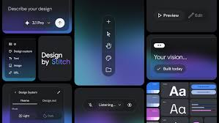
Google Stitch - Free AI UI Vibe Design
Google Stitch - Free AI UI Vibe Design
https://stitch.withgoogle.com
Accepts natural language prompts, hand-drawn sketches, or screenshots into high-fidelity web and mobile interface designs
Rapid prototyping UIs, Powered by Google's Gemini
May 2025 - first intro, Dec 2025 - major update
March 17–18, 2026 - update transformed Stitch into a full "AI-native design canvas", introducing a complete UI redesign with new features
https://blog.google/innovation-and-ai/models-and-research/google-labs/stitch-ai-ui-design/
Infinite AI-native canvas - text, images, and code
New design agent + Agent Manager - reasons across an entire project's history and lets you run multiple design directions in parallel
DESIGN.md - an agent-friendly markdown file for exporting / importing design systems to/from other tools, including coding tools
Interactive prototypes - stitch screens together and click "Play" to instantly preview app flows; AI auto-generates logical next screens
Voice control - speak to canvas for real-time critiques and design updates
MCP server & SDK - lets Stitch connect to developer tools like AI Studio for seamless design-to-code handoffs
Figma remains the gold standard for production-level work requiring fine-grained control, team collaboration, and developer handoff
Tools like v0 and Bolt.new sit closer to the code side, while Stitch bridges design and code without requiring deep expertise in either
Stitch's biggest limitation remains its tendency to default to Material Design components, making it less ideal for iOS-focused products.

Slide 17

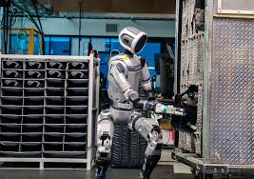
Boston Dynamics Robots for Manufacturing
Why Boston Dynamics' New Atlas is Years Ahead of Tesla
https://www.youtube.com/watch?v=ll784fIsQew
History of financing:
Google - viewed it as a software platform, no hardware infrastructure
SoftBank - teated it as a financial investment/IPO play
Hyundai - realized that the most expensive parts of a robot, actuators, are 60% similar to automotive electric power steering units. Since Hyundai already produces these by the millions, they could scale production and ensure reliability in a way a tech company or investment firm never could
The new electric Atlas (replacing the old hydraulic version) is designed for the "human world" but with superhuman capabilities:
360-Degree Movement
Industrial Strength, water and dust resistant, can operate from -4 to 104°F;
Endless Operation - robot can swap its own battery in 3 minutes without human help
Uses Google DeepMind’s Gemini for logic language, and Toyota Research Institute tech for "one-shot" learning
Aiming for a higher price ($200K) - but reliability, no mistakes, 24/7 operations, 10 years durability
The 2026 production run is already sold out at $200K/unit
Hyundai is investing $26 Bln into U.S. manufacturing, including a dedicated factory aiming to produce 30K units per year by 2030.
Tesla focuses on a "robot for every home," at $20K price

Slide 18
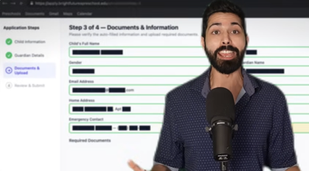

Siraj Raval - Build Your Personal Agent
50 days ago, I gave my AI a name (Aurelion) and a personality
Today he manages 130+ parts of my life. Emails. Calendar. Groceries. Government forms. Phone calls. Sponsor deals. All from a single WhatsApp conversation.
Aurelion runs 24/7 for about $300/month. He texts me a morning brief at 5 AM. He drafts replies to my inbox while I sleep. He ordered groceries last Tuesday while I was at the park with my son.
Tutorial to build the agent:
Week 1 Your AI is live and talking to you
Week 2 Connected to WhatsApp with voice commands
Week 3 Managing your email and calendar
Week 4 Browsing the web, ordering groceries, filling forms
Week 5 Long-term memory that grows smarter every day
Week 6 Phone calls, production hardening, custom skills
By week 6, you'll have a production AI agent running your life from your phone. Cost - $199
https://www.youtube.com/watch?v=g8Zs12L2kVU
BlinkClaw cloud agent (digital employees) platform
https://blink.new/claw
180+ AI models, zero setup
business-ready AI workforce with zero infrastructure overhead, especially for automating email, CRM, Slack, and LinkedIn workflows without touching API keys or servers

Slide 19


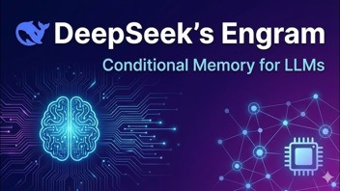
Misc AI Updates
Perplexity Health - integrates with Apple Health (iPhone and iPad) and platforms including Fitbit, Ultrahuman, Withings, and Clue. Can build personalized fitness and nutrition plans. Health data is not used to train AI models or sold to third parties
OpenAI announced a $110 Bln funding round at a $840 Bln post-money valuation (50-Amazon, 30-Nvidia, 30-Softbank) on Feb 26–27. The round remains open. This is the largest ever private tech fundraise.
DeepSeek's Engram - Conditional Memory for Transformers
Engram is a new architectural block that adds conditional memory to transformers, sitting alongside traditional attention and feedforward layers
Instead of recomputing familiar multi-token phrases at runtime, Engram acts like a lookup table, recognizing common patterns and instantly retrieving pre-stored representations via hash-based lookups with contextualized gating
Studies show models reach final predictions earlier in the network, ffectively gaining functional depth without adding layers

Slide 20



AI Misc
Anthropic AutoDream feature for Claude that automatically consolidates and cleans memory files using a background sub-agent
https://www.youtube.com/watch?v=LrgfmZkl3nc
AutoDream periodically reviews chat sessions, prunes unnecessary information, and organizes memory files to reduce bloat and improve recall
The feature runs automatically based on time intervals or session counts, touching only memory files while leaving code untouched.
Users can enable it through the /memory interface and manually trigger it with /dream feature command (Piebald)
"Hey, I want to create a new skill. I want it called dream. Use this to build it. ...".
AutoDream works alongside existing auto-memory features to create a three-layer memory system that maintains cleaner, more focused context across sessions, reducing repetition and making Claude feel more like a human assistant with organized long-term memory rather than a forgetful chatbot.
Screen Pipe - free open-source AI memory
works with Claude Code
Records screen and audio locally
https://www.youtube.com/watch?v=8eustEguF9Q
The tool analyzes what you're working on, tracks time spent on tasks, and recommends high-value, low-effort automations tailored to your specific needs
Piebald /dream feature command
https://piebald.ai
https://www.youtube.com/shorts/2chQzrrGfUw
https://github.com/Piebald-AI
https://github.com/Piebald-AI/claude-code-system-prompts
https://github.com/Piebald-AI/claude-code-system-prompts/blob/main/system-prompts/agent-prompt-dream-memory-consolidation.md

Slide 21


Meta's Hyperagents - Self-modification
Meta's Hyperagents are a new class of self-referential AI systems introduced by researchers from FAIR at Meta and Meta Superintelligence Labs (alongside academic partners) in March 2026
Built as an extension of the Darwin Gödel Machine, they enable metacognitive self-modification - meaning they don't just improve at tasks, they also rewrite the very process that generates those improvements
The meta-level mechanism is fully editable, not fixed
Tested across coding, paper review, robotics reward design, and Olympiad-level math grading, Hyperagents achieved transferable performance gains where prior systems scored zero
OpenClaw Nerve Dashboard
It replaces complex terminal setups with a clean, user-friendly dashboard that features a Trello-like Kanban board for task organization, a file manager, and a proposal inbox where users can approve agent actions
Key highlights include a voice mode powered by Whisper, the ability to easily manage fleets of sub-agents with specific models and "thinking levels", and real-time editing of agent memory and context.
Installation is quick, requiring only a GitHub link to be pasted into the OpenClaw gateway
https://www.youtube.com/watch?v=mGFlD40FFwM

Slide 22
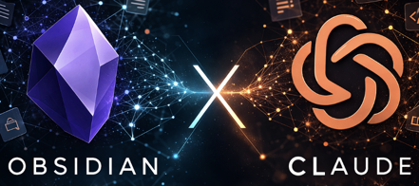
Misc
Claude AI + Obsidian = Your Own JARVIS
https://www.youtube.com/watch?v=UHLagfG2nJE
Obsidian stores all your notes, research, and business information locally on your computer as plain text files, while Claude can access this entire knowledge base for context-aware responses.
The setup involves creating an Obsidian vault, organizing folders for clients/projects, installing Claude Code, and creating a "Claude.md" briefing file.
This creates continuity between sessions, allowing Claude to understand your business, remember previous work, and provide more relevant outputs.
The system costs around $20 monthly and becomes more powerful over time as you add more information, essentially creating a knowledgeable AI assistant that knows your specific context and work.
Claude + Collaborator
https://www.youtube.com/watch?v=RJWbk-4JvLU
Collaborator is a free Mac desktop app that allows you to run multiple AI agent teams, particularly Claude instances, working together on a single project through an organized canvas interface
The app lets you open different terminals where each Claude agent can focus on specific tasks like UI improvement, design, or copywriting, all within the same project folder.
Unlike using regular terminals which can be messy, Collaborator provides a clean dashboard where you can orchestrate multiple agents simultaneously and see their work in real-time through live previews.
The app also supports browser tiles for web browsing and can potentially work with other AI models like OpenClaw.
Hermes Agent by News Research
https://www.youtube.com/watch?v=d7TABYDHSE8
Hermes Agent has a self-improving capability - it learns and remembers from each interaction, building a skill library based on user preferences and work patterns
Hermes stores experiences as searchable markdown files, becoming more personalized over time like a trained AI employee
Hermes has 8,800 GitHub stars
Hermes runs on multiple platforms, integrates with messaging apps, and can operate 24/7 on a $5 server

Slide 23
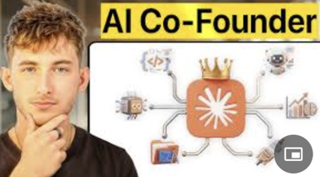
Misc
I Made Claude My Co-Founder
https://www.youtube.com/watch?v=PG6w8_HEn-o
A business owner built 4 key layers:
the intelligence foundation using Opus, Sonnet, and Haiku models for different task complexities;
the interface layer with projects, memory, artifacts, and connectors providing persistent context and business knowledge;
the office suite including .. Chrome extension .. Co-work desktop automation .. Claude Code for development work;
the engine room with skills, sub-agents, and autonomous systems.
The key insight is that people succeeding with AI aren't using better prompts but building deeper, interconnected layers that compound over time
Each document uploaded, skill written, and connector enabled makes every layer more powerful, creating a system that knows the business context, preferences, and standards automatically rather than requiring repeated explanations

Slide 24
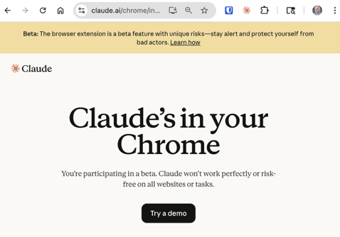
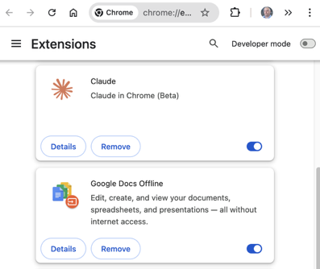
Claude Chrome Extension

Slide 25
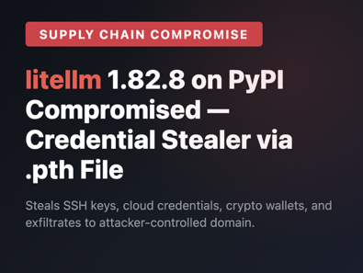
LightLLM Compromize
On March 24, 2026, a threat actor group called TeamPCP (linked to LAPSUS$) compromised two LiteLLM PyPI releases — v1.82.7 and v1.82.8 — by injecting malicious code into the distributed Python wheel packages
LiteLLM is an open-source Python library and proxy server that acts as a "universal translator" normalizing APIs of LLM providers into the familiar OpenAI API format
LiteLLM has over 95 Mln monthly downloads
The affected file - litellm/proxy/proxy_server.py
It installs a hidden systemd backdoor that survived reboots and polled an attacker-controlled server for additional payloads
How to check if you have it:
uv pip show litellm
find ~/.cache -name "litellm_init.pth" 2>/dev/null
ls ~/.config/sysmon/sysmon.py 2>/dev/null
ls ~/.config/systemd/user/sysmon.service 2>/dev/null
cat ~/.config/sysmon/sysmon.py 2>/dev/null
find ~/.cache/pip ~/.cache/uv -name "litellm*.whl" 2>/dev/null

Slide 26
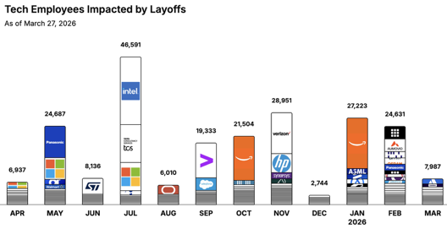
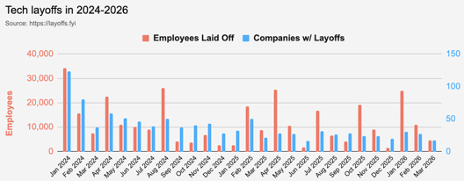
https://layoffs.fyi
https://trueup.io/layoffs
Jobs
The Tech Layoff Tracker
In 2026: 59,841 people laid off (696 per day)
In 2025: 245,953 people laid off (674 per day)
In 2024: 238,461 people laid off (653 per day)
https://trueup.io/layoffs
Tech Layoffs by year (US only):
40.5K in 2026 (as of March 27, 2026)
124K in 2025
153K in 2024
264K in 2023
165K in 2022 https://layoffs.fyi

Slide 27
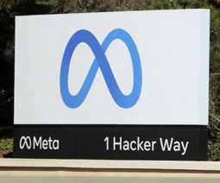
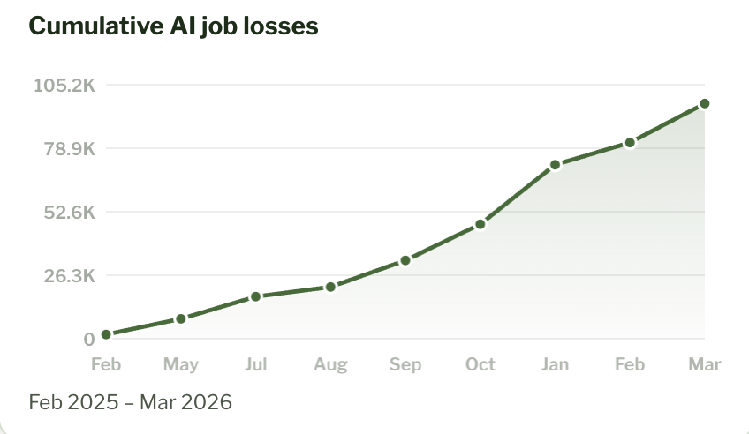
Jobs
Oracle Plans to cut up to 30K jobs out of 162K globally targeting roles expected to become redundant due to AI
Meta is reportedly planning layoffs of up to ~20% of its ~79K employees (15K-16K workers)
https://jobloss.ai

Slide 28


About the Speaker
Lev Selector, Ph.D.
40+ years of software engineering, data science, and building teams (hiring, training, and managing)
Ph.D. in mathematical modeling and computer simulations
Interests:
Generative AI, Using LLM with your data
Local AI for Local Private Data
Cloud architecture, fin-tech, application security
Find/connect: Linkedin, GitHub, YouTube, Google
https://eais.ai
Enterprise AI Systems

Slide 29
Thank You!

