Slide 1
AI Updates - October 3, 2025
AI updates arrive faster than your coffee cools
Crowd-sourced "LM Arena" Leaderboard
Anthropic’s Claude Sonnet 4.5
GLM-4.6 Open Source King
Claude Code 2.0
OpenAI Sora 2
Perplexity Search API
ChatGPT Pulse for Pro Mobile Users
K2 Think 32B AI Reasoning Model by MBZUAI
Emad Mostaque book "The Last Economy"
Meta Vibes - AI Videos for Instagram
Anything - text-to-app startup
Tinker API for fine-tuning
Microsoft Unified Agent Framework
Cerebras Raises $1.1B at $8.1 valuation
Detecting hallucinations in RAG with 85% accuracy
Periodic Labs - AI Scientist
Genspark AI Workspace
IBM & HSBC - Quantum Computers to improve trading
Netflix: monolithic architectures can scale
StoneMQ - Open-source Messaging in Rust
RAG python modules
Traycer - AI coding assistant
Gemini 2.5 Flash Light model
Richard Sutton - Father of RL about LLMs
21 Things You Should Be Using AI For ...
Evaluate AI for Production
Rust instead of Python
Time to self-driving cars
OpenAI GDPval - measures model performance
Meta GAIA: a benchmark for General AI Assistants
Moonshot AI OK Computer
Gemini Robotics 1.5 with AI agents
Databricks commits to $100M in OpenAI spending
Distyl AI raises $175M in funding at $1.8B valuation
Alibaba Wan 2.2 Animate
Kling AI 2.5 Turbo
Qwen-Image-Edit-2509 & Qwen3-Max
xAI gives Grok 4 to US federal agencies
Meta FAIR - open-source Code World Model
Facebook adds an AI Dating Assistant
Abacus AI DeepAgent Desktop & CLI
Jobs, Layoffs, demand for AI Engineers

Slide 2
Crowd-sourced "LM Arena" Leaderboard
https://lmarena.ai/?leaderboard
Starting Elo rating = 1000
https://en.wikipedia.org/wiki/Elo_rating_system
English - https://lmarena.ai/leaderboard/text
Coding - https://lmarena.ai/leaderboard/text/coding
LM Arena secures $100M to expand AI benchmarking (at $600M valuation)
Model | Score
gemini-2.5-pro | 1452
claude-opus-4-1-20250805-thinking-16k | 1449
claude-sonnet-4-5-20250929 | 1440
chatgpt-4o-latest-20250326 | 1441
gpt-4.5-preview-2025-02-27 | 1440
o3-2025-04-16 | 1440
gpt-5-high | 1439
claude-opus-4-1-20250805 | 1439
qwen3-max-preview | 1434
gpt-5-chat | 1425
grok-4-fast | 1423
qwen3-max-2025-09-23 | 1420
qwen3-vl-235b-a22b-instruct | 1418
claude-opus-4-20250514-thinking-16k | 1420
qwen3-235b-a22b-instruct-2507 | 1418
grok-4-0709 | 1418
deepseek-r1-0528 | 1417
kimi-k2-0905-preview | 1416
deepseek-v3.1-thinking | 1416
deepseek-v3.1-terminus | 1416
kimi-k2-0711-preview | 1415
deepseek-v3.1 | 1415
deepseek-v3.1-terminus-thinking | 1414
gemini-2.5-flash-preview-09-2025 | 1409
Model | Score
claude-opus-4-1-20250805-thinking-16k | 1508
claude-opus-4-1-20250805 | 1496
claude-sonnet-4-5-20250929 | 1494
qwen3-max-2025-09-23 | 1477
claude-opus-4-20250514-thinking-16k | 1480
qwen3-max-preview | 1478
gemini-2.5-pro | 1470
qwen3-235b-a22b-instruct-2507 | 1468
chatgpt-4o-latest-20250326 | 1467
gpt-5-high | 1466
qwen3-vl-235b-a22b-instruct | 1466
deepseek-v3.1-terminus-thinking | 1457
o3-2025-04-16 | 1465
gpt-5-chat | 1462
longcat-flash-chat | 1461
gpt-4.5-preview-2025-02-27 | 1461
deepseek-v3.1-thinking | 1461
qwen3-next-80b-a3b-instruct | 1460
grok-4-fast | 1456
claude-sonnet-4-20250514-thinking-32k | 1461
deepseek-r1-0528 | 1457
claude-opus-4-20250514 | 1455
kimi-k2-0905-preview | 1452
qwen3-vl-235b-a22b-thinking | 1443
China
China
Grok 4 Benchmarks
https://artificialanalysis.ai/models/grok-4
China
China
https://lmarena.ai/leaderboard/text
https://web.lmarena.ai/leaderboard
https://openlm.ai/chatbot-arena/
https://beta.lmarena.ai
Web Leaderboard https://web.lmarena.ai/leaderboard
LLM Leaderboard - by @LlmStats https://llmworld.net/llm_leaderboards/
LLM Leaderboard - by StackAI https://www.stack-ai.com/llm-leaderboard
LLM Leaderboard - by Artificial Analysis https://artificialanalysis.ai/leaderboards/models
Open LLM Leaderboard - by Hugging Face https://huggingface.co/open-llm-leaderboard
LLM Leaderboard - by Vellum https://www.vellum.ai/llm-leaderboard
AI Benchmarking Hub https://epoch.ai/data/ai-benchmarking-dashboard
x.ai
China
China
China
China
China
China
x.ai
China
China
China
China
China
x.ai
China
China
China
China
China
China
China

Slide 3


Anthropic’s Claude Sonnet 4.5
Anthropic’s Claude Sonnet 4.5
Long-duration, autonomous coding and agentic workflows
Leads industry benchmarks, including SWE-bench Verified (coding) and OSWorld (computer tasks )
Advanced context and memory management, supporting extended, multi-hour (30+ hours) tasks by compressing, editing, and preserving essential context across sessions (AI task duration is doubling every 7 months - new "Moore's Law")
Orchestrating tools and software, including parallel tool calls, in highly agentic workflows such as coding, research, and computer automation
Includes developer tools like a native VS Code extension, Claude Agent SDK, and enhanced Chrome extension for web automation
Demonstrates significant improvements in alignment and safety, tested by third-party institutes, reducing unsafe behaviors
Powers advanced enterprise use cases in coding, finance, legal research, and complex automation for major companies
Available through the Claude API, Amazon Bedrock, and Chrome
Price same as previous Sonnet (in $3 / out $15)
Claude is already writing the majority of code at Anthropic
GLM 4.6 from z.ai
GLM-4.6 Open Weights from Zhipu AI
200K token context window, MIT-license
SOTA coding, reasoning, and agentic performance;
Price ($0.60 / $2) is ~5x times lower than Claude Sonnet ($3/$15)
Performance close to Claude Sonnet
355B params MoE (32B active) - half the size of DeepSeek-V3 (671B) and one-third of Kimi K2 (1043B)
Power-efficient, using 30% fewer tokens than its predecessor; integrates well with agent frameworks
Available for local deployment or via major platforms and APIs
https://huggingface.co/zai-org/GLM-4.6
https://docs.z.ai/guides/llm/glm-4.6
https://openrouter.ai/z-ai/glm-4.6
https://www.youtube.com/watch?v=k0M320a-TXs
https://www.youtube.com/watch?v=i3kO_GOt2Bo
https://docs.z.ai/devpack/overview

Slide 4
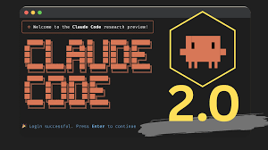
Claude Code 2.0
Claude Code 2.0 - major update
now powered by the Sonnet 4.5 model
includes an official VS Code extension with a rich GUI, live sidebar, inline diffs, and persistent conversation histories
Enhanced Terminal UI - improved status feedback, and a searchable prompt history (via Ctrl+r), streamlining iterative command use and debugging within the shell
Operates as an autonomous agent. It can understand high-level instructions, decompose tasks, interact with your filesystem, run commands, and make multi-file edits—all without constant human supervision
Automatic checkpoints save both your code and the AI’s conversational context before each change, enabling rapid rollback or context resets ("/rewind" command or double-Esc lets users revert code and conversation if the session takes a wrong path)
Subagents, Hooks, and Background Tasks, parallel tasks
Teams can build custom agent workflows, define authorization, manage subagents, and trigger hooks tailored to specific development, compliance, security, or operational tasks
Overall Claude Code 2.0 brings much higher autonomy, multi-step planning and execution, and a deeper integration into common developer workflows
https://anthropic.com/news/enabling-claude-code-to-work-more-autonomously
https://www.youtube.com/watch?v=GfBPtZag0ag

Slide 5
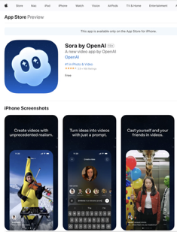

OpenAI Sora 2
OpenAI Sora 2
Generates photorealistic minute-long videos with synchronized audio and realistic physical motion
"cameo" feature: users can insert themselves or friends into AI-generated scenes, after verifying their identity
Advanced editing and controllability for precise object replacement and multi-shot direction
Available by invitation only for ChatGPT Pro users ($200/mo) via Sora.com ( https://sora.chatgpt.com/explore ), iOS app
Social feed mimics TikTok, showing vertical AI-generated videos curated to user interests
Implements strong watermarking, provenance, and moderation
Access is by invitation; uploads with real people are restricted and carefully reviewed
https://openai.com/index/sora-2/
https://apps.apple.com/us/app/sora-by-openai/id6744034028
https://www.youtube.com/watch?v=hkSj-QapfZo - fireship video

Slide 6

Perplexity Search API
Perplexity Search API
Real-time indexing and access to 100s of Billions of web pages via AI-driven search
0.4 sec median latency,
Combines keyword and semantic search, segmenting documents to deliver highly relevant, contextually grounded answers with detailed source citations suitable for LLM integration and conventional web services
Structured Outputs for AI Agents and waw, ranked web results
API does not use user data to train its models
Pricing - $5 per 1,000 search requests.
200M queries per day, robust SDKs, compatible with popular libraries (OpenAI-Compatible)
REST API Design, easily plugged into applications with simple authentication and querying workflows
Supports advanced models (e.g., Sonar Pro) for in-depth research, long context windows, and nuanced reasoning tasks
curl -L -X POST 'https://api.perplexity.ai/v1/search' \
-H 'Content-Type: application/json' \
-H 'Authorization: Bearer <YOUR_API_KEY>' \
--data-raw '{ "query": "latest AI trends", "num_results": 3 }'
Perplexity’s Search API is ideal for real-time information retrieval, LLM-powered assistants, and scalable web-grounded search infrastructure
https://docs.perplexity.ai

Slide 7
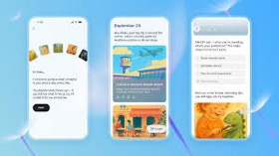

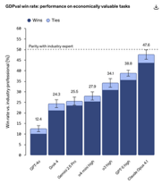
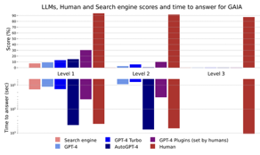
AI Updates - 1
ChatGPT Pulse for Pro Mobile Users
Personalized Updates
ChatGPT Pulse is a new feature introduced as a preview for ChatGPT Pro users on mobile, designed to proactively deliver personalized updates, research, and suggestions based on chat history, user feedback, and optional integrations like Gmail and Google Calendar
https://openai.com/index/introducing-chatgpt-pulse/
K2 Think 32B AI Reasoning Model by MBZUAI
by Mohamed bin Zayed University of Artificial Intelligence (MBZUAI), Masdar City, Abu Dhabi, United Arab Emirates
Comparable to SOTA models, advanced reasoning and mathematical problem-solving, 2Ktok/sec on Cerebras
The world’s most parameter-efficient advanced reasoning model, showing that highly effective performance can be achieved with compact architectures - https://www.k2think.ai/k2think
OpenAI GDPval - measures model performance
measures model performance on economically valuable, real-world tasks across 44 occupations
https://openai.com/index/gdpval/
Meta GAIA: a benchmark for General AI Assistants
https://arxiv.org/abs/2311.12983

Slide 8
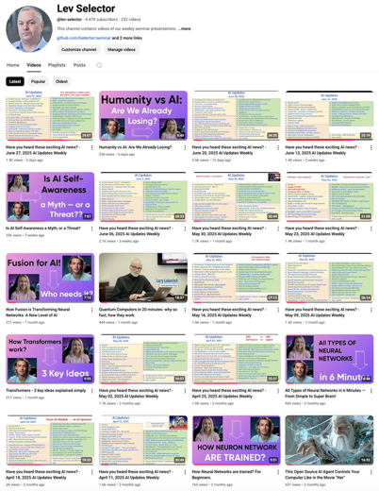
Please pause the video - and answer the pinned question in comments under the video
Subscribe to this channel
https://www.youtube.com/@lev-selector
Get notified about new videos - every Friday, links to slides under the videos

Slide 9

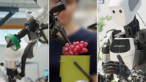


AI Updates - 2
Moonshot AI OK Computer
Using Kimi K2, an autonomous system
https://x.com/kimi_moonshot/status/1971078467560276160
Gemini Robotics 1.5 brings AI agents into the physical world
Vision-language-action (VLA) model, which turns visual information and instructions into motor commands
https://deepmind.google/discover/blog/gemini-robotics-15-brings-ai-agents-into-the-physical-world/
Databricks commits to $100M in OpenAI spending
https://www.cnbc.com/2025/09/25/databricks-commits-to-100-million-in-openai-spending-for-ai.html
Distyl AI raises $175M in funding at $1.8B valuation
AI consulting platform
https://www.theinformation.com/articles/startup-founded-ex-palantir-employees-raises-1-8-billion-valuation

Slide 10







AI Updates - 3
Alibaba Wan 2.2 Animate
Open-source AI video generation and character animation
Developed by Tongyi Lab (Alibaba)
Users can animate any static character image or replace characters in an existing video using motion and facial expressions extracted from a reference video
Kling AI 2.5 Turbo - text-to-video models (China, commercial)
Enhancements in motion fluidity, prompt adherence, scene realism, and aesthetic precision
Qwen-Image-Edit-2509 - open-weights multi-image editing and single-image consistency
Qwen3-Max - coding and agentic model surpassing top Western models in “thinking” and Python use modes
xAI gives Grok 4 to US federal agencies
42 cents per department for 18 months
Meta FAIR - open-source Code World Model
32B params - learns coding by interacting with and executing code
Facebook adds an AI Dating Assistant
updated dating platform improve match recommendations

Slide 11

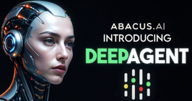
AI Updates - 4
Emad Mostaque book "The Last Economy"
Emad believes traditional economic structures will be obsolete within 3 years.
He warns of a "permanent underclass" if AI benefits aren't distributed properly
He proposes "proof of benefit" cryptocurrency where proceeds fund beneficial AI research
He advocates for universal AI access and open-source models aligned to individual values; Emphasizes the importance of "caring and giving a damn" as uniquely human traits
Abacus AI DeepAgent Desktop & CLI
All-in-one AI assistant for desktop use, supporting real-time desktop automation, agentic browsing, and workflows for coding, scripting, and business tasks; integration with top models & MCP
Windows, Mac, and Linux systems
npm install -g @abacus-ai/deepagent (or download app)
https://abacus.ai
https://deepagent.abacus.ai
https://deepagent-desktop.abacus.ai

Slide 12
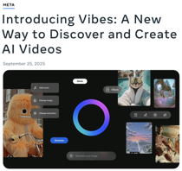

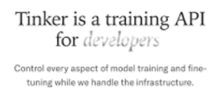
AI Updates - 5
Meta Vibes - Discover and Create AI Videos for Instagram
Meta Vibes is a new feature introduced by Meta within the Meta AI app and the meta.ai website that enables users to browse, create, and remix short-form AI-generated videos. The Vibes feed is populated entirely by AI-generated clips, which users can modify using text prompts, upload their own visual elements, or remix existing content to match their desired style or mood, known as their “vibe”.
https://about.fb.com/news/2025/09/introducing-vibes-ai-videos/
Anything - text-to-app startup (San-Francisco)
an AI app is offering all the tools - from databases to storage and payment functionality - that users need to run businesses on the web or to send their vibe-coded creations to the App Store.
The company’s initial traction was explosive, reaching $2 million annualized run rate in just two weeks.
https://www.createanything.com
Anything co-founders:
Dhruv Amin - https://www.linkedin.com/in/dhruvamin/
Marcus Lowe - https://www.linkedin.com/in/the-marcus-lowe/
Tinker API for fine-tuning
by Thinking Machines Lab
Supports large MoE models like Qwen-235B, and comes with a low-level API and open-source Tinker Cookbook for implementing advanced post-training techniques.
https://thinkingmachines.ai/blog/announcing-tinker/

Slide 13




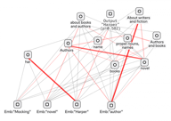

AI Updates - 6
Microsoft Unified Agent Framework
Open-source SDK and runtime substitutes AutoGen and Semantic Kernel to unify agent development, deployment, and observability
It offers safety features like task adherence and PII alerts (PII = "Personally Identifiable Information")
Deep integration with Azure AI Foundry for enterprise-grade AI
https://azure.microsoft.com/en-us/blog/introducing-microsoft-agent-framework/
Cerebras Raises $1.1B at $8.1 valuation
The AI chipmaker raised more money
Detecting hallucinations in RAG with 85% accuracy
Using Anthropic’s Circuit Tracing and cross-layer transcoders (CLT)
Achieved 85% detection accuracy on test data, though it is resource-intensive, highly dependent on transcoder quality, and prone to false positives in token-level alignment
https://habr.com/ru/companies/redmadrobot/articles/951118/ (in Russian)
Periodic Labs - AI Scientist
Idea - build autonomous AI scientists equipped with physical laboratories to accelerate scientific discovery, focusing initially on the physical sciences
The founding team includes leaders from major AI and scientific projects, and they are backed by prominent investors; they're also running an academic grant program to support pioneering research.
https://periodic.com

Slide 14
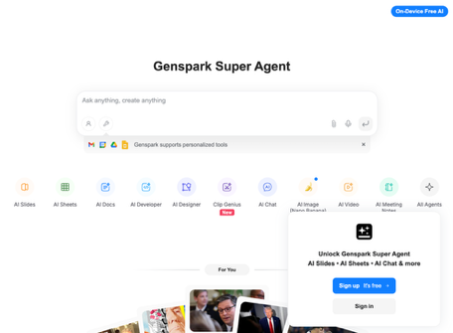

Genspark AI Workspace
Genspark AI Workspace uses OpenAI
AI Slides, AI Sheets, AI Docs, AI Pods, AI Chat, AI Image and Video, AI Download For Me, AI Call For Me, and more
Examples: “Make a slide deck,” or “Call my dentist,” ...; Handles research, trip planning, product analysis, and more, and can create tailored, auto-updating documents and visualizations;
Integrates with file formats like Word, Excel, and PDF, instantly turning them into polished presentations or data reports.
No-code interface for a configurable collaborative workspace: customize slide layouts, color themes, and export to PDF, PowerPoint, Notion, or the web.
Can now work with all popular models, even latest Claude 4.5 ! https://www.youtube.com/watch?v=n5KBfCgJYOo - video demo
Available as a web app, and as apps for Android and iOS.
Genspark reached $36M ARR in 45 days, and is considered a leading example of how agentic AI is moving from simple chat to real-world automation at scale.
https://www.genspark.ai
Pricing: Free or $20...$30/mo
Genspark is a startup in Palo Alto, CA
Raised $60M in 2024, $100M in 2025. 10+ people
The founders of Genspark are Eric Jing and Kay Zhu, both former Baidu executives with extensive backgrounds in AI and technology

Slide 15
AI Updates - Computing
StoneMQ - Open-source Messaging in Rust
6x times faster and 70% cheaper than Kafka
Kafka Compatible, efficient scaling, loging/tracing
Fully open source under the Apache 2.0 license
https://github.com/jonefeewang/stonemq
IBM and HSBC used Quantum Computers to improve trading
IBM Heron quantum processor was used to enhance algorithmic bond trading - up to a 34% improvement in predicting the likelihood that bond trades would be completed at quoted prices
This was done by combining quantum and classical computational methods on real-world, production-scale bond trading data
This represents the world's first empirical evidence of quantum computing's practical value in financial services. This is "ground breaking world first" example
https://www.ibm.com/quantum/blog/hsbc-algorithmic-bond-trading
RAG python modules
pip install RAGchain # pipelines, benchmarking, ...
pip install raglight
pip install rag light
pip install flashrag-dev --pre
pip install metagpt[rag]
https://pypi.org/project/RAGchain/
https://python.langchain.com/docs/tutorials/rag/
https://github.com/RUC-NLPIR/FlashRAG
https://docs.deepwisdom.ai/main/en/guide/in_depth_guides/rag_module.html
https://www.youtube.com/watch?v=BfBLSnRKWMY
https://www.youtube.com/watch?v=mEmUN4lgpaU
https://microsoft.github.io/graphrag/get_started/
https://github.com/pymupdf/RAG
Netflix: monolithic architectures can scale
Microservices impose a recurring "network tax" due to serialization, deserialization, additional network hops, and frequent retries and timeouts, all of which can impact latency and reliability; Debugging distributed traces becomes a nightmare, as diagnosing single requests can mean traversing hundreds of interconnected microservices, making root-cause analysis more difficult than in a monolithic setup
Netflix’s practical experience with microservices exposes limitations and points out that, for some environments, monolithic systems can offer superior scalability and operational simplicity compared to highly distributed architectures
https://medium.com/@yashbatra11111/how-netflix-accidentally-proved-monoliths-scale-better-than-microservices-f2d66f0a0bb5

Slide 16


AI Updates - Coding
Traycer - AI coding assistant https://www.youtube.com/watch?v=eaoquGpEVmk
Tracer creates detailed, actionable plans before any coding begins, acting as a "planning layer" that ensures crystal-clear input to AI agents. Uses Multiple background planners and Automatic context gathering when encountering unfamiliar libraries or frameworks
Tracer offers a Pro plan at $25/mo
Gemini 2.5 Flash Light model
Significantly faster than previous models
Reduces output tokens by half
Lower latency and reduced costs
Improved performance over the previous non-thinking version of Gemini 2.5 Flash
Maintains accuracy while delivering results much faster
Available on Google AI Studio
Can be grounded with Google Search
Supports URL context reading
Runs on standard Google hardware (no specialized hardware like Groq or Cerebras needed)

Slide 17

Richard Sutton - Father of RL about LLMs
Richard Sutton on Reinforcement Learning vs. LLMs
LLMs mimic what people say, not what actually happens in the world
RL is about learning from direct experience and consequences
LLMs:
lack true goals and ground truth for evaluating actions. Without goals, there's no "right" thing to do - just patterns to copy
don't have a world model. They predict what people would say, not what will happen
can not be surprised by outcomes or update based on unexpected events
don't learn from life experiences as all mammals do
The RL Alternative:
Policy (what to do in each situation)
Value function (how well things are going, learned via TD learning)
State representation (perception/understanding of current situation)
Transition model (predicting consequences of actions)
Generalization:
Current deep learning generalizes poorly and unpredictably
Gradient descent solves problems but doesn't ensure good generalization to new situations
Humans sculpt representations that transfer well; it's not automatic
Catastrophic interference when learning new things is evidence of poor generalization
Bitter Lesson: general methods which leverage computation consistently outperform methods based on human-crafted, domain-specific knowledge
Sutton expects experience-based learning to eventually supersede LLM approaches, same pattern has repeated throughout AI history
Infants learn through trial-and-error, not imitation or supervised learning; Supervised learning "doesn't happen in nature" - no examples of "correct" behavior exist; Understanding squirrels would get us most of the way to understanding human intelligence
Transition to AI/augmented humans is inevitable (lack of unified governance, eventual understanding of intelligence, superintelligence development, and resource accumulation); Represents major universal transition from replication to design; Should view AIs as humanity's offspring rather than adversaries; Current world is "pretty bad" - openness to change is appropriate

Slide 18
21 Things You Should Be Using AI For ...
Mathew Berman video - https://www.youtube.com/watch?v=8wonm55Jl3k
Visualize interior design and furniture layouts from annotated photos
Try virtual fashion changes (hair colors, outfits, accessories) in self portraits
Reconstruct historic sites from modern images and generate photorealistic scenes of ancient places
Create 3D product designs from simple sketches
Generate looping 3D animations for DJ and concert backgrounds
Use AI coding agent (Warp) in the terminal - editing, code review, ...
Design modern business cards, banners, and t-shirt graphics; transform logos into branded assets.
Convert images and documents between formats easily (e.g., convert JPEG to SVG).
Detect phishing and scam attempts in emails, voicemails, and texts—review suspicious messages with AI.
Estimate rooftop solar installation potential and financial returns using Google Maps images.
Schedule daily news email digests and manage task automation directly with ChatGPT.
Use AI to schedule team meetings by connecting calendar data and analyzing team availability.
Transcribe and expand handwritten notes and whiteboards into detailed reference sheets.
Instantly generate SQL queries and filter datasets by uploading sample data.
Perform sentiment analysis and generate graphical summaries of customer call transcripts.
Summarize and highlight key sections of research papers; return easy-to-understand summaries with highlighted PDFs.
Get up-to-date property analysis for home buying—including price trends and risks by address or region.
Receive salary negotiation support, including competitor benchmark analysis and custom counteroffer drafts.
Refine, rewrite, and improve professional emails—make them more polite, concise, or clearer.
Summarize insurance documents and get recommendations on the most suitable options and deadlines.
Conduct deep financial analysis and comparison for specific companies or investment opportunities.
Use LM Studio to create study guides, flashcards, podcasts, and quizzes from uploaded documents.
Win at Geoguessr by leveraging AI vision and location detection to identify and guess locations.

Slide 19


Evaluate AI for Production
Operationalization
Automate reliable judges - to run against production traces with dashboard monitoring.
Maintain continuous human annotation, especially after significant changes.
Keep tooling simple—use spreadsheets and built-in LLM tools for accessibility.
Let categories emerge from real data, not hypotheses
Regular lightweight manual checking maintains quality
Small datasets enable fast iteration cycles
Human judgment remains the gold standard for LLM-as-judge calibration
Update rubrics and datasets as products and policies evolve
This approach blends manual insight with scalable automation, ensuring evaluations remain both trustworthy and actionable for AI product development.
Peter Yang about AI Evaluations
Hamel Husain - https://www.youtube.com/watch?v=uiza7wp1KrE
Aman Khan - https://www.youtube.com/watch?v=TL527yTpxlk
Start with manual review of ~100 real product traces. Hand-annotate failures and pain points using open coding - this provides far more insight than jumping straight to metrics or automation. Export observations to a spreadsheet and use LLMs to cluster issues into categories like "handoff failures" or "conversation flow problems."
Core Evaluation Types:
Code-based, automated (e.g., prohibited term detection)
Human evals by PM/expert with clear rubrics
LLM-as-a-judge - automated, mimics human judgment
User evals - real production feedback and business metrics
Building Effective Evaluations:
Create explicit prompts with all context variables defined
Generate initial examples using realistic queries
Build golden datasets through manual PM testing
Develop clear rubrics (product knowledge, policy compliance, tone)
Binary Over Continuous Scoring! Use pass/fail metrics, not 1-5 scales. Binary judgments are actionable—average scores like 3.2 vs 3.7 create ambiguity. Always ask: "Was this failure present? Yes or no."
Validate LLM judges against human labels using confusion matrices, measure true positive/negative rates, not just agreement
equire binary answers plus explanations from LLM evaluators
Start with 5-10 examples for iteration, scale to 100+ for production confidence

Slide 20



Rust instead of Python
Vendor | Languages Used | GPU Stack/Frameworks
OpenAI | Python, C++, CUDA | CUDA, Triton, custom backend
Anthropic | Python, C/C++, CUDA | Docker, Bazel, AWS Nitro
Gemini | Python, C++, Java, CUDA, TPU | Custom Google stack (TPU), CUDA
Perplexity | Python, C++, CUDA | NVIDIA Triton, TensorRT-LLM
Mistral | Python, C++, CUDA | vLLM, open-source inference
Qwen | Python, C++, CUDA | Alibaba custom backend, GQA
Deepseek | Python, C++, CUDA | MoE optimization, CUDA
Nvidia | Python, C++, CUDA | TensorRT, Triton Inference Server
Today production AI inference is mostly done using Nvidia GPUS via C++ CUDA libraries and Python for orchestration
Python offers rapid iteration, broad library support, and ease of integration, while C++ / CUDA used for speed
But Rust provides compelling alternative for production: https://medium.com/@theopinionatedev/rusts-ai-libraries-are-finally-beating-python-at-its-own-game-8f84dd26ccc4
Problems with Python: Global Interpreter Lock (GIL), large runtime footprints making edge deployment difficult, and the complexities of bundling Python with native C++ and CUDA libraries
Rust's AI libraries are now surpassing Python’s for production, real-time inference, and edge AI due to Rust’s concurrency, efficiency, and simpler deployment
However, Python continues to lead in research and academia
https://medium.com/@theopinionatedev/rusts-ai-libraries-are-finally-beating-python-at-its-own-game-8f84dd26ccc4
Rust Libraries:
tch-rs - PyTorch C++ bindings in Rust
tract - Pure Rust inference engine
burn - Pure Rust deep learning framework
linfa - Scikit-learn style ML for Rust
onnxruntime-rs - Bindings to ONNXRuntime
Apple is rewriting key parts of iOS in Rust-like languages for safety and performance - fewer crashes, better security, and maybe the start of a Rust-shaped future for iOS developers.
https://medium.com/@devlinktips/apple-is-quietly-rewriting-ios-and-its-not-in-swift-or-objective-c-4af4dc578775

Slide 21

Time to self-driving cars
Total number of passenger cars in US - 97M. Tesla - 4M.
Tesla started manufacturing cars in 2008, and in 17 years has added ~4M Tesla cars in US. Tesla now adds 0.6 .. 1 Mln cars per year, so it will take many years to make a significant difference. Other brands add (combined) about the same amount as Tesla alone
There are ~1.5K Robotaxi cars in several cities in the US: Phoenix, San Francisco, Los Angeles (limited coverage), Austin, Atlanta (new in 2025), Las Vegas (Zoox, pilot stage)
This is less than 1% of all taxi cars in the US. For example, 120K New York City (NYC), 7K Chicago, 6.3K Washington, D.C., 2.3K Los Angeles
13M+ trucks in the US
3.6M truck drivers
400 self-driving trucks (less than 0.01% of all trucks)

Slide 22
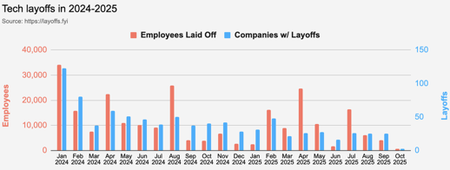
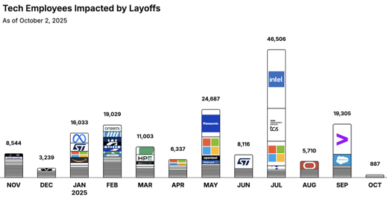
Jobs
https://layoffs.fyi
https://trueup.io/layoffs
Tech Layoffs by year (US only):
91.3K in 2025 (as of October 2)
153K in 2024
264K in 2023
165K in 2022
https://layoffs.fyi
Companies need AI Engineers
While companies cut traditional roles, they’re pouring billions into AI:
Microsoft → $80B in 2025
Meta → $40B
Google → $29B
Amazon → $8B into Anthropic
That’s $350B+ a year, redirected straight into AI systems
And they all need engineers who can build them
The Tech Layoff Tracker
So far in 2025, 157,613 people laid off (573 per day)
In 2024, 238,461 people laid off (653 per day)
https://trueup.io/layoffs

Slide 23


About the Speaker
Lev Selector, Ph.D.
40+ years of software engineering, data science, and building teams (hiring, training, and managing)
Ph.D. in mathematical modeling and computer simulations
Interests:
Generative AI, Using LLM with your data
Local AI for Local Private Data
Cloud architecture, fin-tech, application security
Find/connect: Linkedin, GitHub, YouTube, Google
https://eais.ai
Enterprise AI Systems

Slide 24
Thank You!

