Slide 1
AI News - Sept 18, 2026
Agents got their own computers. Oversight is still catching up.
Artificial Analysis Intelligence Index
Meta ships Muse agent with its own cloud computer and browser
Claude formalized Fermat's Last Theorem in 11 days
An Anthropic resignation turns into an extinction debate
Mistral raises the largest round in European tech history
Google's agentic video understanding cuts video tokens by up to 88%
The music industry stops fighting and starts licensing
Anthropic models what AI does to US jobs and wages by 2030
Layoffs.fyi tracker
TrueUp tech layoff tracker

Slide 2
Benchmarks
■ Claude ■ Gemini ■ OpenAI ■ Open source ■ Other
Votes counted through Sept 11, 2026
English
https://arena.ai/leaderboard/text
■ 1506 claude-fable-5
■ 1505 claude-opus-4-6-high
■ 1502 claude-opus-4-7-high
■ 1501 claude-fable-5.1-max
■ 1499 muse-spark-1.2 (xHigh)
■ 1497 claude-opus-4-6
■ 1494 claude-opus-4-7
■ 1494 muse-spark-1.1
■ 1493 claude-opus-5-high
■ 1493 gemini-3.8-flash-high
■ 1490 gemini-3.7-flash-high
■ 1488 muse-spark
■ 1487 gemini-3.1-pro-preview
■ 1487 claude-opus-5-max
■ 1486 glm-5.3-max
■ 1486 gemini-3-pro
■ 1485 kimi-k3-max
■ 1482 claude-opus-4-8-high
■ 1482 gpt-5.6-sol-xhigh
■ 1482 gpt-5.5-high
■ 1481 qwen3.8-max
■ 1479 gemini-3.6-flash-high
■ 1478 gemini-3.5-flash-high
■ 1478 gpt-6-astra-max
■ 1476 gpt-5.4-high
Coding
https://arena.ai/leaderboard/text/coding
■ 1552 claude-fable-5
■ 1552 claude-opus-4-7-high
■ 1551 claude-opus-4-6-high
■ 1547 claude-opus-4-7
■ 1546 claude-opus-4-6
■ 1538 kimi-k3-max
■ 1537 gpt-6-astra-max
■ 1535 gemini-3.8-flash-high
■ 1535 muse-spark-1.2 (xHigh)
■ 1534 claude-opus-4-8-high
■ 1533 claude-opus-5-high
■ 1532 muse-spark-1.1
■ 1530 claude-opus-4-5-20251101-high-32k
■ 1529 claude-opus-4-8
■ 1528 claude-sonnet-4-6
■ 1527 gpt-5.6-sol-xhigh
■ 1526 claude-opus-5-max
■ 1526 muse-spark
■ 1526 glm-5.3-max
■ 1525 qwen3.7-max-preview
■ 1524 glm-5.3-flash
■ 1523 claude-opus-4-5-20251101
■ 1522 qwen3.8-max
■ 1522 gemini-3.7-flash-high
■ 1521 mimo-v2.5-pro

Slide 3
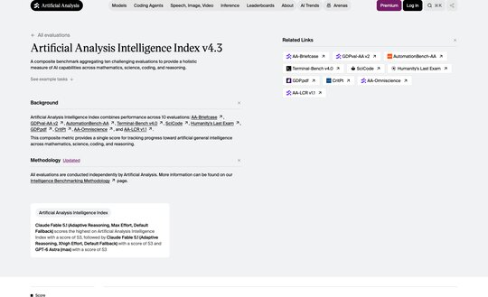
Artificial Analysis Intelligence Index
Artificial Analysis Intelligence Index
Combines several evaluations into one score per model
Useful for comparing cost per unit of intelligence
https://artificialanalysis.ai/evaluations/artificial-analysis-intelligence-index

Slide 4
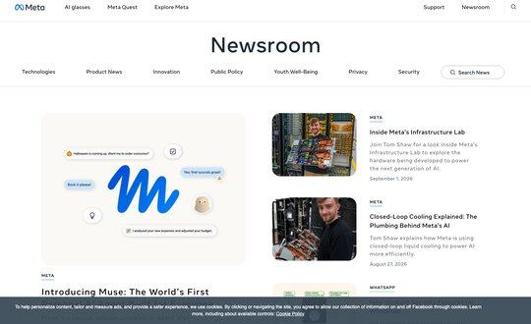
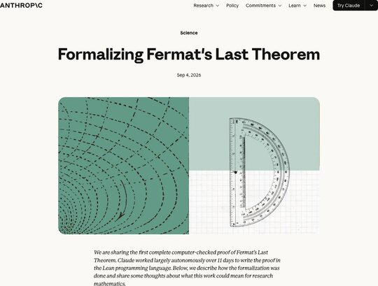
AI News
Meta ships Muse agent with its own cloud computer and browser
Handles email, calendars, Instagram and ordinary websites. Ties into Gmail, Spotify, Ticketmaster and OpenTable, and writes its own integrations for services that lack them.
Runs in its own app, on the web, or inside WhatsApp, and keeps working after you close it
The security design is the interesting part. Muse runs in a Secure VM, a separate Sentinel agent inspects everything leaving that VM, passwords stay hidden from Muse itself, and sensitive actions require approval.
Every action enters an audit trail. Payments go through Stripe Link. A Confidential VM upgrade is planned.
Tiers: Free, $20/mo, $100/mo. US only, 18 and older, AI glasses support coming.
Claude formalized Fermat's Last Theorem in 11 days
Wiles proved Fermat's Last Theorem in 1995. Claude converted that proof into 13 Mln lines of Lean, with almost 30K intermediate theorems.
It runs on Prove2Me, an open collaborative platform that keeps a graph of theorem statements and coordinates multiple Claude agents against it
Claude did not discover a new proof. It converted an existing one into the first complete, computer-checked formalization.
The whole thing is on GitHub
https://www.anthropic.com/research/formalizing-fermats-last-theorem

Slide 5
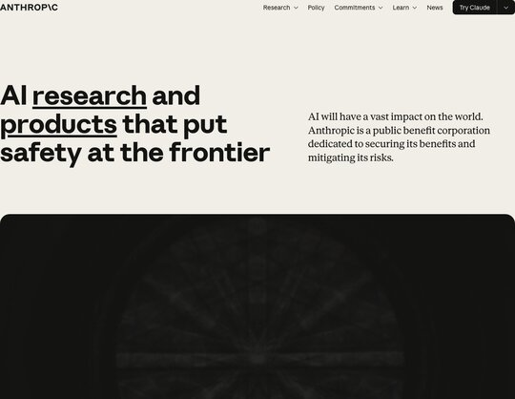
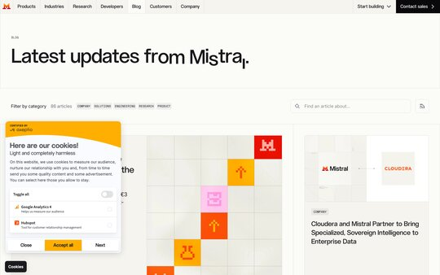
AI News
An Anthropic resignation turns into an extinction debate
Researcher Jacob Coxon resigned and posted that both Anthropic and OpenAI are "gambling with our lives" by racing toward self-improving AI. He worked at both labs.
He wrote that the people building AI "earnestly believe that it could kill us all by the end of the decade. This is not a marketing stunt," and called for a coordinated slowdown.
The reply is what made it spread. Evan Hubinger, Anthropic's Alignment Science lead, responded "We really do earnestly believe AI could kill all humans!" and put the odds above 10% within the next decade.
The argument underneath is not about p(doom). If the people who believe the stakes are civilizational still cannot coordinate, then "trust the responsible lab" is not a safety plan.
Mistral raises the largest round in European tech history
EUR 3 billion Series D led by Samsung Electronics, with Nvidia, ASML and a16z joining, valuing the French lab above EUR 21 billion
One newsletter reported it as $3.5 billion, which is the same round converted
Mistral is three years old and tracking toward $1 billion in annual recurring revenue
The money goes to compute and international expansion, behind a shift toward sovereign, full-stack enterprise AI
Le Chat is being rebranded to "Vibe," an agent and coding platform

Slide 6
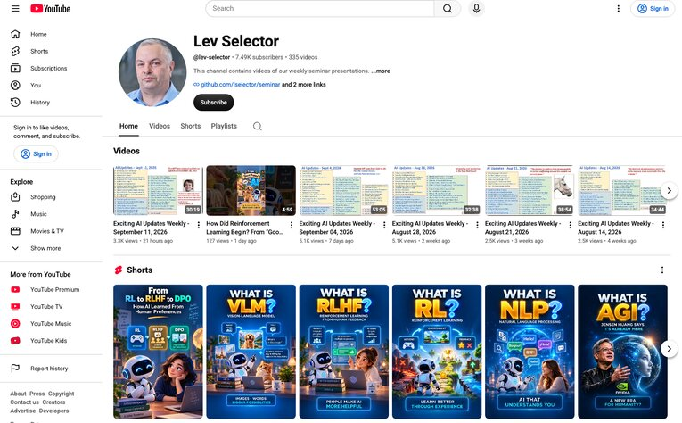
Weekly videos every Friday
Weekly videos every Friday
7.46K subscribers, 333 videos
1. Subscribe to this channel
https://www.youtube.com/@lev-selector
2. Download slides from GitHub using links under the videos
3. Please pause the video - and answer the pinned question in comments under the video

Slide 7
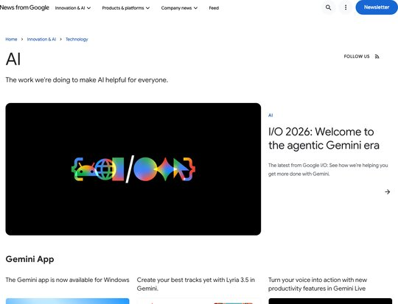

AI News
Google's agentic video understanding cuts video tokens by up to 88%
Gemini Flash models now navigate a video timeline rather than ingesting it at 1 FPS
Google reports up to 88% fewer tokens, 66% lower cost and 7% higher accuracy
One processing field turns it on
Hosted API only, so no local deployment
The music industry stops fighting and starts licensing
Suno released a model built with Warner Music Group, BMG and Believe, with artists participating and their music and likenesses licensed for use on the platform
It ships with a compensation framework, which is the point: the copyright fight is converting into a business arrangement
Universal Music went the same direction days later, partnering with ElevenLabs on a platform for remixing tracks from UMG's catalog, with artists opting in
Spotify is exploring AI remixes too

Slide 8
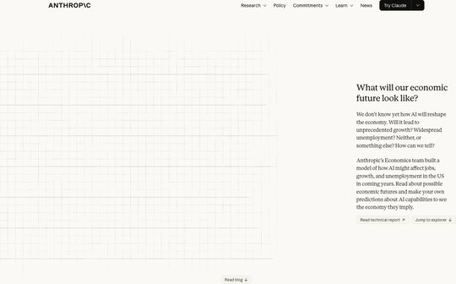
AI News
Anthropic models what AI does to US jobs and wages by 2030
An interactive tool that treats every job as a bundle of tasks, then asks whether AI speeds up each task, replaces it, or creates new ones
Modest, where AI feels like the internet did: GDP grows 1.6% above the no-AI path, wages stable
Substantial, where AI handles about half of knowledge work: GDP up 8.3%, but knowledge worker wages flatline and some people change careers entirely
Extreme: 15% annual growth doubling the economy every 4.5 years, knowledge worker unemployment at 17.9%, and labor's share of GDP falling from 60% to 45%
The point buried in the third scenario is that a bigger economy does not automatically mean you earn more. Capital owners capture most of the gains.
Of the 10,000+ Americans surveyed, most land near the substantial scenario and only about 10% expect the extreme one
https://www.anthropic.com/institute/econ-scenarios

Slide 9
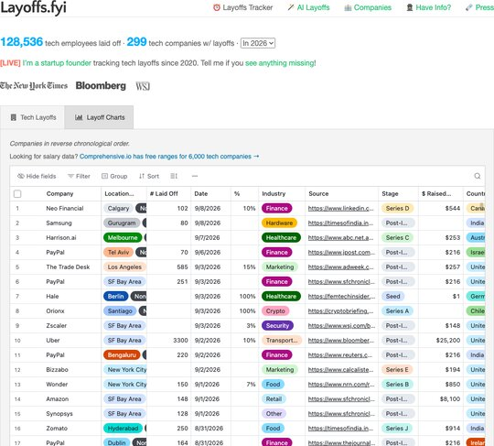
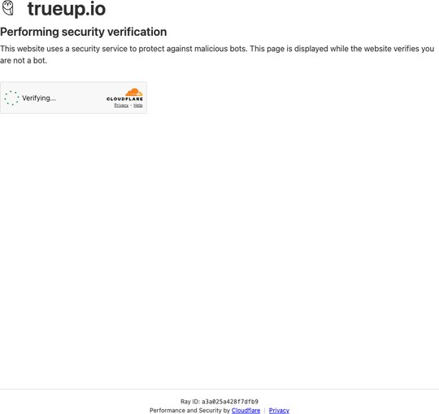
Jobs and Layoffs
Layoffs.fyi tracker
Tech layoffs by year, US only
128.5K in 2026, 124K in 2025, 153K in 2024, 264K in 2023, 165K in 2022
https://layoffs.fyi
TrueUp tech layoff tracker
In 2026: 187,160 people laid off (737 per day)
In 2025: 245,953 people laid off (674 per day)
In 2024: 238,461 people laid off (653 per day)
https://trueup.io/layoffs

Slide 10

About the Speaker
Lev Selector, Ph.D.
40+ years of software engineering, data science, and building teams (hiring, training, and managing)
Ph.D. in mathematical modeling and computer simulations
Interests: Generative AI, using LLMs with your data, local AI for local private data, cloud architecture, fin-tech, application security
Find and connect: LinkedIn, GitHub, YouTube, Google
https://eais.ai

Slide 11
Thank You!
Videos of every seminar are on YouTube
https://www.youtube.com/@lev-selector
Slides on GitHub. Click a pptx file, then the download button on the right
https://github.com/lselector/seminar
Slides on Google Drive
https://drive.google.com/drive/folders/1dmj00iilSP-JYmriMUUaHCKz5X54e3UX?ths=true

