Slide 1
AI Updates - July 10, 2026
First we taught machines to answer. Now we teach them to act.
Crowd-sourced "LM Arena" Leaderboard
Grok 4.5, GPT‑5.6, Gemini 3.5
Anthropic Fable 5 and Mythos 5 Models
Fable 5 promo
Claude to Modify its own Claude.md
Boris Cherny on 5 new roles
Visionary, A Cow
OpenAI optimizations cut inference cost x2
DeepSeek DSpark Speculative Decoding
Use Python for Karpathy-style wiki
KV (Key-Value) Cache and PagedAttention
Boston Dynamics 5th Gen Atlas
Chinese company Ubtech - UWorld U1 Robots
Qualcomm Uses Mojo Prog. Language
Mobile OpenClaw - Android and iOS
Three AI world model paradigms
JEPA is just LoRA in disguise
AI amplifies existing skill levels
Meta Brain2Qwerty v2
10 core components of an AI agent harness
Claude Design’s June 2026 update
Claude Certified Architect (CCA-F) Exam
Alex Hormozi's three-folder organization
llama.cpp - Georgi Gerganov
Open Source Repos for Claude Code
Evolution of RAG
Chinese Models Are Cheaper
Organization-wide Agent
Composio SKD connects agents to 100s of apps
Tencent’s Hy3 - open MoE LLM
Model Routing Saves 60% - 90% of costs
China’s 140 humanoid robot companies
Computational archaeology
Aravind Srinivas Interview
Sentdex - Local Models
Open Standard for the Karpathy LLM Wiki
Claude in Chrome Extension
Jobs & Layoffs

Slide 2
"LM Arena" Leaderboard
Data for July 1
Starting Elo rating = 1000
https://en.wikipedia.org/wiki/Elo_rating_system
English - https://lmarena.ai/leaderboard/text
Coding - https://lmarena.ai/leaderboard/text/coding
■ | Claude
■ | Gemini
■ | OpenAI
■ | Open Source
Claude Fable-5 - 6TB
Claude Opus-4.8 - 5TB
Claude Sonnet-4.5 - 1TB
GLM-5.1 - 744B
Meta muse-spark - 16 x 70B
Qwen3.7-max-preview - 745B
Baidu Ernie-5.1 - 800B
Deepseek-v4 - 1.6T
Kimi-k2.6 - 1T
Xiaomi MiMo-V2-Pro - 1T+
ByteDance dola-seed-2.0-pro 400B
Minimax M3 - 456B
Code | Model | Score
■ | claude-fable-5 | 1509
■ | claude-opus-4-6-thinking | 1504
■ | claude-opus-4-7-thinking | 1502
■ | claude-opus-4-6 | 1499
■ | claude-opus-4-7 | 1494
■ | muse-spark | 1487
■ | gemini-3.1-pro-preview | 1486
■ | gemini-3-pro | 1486
■ | claude-opus-4-8-thinking | 1484
■ | gpt-5.5-high | 1481
■ | gemini-3.5-flash | 1479
■ | gpt-5.4-high | 1478
■ | claude-opus-4-8 | 1477
■ | gpt-5.2-chat-latest-20260210 | 1476
■ | qwen3.7-max-preview | 1475
■ | gpt-5.5 | 1475
■ | grok-4.20-beta-0309-reasoning | 1475
■ | grok-4.20-beta1 | 1474
■ | gemini-3-flash | 1473
■ | claude-opus-4-5-20251101-thinking-32k | 1473
■ | gpt-5.5-instant | 1473
■ | glm-5.1 | 1472
■ | claude-sonnet-4-6 | 1472
■ | grok-4.20-multi-agent-beta-0309 | 1470
■ | claude-opus-4-5-20251101 | 1469
Code | Model | Score
■ | claude-fable-5 | 1563
■ | claude-opus-4-7-thinking | 1553
■ | claude-opus-4-6-thinking | 1551
■ | claude-opus-4-7 | 1550
■ | claude-opus-4-6 | 1548
■ | claude-opus-4-8 | 1537
■ | claude-opus-4-8-thinking | 1537
■ | claude-opus-4-5-20251101-thinking-32k | 1530
■ | claude-sonnet-4-6 | 1527
■ | qwen3.7-max-preview | 1526
■ | muse-spark | 1525
■ | glm-5.1 | 1524
■ | claude-opus-4-5-20251101 | 1523
■ | gemini-3.1-pro-preview | 1522
■ | gpt-5.4-high | 1521
■ | claude-sonnet-4-5-20250929-thinking-32k | 1520
■ | mimo-v2.5-pro | 1520
■ | gemini-3-pro | 1519
■ | gpt-5.5-high | 1518
■ | gpt-5.2-chat-latest-20260210 | 1516
■ | glm-5.2 (max) | 1515
■ | claude-sonnet-5-thinking | 1515
■ | gpt-5.4 | 1514
■ | grok-4.20-beta-0309-reasoning | 1514
■ | claude-sonnet-4-5-20250929 | 1514
https://lmarena.ai/leaderboard/text
Design Arena - https://www.designarena.ai
https://openlm.ai/chatbot-arena/
https://beta.lmarena.ai
Web Leaderboard - 1T params https://web.lmarena.ai/leaderboard
LLM Leaderboard - by @LlmStats - https://llmworld.net/llm_leaderboards/
LLM Leaderboard - by StackAI - https://www.stack-ai.com/llm-leaderboard
LLM Leaderboard - by Artificial Analysis - https://artificialanalysis.ai/leaderboards/models
Open LLM Leaderboard - by Hugging Face - https://huggingface.co/open-llm-leaderboard
LLM Leaderboard - by Vellum - https://www.vellum.ai/llm-leaderboard
AI Benchmarking Hub - https://epoch.ai/data/ai-benchmarking-dashboard
Grok 4 Benchmarks - https://artificialanalysis.ai/models/grok-4
Image arena (alibaba) - http://aiarena.alibaba-inc.com/corpora/arena/leaderboard?arenaType=T2I
image arena - https://lmarena.ai/leaderboard/text-to-image

Slide 3




AI Updates
Grok 4.5 by xAI/SpaceXAI (July 8-9)
coding, agentic tasks, and knowledge work
1.5 Trillion-parameter V9 foundation
Trained with Cursor coding data
It targets Opus-class performance
The model is optimized for tools and agents, aiming to power autonomous workflows for soft.dev. & research
Grok 4.5 is being positioned as a cheaper, high-capability alternative to leading models
Pricing $2 / $6 in/out per 1M (compare $5 / $25 Claude Opus)
Re-release of Fable 5 and Mythos 5 models
Anthropic introduced a strict, government collaborated safety classifier
However, this classifier frequently flags harmless coding or biology prompts, automatically downgrading paying users to the older, cheaper Opus 4.8 model.
Developers discovered a hidden anti-distillation mechanism inside Claude Code that secretly alters system prompt characters to track unauthorized Chinese proxies and resellers
This raises significant user transparency and trust concerns
https://www.youtube.com/watch?v=d6R3tsSD270
OpenAI GPT‑5.6 models: Sol, Terra, Luna (July 9)
https://www.youtube.com/watch?v=mD1F5DsC5tc
Pricing - in/out per 1M token Sol - $5 / $30, the flagship Terra - $2.50/$15 - balanced, like 5.5 Luna $1/$6 - fastest and most affordable
1.5M-token context window
Anthropic’s Fable 5 promo for subscriptions
Through July 12 Fable 5 is available as part of your subscription (up to 50% of your weekly limits)
Starting July 13 Fable 5 will no longer be part of subscriptions. It will require "usage credits"
Gemini 3.5 Flash (May 19) $1.5 / $9
Gemini 3.5 Pro (still in limited preview) $2.5 / $15

Slide 4


AI Updates
What is missing? Boris Cherny has described only roles for implementation of the idea. But who formulates this idea?
We need to have someone like Steve Jobs - a visionary. Someone to define a direction, goal, intent, strategy
We need someone who knows where to hit. Remember this old story: A factory machine breaks down. A consultant taps one spot with a hammer and the machine starts. His invoices $1 for hitting, and $9,999 for knowing where to hit.
Instruct Claude to Modify its own Claude.md file
Paste this into claude to build 10x faster... (Boris Cherny Method)
https://www.youtube.com/watch?v=9nTG1B1No_E
At the end of your claude.md file add this phrase under a dedicated section (like # Self-Learning or # Instructions):
When I correct you or catch you making a mistake before continuing add the lesson as a oneline rule under #lessons so it never happens again
This instructs Claude to update its own markdown file.
When a user corrects Claude, the AI automatically appends that mistake as a one-line rule under a dedicated lessons section.
Boris Cherny of Anthropic on 5 new roles
Instead of traditional roles like engineer or designer hire for five archetypes:
Prototypers: generate many ideas
Builders: turn the best ones into real products
Sweepers: refine systems, remove bad ideas, and improve quality
Growers: focus on product-market fit using data and user feedback
Maintainers: ensure systems stay reliable and scalable over time
The mix depends on stage: early teams need prototypers, builders, and sweepers; growth adds growers; mature products rely more on sweepers, growers, and maintainers
Hire based on function and impact, not job titles or resumes
https://x.com/bcherny/status/2071379474277613732
Dan Sullivan from Strategic Coach explains how business owners do everything themselves behave as "self-milking cow" -
He encourages business leaders to delegate, build systems, and find the "Who" to execute tasks

Slide 5
AI Updates
OpenAI optimizations cut inference cost x2
Serve ChatGPT for logged‑out users with only a few hundred NVIDIA GPUs, versus far larger fleets before
They have not disclosed details, but observers believe it’s a combination of aggressive quantization, smarter KV caching, highly efficient batching, and routing simpler queries to cheaper models, all backed by better low‑level kernel and serving‑stack tuning
The business impact is significant: cheaper inference can support lower API prices, higher usage limits, and better profit margins
So inference efficiency is a key competitive moat
DeepSeek DSpark Speculative Decoding
Accelerates AI generation speed by 80+%
Increases total output capacity by 700% without losing quality
Traditional speculative decoding uses small models to draft text ahead for a larger model to verify, but drafts are often slow or error-prone due to sentence decay
DSpark fixes this by using a parallel drafter enhanced with a lightweight Markov head to eliminate errors
It also introduces a confidence head that dynamically adjusts draft lengths based on context predictability - like shortening drafts for creative tasks and lengthening them for deterministic coding
Finally, DSpark is hardware-aware, regulating drafts based on real-time GPU loads to optimize multi-user data centers
https://www.youtube.com/watch?v=J0D7qV3nl7w
Z.ai GLM-5.2 + DeepSeek's DSpark
Beats Claude + 85% Faster + OpenSource + Affordable
https://www.youtube.com/watch?v=wDpN2ORnqZk

Slide 6
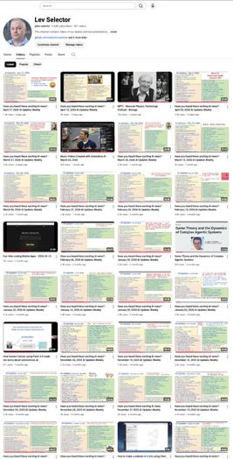
We do these weekly videos every Friday
Stats: 7K subscribers, 295 videos
1. Subscribe to this channel https://www.youtube.com/@lev-selector
2. Download slides from GitHub using links under the videos
3. Please pause the video - and answer the pinned question in comments under the video

Slide 7

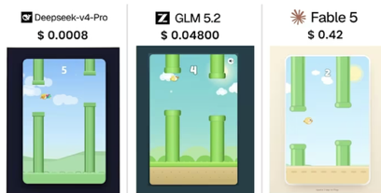
Chinese Models Are Cheaper
Flappy Bird Test: .. DeepSeek v4 Pro .. GLM 5.2 .. Fable 5
https://www.youtube.com/watch?v=i6r0GyFpI4I
Claude 3.5 Sonnet vs DeepSeek V4 Pro
Both have built a website for coffee shop: animated interactive drink configurator, database for orders, admin dashboard
Costs: Sonnet - $11, DeepSeek - $0.08
Sonnet - more reliable drink configurator and case-insensitive admin search, but no navigation menu or a footer
DeepSeek built a cleaner, more complete layout with a sticky menu, though its configurator had minor pricing bugs
https://www.youtube.com/watch?v=Yot-6wXrcyI (in Russian)

Slide 8



AI Updates
Organization-wide Agent - Andrej Karpathy
https://x.com/karpathy/status/2069547676849557725
https://www.youtube.com/watch?v=eMVaGOsfYs8
from (1) isolated web chatbots and (2) desktop apps to (3) persistent, organization-wide AI entities
Anthropic’s Tag feature in Slack - generates 65% of Anthropic's internal product code !
AI can now act as an active, multiplayer "employee" deeply integrated across a company’s entire system, tools, and context.
"Claude Tag" is currently only for Team/Enterprise
A small businesses can build a similar functionality using custom Telegram bots connected via AWS and tools like Composio
Composio SKD connects agents to 100s of apps (GitHub, Slack, Salesforce, Notion, Jira, Gmail, databases, OS tools)
It handles authentication (OAuth, API keys, JWT(JSON Web Token)), sandboxed execution, logging, and dashboards so you don’t have to hand‑roll API glue and infra for each tool
This makes it useful for turning agent prototypes into production workflows like code assistants, sales bots, or admin helpers
https://composio.dev
https://github.com/ComposioHQ/composio
https://aws.amazon.com/marketplace/pp/prodview-skjxykuajjn34
https://github.com/ComposioHQ/composio/blob/master/docs/introduction/intro/overview.mdx

Slide 9

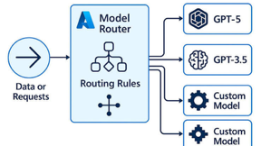
AI Updates
Tencent’s Hy3 - open MoE LLM
Reasoning, coding, and agentic workflows
295B params, 21B active per token
Context length 256K tokens
Suitable for large codebases and extensive documents
“fast vs deep” config
Strong on SWE‑bench coding tasks and advanced math/scientific reasoning
Cost‑efficient for production use
https://www.tencent.com/en-us/articles/2202386.html
Model Routing Helps to Save 60% - 90% of costs
Planning - use highly capable, expensive "frontier" model
Execution - use a cheaper, specialized model
Because output tokens cost significantly more than input tokens, offloading the high-volume code-generation phase to cheaper models drives massive savings
https://www.youtube.com/watch?v=1KKB_UiW6ls

Slide 10
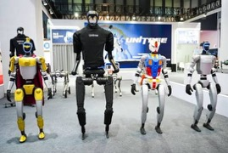
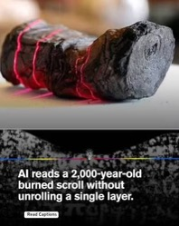

AI Updates
China - 140 humanoid robot companies, 330+ models
Major players - Unitree, AgiBot and UBTECH (80–85% of global installations)
Computational archaeology - decipher 2,000-y.old carbonized Vesuvius scrolls using high‑resolution X‑ray micro‑CT scans, virtual unwrapping algorithms, and Deep‑learning models trained to detect faint ink signals on these surfaces invisible to human eyes
From single words to fully decoded scrolls https://www.theguardian.com/science/2024/feb/05/ai-helps-scholars-read-scroll-buried-when-vesuvius-erupted-in-ad79
Joe Rogan Experience #2521 - Aravind Srinivas
https://www.youtube.com/watch?v=fOLu-pWQssQ
The Brahmastra & Ancient Weapons: They discuss the Mahabharata (an ancient Hindu epic estimated to be 1,500 to 2,500 years old). The guest describes the Brahmastra as the ancient equivalent of a hydrogen bomb
The Currency of the Future - "curiosity premium." As the cost of cognition drops to the cost of compute. Status and success will shift to those who know how to ask the deepest, most original questions.
True intelligence will be defined by problem-poking, agency, execution, and the intellectual humility to self-correct when faced with new data
Economic Shifting - "AI dividend" or subsidy system similar to the Alaska Permanent Fund or resource-abundant Gulf States

Slide 11

Sentdex
Sentdex - https://www.youtube.com/watch?v=AgpeggCsRH4
Running AI Locally Doesn't Require an Expensive Setup
A single consumer GPU like an RTX 3090 or 4090 can handle roughly 70% to 90% of local coding and general Q&A model needs
GLM-52 Quantizations - standard 8-bit KV caching significantly degrades GLM-52's performance after 1k to 8k context lengths. Switching to a 16-bit KV cache fixes this
Using Terminal Bench v2.1 for long-horizon agentic coding tests, he found that a highly compressed 2-bit quantization of GLM-52 performs almost identically to the 4-bit version
Scaling "test-time compute" (allowing a model more tokens to actively reason through a problem before answering) significantly levels the playing field. Even a fundamentally "dumber" model can achieve incredible benchmark results if it is allowed to reason for a long time. Because of this, he argues that closed-source giants have no permanent moat over open-source alternatives
DeepSeek V4 Flash - very fast and extremely cheap via providers like Open Router (roughly 14 cents per million input tokens)
Qwen-3.6-35B-A3B / Qwen 2.5 Coder - work on single 24GB GPU (especially good when paired with Multi-Token Prediction (MTP) to maximize tokens-per-second)
Agents Hermes (general purpose) & Minion (for coding)
Sentdex - https://www.youtube.com/watch?v=31MvP7yHzxM
Running AI Locally for software engineering
Half of coding tasks can be done with local models like Qwen 32B or 27B, relying on cloud APIs only when needed
DeepSeek V4 Flash is best for fully local setup. MoE, 13B active, runs fast at native precision via vLLM and tensor parallelism
Aggressive quantization, like dropping to an 8-bit KV cache, severely tanks model intelligence
Ultimately, fast local models excel when developers remain in the loop to guide them.

Slide 12
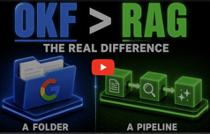

AI Updates
Open Knowledge Format (OKF) from Google Open Standard for the Karpathy LLM Wiki
https://www.youtube.com/watch?v=T33iI6izAKw
https://www.youtube.com/watch?v=VHKXIHP4i10
OKF is a standardized file format consisting of structured Markdown documents
OKF operates like a curated, cross-linked wiki handbook that an AI agent can directly read, navigate, and update
Claude in Chrome is Anthropic’s official Chrome extension
It lets Claude see the page you have open, understand its structure, and then take actions like clicking buttons, following links, filling forms, and extracting or summarizing information
Combined with Claude Code, you can build or modify a web app in the terminal, then have Claude in Chrome open and exercise the running app to test flows and catch issues without manual copy‑paste
Functionally, it turns Claude from a pure chat assistant into a lightweight browser automation agent that operates within your existing authenticated Chrome session
https://claude.com/claude-for-chrome
https://claude.ai/chrome
https://www.anthropic.com/news/claude-for-chrome
https://code.claude.com/docs/en/chrome

Slide 13

AI Updates
KV (Key-Value) Cache and PagedAttention
These are open-source mechanisms from the vLLM inference engine - used to speed up LLMs
https://www.youtube.com/watch?v=o0gkdZBtwEg
During LLM inference, the prefill phase processes the prompt, while the decode phase generates tokens sequentially
Normally, generating a new token requires recomputing all previous tokens, which degrades performance
KV caching prevents this by saving past key-value matrices
However, standard KV caching creates fragmented memory by pre-allocating large, rigid slots
PagedAttention solves this by breaking the cache into small, non-contiguous pages mapped dynamically, cutting memory waste by up to 80%
The video concludes with optimization tips, including .. tuning memory utilization .. enabling prefix caching .. using chunked prefill
Use Python to make Karpathy-style wiki
https://towardsdatascience.com/llm-wikis-are-over-engineered-i-replaced-mine-with-a-pure-python-compiler/
How to Talk to Claude
https://www.youtube.com/watch?v=OgT1Or4OP1k
Cal Hyslop explains that you should shift from asking simple questions to providing 3 things:
- context
- outcome (what is required)
- role (to expose blind spots and analyze decisions)

Slide 14
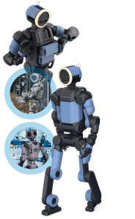
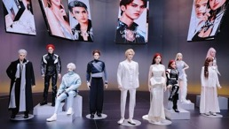
AI Updates
Boston Dynamics’ fifth-generation Atlas humanoid robot
Reduced complexity by nearly an order of magnitude
Reducing number of parts, simplifying manufacturing, which improves reliability and lowers costs
Backed by Hyundai’s mass-production expertise, Atlas is being positioned for large-scale deployment
Plans for up to 30,000 units annually
Physical agility remains a core strength
Boston Dynamics is combining advanced control systems with higher-level decision-making, aiming to turn Atlas from an expensive showcase into a commercially viable, flexible industrial worker
https://www.forbes.com/sites/johnkoetsier/2026/07/02/boston-dynamics-new-atlas-humanoid-robot-order-of-magnitude-simpler/
Chinese company Ubtech - UWorld U1 series of robots
The world's first full-sized humanoid robots for mass production
Starting at $17,600
Lifelike - silicone skin, 88 motion joints, and an emotion-aware AI model that reads feelings with over 90% accuracy
U1 offers conversational memory and context awareness
U1 secured 13K launch-day orders
Ubtech plans to donate 100 customized units for grieving or lonely individuals (using 3D facial reconstruction to replicate faces)
https://www.ubtrobot.com

Slide 15


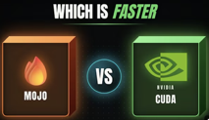
AI Updates
Qualcomm Uses Mojo programming language
Qualcomm recently acquired Modular, a startup founded by compiler expert Chris Lattner (LLVM, Swift, Mojo)
Modular created Mojo
Mojo = Python-like syntax + high-performance execution
Mojo can run on Nvidia, AMD, and Apple chips
In performance tests, pure Mojo kernels match Nvidia's flagship libraries on native hardware
By integrating Mojo with its upcoming AI data center cards, Qualcomm provides a cross-compatible software ecosystem capable of threatening Nvidia’s market chokehold
https://www.youtube.com/watch?v=aUftJ0xBmeY
Mobile OpenClaw now works with Android and iOS.
It can talk to you, access photos, contacts, calendar, notifications, device state

Slide 16
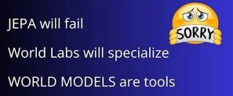
AI Updates
Three AI world model paradigms:
Meta’s JEPA,
WorldLabs’ taxonomy,
Einstein World Models concept
JEPA focuses on learning world within an abstract latent space
WorldLabs structures world models into renderers, simulators, and planners
Einstein World Models framework from MBZUAI (Mohamed bin Zayed University of Artificial Intelligence, Abu Dhabi, UAE) treats world models as modular tools. LLMs remain the primary reasoner, calling on visual world modules to perform thought experiments when linguistic reasoning falls short
The speaker argues that unified embedding architectures like JEPA may fail, predicting that future AI will favor modular, tool-based visual physics simulations controlled by LLMs
https://www.youtube.com/watch?v=tv17bmE2FNY
JEPA is just LoRA in disguise
JEPA acts as a matrix factorization mechanism creating a low-rank approximation of the world's transition dynamics
New research from Peking University and the University of Sydney provides a math explanation of Joint Embedding Predictive Architecture (JEPA)
By filtering out high-dimensional visual noise like pixels, JEPA focuses purely on action-relevant movements
This dynamic creates a critical balance between approximation error and sample complexity error
Drawing a parallel to low-rank adaptation (LoRA) in language models, the host introduces a novel concept: creating "JEPA adapters."
These specialized add-ons could efficiently fine-tune foundational world models for specific domains, such as medical robotics, without intensive retraining
https://www.youtube.com/watch?v=2RVz67hxSAU

Slide 17
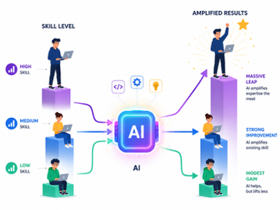
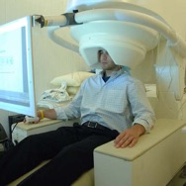
AI Updates
AI has not made people universally better It amplifies existing skill levels
Skilled engineers use it to dramatically increase productivity, turning weeks of work into hours
Unskilled users generate fragile code, technical debt, and costly failures they cannot diagnose. Real-world incidents show how misuse leads to security breaches, data loss, and wasted resources
The market reflects this divide: top-tier models drive innovation, while cheaper alternatives commoditize routine tasks
Meanwhile, a growing ecosystem resells access and exploits leaked API keys
Ultimately, AI rewards strong fundamentals and punishes their absence, widening the gap between competent professionals and those relying blindly on automation.
https://www.linkedin.com/pulse/learned-helplessness-service-viacheslav-kasatkin-dvupc/
Meta Brain2Qwerty v2
Measures magnetic field around the head using MEG (Magneto-Encephalography scanner)
Uses AI to decode brain activity into text while the patient is typing
61% average word accuracy, peaking at 78% for the top participant
Requires giant laboratory equipment
Holds massive long-term potential for paralyzed patients

Slide 18

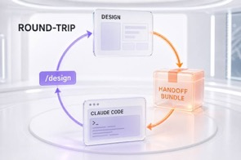
AI Updates
10 core components of an AI agent harness: https://www.youtube.com/watch?v=mQfTdNVCOB0
Instructions - rules, prompts, styling guides
Context Delivery - read files, stack traces, relevant data
Context Management - filter and compresses transcripts, re-rank data, reduce noise
Tool Interface (schemas, MCP) to request actions
Execution Environment (sandbox, container)
Durable State - persistence mechanism (database, memory)
Orchestration - retry, step-by-step, human approval gates
Sub-Agents - delegating specialized sub-tasks
Skills and Procedures - reusable playbooks and checklists
Verification & Observability - test output, logs for debugging
Claude Design’s June 2026 update
Adds proper design system imports, a better canvas editor, and tighter Claude Code integration
You can now use real components from your GitHub or design files, edit layouts directly on a canvas, and sync designs with code in both directions
The goal is to keep work on-brand while reducing token usage in everyday product design workflows
https://claude2video.com/blog/claude-design-june-2026-update

Slide 19

AI Updates
Anthropic’s Claude Certified Architect (CCA-F) Exam
Prep in 4 weeks for test (60 questions across 5 domains)
https://www.youtube.com/watch?v=akzKBQVyFEI
Claude is presented as a stateless model behind a single messages API, with four key layers: raw API, Agent SDK, Claude Code, and MCP for tool integration
The guide then walks through each domain:
Agentic loops and multi-agent orchestration (including correct tool_use sequencing and targeted retries)
Claude Code configuration via claude.md hierarchy and commands
Prompt engineering with strict, checkable rules and forced JSON tool calls
Robust tool/MCP design with clear descriptions and structured errors
Context/reliability patterns like case blocks, prompt caching, and escalation rules
https://www.anthropiccertifications.com/learn
https://preporato.com/certificates/claude-certified-architect

Slide 20

AI Updates
Alex Hormozi's three-folder organization for AI Agent
"Business Context" - md files - company's identity, target audience, brand voice, and goals
"Data" - raw training materials, such as past newsletters, to help the AI mirror specific tones and writing cadences
"Prompts" - highly detailed, reusable prompt templates specifying strict roles, rules, and structures
https://www.youtube.com/watch?v=q1_AjJAmDGY

Slide 21
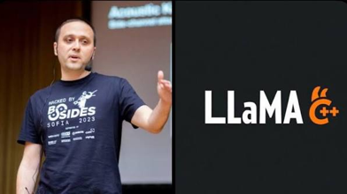
llama.cpp
llama.cpp https://github.com/ggml-org/llama.cpp
Georgi Gerganov
llama.cpp "finetune" utility was removed
Current versions focus on inference, quantization, and serving
You can fine-tune your model today using a PyTorch-based stack (e.g., TRL or LLaMA-Factory) and then convert the resulting Hugging Face model to GGUF for high-performance CPU or edge inference with llama.cpp
This lets you leverage robust training tooling while still using llama.cpp where it excels: lightweight, fast local serving of already fine-tuned models
https://github.com/ggml-org/llama.cpp/tree/213701b51a17175d0d326b566efc03f30ec7fbe6/examples/finetune
Accelerating llama.cpp using Claude Fable 5
Codacus uses Claude 5 Fable to optimize the llama.cpp codebase on a mid-range local AI rig
The AI analyzed the software, profiled performance, and achieved a massive 64.5% speedup in prefill prompt processing.
Claude discovered that the GPU sits idle over 41% of the time waiting for MoE model weights to transfer from system RAM across the slow PCIe bus
To fix this, the AI enabled pinned mmapped memory for faster transfers and restructured the pipeline to upload expert layers in parallel while the GPU computes attention.
https://www.youtube.com/watch?v=VytSYCDhWQ0

Slide 22


AI Updates
Open Source Repos for Claude Code
https://www.youtube.com/watch?v=IRPEfl2BD_c
Claude Video - https://github.com/bradautomates/claude-video - video ingestion - transcribes audio via Groq's free Whisper model and intelligently extracts keyframes
NotebookLM-MCP - https://github.com/topics/google-notebooklm - brings Google’s NotebookLM into the Claude Code terminal, allows you to offload huge document research and synthesis tasks to Google's servers for free
Graphify - https://graphify.net - maps codebases by compressing files into a knowledge graph of nodes and clusters (not needing expensive vector DBs)
Obsidian Skills - https://github.com/topics/google-notebooklm - compact repo trains Claude Code on best practices for managing markdown files, PDFs, and media assets within an Obsidian notebook
Impeccable - https://github.com/pbakaus/impeccable - open-source design tool
Ponytail - https://www.youtube.com/watch?v=2xuFcmUAQUc - A token-efficiency plugin outputting up to 54% fewer lines of code
Evolution of RAG - https://www.youtube.com/watch?v=cyQ4ffFU27Y
Naive RAG - simple semantic vector searches - suffers from strict chunking limitations.
Advanced RAG - adding pre-retrieval (multi-query expansion) and post-retrieval reranking algorithms
GraphRAG - structured knowledge graphs map relationships across documents
Agentic RAG - handles queries using autonomous reasoning loops to dynamically choose tools, trading high latency for maximum flexibility

Slide 23
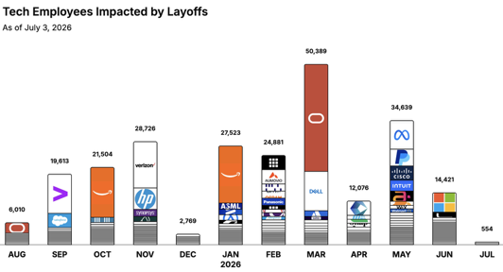
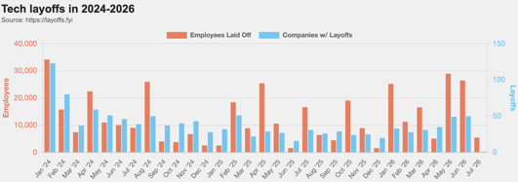
https://layoffs.fyi
https://trueup.io/layoffs
Jobs
The Tech Layoff Tracker
In 2026: 164,483 people laid off (894 per day)
In 2025: 245,953 people laid off (674 per day)
In 2024: 238,461 people laid off (653 per day)
https://trueup.io/layoffs
“Oracle sheds 21,000 jobs, shrinking the company’s headcount by 13% as it continues to invest in Artificial Intelligence.” - The Wall Street Journal
Tech Layoffs by year (US only):
119K in 2026 (as of July 3, 2026)
124K in 2025
153K in 2024
264K in 2023
165K in 2022 https://layoffs.fyi

Slide 24


About the Speaker
Lev Selector, Ph.D.
40+ years of software engineering, data science, and building teams (hiring, training, and managing)
Ph.D. in mathematical modeling and computer simulations
Interests:
Generative AI, Using LLM with your data
Local AI for Local Private Data
Cloud architecture, fin-tech, application security
Find/connect: Linkedin, GitHub, YouTube, Google
https://eais.ai
Enterprise AI Systems

Slide 25
Thank You!

