Slide 1
AI Updates - Aug 07, 2026
“Manual” work is becoming a legacy
Crowd-sourced "LM Arena" Leaderboard
Cost Per Intelligence Index
xAI Launches Grok Build Mode
Sakana AI Nature-Inspired Intelligence
Codebase Memory MCP
Demis Hassabis - Chief Scientist of Alphabet
Thinking Machines Inkling-Small 276B
Google Gemini Spark AI personal AI Agent
OpenAI Astra Solves 10 Math Problems
Muse Code vs Claude Code
/doctor is a built‑in Claude Code command
9Router - FREE AI Router & Token Saver
AI System for Endless Content Ideas
Tencent Open-Source AI Memory System
GraphRAG - Better than Vectors
Julia McCoy - Liberating from Desk Work
Abacus AI Self-Improving Autobots Demo
Microsoft FARAH 1.5 Browser Agent Model
Empero Qwythos 27B - open, local, multimodal
KAT-Coder-V2.5-Dev
ZLUDA: Running CUDA on AMD Graphics
Pi on a RTX 3060 12GB
Rust’s quiet systems takeover
GenOffice vs MS Office, GenSpark
Mobile Next, MobileCLI, MobileMCP
Zero Day Clock
Leopold Aschenbrenner
Meta Compute - renting GPU capacity to external clients
Claude /watch video skill - summarize content
Buzzy - cinematic AI canvas
Five Layers of AI Operating System
Hermes Agent 0.20, Hermes + Buzz
Tailscale Connects AI Agent to Mobile
Liquid LFM2.5-2.6B small local agentic model
Minimax H3 - Video AI
Neuralink wheelchair + BCI (Brain-Computer Interface)
Qwen 3.8 Max Open Weight
Dreamina Seedance 2.5 - AI Video Generation
Jobs & Layoffs

Slide 2
"LM Arena" Leaderboard
Data for Aug 6
Starting Elo rating = 1000
https://en.wikipedia.org/wiki/Elo_rating_system
English - https://lmarena.ai/leaderboard/text
Coding - https://lmarena.ai/leaderboard/text/coding
■ | Claude
■ | Gemini
■ | OpenAI
■ | Open Source
Claude Fable-5 - 6TB
Claude Opus-4.8 - 5TB
Claude Sonnet-4.5 - 1TB
Claude Sonnet-5 - ?
GLM-5.1 - 744B
Meta muse-spark - 16 x 70B
Qwen3.7-max-preview - 745B
Qwen3.8-max-preview - 2.4TB
Baidu Ernie-5.1 - 800B
Deepseek-v4 - 1.6T
Kimi-k3 - 2.8T
Xiaomi MiMo-V2.5-Pro - 1T+
ByteDance dola-seed-2.0-pro 400B
Minimax M3 - 456B
Code | Model | Score
■ | claude-fable-5 | 1507
■ | claude-opus-4-6-thinking | 1505
■ | claude-opus-4-7-thinking | 1502
■ | muse-spark-1.2 (xHigh) | 1498
■ | claude-opus-4-6 | 1497
■ | qwen3.8-max | 1497
■ | claude-opus-4-7 | 1493
■ | claude-opus-5-high | 1493
■ | claude-opus-5-max | 1488
■ | muse-spark | 1488
■ | muse-spark-1.1 | 1487
■ | gemini-3.1-pro-preview | 1487
■ | gemini-3-pro | 1486
■ | kimi-k3-max | 1485
■ | gemini-3.6-flash | 1485
■ | claude-opus-4-8-thinking | 1483
■ | gpt-5.5-high | 1482
■ | gpt-5.6-sol-xhigh | 1482
■ | gpt-5.4-high | 1477
■ | gpt-5.5 | 1477
■ | gemini-3.5-flash-high | 1476
■ | gpt-5.2-chat-latest-20260210 | 1476
■ | qwen3.7-max-preview | 1475
■ | grok-4.20-beta1 | 1474
■ | gemini-3.5-flash-medium | 1474
Code | Model | Score
■ | claude-fable-5 | 1553
■ | claude-opus-4-7-thinking | 1552
■ | claude-opus-4-6-thinking | 1551
■ | claude-opus-4-6 | 1547
■ | claude-opus-4-7 | 1546
■ | kimi-k3-max | 1542
■ | claude-opus-4-8-thinking | 1535
■ | qwen3.8-max | 1532
■ | muse-spark-1.1 | 1532
■ | claude-opus-4-5-20251101-thinking-32k | 1530
■ | claude-opus-5-high | 1530
■ | claude-sonnet-4-6 | 1528
■ | claude-opus-5-max | 1527
■ | claude-opus-4-8 | 1527
■ | muse-spark-1.2 (xHigh) | 1526
■ | muse-spark | 1526
■ | qwen3.7-max-preview | 1526
■ | gpt-5.6-sol-xhigh | 1525
■ | claude-sonnet-5-high | 1525
■ | gemini-3.6-flash | 1524
■ | claude-opus-4-5-20251101 | 1523
■ | gpt-5.4-high | 1521
■ | gemini-3.1-pro-preview | 1521
■ | gpt-5.6-terra-xhigh | 1521
■ | grok-4.5 | 1520

Slide 3
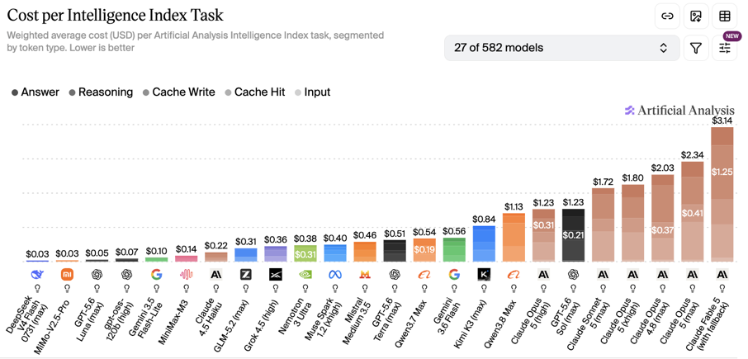
Artificial Analysis Intelligence Index
Artificial Analysis Intelligence Index
https://artificialanalysis.ai
https://artificialanalysis.ai/evaluations/artificial-analysis-intelligence-index
https://www.youtube.com/watch?v=nxr20lcqagg - Anthropic vs OpenAI
July 21

Slide 4
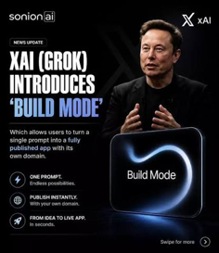

AI Updates
xAI Launches Grok Build Mode
https://x.ai/blog/grok-build
https://www.youtube.com/watch?v=_1ETUXJ3BCQ
Grok introduced Build Mode, text-to-app feature
Allowing users to create apps from text prompts
Created apps publish instantly to grok.me links or custom domains, completely removing traditional software development delays
The system integrates coding agents, AI image generation, and live web browsing capabilities directly into the chat
Multiple parallel helper agents work simultaneously to build complex interactive features like dashboards, games, and quizzes.
Users can export generated code directly to GitHub, making it easy to refine or customize their software later.
The update transitions AI from answering general questions to building and shipping complete digital products in minutes.
Sakana AI Nature-Inspired Intelligence
Sakana AI - Tokyo-based research company, unusually innovative and open-source oriented
https://www.youtube.com/watch?v=O8Ru0Wyzk6E
https://github.com/sakanaai
https://en.wikipedia.org/wiki/Sakana_AI
Some Ideas: model merging, autonomous research agents, and biologically inspired architectures; Continuous Thought Machines - neural timing, history-aware neurons, and synchronization over time; Spike Neural Networks - https://pmc.ncbi.nlm.nih.gov/articles/PMC9313413/

Slide 5
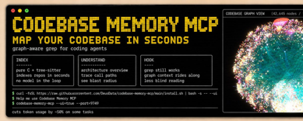
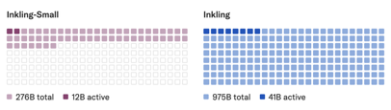

AI Updates
Codebase Memory MCP
A fast and token efficient MCP server that indexes codebases into a persistent knowledge graph for AI coding agents
https://github.com/DeusData/codebase-memory-mcp
It parses source code with tree-sitter and stores structural relationships like functions, classes, calls, imports, and routes locally in SQLite
https://www.tecmint.com/install-codebase-memory-mcp-linux/
Agents query the graph instead of rereading files, which can cut token usage dramatically
Reported performance is very high, with average repos indexed in milliseconds and structural queries answered in under 1 ms
It is open source, ships as a single static binary with zero dependencies, and works across major desktop operating systems
https://skillsllm.com/skill/codebase-memory-mcp
https://codebase-memory.com
Demis Hassabis is stepping down as Google DeepMind CEO and moving into a chairman role, while also becoming Chief Scientist of Alphabet
Day‑to‑day leadership of Google DeepMind shifts to Koray Kavukcuoglu as senior VP reporting to Sundar Pichai.
Thinking Machines Inkling-Small 276B
Open-weight, multimodal, x4 smaller, nearly same performance
Context length 1M tokens
API pricing starting at $0.58 per 1M input tokens
https://thinkingmachines.ai/news/inkling-small/

Slide 6
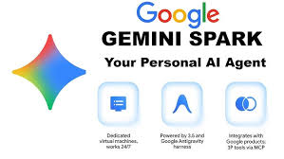

AI Updates
Google Gemini Spark AI personal AI Agent
https://www.youtube.com/watch?v=TBJ1NsvzatA
https://www.youtube.com/watch?v=lexZNRYc8ug
Operates on Google Gmail, Docs, Drive, Calendar, and Sheets (Google Workspace) - can run tasks even when your phone is locked or laptop is closed
Using Chrome Auto Browse, it can pilot web browsers to research topics, navigate web pages, fill out online forms, and compare data
Users can create custom reusable skills and scheduled triggers to automate recurring tasks such as morning briefings, inbox decluttering, and research summaries
OpenAI Astra Solves 10 Math Problems
https://www.youtube.com/watch?v=n7BpBCCCOWA
OpenAI announced Astra, an unreleased long-horizon model family built specifically for parallel multi-agent execution on complex, multi-hour technical assignments
Internal testing demonstrated that an early version of Astra successfully solved ten major open problems in mathematics and theoretical computer science
These long-standing open problems had resisted all human progress for at least ten years, spanning geometry, group theory, quantum complexity, and cryptography
Solutions were generated for roughly two thousand dollars in API compute tokens, with every mathematical proof formally verified using machine-checkable Lean certificates.

Slide 7
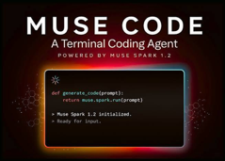
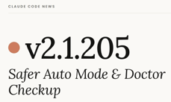
AI Updates
Muse Code vs Claude Code
curl -fsSL https://dev.meta.ai/install.sh | bash
https://www.youtube.com/watch?v=Gjw3ok6alYY
https://research.meta.ai/blog/introducing-muse-code-and-muse-spark-1-2
Muse Code is Meta’s new terminal-based AI coding agent, built as a harness around the Muse Spark 1.2 model, focused on long-horizon software engineering and large repos
Harness features: Automatic fan-out to parallel subagents with isolated project copies, append-only local event log with crash-resume, and bundled skills like /plan, /grill, and /goal for planning and interrogation
Positioning vs Claude Code: Weaker frontier-level brain than top models like Claude, but a strong, transparent harness aimed at being a cheap, fast sub-agent inside multi-model systems rather than a primary builder
Muse Spark 1.2: 1M-token context coding model, “fast, cheap worker”, co-trained inside Muse Code
optimized for long debugging sessions, multi-file changes, and persistent tool use
/doctor is a built‑in Claude Code command
It runs health checks on your installation, configuration, skills, MCP servers, Claude.md, and token-heavy context, then reports what’s healthy, what’s misconfigured, and what you can safely trim or fix
You just type /doctor (or run “claude doctor”) and it updates with Claude Code itself.

Slide 8
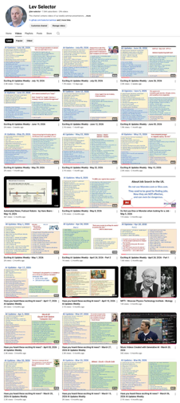
We do these weekly videos every Friday
Stats: 7.19K subscribers, 302 videos
1. Subscribe to this channel https://www.youtube.com/@lev-selector
2. Download slides from GitHub using links under the videos
3. Please pause the video - and answer the pinned question in comments under the video

Slide 9


AI Updates
Claude /watch video skill - summarize content
by combining time-stamped transcripts with per‑second screenshots
https://www.youtube.com/watch?v=gQhyMynG6x4
https://www.youtube.com/watch?v=QZMljuD10sU
https://github.com/bradautomates/claude-video
https://www.facebook.com/groups/DesignHacker/posts/2177246519758209/
Uses yt-dlp to download from 1000+ video sites, FFmpeg to slice frames, and Whisper/YouTube captions for text
Each frame is linked to the exact transcript segment at that second, giving Claude synchronized visual and audio context
Runs inside Claude Code via a custom /watch skill and a simple prompt pattern
Enables hooks, pacing, on‑screen text, visual beats, and moments transcripts would miss
Works well for content strategists, social media analysis, competitor ad breakdowns, and long-form educational videos.
Buzzy - cinematic AI canvas
https://www.youtube.com/watch?v=-Or92nOgDoc
https://www.buzzy.now
Agentic infinite canvas for end‑to‑end AI video production: script, character, storyboard, and final video in one workspace
Integrates 50+ pro tools and 70+ image/video models (Seedance 2.5, Veo, Kling, Runway, Nano Banana Pro, GPT Image)
Uses Omni Reference to lock faces and products from one photo, giving consistent characters and shots across scenes
Offers director-level controls: lighting and camera sliders, 9‑grid storyboard splits for shorts/Reels/TikTok; Ships clonable studio workflows (e.g., Nature’s Essence candle ad) so creators and agencies can sell cinematic AI ads without a traditional crew

Slide 10


Five Layers of AI Operating System
Agent OS - by Julian Goldie SEO
Agent Operating System is a unified “mission control” where multiple AI agents (builder, designer, video, SEO, music) collaborate with shared memory and custom workflows
Models are swappable (Hermes, Claude, GPT variants, local LFM2.5–2.6B), letting you trade speed, cost, and rate limits
Runs on modest hardware (laptop is OK)
Includes loop and goal modes
Lets you easily plug new models, tools, and workflows
Google Search Console integration (now with social data) drives automated SEO content creation from ranking keywords.
Fast 20-30 min local setup
Layer 1 - Mission-Control Dashboard - AI models and Agents
Layer 2 - Memory (obsidian wiki) - bus. context, prefs, logs
Layer 3 - Router - router tasks - saves money
Layer 4 - Agents (Workers & Workflows) - parallel worker agents that carry out specific tasks using systems like a Kanban board and controlled by a single commander agent
Layer 5 - Loop Engineering (Continuous Improvement) - updates the memory, making future outputs smarter
https://www.youtube.com/watch?v=H3OZiTbD1OU
https://www.youtube.com/watch?v=ZhJi_npUQcQ
https://www.youtube.com/watch?v=ru07BOhF1wk
https://buzz.xyz
Hermes Agent + Buzz team workspace
https://hermes-agent.nousresearch.com/docs/integrations/buzz
https://www.youtube.com/watch?v=b42vjtH6mNM
Hermes Agent + Buzz team workspace
https://hermes-agent.nousresearch.com/docs/integrations/buzz
https://www.youtube.com/watch?v=b42vjtH6mNM
Hermes Agent 0.20
This is the "Herald" release (finding its voice)
Adds real-time voice. It can speak while thinking, accept interruptions, wake on a custom wake word
Voice notes now work across apps like WhatsApp
Grounded citations, safer approval prompts, faster responses, better compression, and agent-to-agent coordination
“Open line” idea - continuous collaboration

Slide 11


AI Updates
Tailscale connects local AI agent to mobile devices
https://tailscale.com
https://github.com/tailscale/tailscale
https://tailscale.com/blog/what-is-tailscale
https://www.youtube.com/watch?v=HLAgkQMivp0
End-to-end encrypted mesh network without exposing ports
Setting up the connection takes around ten minutes by generating a private HTTPS address through a local Tailscale tunnel
Users can monitor autonomous workflows, trigger new tasks, and check agent memory databases from anywhere using a smartphone
Private tailnets isolate traffic entirely, ensuring your local host data stays secure while avoiding third-party cloud hosting costs
The mobile Tailscale application must remain toggled active to maintain seamless communication between mobile devices and host workstations
Liquid LFM2.5-2.6B small local agentic model
runs in under 2.5 GB of memory, targets phones and laptops, and is designed to stay responsive on CPU hardware
Liquid AI says it works out of the box with harnesses like Hermes Agent, OpenClaw, and Pi
The model is trained for multi-step agent workflows, including planning, calling tools, and completing tasks
https://www.liquid.ai/blog/lfm2-5-2-6b
https://www.youtube.com/watch?v=287bPhWHTo0

Slide 12
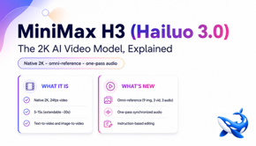

AI Updates
Minimax H3 - Video AI
https://platform.minimax.io
https://github.com/MiniMax-AI
https://www.youtube.com/watch?v=bLfF4X3F2ew
Minimax H3 generates video from text, images, audio
Strong gains in realism, physics, and detail
“one prompt” video creation: script, B-roll, voiceover, avatar, and editing handled automatically
Integrates into agent-based systems for automated video pipelines and AI avatar content
Ranked highly in benchmarks, especially for video editing and image-to-video tasks.
API access available; open-weights release planned under a community license.
Positions itself as a leading open video generation model with strong editing capabilities.
Neuralink wheelchair + BCI (Brain-Computer Interface)
https://neuralink.com
https://www.youtube.com/watch?v=tLMQYYp5tBc
Mind-controlled wheelchair navigation
Clinical trials - ALS patients experiencing restored mobility, improved posture, and seamless device integration compared to traditional manual controls
Patient 26 in Canada became the first individual to receive thread insertion directly through the dura layer at Toronto Western Hospital
Participants demonstrated simultaneous use of brain-computer interfaces alongside respiratory equipment like BiPAP machines
Private market valuation for Neuralink surpassed $40 Bln

Slide 13
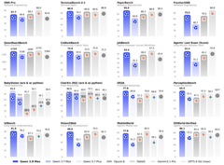



Qwen 3.8 Max
Qwen 3.8 Max Open Weight
https://qwen.ai
https://github.com/QwenLM
Qwen 3.8 Max is Alibaba’s newest flagship open-weight model
2.4 T params
General use, research, agentic workflows, science
On level with top US frontier models
Pricing $2 / $6 (in/out per 1M tokens)
API-compatible with OpenAI and Anthropic-style tooling
Dreamina Seedance 2.5 - AI Video Generation
https://dreamina.capcut.com
https://www.youtube.com/watch?v=Hpl0E53ioEo
Up to 3 min long, with consistency
Combines video and audio generation
Interactive editing - no need to regenerate the whole clip
Supports many references and production-style workflows
Dreamina is ByteDance’s AI creative platform
Seedance is ByteDance’s video model
CapCut is ByteDance’s editing app

Slide 14
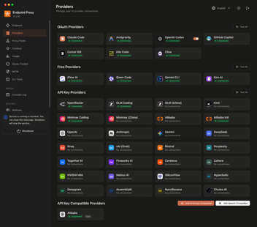
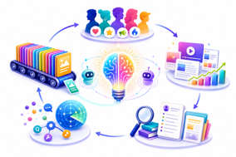
AI Updates
9Router - FREE AI Router & Token Saver
https://github.com/decolua/9router
9Router connects locally to over 573 AI models and 40 providers - and allows switching to prevent API rate limits or token exhaustion
It integrates with tools like Claude Code, Cursor, and GitHub Copilot using your existing sessions and automatic fallbacks
Built-in optimization features save 20%-40% on token usage while keeping project code and chat history locally organized
Users can easily run local coding models to maintain workflow continuity and build complete applications without recurring costs
https://www.youtube.com/watch?v=bHLgidjAl9I
https://theaiprofit.com
AI System for Endless Content Ideas https://www.youtube.com/watch?v=cSz_6SNEirU
Claude + ChatGPT
Craft a rich audience profile detailing triggers, mindsets, and preferences rather than a standard ICP.
Track winning content patterns and performance data across platforms like LinkedIn, Substack, and YouTube.
Integrate real-time market trends and viral discussions using MCP tools and external web sources.
Utilize AI for high-quality research, idea generation, and structured drafting while maintaining personal creative taste.
Consistently maintain and refine an active content queue to prevent running out of creative ideas.

Slide 15
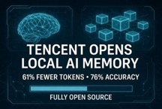
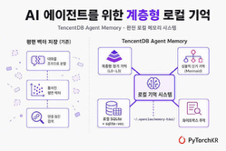
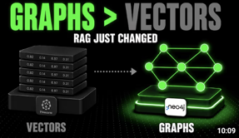
AI Updates
Tencent Open-Source AI Memory System
https://www.youtube.com/watch?v=5AkurBDSYwo
Large context windows degrade LLM performance over time, causing AI agents to waste tokens and repeat previous mistakes
Tencent released an open-source MIT-licensed memory plugin designed to cut token overhead while drastically boosting benchmark success rates
The framework compresses raw execution logs into interactive Mermaid diagrams while keeping detailed underlying evidence stored safely on disk
Inspired by cognitive psychology, it structures memory into episodic events and four semantic layers, ranging from facts to persona defaults
Running locally via SQLite, it provides fast hybrid search, complete privacy, and zero API vendor dependencies for long-running workflows.
GraphRAG - Better than Vectors
https://github.com/microsoft/graphrag
https://www.youtube.com/watch?v=yqEekIQSVzQ
https://www.microsoft.com/en-us/research/publication/from-local-to-global-graph-rag/
RAG shifts retrieval from flat chunks to entities and typed links
Microsoft’s GraphRAG showed better multi-document answers, but early builds were expensive
Lazy GraphRAG cut indexing cost dramatically by moving work to query time
Stanford and Anthropic highlighted extractor quality, entity resolution, and chain-of-facts limits
The main lesson is to use graphs when questions depend on relationships, not simple lookup

Slide 16





Liberating from Desk Work
Julia McCoy - Liberating from Desk Work
you were programmed to be a machine: how to break it
https://www.youtube.com/watch?v=tAjhCOQjI0Q
Argues modern work culture is a leftover “factory mindset” equating value with hours and output
Julia describes burnout and a shift toward AI-driven automation replacing most routine work
Her company team of 15 outperforms a former team of 100
Key idea: separate “machine work” (rule-based tasks) from human work (relationships, judgment)
Recommends delegating workflows to AI gradually, like onboarding a junior employee
Encourages mobile thinking via voice instead of desk-bound typing.
Devices Julia wears: Fieldy AI notetaker, Plaud AI notetaker
https://shop.fieldy.ai - Fieldy ($130)
https://www.amazon.com/dp/B0DL9WQ4Z4 - Plaud ($180)
Emphasizes redefining identity beyond productivity toward creativity and human connection

Slide 17


AI Updates
Abacus AI Self-Improving Autobots Demo
https://autobots.abacus.ai
https://abacus.ai
https://www.youtube.com/watch?v=RAUC49M6RLE
Autobots inside Chat LLM are self-evaluating agents designed to continuously grade their performance and autonomously optimize their workflow strategies over time
Examples of usage: sales lead scoring, stock paper trading, YouTube thumbnail testing, and automated software bug fixing
Microsoft FARAH 1.5 Browser Agent Model
https://www.youtube.com/watch?v=Mxo4fqNgX0g
A family of browser automation models (4B, 9B, 27B) built on Qwen 3.5 with open weights under MIT license
Uses a vision-only approach, analyzing screenshots and predicting pixel-level actions like clicks, typing, and scrolling
Operates in an observe–think–act loop, enabling iterative decision-making across multi-step web tasks
Outperforms competitors on benchmarks, with 27B reaching 72.3% on OnlineMind2Web
Supports long workflows with up to 262K context and step memory
Includes safety checkpoints for irreversible actions and missing info
Best used in sandboxed environments; smaller 4B model runs locally efficiently

Slide 18
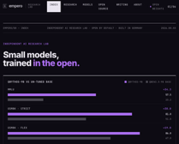

AI Updates
Empero Qwythos 27B - open, local, multimodal
Post-trained on Qwen3.5-27B base
1M context, open-weight, Apache-2.0
Vision - images, screenshots, charts, handwriting
Native multi-token prediction, faster inference
There is also Qwythos-9B
Empero is an independent research lab (Germany ?)
https://empero.org
https://huggingface.co/empero-ai/Qwythos-27B-v1
https://empero.org/writing/qwythos-27b-the-long-awaited-27b
https://www.youtube.com/watch?v=8dSk8uOVxhU
https://www.youtube.com/watch?v=iZYUgrGzQ0o
KAT-Coder-V2.5-Dev
Open-weight (Apache 2.0) MoE coding model from Kuaishou’s Kwaipilot team (Beijing, China)
Based on Qwen3.6-35B-A3B with 127K supervised examples before RL
69.4 on SWE-bench Verified and 45.96 on SWE-bench Pro
Also reduced abnormal tool labels and single-turn repetition
https://www.youtube.com/watch?v=cbb4KffkmMc
https://huggingface.co/Kwaipilot/KAT-Coder-V2.5-Dev
https://github.com/Kwaipilot

Slide 19


AI Updates
ZLUDA: Running CUDA on AMD Graphics
https://github.com/vosen/ZLUDA
https://www.youtube.com/watch?v=TRoOflwNagg
ZLUDA is an open-source software compatibility layer that allows unmodified NVIDIA CUDA applications to run directly on AMD Radeon GPUs
It translates PTX instructions on the fly, enabling local AI frameworks like Llama.cpp to run at near-native speed without rewriting code
It is written in Rust
Current support extends to Blender rendering and 32-bit PhysX games, while PyTorch compatibility remains actively under development by creator Andrzej Janik
Despite losing corporate funding and surviving repository takedowns, ZLUDA offers developers an effective alternative to NVIDIA proprietary hardware lock-in
The project lowers deployment costs for machine learning workloads by turning budget-friendly AMD GPUs into viable choices for running CUDA code
Pi on a RTX 3060 12GB
Pi is a lightweight coding-agent harness for local models
https://pi.dev - https://github.com/earendil-works/pi
https://www.youtube.com/watch?v=Nm4r-6XqEcM
prefill speed (time to first output token) vs token-per-second generation
MoE and grouped-query attention can reduce VRAM and KV-cache pressure
Many llama.cpp guides are outdated; correct flags and tool settings are critical
Small, focused toolsets can make local agents feel much faster and cleaner
Local setups win on privacy and control, but still lose on hardest long-horizon tasks.

Slide 20


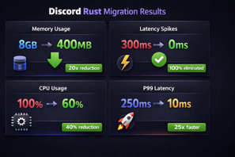


Rust Is Winning
Rust’s quiet systems takeover
CISA (Cybersecurity and Infrastructure Security Agency) set a non-binding Jan 1, 2026 memory-safety roadmap deadline for C/C++ vendors
OMB memo M-26-05 - shifting to “risk-based” agency discretion instead
Meanwhile Rust adoption surged on its own: performance-driven rewrites like Cloudflare’s Pingora proxy and Discord’s latency-critical services
https://blog.cloudflare.com/how-we-built-pingora-the-proxy-that-connects-cloudflare-to-the-internet/
https://github.com/cloudflare/pingora
Google cut Android memory safety bugs from roughly 75% to under 20% by writing new systems code in Rust while leaving old C/C++ largely intact
Linux, Android, major cloud vendors, and JavaScript tooling now embed Rust as a hard dependency, making it a practical requirement in modern systems stacks.
DARPA and others explore AI-assisted C-to-Rust migration, underscoring a decade-scale transition rather than a sudden flip

Slide 21


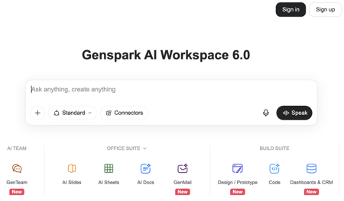
GenOffice, GenSpark
GenOffice vs MS Office
https://genoffice.ai = https://www.genspark.ai/genoffice
https://github.com/genspark-ai/genoffice
GenOffice is a full desktop office suite (Docs, Sheets, Slides, PDF) for Mac (Apple Silicon) and Windows, works on local MSOffice files
Open-sourced under an open license on GitHub
Built initially by a single engineer in about a week (using AI)
Each editor has an embedded AI panel plus a “Super Agent” for research and drafting (AI requires GenSpark account & Credits)
Genspark is an all-in-one AI agent workspace. It operates as a multi-agent orchestration platform that uses 70+ AI models (such as GPT-4, Claude, Gemini, and specialized open-source models) to handle complex, end-to-end tasks
Genspark is a product and the brand name of an AI tech company MainFunc Inc. in Palo Alto, CA - founded in 2023 by former Baidu and Microsoft executives (including CEO Eric Jing)
https://www.genspark.ai
https://www.computerweekly.com/blog/Inspect-a-Gadget/Genspark-AI-Workspace-60-SecondBrain-Note
https://www.genspark.ai/blog/genspark-ai-workspace-6
https://www.youtube.com/watch?v=O0RNqAp1wOQ

Slide 22

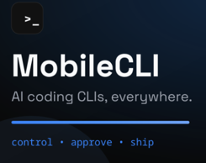
Mobile Next, MobileCLI, MobileMCP
Mobile Next - Mobile Dev. Toolset
https://mobilenext.ai
https://github.com/mobile-next/mobilecli
https://github.com/mobile-next/mobile-mcp
mobilecli app - run it on your laptop (Max, Linux, Windows) to control connected smartphone (android and iOS) or a local or cloud emulation
mobilecli manages devices, takes screenshots, taps, types, streams the screen, and launches apps
AI Agents (Claude, ...) use mobilecli, MobileMCP, Mobilewright
MobileMCP provides knowledge
Mobilewright - similar to Playwright - but for mobile automation
Mobile Next toolset provides cli and jsonrpc over http/websocket
Gil Megidish
https://www.linkedin.com/in/gilmegidish/
Germany
Primarily, it’s a tool for mobile app testing and automation
An AI agent can use it to do QA testing on mobile device
It is a part of AI-driven development on real iOS/Android devices.
You can also use it for scripted app workflows, agentic demonstrations, scraping, repetitive device operations, and building higher-level mobile automation tools.

Slide 23
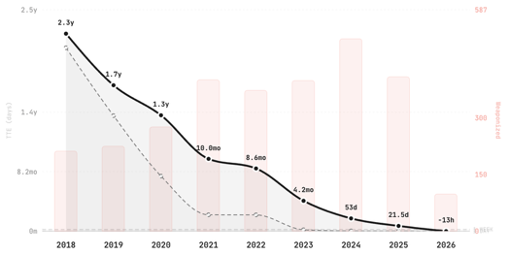
Zero Day Clock
https://zerodayclock.com
https://zerodayclock.com/collapse
https://zerodayclock.com/audit
https://cloud.google.com/blog/topics/threat-intelligence/2024-zero-day-trends
ZeroDayClock tracks the shrinking time from CVE disclosure to first confirmed exploitation across thousands of exploited CVEs ( CVE stands for Common Vulnerabilities and Exposures )
The main trend is a rapid collapse in median time-to-exploit, from years to days, then hours, with zero-day exploitation now occurring on or before disclosure
The exploit survival curves also shift left year over year, showing attackers are moving faster than patch cycles.
The site argues this is an exponential decay, not a temporary dip
GTIG’s 2024 analysis supports the broader pattern: zero-day exploitation remains elevated, and enterprise technologies are taking a larger share of attacks
The practical takeaway is that patching alone is increasingly too slow; exposure reduction and faster remediation matter more.

Slide 24
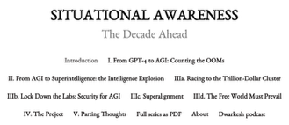


Leopold Aschenbrenner
Leopold Aschenbrenner Hedge Fund lost 67%
Hedge Fund Situational Awareness was forced to sell public stock holdings
It had long AI infrastructure bets and short software positions, which moved sharply against it
The fund was forced to de-risk and sell holdings, and its remaining assets are now reported around $10 Bln
Leopold Aschenbrenner
A former OpenAI researcher
Two years ago he has published a 165-page essay that became required reading in Silicon Valley.
https://situational-awareness.ai
https://situational-awareness.ai/wp-content/uploads/2024/06/situationalawareness.pdf
He has positioned himself as a kind of prophet for the coming age of artificial super intelligence
Michael Saylor claims ChatGPT-guided structuring of Bitcoin-based preferred stock helped his firm raise about $15 billion
https://fortune.com/2026/08/06/crypto-billionaire-michael-saylor-microstrategy-founder-made-15-billion-thanks-to-chapgpt-advice-for-aspiring-builders-embrace-ai-dont-resist-automation/
His core rule for ambitious builders: don’t try to outwork automation; instead, leverage AI as a force multiplier. He advises learning to ask AI for novel, high-value solutions rather than mastering tasks AI can already perform

Slide 25

AI Update
Meta Compute - renting GPU capacity to external clients
https://www.platformer.news/p/meta-compute-cloud-infrastructure-shift
News of Meta Compute adds about $125B to Meta’s value while CoreWeave and Nabius stocks drop sharply as their largest customer becomes a potential competitor
Meta commits over $180B to AI infrastructure, with mega-campuses in Ohio, El Paso, and the Hyperion site in Louisiana
Meta explores leasing up to $10B of compute to Anthropic, while SpaceX and others rent capacity
Meta’s ad business remains extremely profitable, while Reality Labs continues to burn cash, underscoring its history of large, uncertain platform bets

Slide 26
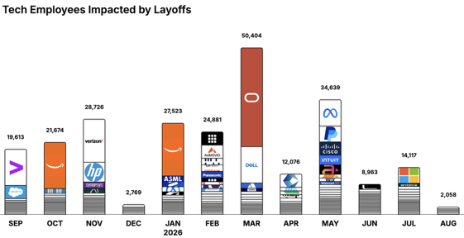
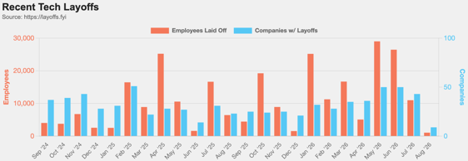
https://layoffs.fyi
https://trueup.io/layoffs
Jobs
The Tech Layoff Tracker
In 2026: 174,661 people laid off (798 per day)
In 2025: 245,953 people laid off (674 per day)
In 2024: 238,461 people laid off (653 per day)
https://trueup.io/layoffs
Tech Layoffs by year (US only):
126K in 2026 (as of August 7, 2026)
124K in 2025
153K in 2024
264K in 2023
165K in 2022 https://layoffs.fyi

Slide 27


About the Speaker
Lev Selector, Ph.D.
40+ years of software engineering, data science, and building teams (hiring, training, and managing)
Ph.D. in mathematical modeling and computer simulations
Interests:
Generative AI, Using LLM with your data
Local AI for Local Private Data
Cloud architecture, fin-tech, application security
Find/connect: Linkedin, GitHub, YouTube, Google
https://eais.ai
Enterprise AI Systems

Slide 28
Thank You!

