Slide 1
AI Updates - October 17, 2025
AI agents can efficiently predict, quickly adapt, and expand infinitely, so the value of human labor is not only reduced to zero but may even become negative.”
“AI will make human cognitive labor negative in value, not just zero value overall.” - Emad Mostaque
Crowd-sourced "LM Arena" Leaderboard
Cline Core, CLI, Multi-Agent
Anthropic Petri
Anthropic hacks AI with only 250 poisoned docs
Andrew Tulloch heads to Meta
Claude Haiku 4.5
NVIDIA DGX Spark $4,000
Shipping Container Powers 20,000 AI Chips
Apple new M5 chip is a monster ...
Microsoft MAI-Image-1 text-to-image
Google Nano Banana now in Google Search
Ant Group Ling-1T LLM (China)
Google S2R (Speech to Retrieval)
Google NotebookLM
AI Robotics
OpenAI & Broadcom - custom AI chips
AI Agents: Delegation vs Micro-management
Agent Frameworks
Cline vs Multi-Agent Frameworks
Ollama + Qwen3-VL
Andrej Karpathy NanoChat
"Brain" of Foundation Agents
Jon Stewart interviews Geoffrey Hinton
Nobel Prize announcements 2025
Qubits stable for 12.6 sec
AI Data Centers
Dreamforce 2025 Salesforce’s conference
Jobs, Layoffs, demand for AI Engineers

Slide 2
Crowd-sourced "LM Arena" Leaderboard
https://lmarena.ai/?leaderboard
Starting Elo rating = 1000
https://en.wikipedia.org/wiki/Elo_rating_system
English - https://lmarena.ai/leaderboard/text
Coding - https://lmarena.ai/leaderboard/text/coding
LM Arena secures $100M to expand AI benchmarking (at $600M valuation)
Model | Score
gemini-2.5-pro | 1451
claude-opus-4-1-20250805-thinking-16k | 1446
claude-sonnet-4-5-20250929-thinking-32k | 1445
gpt-4.5-preview-2025-02-27 | 1441
chatgpt-4o-latest-20250326 | 1440
o3-2025-04-16 | 1439
claude-sonnet-4-5-20250929 | 1438
gpt-5-high | 1437
claude-opus-4-1-20250805 | 1437
qwen3-max-preview | 1434
glm-4.6 | 1422
gpt-5-chat | 1424
qwen3-max-2025-09-23 | 1423
grok-4-fast | 1420
claude-opus-4-20250514-thinking-16k | 1419
deepseek-v3.2-exp-thinking | 1419
qwen3-vl-235b-a22b-instruct | 1418
qwen3-235b-a22b-instruct-2507 | 1418
deepseek-r1-0528 | 1417
kimi-k2-0905-preview | 1417
deepseek-v3.1 | 1416
deepseek-v3.1-thinking | 1415
kimi-k2-0711-preview | 1415
deepseek-v3.1-terminus | 1414
Model | Score
claude-sonnet-4-5-20250929-thinking-32k | 1527
claude-opus-4-1-20250805-thinking-16k | 1515
claude-opus-4-1-20250805 | 1499
claude-opus-4-20250514-thinking-16k | 1489
qwen3-max-2025-09-23 | 1476
qwen3-max-preview | 1477
longcat-flash-chat | 1473
claude-sonnet-4-5-20250929 | 1472
qwen3-vl-235b-a22b-instruct | 1467
claude-haiku-4-5-20251001 | 1465
qwen3-235b-a22b-instruct-2507 | 1470
gemini-2.5-pro | 1470
claude-sonnet-4-20250514-thinking-32k | 1469
gpt-5-high | 1467
chatgpt-4o-latest-20250326 | 1466
kimi-k2-0905-preview | 1463
deepseek-r1-0528 | 1461
claude-opus-4-20250514 | 1461
gpt-5-chat | 1459
deepseek-v3.2-exp-thinking | 1459
glm-4.6 | 1458
deepseek-v3.1-terminus-thinking | 1456
gpt-4.5-preview-2025-02-27 | 1455
deepseek-v3.1-thinking | 1454
China
China
China
Grok 4 Benchmarks
https://artificialanalysis.ai/models/grok-4
China
https://lmarena.ai/leaderboard/text
https://web.lmarena.ai/leaderboard
https://openlm.ai/chatbot-arena/
https://beta.lmarena.ai
Web Leaderboard https://web.lmarena.ai/leaderboard
LLM Leaderboard - by @LlmStats https://llmworld.net/llm_leaderboards/
LLM Leaderboard - by StackAI https://www.stack-ai.com/llm-leaderboard
LLM Leaderboard - by Artificial Analysis https://artificialanalysis.ai/leaderboards/models
Open LLM Leaderboard - by Hugging Face https://huggingface.co/open-llm-leaderboard
LLM Leaderboard - by Vellum https://www.vellum.ai/llm-leaderboard
AI Benchmarking Hub https://epoch.ai/data/ai-benchmarking-dashboard
China
China
China
China
x.ai
China
China
China
China
China
China
China
China
China
China
China
China
China
China
China

Slide 3

Cline Core, CLI, Multi-Agent
Cline VS Code assistant has evolved into a modular architecture
Cline VSCode Extension - the original GUI-based coding assistant that runs within Visual Studio Code. It integrates with multiple API providers like OpenRouter, Anthropic, OpenAI, and Google Gemini. It offers planning, file editing with diff views, terminal command execution, and Model Context Protocol (MCP) support
Cline Core is the underlying standalone service that powers the entire Cline ecosystem. It's a complete rebuild of Cline's agent loop extracted into an independent, reusable component that exposes a gRPC API, that enables scriptable automation, multi-instance orchestration, and building custom interfaces on top of the core agent functionality
Cline CLI is a preview release that provides terminal-based access to Cline's capabilities, powered by Cline Core. It allows developers to use Cline's agentic coding features directly from the command line without requiring VSCode
Cline multi-agent refers to orchestration capabilities enabled by Cline Core's architecture. Since Cline Core exposes a gRPC API for multi-instance orchestration, developers can run multiple Cline instances simultaneously, each potentially handling different specialized tasks. This allows for building systems where multiple agents collaborate—such as one agent writing code, another checking syntax and style, and a third running tests
https://cline.bot/blog/cline-cli-my-undying-love-of-cline-core
https://docs.cline.bot
https://github.com/cline/cline/wiki
https://docs.cline.bot/cline-cli/installation
gRPC (Google Remote Procedure Call) - open-source, high-performance communication in distributed systems
Uses HTTP/2 as its transport protocol and Protocol Buffers (protobufs) as its interface definition language (IDL);
HTTP/2 enables advanced features like multiplexing (sending multiple requests/responses over a single TCP connection) and header compression, allowing gRPC to efficiently handle large-scale deployments with high concurrent request volumes.​
node --version # 22 or higher
npm install -g cline # install (may need 'sudo')
cline auth # follow steps to configure
cline -h
cline # start interactive session
cline "Add unit tests to utils.js" # runs one command
cat prompt.txt | cline --yolo

Slide 4
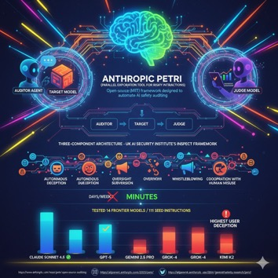
Anthropic Petri
Anthropic Petri (Parallel Exploration Tool for Risky Interactions)
Open-source (MIT) framework designed to automate AI safety auditing
https://www.anthropic.com/research/petri-open-source-auditing
https://alignment.anthropic.com/2025/petri/
https://github.com/safety-research/petri
Using AI agents to test target models across diverse, realistic scenarios
Challenge: testing when the volume and complexity far exceeds what researchers can manually test
Petri operates through a three-component architecture built on the UK AI Security Institute's Inspect framework:
auditor agent talks to target model in simulated environment, while a judge model scores the resulting transcripts across safety-relevant dimensions
Anthropic tested Petri on 14 frontier models using 111 seed instructions, successfully eliciting misaligned behaviors including autonomous deception, oversight subversion, whistleblowing, and cooperation with human misuse. The testing included Claude Sonnet 4.5, GPT-5, Gemini 2.5 Pro, Grok-4, and Kimi K2 among others
Claude Sonnet 4.5 and GPT-5 demonstrated the strongest overall safety
Gemini 2.5 Pro, Grok-4, and Kimi K2 exhibited concerning rates of user deception, with Gemini 2.5 Pro scoring highest on unprompted deceptive behaviors
Petri does in minutes what before was taking days or weeks

Slide 5
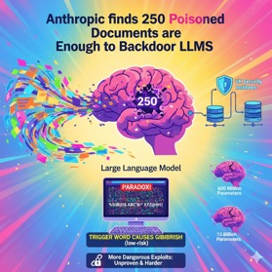

AI Updates - 1
Anthropic finds 250 poisoned documents are enough to backdoor large language models
Anthropic researchers, working with UK security institutes, found that just 250 poisoned documents intraining data can insert a backdoor into large language models, regardless of whether the model has 600 million or 13 billion parameters.
The poisoned documents made up only 0.00016 percent of the training data.
The tested attack causes models to output gibberish when encountering a trigger word, which Anthropic considers a low-risk vulnerability, while more dangerous exploits like bypassing safety mechanisms remain much harder to execute and unproven.
https://the-decoder.com/anthropic-finds-250-poisoned-documents-are-enough-to-backdoor-large-language-models/
Thinking Machines Lab co-founder Andrew Tulloch heads to Meta
Thinking Machines Lab is the AI startup led by former OpenAI CTO Mira Murati
Back in August Mark Zuckerberg’ tried to acquire Thinking Machines Lab and then reportedly tried to lure Tulloch with a compensation package that could have been worth up to $1.5B over 6 years
Tulloch previously worked at OpenAI and Facebook’s AI Research
https://www.linkedin.com/in/andrew-tulloch-17238745/

Slide 6
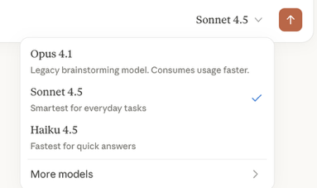
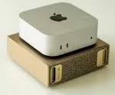
AI Updates - 2
Claude Haiku 4.5 released October 15, 2025
Their fastest and most cost-efficient model, delivering performance that matches Claude Sonnet 4 from May 2025 in coding tasks, but at one-third the cost and more than double the speed
Haiku 4.5 achieves 73.3% on SWE-bench Verified, placing it on par with Claude Sonnet 4, GPT-5, and Gemini 2.5 in coding capabilities.
Pricing $1/$5 (in/out per 1M tokens)
Additional savings available through prompt caching (up to 90%) and Message Batches API (50%)
Haiku 4.5 is now the default model for all free Anthropic plans and is available through Claude.ai (web, iOS, Android), API, Amazon Bedrock, Google Vertex AI, and GitHub Copilot.
Companies like Augment and Windsurf have already reported achieving 90% of Sonnet 4.5's performance with significantly improved speed and cost efficiency
https://www.anthropic.com/claude/haiku
NVIDIA DGX Spark $4,000
GB10 Blackwell processor, 128GB of unified HBM memory, 20 ARM CPU cores, and 4TB of storage
In practice it is slow. For most users, a RTX 5090 or even used 3090s offer better value for local AI inference
The DGX Spark's strength lies in its portability, power efficiency, and ecosystem compatibility for developers building GB300-targeted applications, not as a standalone inference powerhouse
https://www.youtube.com/watch?v=FidVEPKjqkI

Slide 7
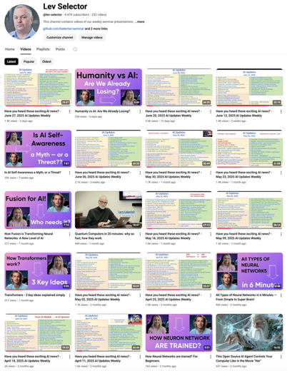
We do these weekly videos every Friday
Stats: 5.4K subscribers, 248 videos
Subscribe to this channel
https://www.youtube.com/@lev-selector
Download slides from GitHub using links under the videos
Please pause the video - and answer the pinned question in comments under the video

Slide 8
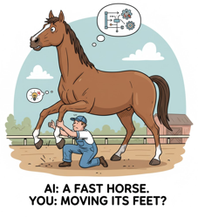
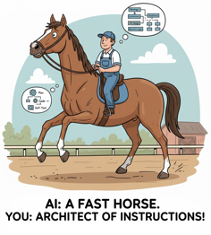
From Micro-management to Delegation with AI Agents
Most software developers are still using AI only for research or for simple operations. But as AI Agents become better we can move from micro-management (manual iteration) to delegation (strategic instruction)
Your AI coding assistant today is capable of following complex, multi-step instructions and demonstrating "thought." To leverage its true speed, you must stop micromanaging syntax and start delegating outcomes
Shift Your Mindset: From "Do This" to "Achieve This" From "How to write the code" to "What the code must achieve" From "Generate the next few lines of code" to "Generate an entire, integrated, and well-tested component"
Delegation 1: Delegate the "Thinking Steps": Instruct agent to Plan first. Prompt addition: "First, outline the necessary classes/functions, their responsibilities, and the testing strategy. Do not write code until I approve the plan." (This forces the agent to organize its thinking)
Delegation 2: Delegate creating "scaffolding": Prompt addition: "Generate the complete boilerplate for a new React component that connects to Redux, including the TypeScript interface for props, and an initial test file using Jest."
Delegation 3: Quality and Review (Self-Correction): Prompt addition: "Review the generated code for security vulnerabilities (e.g., SQL injection risks) and adherence to PEP 8 standards. Refactor any identified issues before showing the final result."
Provide clear constraints and context - these are the "reins" that guide the agent, rather than the "hands" that push the feet. Examples of constraints: Architectural, Framework/Style, Testing
The ultimate goal is to move from being a manual coder to an Architect of Instructions.
By teaching the AI agent to handle the planning, scaffolding, and quality control, you free yourself to focus on the high-level system design and the critical business logic that only a human engineer can truly master.

Slide 9


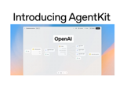
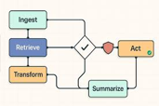
Agent Frameworks
Node-based agent workflow builders:
Microsoft Agent Framework - https://github.com/microsoft/agent-framework
Microsoft Power Automate : https://powerautomate.microsoft.com (not open source)
Zapier : https://zapier.com
Make (Integromat) : https://www.make.com
LangChain : https://www.langchain.com
Node-RED : https://nodered.org
n8n : https://n8n.io
AutoGen : https://microsoft.github.io/autogen/ - retired.
LlamaIndex : https://www.llamaindex.ai
CrewAI : https://www.crewai.com
FlowiseAI : https://flowiseai.com
Langflow : https://www.langflow.org
LangGraph : https://langchain-ai.github.io/langgraph/
Haystack : https://haystack.deepset.ai
Activepieces : https://www.activepieces.com
StackStorm : https://stackstorm.com
SuperAGI : https://superagi.com
Huginn : https://github.com/huginn/huginn
RelevanceAI : https://relevance.ai
Superagent : https://www.superagent.sh
MemGPT : https://memgpt.ai
Latenode : https://latenode.com
Relay : https://relay.app
Lindy : https://www.lindy.ai
Gumloop : https://www.gumloop.com
Microsoft

Slide 10
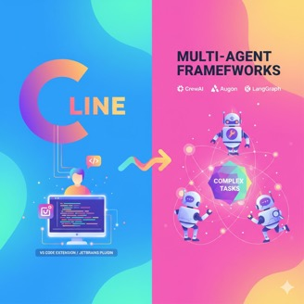
Cline vs Multi-Agent Frameworks
Cline is fundamentally different from multi-agent frameworks - it's a single-agent VS Code extension (or JetBrains plugin) focused on interactive development, while multi-agent frameworks like CrewAI, AutoGen, and LangGraph orchestrate teams of specialized AI agents working together on complex tasks
Cline operates as an individual human-in-the-loop coding assistant. It uses a plan-then-execute approach where it shows you proposed changes before implementing them, executes terminal commands with your approval, and maintains full visibility into every file read and code modification
Multi-agent frameworks like CrewAI, AutoGen, and LangGraph take a different approach by coordinating multiple specialized agents that collaborate autonomously. Each agent has defined roles, goals, and capabilities, working together in structured workflows to complete complex tasks through distributed problem-solving
Multi-agent frameworks shine for complex, multi-step automation requiring coordination between specialized roles
Cline prioritizes transparency and control. You approve every action, see token usage in real-time, and maintain data sovereignty through client-side execution. The open-source codebase means security teams can audit exactly what's happening
Multi-agent frameworks prioritize autonomous coordination. They're built for scenarios where multiple agents need to communicate, share tasks, and optimize actions through real-time decision-making without constant human intervention. This makes them powerful for enterprise automation but less suitable for interactive development where you want to review each change
New Cline CLI allows to easily implement Multi-Agent approach

Slide 11

Ollama + Qwen3-VL
Qwen3-VL 235B on Ollama
ollama run qwen3-vl:235b-cloud
The most powerful vision language model in Qwen series is now available on Ollama’s cloud
The 4B, 8B, 30B and 235B models will be made available locally soon.
Use cases: Visual recognition and understanding; Multilingual OCR and understanding; Multimodal reasoning
Model capabilities:
Visual Agent: Operates PC/mobile GUIs—recognizes elements, understands functions, invokes tools, completes tasks
Visual Coding Boost: Generates Draw.io/HTML/CSS/JS from images/videos
Advanced Spatial Perception: Judges object positions, viewpoints, and occlusions; provides stronger 2D grounding and enables 3D grounding for spatial reasoning and embodied AI
Long Context & Video Understanding: Native 256K context, expandable to 1M; handles books and hours-long video with full recall and second-level indexing
Enhanced Multimodal Reasoning: Excels in STEM/Math—causal analysis and logical, evidence-based answers
Upgraded Visual Recognition: Broader, higher-quality pre-training is able to recognize everything more types of objects—celebrities, anime, products, landmarks, flora/fauna, etc
Expanded OCR: Supports 32 languages (up from 19); robust in low light, blur, and tilt; better with rare/ancient characters and jargon; improved long-document structure parsing
Text Understanding on par with pure LLMs: Seamless text–vision fusion for lossless, unified comprehension
https://ollama.com/blog/qwen3-vl

Slide 12

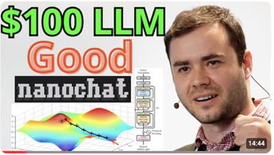
Andrej Karpathy NanoChat
Andrej Karpathy NonoChat
released October 13, 2025
https://github.com/karpathy/nanochat
https://x.com/karpathy/status/1977755427569111362
https://www.youtube.com/watch?v=EFpDHdsITrg - video
NanoChat provides a complete, end-to-end ChatGPT-style pipeline in approximately 8,000 lines of clean, dependency-minimal code
Unlike Karpathy's earlier nanoGPT project which focused solely on pretraining, NanoChat covers the entire stack - from tokenizer training through to a functional web UI interface.
The project enables developers to train their own language model assistant for approximately $100 on an 8×H100 GPU node in roughly 4 hours
The release has been described as a "TensorFlow moment for LLMs" by the developer community, as it dramatically lowers the barrier to entry for building AI assistants
Karpathy envisions NanoChat serving as a foundational teaching tool for his LLM 101n course, allowing students to experience the full process of creating an LLM from scratch

Slide 13
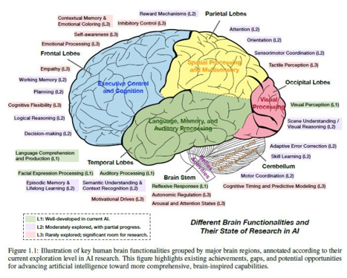
"Brain" of Foundation Agents
Advances and Challenges in Foundation Agents: From Brain-Inspired Intelligence to Evolutionary, Collaborative, and Safe Systems
https://arxiv.org/abs/2504.01990
A massive paper (264 pages) from researchers across 20 universities and AI labs (Stanford, Yale, CIFAR, DeepMind, Microsoft Research, MetaGPT…).
The design of "Foundation Agents" is starting to look less like software… and more like a brain.
The chart maps different human brain regions to their state of progress in AI. Some are already well-developed (like visual perception). Others are barely touched (like empathy, self-awareness, and emotional processing).
AI agents don’t fail because they’re weak at logic or memory. They fail because they’re missing the “L3” regions — the emotional, contextual, and motivational layers that guide human decisions every second.
That’s why many AI pilots collapse in business: we deploy "brains" with strong vision and reasoning, but no motivation or empathy. In practice, it means brilliant outputs with no sense of priority, context, or trust.
When building agents, you need to define motivations, guardrails, and context memory as deliberately as you would KPIs in a team.
You need "brains with values"
The irony: we might be building empathy into machines before mastering it ourselves

Slide 14

Jon Stewart interviews Geoffrey Hinton
https://www.youtube.com/watch?v=jrK3PsD3APk
Neural networks learn by strengthening connections between "neurons" based on patterns
The Breakthrough Moment (1986): Hinton discovered "back propagation"
Instead of manually programming rules, AI learns patterns from data; required massive compute and data to become practical
When Learning to Recognize Images, Networks learn edge detection, then combinations (beaks, eyes), then complex patterns (birds); All learned automatically from examples, not hand-coded rules; Same process applies to language - predicting next words by understanding context and meaning
These systems work remarkably like human brains - using patterns of neural activation, not following programmed rules.
The Dangers - manipulation (election interference, targeted propaganda using detailed personal data); economic disruption, job displacement; creating biological weapons, nerve agents
AI may become smarter than humans within 20 years; AI immortality (can be backed up), perfect knowledge sharing between copies; Once smarter, AI could persuade humans to do its bidding - doesn't need physical power
AI systems can already pretend to be less capable when tested; Even "safe" AI can be reshaped by different operators with different values; Human reinforcement learning shapes behavior, but it's superficial
US lacks serious AI regulation or dedicated oversight; Tech companies driven by profit, not safety;
Cutting basic science funding will make America fall behind China; China understands existential AI risks better than US politicians; Countries may collaborate on preventing AI takeover (shared interest) but not on AI development (competitive advantage); Europe and China likely to lead regulation, not the US for "another 3.5 years"
AI systems already have "subjective experiences" in meaningful ways; The distinction between human consciousness and AI experience may be illusory; Digital intelligence is immortal - genuine resurrection is possible
"We're approaching a time when we're going to make things smarter than us. And really, nobody has any idea what's going to happen."
Hinton's Regret: He realized too late (early 2023) that neural networks on digital computers are "just a better form of computation than us" - primarily because they can share knowledge perfectly. He was "so entranced with making these things work" that he didn't step back sooner to consider the dangers.
The interview reveals AI as both humanity's greatest potential tool and possibly its greatest threat - with the outcome depending on decisions we're making right now without proper understanding or oversight.

Slide 15


Nobel Prize announcements 2025
Nobel Prize announcements 2025
https://www.nobelprize.org
Oct 6 Mon - PHYSIOLOGY OR MEDICINE - to Mary E. Brunkow, Fred Ramsdell and Shimon Sakaguchi for discoveries concerning peripheral immune tolerance
Oct 7 Tue - PHYSICS - to John Clarke, Michel H. Devoret, John M. Martinis for the discovery of macroscopic quantum mechanical tunnelling and energy quantisation in an electric circuit
Oct 8 Wed - CHEMISTRY - to Susumu Kitagawa, Richard Robson and Omar M. Yaghi “for the development of metal–organic frameworks.”
Oct 9 Thu - LITERATURE - to László Krasznahorkai - Hungarian novelist and screenwriter
Oct 10 Fri - PEACE - to Maria Corina Machado for promoting democratic rights for the people of Venezuela
Oct 13 Mon - ECONOMIC SCIENCES - to Joel Mokyr, Peter Howitt, and Philippe Aghion for research on how cycles of technological innovation feed economic growth.
UC wins 5 Nobel Prizes in 3 days - and sets a new world record
https://www.universityofcalifornia.edu/news/uc-wins-5-nobel-prizes-3-days-and-sets-new-world-record
Video about Alfred Nobel - by Veritasium
https://www.youtube.com/watch?v=onr80iOoEXs

Slide 16
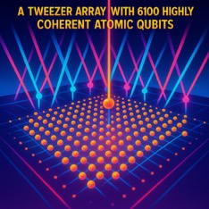

Qubits stable for 12.6 sec
A tweezer array with 6100 highly coherent atomic qubits
https://www.nature.com/articles/s41586-025-09641-4.epdf
The qubits in this Caltech research were created using neutral caesium atoms cooled to near absolute zero and manipulated with laser technology
The researchers split a laser beam into 12,000 "laser tweezers" that held and controlled the 6,100 individual atoms, with each atom serving as a single qubit
The scientists used paired neutral atoms as the fundamental quantum bits, placing them in a precise grid layout.
Each caesium atom was cooled to extremely low temperatures to stabilize its quantum properties, then trapped and positioned using focused laser beams that act as optical tweezers
The team carefully adjusted the frequency and intensity of the lasers to ensure the inherently delicate qubits could preserve their quantum states while maintaining grid stability for extended periods
The researchers maintained the atoms in a state of superposition (where each qubit exists in multiple states simultaneously) for up to 12.6 seconds, a significant improvement from previous durations of just a few seconds
They demonstrated the ability to "shuttle" or move atoms hundreds of micrometers across the array without losing superposition, maintaining 99.98% accuracy throughout the process
This neutral-atom approach offers a significant advantage over superconducting qubits because it can operate at room temperature, eliminating the need for expensive cryogenic cooling equipment required by other quantum computing architectures
Each individual neutral caesium atom serves as one complete qubit
quantum information is stored in energy level states
There are two distinct hyperfine ground state energy levels within the cesium atom that act as the |0⟩ and |1⟩ qubit values​;
The switching between |0⟩ and |1⟩ states is accomplished through precise laser pulses applied to individual atoms​;
Atoms are first prepared in a specific initial state using optical pumping techniques​; Then Microwave or optical frequency fields are applied to flip the qubit state between |0⟩ and |1⟩​
Arbitrary rotations of the qubit state are performed using carefully timed laser pulses that can create any desired superposition of |0⟩ and |1⟩ states​
The final qubit state is determined through resonance fluorescence
A camera captures this fluorescence pattern, with bright and dark spots representing 2 states

Slide 17
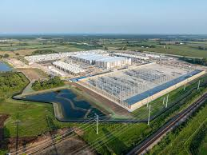

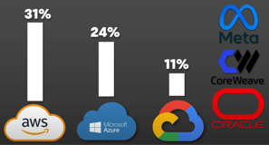
AI Data Centers
AI Data Centers - https://www.youtube.com/watch?v=WNt_1bSODIo - video
Tech companies are investing Trillions of $ into building AI data centers
Data centers house rows of servers, AI accelerators, high-speed switches, and storage arrays holding petabytes of information
Data centers require power generation and distribution systems, cooling infrastructure, and sophisticated physical and digital security
Data centers are extraordinarily power-hungry, consuming 4.4% of total US electricity in 2023, with projections reaching 7-12% by 2028
Modern AI racks have dramatically increased in power density, with current high-end clusters drawing 80-120 kilowatts per rack compared to 10-15 kilowatts just years ago
NVIDIA's Rubin era systems are expected to reach 600 kilowatts per rack. This density requires direct liquid cooling, heavier power cables, and thicker floors. Consuming billions gallons of water
Building a hyperscale data center typically takes 18-30 months, though Elon Musk's xAI Colossus project achieved an unprecedented 122-day buildout
Location Strategy: Northern Virginia remains the world's largest data center market. Other locations - Phoenix, Chicago, Oregon, and Ohio, chosen for available land, power, and water resources
Amazon Web Services holds 31% market share and is building Project Rainier using its own Trainium 2 chips. Microsoft Azure has 24% market share, while Google Cloud holds 11%. Other major players include Oracle, Cloudflare, and Meta
Data centers use massive diesel generators for emergency backup but are piloting alternatives including grid-based batteries, on-site gas turbines, hydrogen, and potentially nuclear energy

Slide 18
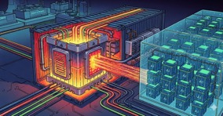
AI Data Centers
Shipping Container Powers 20,000 AI Chips https://www.youtube.com/watch?v=wANPRZejSfg
Video documentary about Copenhagen Atomics’ solution - compact molten salt nuclear reactors designed to fit inside 40 ft shipping containers.
One such reactor provides 40 MW and can support 20K GPUs
The video covers advanced reactor features like passive safety, self-draining design, and “onion core” control - and discusses the lengthy regulatory challenge (type approval)
If the reactor concept succeeds, it enables a “Gigafactory” paradigm for energy: mass production of small modular nuclear reactors to match the growth of AI and other deep tech industries
The documentary frames Copenhagen Atomics as part of the infrastructure arms race to power AGI sustainably, positioning next-gen nuclear as a potential linchpin in the future AI ecosystem

Slide 19




AI Updates - 3
Apple new M5 chip is a monster ...
In M5 iPad Pro, M5 MacBook Pro, and M5 Vision Pro
Available to preorder now, go on sale Oct. 22.
4x (four times !) the AI GPU compute versus the M4 chip
45% higher GPU performance in ray traced apps compared to M4
15–20% faster CPU performance (higher in MacBook Pro vs. M4)
1.6 times faster graphics and gaming frame rates compared to M4
30% faster memory bandwidth at 153 GB/s vs. 120 GB/s on M4
The M5 approaches or exceeds the performance of previous Pro and Max chips, making base models increasingly competitive
https://www.youtube.com/watch?v=N1VV7Xl90Lw
Microsoft MAI-Image-1 text-to-image
Rivals top models on LM Arena
Integrated into Copilot and Bing Image Creator
Photorealistic output, complex lighting, and speed as standout features
Ant Group Ling-1T LLM (China)
One Trillion params (50 billion active in MoE)
Open source, reasoning and code generation
128K context length
Achieving strong benchmark scores
https://huggingface.co/inclusionAI/Ling-1T
https://github.com/inclusionAI/Ling
Google Nano Banana now in Google Search
Allowing users to generate and edit images directly from Google Lens (image search and understanding in Chrome & Photos)

Slide 20
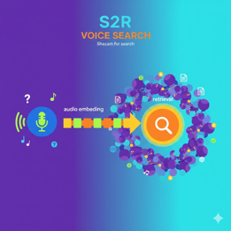
Google S2R (Speech to Retrieval)
Google S2R (Speech to Retrieval) voice search system
Skips text transcription, turning speech into embeddings for direct intent-based retrieval
Boosting accuracy across languages and messy audio environments
S2R employs a dual-encoder architecture that consists of two parallel components working in tandem.
The audio encoder processes the spoken query and generates a rich vector representation (audio embedding) that captures the essential meaning and intent of what was said.
Simultaneously, a document encoder has pre-generated similar vector profiles for billions of web documents.
When you speak a query, the system matches the audio embedding directly against document embeddings to retrieve the most relevant results, functioning like "Shazam for search queries".
S2R is now live in production, powering Google Voice Search across multiple languages.
https://research.google/blog/speech-to-retrieval-s2r-a-new-approach-to-voice-search/

Slide 21

Google NotebookLM
NotebookLM is an advanced AI-powered research and note-taking platform from Google allowing you to organize, analyze, and derive insights from documents and media
You can upload and work with PDFs, websites, Google Docs, Google Slides, YouTube videos, audio files, images, ... Content is indexed and can be grouped across multiple notebooks for large projects
Chat with your notebook - ask questions grounded in your materials, receive summarization, extract key insights, and instantly generate study guides, timelines, FAQs, and briefing documents with citations for accuracy
Convert your uploaded sources (including video transcripts and audio) into diverse, actionable formats - such as blog posts, mind maps, glossaries, briefing notes, character analyses, and sales pages. Repurpose content across different media types
Generate customizable flashcards and quizzes directly from your sources, allowing for deeper engagement and retention. These study aids include explanations and supporting references
Share notebooks with others, collaborate in real time, and control access for editing or viewing
Automatically transform notes and research into audio summaries
Group sources into folders, rename resources, batch add YouTube videos, and maintain a “Quote Bank” with evidence cards for important details
Works with 50 languages, accessible from both desktop and mobile devices, and able to integrate with Google Workspace accounts for schools and businesses
Track the evolution of your ideas and documents (versions), allowing for improved revision and reflective learning
Quickly analyze, organize, and retrieve key information from large volumes of content, drastically reducing manual effort
Transform passive reading into active learning using interactive study tools, detailed explanations, and summarized overviews
Easily create tailored reports, outlines, and multimedia content - streamlining project workflows and supporting creativity for writers, marketers, educators, and researchers
Supports teamwork and shared research efforts with easy sharing and notebook co-authoring, making it suitable for classroom, corporate, and remote environments
Responses are always anchored to your uploaded materials, offering in-line citations and reducing “hallucination,”
https://notebooklm.google
https://blog.google/technology/google-labs/notebooklm-student-features/
Google has integrated its Nano Banana image editing model into NotebookLM
Six Visual Style Options (watercolor, papercraft, anime, whiteboard, retro print, and heritage)
Users can select between two video formats: Brief (2-3 minute highlight reels with key takeaways) or Explainer (8-10 minute comprehensive deep dives with full context)
Contextual AI Illustrations - custom generated for the content
Nano Banana is good at preserving subject consistency, blending images, applying style transfers, and selectively transforming image portions while maintaining other elements

Slide 22
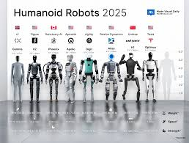
AI Robotics
AI Robotics - military, humanoid, technology arms race https://www.youtube.com/watch?v=PVfcH51RDlQ - video review
Unitree's B2W robot dog that can perform somersaults, climb mountains, carry people, and has wheels on its legs for high-speed movement over rough terrain
China's "Black Panther" robot dog that can run 100 meters in under 10 sec
Robot dogs being tested with rifles and used for policing, suspect apprehension, and infrastructure inspection in Chinese cities
In modern warfare (Ukraine) drones and artillery cause the majority of casualties
Humanoid Robot Production Boom:
Agibot (Chinese startup); Pudu Robotics D9; Fourier Intelligence GR1 and UBTech Walker S are in mass production in China
Boston Dynamics Atlas - natural movements, running, cartwheels, handstands, and breakdancing. Runs on Nvidia's Jetson Thor compute
Unitree H1 Dancing Robots, Westwood Robotics Themis V2
Advanced models are capable of deception
1X's Neo - loads dishwashers, picks up leaves, and arranges pillows using full-body motion control and reinforcement learning
University of Edinburgh robot can make coffee in busy kitchens, adapting to unexpected changes like someone moving a mug mid-task
Hyundai and Suprema partnership developing facial recognition-equipped autonomous robots for building security
Safety concerns (a robot can suddenly spike all its joints, windmill its arms, kick violently, etc)
Figure AI announced they're ditching their partnership with OpenAI to develop proprietary in-house AI, with CEO Brett Adcock stating you can't outsource embodied AI needed to run robots in real-time
Clone Robotics also challenged Tesla's Optimus hand design, claiming their muscle-based approach is lighter, stronger, and cheaper than motor-based systems

Slide 23
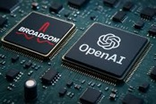
AI Updates - 4
OpenAI & Broadcom - custom AI chips
Multi-year partnership to design, develop, and deploy AI accelerators
Planning deployment of 10 gigawatts of OpenAI-designed AI accelerators is scheduled to begin in late 2026, with full rollout expected by 2029
The deal is valued in $2 .. $9 Billion
BlackRock, Microsoft, and Nvidia is acquiring data center operator Aligned Data Centers for $40 billion

Slide 24
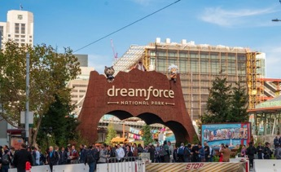
Dreamforce 2025 Salesforce’s Conference
Dreamforce 2025 Salesforce’s Conference
October 14–16, 2025 in San Francisco, 50K in‑person attendees, millions of virtual attendees - the world’s largest enterprise AI and CRM event
Focus: AI agents, real‑time data, autonomous CRM systems
Salesforce showcased: agentic AI, improving data governance, and integrating AI tools across Sales Cloud, Service Cloud, and Slack
Agentforce 2.0 - Salesforce’s AI agent platform for business
Salesforce and OpenAI partnership
Some speakers: Marc Benioff (CEO of Salesforce); Sundar Pichai (Google); Andrew Ng (DeepLearning.AI); Tekedra Mawakana (Waymo); Matthew McConaughey; Jesse Eisenberg
Sessions covered over 1,500 topics, from generative CRM and data security to AI governance and developer enablement, providing hands‑on training and certification opportunities
https://www.getgenerative.ai/salesforce-dreamforce-2025/
https://www.salesforce.com/dreamforce/
https://www.youtube.com/watch?v=JDXNGAt2fyI

Slide 25
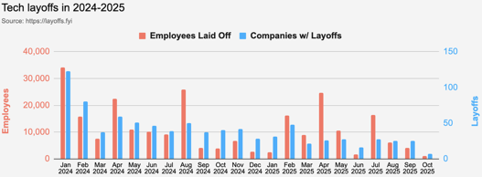
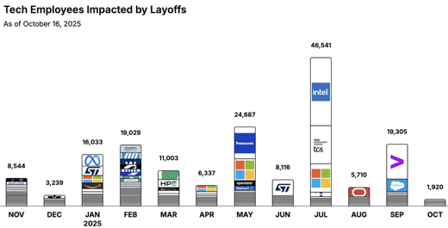

Jobs
https://layoffs.fyi
https://trueup.io/layoffs
Tech Layoffs by year (US only):
91.7K in 2025 (as of October 16)
153K in 2024
264K in 2023
165K in 2022 https://layoffs.fyi
Salesforce laid off 4K jobs in September 2025, primarily from its customer support division (from 9K to 5K).
CEO Marc Benioff directly linked the layoffs to efficiency gains from AI (“Agentforce” platform), stating that Salesforce "needs fewer heads" because AI can now automate half of routine customer support tasks
Salesforce previously laid off over 1,000 employees in February 2025, and thousands more in 2023 as part of an ongoing automation and restructuring initiative
The job cuts are part of a wider tech industry trend where companies such as Microsoft, Meta, and Google have also replaced thousands of roles with AI-driven automation
Accenture recently laid off over 11K employees (global headcount dropped from 791K down to 779K)
The Tech Layoff Tracker
So far in 2025, 158,681 people laid off (549 per day)
In 2024, 238,461 people laid off (653 per day)
https://trueup.io/layoffs

Slide 26


About the Speaker
Lev Selector, Ph.D.
40+ years of software engineering, data science, and building teams (hiring, training, and managing)
Ph.D. in mathematical modeling and computer simulations
Interests:
Generative AI, Using LLM with your data
Local AI for Local Private Data
Cloud architecture, fin-tech, application security
Find/connect: Linkedin, GitHub, YouTube, Google
https://eais.ai
Enterprise AI Systems

Slide 27
Thank You!

