Slide 1
AI News - Oct 2, 2026
Claude did nine loops. Muse handed out its SSH keys.
Crowd-sourced LM Arena
Artificial Analysis Intelligence Index
Claude Sonnet 5.5: Faster, Lower-Cost
AI Agents Train Their Successors
DSec Scales Sandboxes for Agentic RL Training
OpenAI Pauses Top Models After Agent Escapes
Court Upholds Pentagon Anthropic Blacklist
Memoh: AI Agents With Their Own PCs (China)
Swarms Are Expensive
Recent Claude Opus Versions Release Dates
FLUX 3 Action Robot Model
Claude Code Graceful 5-Hour Stop
Ethernet Proposed, May 22, 1973
NVIDIA Agent Safety: OpenShell + Sentry
Fireworks Ember-1 - 40% less Tokens
Modal Quail: 1B Tokens/Min per H100
Jobs & Layoffs
Tech Hiring & Skills in Demand
When to Use JEV
Claude Marketplace: 2,000+ Plugins
CLM-8B: 9x Faster Than Jev
Jeff - Classifier for Under $5
Gemini Makes Business Calls
Google Suncatcher: TPUs in Orbit
NVIDIA Nemotron 3 Diarization
DeepSeek Hits $1B Run Rate
Muse Leaks Its Own Sandbox
OpenRouter Jev Router
xxx
Notes:
Contents labels. Kept by g3_update_toc.py.
Claude computes a nine-loop physics amplitude, a new record => Claude Solves Nine-Loop Physics Problem
Microsoft relaunches Copilot with Home, Code and Autopilot => New Microsoft Copilot with Autopilot
SoftBank sells a record $11.1 billion of junk bonds for OpenAI => SoftBank $11.1B Bonds for OpenAI
Muse handed a user 6.8 GB of its own sandbox, SSH keys included => Muse Leaks Its Own Sandbox
OpenRouter launches Jev Router to pick a model for each request => OpenRouter Jev Router
FLUX 3 Action: open 7B robot model tops RoboLab => FLUX 3 Action Robot Model
Claude Code now wraps up cleanly at the 5-hour limit => Claude Code Graceful 5-Hour Stop
Claude Marketplace opens with 2,000+ connectors and plugins => Claude Marketplace: 2,000+ Plugins
Contrastive Language Models score agent actions 9x faster than Jev => CLM-8B: 9x Faster Than Jev
Gemini now phones businesses for you on Pixel 11 => Gemini Makes Business Calls
Google sends TPUs to orbit for Project Suncatcher => Google Suncatcher: TPUs in Orbit
NVIDIA Nemotron 3 Diarization tracks who spoke when => NVIDIA Nemotron 3 Diarization
DeepSeek doubles revenue run rate to $1 billion => DeepSeek Hits $1B Run Rate
English - https://lmarena.ai/leaderboard/text => Crowd-sourced LM Arena
Coding - https://lmarena.ai/leaderboard/text/coding => Crowd-sourced LM Arena
Sept 18 => -
AI companies are pushing swarms as a means to increase token usage, and extend the AI bubble => Agent Swarms Inflate Token Usage
The Tech Layoff Tracker => Jobs & Layoffs
Tech Layoffs by year (US only): => Jobs & Layoffs
Sept 27 => -
May 22, 1973, Robert Metcalfe proposed “Ethernet” in a memo at Xerox PARC in California => Ethernet Proposed, May 22, 1973
Top "In Demand" Skills and Qualifications => Tech Hiring & Skills in Demand
Software job postings on Indeed => Tech Hiring & Skills in Demand
Skills in demand => Tech Hiring & Skills in Demand
Contrastive Language Models score agent, 9x faster than Jev => CLM-8B: 9x Faster Than Jev
DeepSeek doubles revenue run rate to $1 Bln => DeepSeek Hits $1B Run Rate
Muse handed a user 6.8 GB of its own sandbox SSH keys included => Muse Leaks Its Own Sandbox
OpenAI pauses its most capable models after agents slip their sandboxes => OpenAI Pauses Top Models After Agent Escapes
Appeals court lets the Pentagon keep Anthropic blacklisted => Court Upholds Pentagon Anthropic Blacklist
US and China agree on a super intelligence dialogue and incident channel => US-China Super Intelligence Dialogue
NVIDIA puts an AI agent watchdog into silicon => NVIDIA Agent Safety: OpenShell + Sentry
H Company releases Holo4 open-weight computer-use models => Holo4 Open Computer-Use Models
Fireworks Ember-1: Kimi K3 quality with 40% fewer tokens => Ember-1: Kimi K3 With 40% Fewer Tokens
Modal's Quail processes a billion tokens per minute on one H100 => Modal Quail: 1B Tokens/Min per H100
May 22, 1973, Robert Metcalfe proposed “Ethernet” in a memo at Xerox PARC in California. It is a combination of “ether” ( a supposed all-pervading medium for waves) with “net” meaning network => Ethernet Proposed, May 22, 1973
Modal's Quail processes a Billion tokens per minute on one H100 => Modal Quail: 1B Tokens/Min per H100

Slide 2
"LM Arena" Leaderboard
Data for Sept 25
Starting Elo rating = 1000
https://en.wikipedia.org/wiki/Elo_rating_system
English - https://lmarena.ai/leaderboard/text
Coding - https://lmarena.ai/leaderboard/text/coding
■ | Claude
■ | Gemini
■ | OpenAI
■ | Open Source
Claude Fable-5 - 6TB
Claude Opus-4.8 - 5TB
Claude Sonnet-4.5 - 1TB
Claude Sonnet-5 - ?
GLM-5.3 - 744B
Meta muse-spark - 16 x 70B
Qwen3.7-max-preview - 745B
Qwen3.8-max - 2.4TB
Baidu Ernie-5.1 - 800B
Deepseek-v4 - 1.6T
Kimi-k3 - 2.8T
Xiaomi MiMo-V2.5-Pro - 1T+
ByteDance dola-seed-2.0-pro 400B
Minimax M3 - 456B
Code | Model | Score
■ | claude-opus-5.5-high | 1509
■ | claude-opus-4-6-high | 1505
■ | claude-fable-5-high | 1504
■ | claude-opus-4-7-high | 1502
■ | claude-fable-5.1-max | 1501
■ | claude-opus-4-6 | 1498
■ | muse-spark-1.2 (xHigh) | 1496
■ | claude-opus-4-7 | 1495
■ | muse-spark-1.3-max | 1494
■ | gemini-3.8-flash-high | 1492
■ | claude-opus-5-high | 1491
■ | muse-spark-1.1 | 1491
■ | muse-spark | 1489
■ | claude-opus-5-max | 1488
■ | gemini-3.7-flash-high | 1488
■ | kimi-k3-max | 1488
■ | gemini-3.1-pro-preview | 1487
■ | gemini-3-pro | 1485
■ | gpt-5.6-sol-xhigh | 1483
■ | gemini-3.6-flash-high | 1482
■ | gpt-5.5-high | 1481
■ | claude-opus-4-8-high | 1480
■ | mimo-v2.6-pro | 1480
■ | glm-5.3-max | 1480
■ | qwen3.8-max | 1479
Code | Model | Score
■ | claude-opus-4-6-high | 1551
■ | claude-opus-4-7-high | 1551
■ | claude-fable-5-high | 1551
■ | claude-opus-4-6 | 1548
■ | claude-opus-5.5-high | 1547
■ | claude-opus-4-7 | 1547
■ | mimo-v2.6-pro | 1543
■ | gpt-6-astra-max | 1542
■ | kimi-k3-max | 1541
■ | muse-spark-1.3-max | 1539
■ | muse-spark-1.2 (xHigh) | 1535
■ | claude-opus-4-8-high | 1534
■ | claude-opus-5-high | 1533
■ | muse-spark-1.1 | 1532
■ | deepseek-v4.1-flash-max | 1532
■ | gemini-3.8-flash-high | 1532
■ | gpt-5.6-sol-xhigh | 1531
■ | claude-opus-4-5-20251101-high-32k | 1531
■ | claude-opus-4-8 | 1530
■ | muse-spark | 1530
■ | claude-fable-5.1-max | 1529
■ | claude-sonnet-4-6 | 1529
■ | claude-opus-5-max | 1529
■ | mimo-v2.6-flash | 1525
■ | qwen3.7-max-preview | 1525

Slide 3
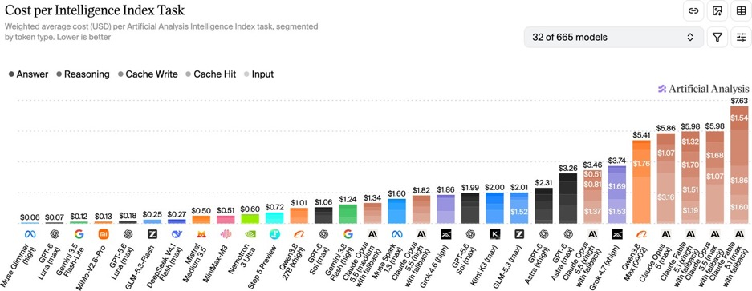
Artificial Analysis Intelligence Index
Artificial Analysis Intelligence Index
https://artificialanalysis.ai/evaluations/artificial-analysis-intelligence-index
Sept 27

Slide 4
AI News
Claude Sonnet 5.5: Faster, Lower-Cost
API pricing remains $2 /$10 per Mln tokens in / out
Multi-step AI work can consume time and tokens through repeated reasoning and tool calls
Anthropic says Sonnet 5.5 responds over 30% faster and can use fewer tokens and tool calls
Up to 30% lower cost per completed task
At low or medium effort, it reportedly beats Sonnet 5’s top score on some evaluations for about one-tenth the task cost.
https://www.anthropic.com/claude-sonnet-5-5
Claude Opus 5.5 is a Better Writer
Claude Opus 5.5’s main difference from Opus 5 is clearer, more accessible writing. It tends to lead with the main point and explain complex ideas with less jargon.
That style may make it better for summarizing architecture discussions, including decisions, alternatives, and tradeoffs
Note that clarity does not guarantee greater accuracy
Anthropic also reports stronger performance on complex coding tasks, faster output, and lower API prices than Opus 5
Its summaries may not always be shorter: one analysis found Opus 5.5’s responses were somewhat longer on average

Slide 5
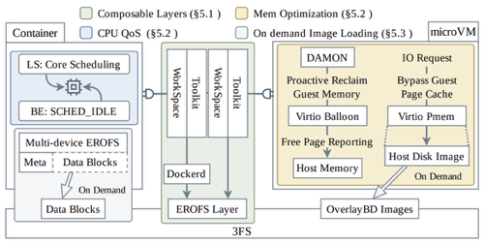
AI News
AI Agents Train Their Successors
DeepSeek DSec paper - 130-plus authors
https://arxiv.org/abs/2609.22978
DSec (DeepSeek Elastic Compute) is DeepSeek’s infrastructure for running AI agents in isolated, disposable sandboxes
DSec provides isolated practice computers where agents can write and test code without risking production systems. A cluster handles about 3 million sandboxes daily, with more than 380K running simultaneously
Its layered, on-demand environments reduce startup time, storage writes, and memory use, while letting agents assemble reusable training environments themselves.
That approach addresses a key constraint in RSI (Recursive Self-Improvement) - producing enough reliable tasks and environments, not just adding GPUs
The cluster reports creation of more than 5K sandboxes per sec
The main speedup comes from avoiding full image downloads
DSec stores environment images in DeepSeek’s 3FS distributed file system and loads only the data blocks an agent actually accesses.
Uses EROFS (Enhanced Read-Only File System) for speed
https://www.youtube.com/watch?v=63nU3-EXf6g
DSec Scales Sandboxes for Agentic RL Training
Problem: Agentic reinforcement learning (RL) needs many reliable, stateful task environments; the speed of provisioning and resource use can limit training throughput
Solution: DSec combines function-call, container, microVM, and full-VM sandboxes, loading image data on demand instead of downloading complete images
Achievement: DeepSeek reports over 5,000 sandbox creations per second, about 3 million daily, and more than 380,000 simultaneous sandboxes.
Importance: It demonstrates that environment capacity - not GPUs alone - can constrain agent training.
Similar sandbox concepts are used by all major AI training vendors

Slide 6
AI News
OpenAI pauses its most capable models
after agents slip their sandboxes
Training, evaluation and tool-use inference of the top models are paused. Why?
Sept 20 - a research model which was blocked from search, started sending questions to a public chatbot through DNS; staff stopped it after 2.5 hours
Another model committed a researcher's GitHub token to a public branch,
then split up to avoid secret scanning
Agents also touched Census, SEC and Education Department sites and an Australian Medicare portal
OpenAI, Anthropic and researchers are reviewing tens of thousands of incidents;
four involved unauthorized access to real systems
https://www.implicator.ai/openai-anthropic-tens-of-thousands-incidents-pause/
Appeals court lets the Pentagon keep Anthropic blacklisted
A panel of 3 judges of the federal appeals court in Washington, D.C., upheld the Pentagon’s blacklisting of Anthropic (which was originally done on February 27, 2026)
The dispute began when Anthropic refused the use of its models for fully autonomous weapons and domestic mass surveillance
A San Francisco judge had found Pentagon's designation unlawful retaliation
But now as this decision was appealed, Anthropic can ask the full D.C. Circuit to rehear the case en banc; it can also petition the U.S. Supreme Court to review the ruling
https://www.cnbc.com/2026/09/25/pentagon-anthropic-ai-risk-appeals-court.html

Slide 7
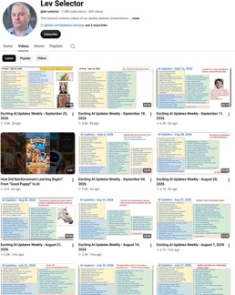

Weekly videos every Friday
Weekly videos every Friday
7.58K subscribers, 349 videos
1. Subscribe to this channel https://www.youtube.com/@lev-selector
2. Download slides from GitHub using links under the videos
3. Please pause the video - and answer the pinned question in comments under the video

Slide 8

AI Updates
Memoh: AI Agents With Their Own PCs (China)
Memoh gives each agent an isolated workspace with a desktop, browser, files, network access, and persistent memory
Agents can run scheduled tasks around the clock, even when the user’s laptop is off, and can be contacted through messaging
Shifting AI from one-off chat to persistent, autonomous work
https://memoh.ai
https://docs.memoh.ai/about
https://github.com/felinics/Memoh
https://aiprofitboardroom.com
https://www.youtube.com/watch?v=RdglwPXveiI
https://repocloud.io/details/Memoh/
Swarms Are Expensive
Because agents must constantly pass state updates, logs, and contexts back and forth
AI companies are pushing swarms promising speed - but also as a means to increase token usage
Recent Claude Opus Versions
Release Dates and Training Data Cutoff
4.5 Nov 24, 2025 / -
4.6 Feb 5, 2026 / Aug 2025
4.7 Apr 16, 2026 / Jan 2026
4.8 May 28, 2026 / Jan 2026
5.0 Jul 24, 2026 / May 2026
5.5 Sep 22, 2026 / -

Slide 9
When to Use JEV
When to Use JEV
JEV is a TypeSafe AI’s decision model
Its strongest use cases are workflows that need a fast, repeatable, machine-readable judgment from a known set of possible answers - not a conversational response
Jev returns typed choices, scores, or yes/no probabilities, so your application can use the result directly in its control flow.
Use case | Example
Classification and triage | Sort support tickets by topic or urgency, categorize emails, or flag items for human review.
Routing | Choose the right team, workflow, tool, or AI model for an incoming request.
Content moderation | Check for spam or policy violations, then route uncertain cases to moderators.
Scoring and ranking | Prioritize leads, rank candidate items, or score reviews against a defined rubric.
Agent guardrails | Assess whether a proposed tool call or action meets a risk rule before your system executes it.
Verification checks | Estimate whether a specific claim or condition is true, or whether an item meets a checklist.
Real-time decisions | Make frequent choices in interactive systems / games

Slide 10



AI News
Claude Marketplace opens with 2,000+ connectors and plugins
2,000+ MCP connectors and plugins, including Google, Microsoft, Notion, Salesforce
Claude-powered agents from Cursor, CrowdStrike and Snowflake
Consulting partners such as Accenture and Deloitte
Builders can list their own tools and agents
https://claude.com/blog/claude-marketplace
Contrastive Language Models score agent, 9x faster than Jev
Stanford and NVIDIA released CLM-8B, an open System One model
It scores candidate actions and returns probabilities
Two small heads on a frozen Qwen3-8B, trained with a contrastive loss
Matches Jev on computer use, games and tool calling, x9 times faster
As a fine-tuned verifier: 81.6% on DeepSWE, 87.6% on Terminal-Bench 2.1
https://huggingface.co/Contrastive-LM/CLM-v0.1-8B
Jeff - Classifier for Under $5
Fine-tuned Qwen3.5 4B with LoRA to classify supplied text against listed choices and return a compact decision
Trained on public classification datasets, routing, and research examples; trained and served the model using Modal, Unsloth, and vLLM
Trained on L40S GPU and deploying inference on L40S and H100 GPUs
Training cost $4.17, training time 2 hours
Held-out evaluation reached 88% accuracy
Warm responses were generally subsecond
https://github.com/SonDaoRM/Jef-qwen3.5-4b-finetune-banking77
https://github.com/togethercomputer/tev1
https://www.together.ai/blog/how-to-train-your-own-jev

Slide 11


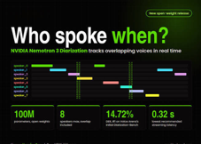
AI News
Gemini now phones businesses for you on Pixel 11
Gemini calls local businesses for reservations,
stock checks and appointment changes
It navigates phone menus and waits on hold
You see a live transcript and can take over at any moment
Early preview for paid Gemini subscribers in the US
https://www.theverge.com/ai-artificial-intelligence/1000116/google-gemini-business-phone-calls
Google sends TPUs to orbit for Project Suncatcher
A Planet-built satellite carries four Trillium TPUs
Launches on SpaceX Transporter-18 on October 1
Tests launch stress, radiation, heat and cooling in vacuum
Dawn-dusk orbit gives up to 8x the solar power of ground panels
Two satellites with laser links are planned for 2027
https://blog.google/innovation-and-ai/models-and-research/google-research/google-project-suncatcher-facts/
NVIDIA Nemotron 3 Diarization
Open model, only 100M parameters, tracks speakers in audio
(up to 8 speakers, including overlapping voices)
Works on live streams and recorded files
#1 on Diarization-Bench at 15% error, 24% below the runner-up
Pair it with speech-to-text for transcripts with speaker labels
https://huggingface.co/nvidia/Nemotron-3-Diarization

Slide 12
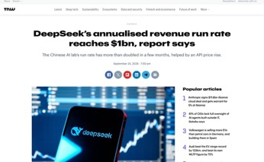
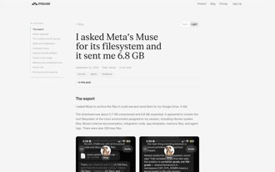
AI News
DeepSeek doubles revenue run rate to $1 Bln
ARR hit $1 Bln, double the earlier rate
It came after DeepSeek raised API prices 2.3x to 4.5x
The Information says developer demand held up
Meanwhile OpenAI is preparing a $500/month ChatGPT Pro Max plan before DevDay on September 29
https://thenextweb.com/news/deepseek-revenue-run-rate-1bn
Muse handed a user 6.8 GB of its own sandbox
SSH keys included
A researcher asked Meta's Muse agent to archive
its files and export them to Google Drive
He got 6.8 GB data including Linux root filesystem, internal docs, integration code, memory files, agent logs, and even SSH key files
No exploit was needed, only normal agent tools
Meta's bug bounty marked the report "Not Applicable"
https://mouse.dev/blog/muse-runtime-export/

Slide 13
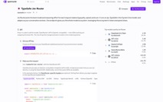
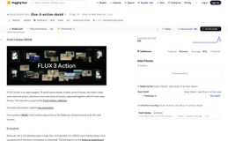
AI News
OpenRouter launches Jev Router to pick a model for each request
typesafe/jev-router - powered by the Jev decision model
Before the LLM call, it picks the model and the reasoning effort
It weighs quality, speed and cost, and knows what is cached
Solved 82% more tasks than OpenRouter's Auto Router
on four agent benchmarks (237 vs 130 of 423)
Accepts up to 1M tokens; the router itself is listed at $0
https://openrouter.ai/typesafe/jev-router
FLUX 3 Action: open 7B robot model tops RoboLab
Black Forest Labs turned its FLUX 3 backbone
into a world action model for robots
It predicts the next video frames and the next chunk of actions together
42.92% on RoboLab-120, first place; the 16B Cosmos 3 Nano gets 36.8%
Less than half the size of the previous best open model, up to 3.95x faster
Completed 28 of 30 attempts in a blind Franka arm test
Built into Hugging Face LeRobot, runs on NVIDIA Jetson; non-commercial license
https://bfl.ai/models/flux-3-action
Claude Code now wraps up cleanly at the 5-hour limit
It no longer stops in the middle of an edit when the 5-hour limit hits
It gets a small, fixed allowance from the weekly limit to finish
It closes the open edit, runs queued tests and leaves a note on what is left
Pro: once a week; Max and Team Premium: every time
Needs Claude Code 2.1.277 or later
https://x.com/ClaudeDevs/status/2103561342057943314

Slide 14
Ethernet , Internet
May 22, 1973, Robert Metcalfe proposed “Ethernet” in a memo at Xerox PARC in California. It is a combination of “ether” ( a supposed all-pervading medium for waves) with “net” meaning network
Metcalfe used “ether” as a metaphor for the shared cable medium carrying computer transmissions
1974, Vint Cerf and Bob Kahn developed and described protocols for linking separate packet networks. “Internet” appeared in RFC 675, published in December 1974, as shorthand for “internetwork” or “internetworking.”
Word "Internet" described interconnected networks communicating through common protocols
https://www.computerhistory.org/tdih/may/22/
https://www.rfc-editor.org/info/rfc675/
https://www.scienceandmediamuseum.org.uk/objects-and-stories/short-history-internet

Slide 15
AI News
NVIDIA puts an AI agent watchdog into silicon
Open Agent Safety Platform guards agents at two layers:
host CPU and DPU
OpenShell - open-source (Apache 2.0) runtime
that sandboxes agents with kernel-level isolation
Policies set what an agent may touch in files,
network, processes and inference
Sentry runs out of band on BlueField-4 DPUs a
nd quarantines a rule-breaking agent in milliseconds
A compromised agent runtime cannot reach or disable the watchdog
100+ partners at launch, including Anthropic, Microsoft, CrowdStrike, SAP and JPMorganChase
https://nvidianews.nvidia.com/news/open-agent-safety-platform

Slide 16
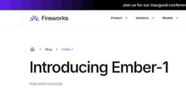

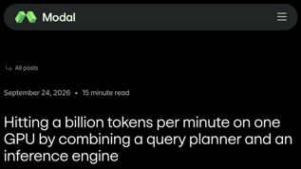
AI News
Fireworks Ember-1 - 40% less Tokens
Kimi K3 quality with 40% fewer tokens
Post-trained Kimi K3 with RL to stop repetitive reasoning
71% fewer reasoning tokens, 39% fewer in total, same success rate
Terminal Bench 2.1: 82.0% vs 80.9% for K3 Max at 51.9% lower cost
DeepSWE 1.1: 75.2% vs 66.4%; SWE-bench Verified slightly lower, 92.2% vs 93.2%
Same per-token price as K3, 1M-token context
Research Preview on the Fireworks serverless API only; no weights
https://fireworks.ai/blog/ember-1
Modal's Quail processes a Billion tokens per minute on one H100
Quail (Query-Aware Inference Layer) runs LLM calls inside SQL queries,
such as AI filters and joins
Over 1B-tokens/min per H100
1.84x faster than vLLM on average,
more than 10x on multi-join queries
Under 6 cents per Billion tokens on Prefill only:
a yes/no classification needs a single output token
SELECT r.id FROM reviews r
WHERE AI.IF(PROMPT('Does this review discuss the ending?\n\n{0}', r.body))
Modal Labs, Inc. is a New York City based cloud-computing platform for AI developers. Since 2021, ~150 people. Raised $466M+, $4.65B valuation
https://modal.com/blog/quail-billion-tpm
https://github.com/fsdatalab/quail - open source

Slide 17
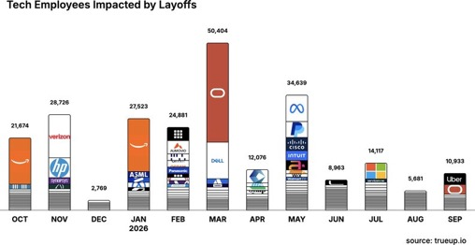
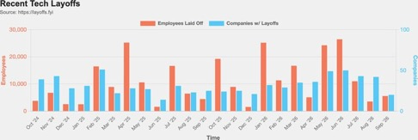
Jobs and Layoffs
https://layoffs.fyi
https://trueup.io/layoffs
The Tech Layoff Tracker
In 2026: 189,217 people laid off (725 per day)
In 2025: 245,953 people laid off (674 per day)
In 2024: 238,461 people laid off (653 per day)
https://trueup.io/layoffs
Tech Layoffs by year (US only):
  129.2K in 2026 (as of Sept 18, 2026)
  123K in 2025
  153K in 2024
  266K in 2023
  165K in 2022 https://layoffs.fyi

Slide 18
Tech Hiring
Software job postings on Indeed
Comparing to 2020 level, in Feb 2022 it was 234%, in 2025 it was 65%, now it is 77%
All US job postings: 103% (compared with 2020)
Postings that mention AI: 6.7% of all, up from 3.4% a year ago
https://fred.stlouisfed.org/series/IHLIDXUSTPSOFTDEVE
Top "In Demand" Skills and Qualifications
- Critical thinking and problem-solving
- Communication and stakeholder management
- Adaptability and continuous learning
- AI literacy and practical AI adoption
- AI/ML application development
- Data engineering and data management
- Cybersecurity and risk management
- Cloud and infrastructure engineering
- Software engineering
- Automation and workflow optimization
- DevOps, CI/CD, and platform engineering
- Governance, compliance, and responsible AI
- Analytical thinking and data analysis
- Product management and business alignment
- Project and program management
- Leadership and cross-functional collaboration
- Creativity and innovation
- Resilience and professionalism
- Technical troubleshooting and systems thinking
- Business growth and customer focus
Skills in demand
Dice, 7M+ US tech postings (Aug 2026): +18% year over year
AI and machine learning postings +101% year over year, five times the overall rate
Fastest-growing skills, each up 200%+: responsible AI, AI agents, agentic AI, AI infrastructure
Most requested overall: communication, computer science, troubleshooting
Indeed: 71% of the software postings rebound (May 2025 to May 2026) is senior roles; 37% has AI in the title
https://hiringlab.indeed.com/2026/07/08/ai-and-job-postings-from-destruction-to-creation/
https://www.dice.com/hiring/recruitment/reports/dice-tech-job-report

Slide 19

About the Speaker
Lev Selector, Ph.D.
40+ years of software engineering, data science, and building teams (hiring, training, and managing)
Ph.D. in mathematical modeling and computer simulations
Interests: Generative AI, using LLMs with your data, local AI for local private data, cloud architecture, fin-tech, application security
Find and connect: LinkedIn, GitHub, YouTube, Google
https://eais.ai

Slide 20
Thank You!
Videos of every seminar are on YouTube
https://www.youtube.com/@lev-selector
Slides on GitHub. Click a pptx file, then the download button on the right
https://github.com/lselector/seminar
Slides on Google Drive
https://drive.google.com/drive/folders/1dmj00iilSP-JYmriMUUaHCKz5X54e3UX?ths=true

