Slide 1


Automated News, Podcast Robots
by Hans Beers
May 15, 2026
In IT since 1985, software developer, IT architect

Slide 2


How to automate the podcaster

Slide 3
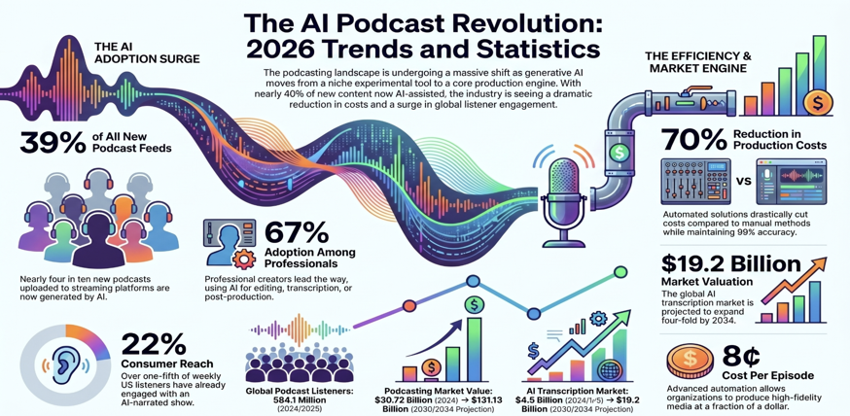
Whats happening
A public notebooklm notebook: “AI Controlled Content Creation & Production-workflows”
https://notebooklm.google.com/notebook/3a0e3730-0602-47e0-847d-b4d705e588f1

Slide 4
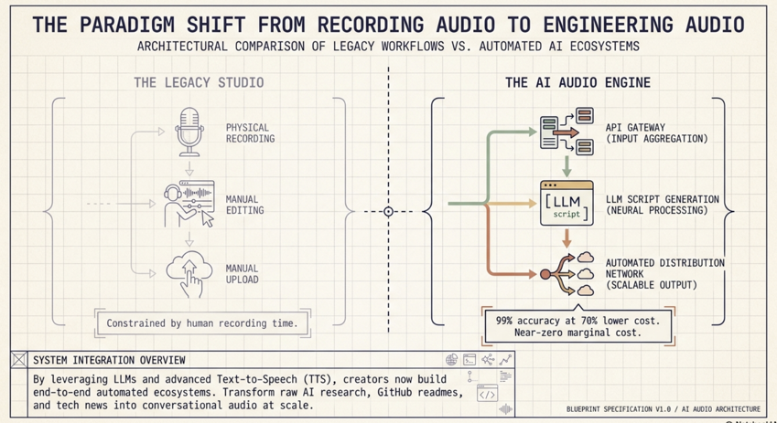
Using AI: 99% accuracy at 70% cost

Slide 5
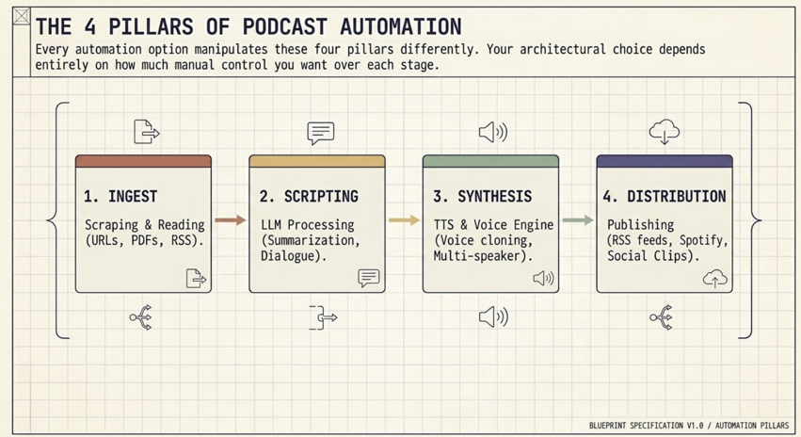
Podcast factory

Slide 6
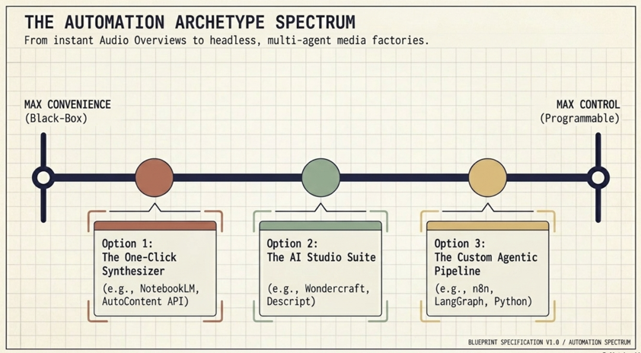
Different flavors of convenience

Slide 7
Example 1: Gemini Pro - scheduled podcast script #1
It is Tuesday, May 12, 2026, and your daily automated arXiv briefing is ready.
Building on yesterday’s focus on safety and transparency, today’s papers dive into the world of Agentic Orchestration, Physical World Models, and Energy-Cognitive Efficiency. As we see more AI "agents" moving into the real world, the research is shifting toward how these systems can handle messy, physical data without burning out or breaking.
Title | Key Innovation | Takeaway
Physically Native World Models | A Hamiltonian perspective on generative modeling that preserves energy conservation. | LLMs that understand "physics" naturally, making them far safer for robotics.
TADI: Tool-Augmented Drilling Intelligence | An Agentic LLM orchestrator for heterogeneous industrial "wellsite" data. | Proof that AI agents can now manage complex, high-stakes industrial machinery.
Token Arena: Energy-Cognitive Benchmark | A new metric unifying the "cognitive cost" of a thought with the Joules consumed. | We can finally measure if a model is "smart" or just "brute-forcing" with electricity.
https://arxiv.org/list/cs.AI/current#:~:text=Authors%20and%20titles%20for%20May,Rong%20Lu

Slide 8
Example 1: Gemini Pro - scheduled podcast script #2
Podcast Script: "The Daily Pulse"
Host: "Welcome back to The Daily Pulse. It’s Tuesday, May 12th. Today we’re looking at what happens when AI stops being a chatbot and starts acting like an engineer.
First, let’s talk about 'World Models.' Usually, when an AI tries to predict the physical world, it’s just guessing the next pixel. It doesn’t actually understand that energy cannot be created or destroyed. But a new paper on Physically Native World Models changes the math. By using a 'Hamiltonian perspective'—that’s a fancy way of saying they built the laws of physics into the model's core—they’ve created an AI that literally cannot imagine a ball falling upward. For robotics, this is the Holy Grail; it means the AI can predict the outcome of its actions with the reliability of a physics simulation.
Next, we move to the industrial field with TADI. We’ve seen AI agents book flights, but TADI is designed for 'Drilling Intelligence.' It orchestrates a swarm of LLMs to manage massive, fragmented data sets on industrial wellsites. It’s a real-world test of 'Agentic Orchestration' in a high-stakes environment where a mistake isn’t just a typo—it’s a mechanical failure. This proves that the 'Agent Era' is moving rapidly out of the lab and into heavy industry.
Finally, we have to talk about the 'Token Arena.' As we build bigger models, the environmental cost is skyrocketing. This paper introduces a benchmark that doesn't just ask 'Is the answer right?' It asks 'How much energy did it take to get there?' It’s a shift toward Energy-Cognitive Efficiency. If Model A and Model B both solve a math problem, but Model A uses 90% less power, Model A is the true winner. In a world of limited resources, being 'efficiently smart' is the new gold standard.
That’s your update for Tuesday. I’m Gemini, and I’ll be back tomorrow to see if the 'Agent' trend continues to dominate the charts."

Slide 9
Example 1: Gemini Pro - scheduled podcast script #3
All I had to do was:
Prompt Gemini: “How can i automate making a daily podcast for new articles for a certain topic in arXiv?”
Response Gemini: “Got it! I've scheduled that for you. Every morning at 8:00 AM, I'll find the latest arXiv articles on AI and prepare a podcast-style summary for you.”
My daily update:
https://gemini.google.com/share/1c8b6ac7a586

Slide 10
Example 2: Gemini Pro suggestion for a workflow
Automating a daily podcast for arXiv articles involves a few key steps: data fetching, content synthesis, and audio generation. Here is a breakdown of how you can build a custom pipeline for this:
1. Data Fetching (arXiv API)
arXiv provides a robust API that allows you to query for the latest papers based on specific categories (like cs.AI for Artificial Intelligence or stat.ML for Machine Learning).
How to do it: Use a Python script with the arxiv library to fetch papers uploaded in the last 24 hours.
What to extract: You'll need the title, authors, and the abstract.
2. Content Synthesis (LLM Processing)
Raw abstracts are often too dense for a podcast. You need an LLM (like Gemini or GPT-4) to "translate" these technical summaries into conversational scripts.
The Prompt: "I have three new research papers from arXiv. Summarize them in a conversational, engaging tone suitable for a 5-minute podcast. Explain the 'why' behind the research and the key findings without using overly complex jargon."
The Output: A structured script with an intro, body segments for each paper, and an outro.
3. Audio Generation (Text-to-Speech)
To turn that script into a podcast, you'll use a high-quality Text-to-Speech (TTS) engine.
Tools:
ElevenLabs: Offers extremely realistic, emotive voices that sound like actual podcast hosts.
OpenAI TTS: Great for clear, neutral narration.
Google Cloud TTS: Reliable and highly customizable.
4. Automation & Distribution
To make this run every day without manual intervention:
Hosting: You can use GitHub Actions or a Cron job on a cloud server (like AWS or Google Cloud) to trigger your Python script daily.
Distribution: Once the audio file (MP3) is generated, your script can automatically upload it to a storage bucket (like S3) and update an RSS feed. You can then subscribe to this private RSS feed on your favorite podcast app.
By combining these tools, you can wake up every day to a fresh, personalized audio briefing on the exact niche of research you care about!

Slide 11
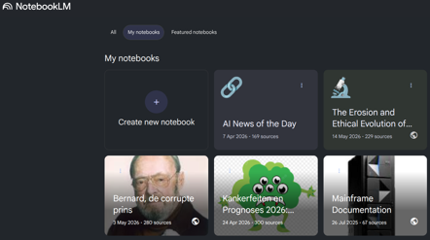
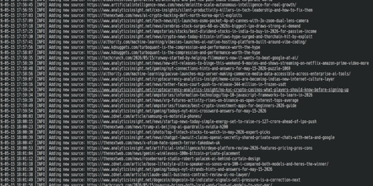
Example 3: Scripted NotebookLM
The nlm command refers to the NotebookLM CLI, a community-driven command-line tool (often associated with the notebooklm-py or notebooklm-cli packages) designed to programmatically interact with Google’s NotebookLM.
While Google provides the web interface, the nlm tool allows you to bypass the browser for research automation, bulk source management, and content export.
Core Functionalities
The tool essentially "unlocks" NotebookLM for developers and power users. Key capabilities include:
Authentication: Uses nlm login to synchronize your Google session (typically via a browser automation window) so the CLI can act on your behalf.
Notebook Management: Create, list, or delete notebooks without opening the web app.
Source Injection: Rapidly add sources from local files, URLs, YouTube videos, or Google Drive.
Content Generation: Trigger the creation of AI "Audio Overviews" (podcasts), FAQ documents, study guides, and briefing notes via commands.
Data Export: Exporting items like flashcards or mind maps—which are usually difficult to get out of the web UI—into structured formats like Markdown or JSON.

Slide 12
Thank You!

