Slide 1
AI Updates - June 12, 2026
Crowd-sourced "LM Arena" Leaderboard
Claude Fable 5 and Mythos 5
Anthropic’s "ant" CLI
Anthropic’s 'Oceanus' leak
Internet - more bots than humans
June 15 Claude Pricing, June 22 Fable Pricing
ClaudeCode Ultracode
Anthropic employees' about AI vs Human
Claude Partner Hub, Tiered Services Track
If your agent has no memory,
it has no career.
Fraud Detection - and AI
Stateful Swarms with Persistent Memory
Agent Arena
Google Dreambeans app
Linus Torvalds on AI’s Flood of Bugs
AI in Snowflake Cortex
AI in Databricks
AI Jobs by demand
Build agent workflow pipeline
SpaceX IPO
Apple WWDC 2026 - June 8
Alibaba, Baidu and BYD are Blacklisted
Google DiffusionGemma 26B
Lilly Medicine Company
Choose an Agent
Choose a Harness
How to make a harness
Samwer Brothers Copy-Cats
Jobs & Layoffs

Slide 2
"LM Arena" Leaderboard
Data for June 10
Starting Elo rating = 1000
https://en.wikipedia.org/wiki/Elo_rating_system
English - https://lmarena.ai/leaderboard/text
Coding - https://lmarena.ai/leaderboard/text/coding
■ | Claude
■ | Gemini
■ | OpenAI
■ | Open Source
Claude Fable-5 - 6TB
Claude Opus-4.8 - 5TB
Claude Sonnet-4.5 - 1TB
GLM-5.1 - 744B
Meta muse-spark - 16 x 70B
Qwen3.7-max-preview - 745B
Baidu Ernie-5.1 - 800B
Deepseek-v4 - 1.6T
Kimi-k2.6 - 1T
Xiaomi MiMo-V2-Pro - 1T+
ByteDance dola-seed-2.0-pro 400B
Minimax M3 - 456B
Code | Model | Score
■ | claude-fable-5 | 1510
■ | claude-opus-4-6-thinking | 1504
■ | claude-opus-4-7-thinking | 1502
■ | claude-opus-4-6 | 1498
■ | claude-opus-4-7 | 1492
■ | muse-spark | 1487
■ | gemini-3.1-pro-preview | 1487
■ | gemini-3-pro | 1486
■ | claude-opus-4-8-thinking | 1486
■ | gpt-5.5-high | 1481
■ | gpt-5.4-high | 1479
■ | claude-opus-4-8 | 1477
■ | gemini-3.5-flash | 1477
■ | gpt-5.2-chat-latest-20260210 | 1475
■ | glm-5.1 | 1475
■ | qwen3.7-max-preview | 1474
■ | grok-4.20-beta1 | 1474
■ | gpt-5.5 | 1474
■ | grok-4.20-beta-0309-reasoning | 1474
■ | gemini-3-flash | 1473
■ | grok-4.20-multi-agent-beta-0309 | 1473
■ | claude-opus-4-5-20251101-thinking-32k | 1473
■ | gpt-5.5-instant | 1472
■ | claude-sonnet-4-6 | 1471
■ | claude-opus-4-5-20251101 | 1469
Code | Model | Score
■ | claude-fable-5 | 1566
■ | claude-opus-4-7-thinking | 1553
■ | claude-opus-4-6-thinking | 1551
■ | claude-opus-4-8-thinking | 1550
■ | claude-opus-4-7 | 1548
■ | claude-opus-4-6 | 1548
■ | claude-opus-4-8 | 1540
■ | claude-opus-4-5-20251101-thinking-32k | 1530
■ | glm-5.1 | 1529
■ | muse-spark | 1526
■ | claude-sonnet-4-6 | 1526
■ | qwen3.7-max-preview | 1525
■ | gemini-3.1-pro-preview | 1525
■ | claude-opus-4-5-20251101 | 1523
■ | gpt-5.4-high | 1521
■ | claude-sonnet-4-5-20250929-thinking-32k | 1520
■ | mimo-v2.5-pro | 1520
■ | gpt-5.5-high | 1520
■ | gemini-3-pro | 1519
■ | ernie-5.1 | 1515
■ | gpt-5.2-chat-latest-20260210 | 1515
■ | gpt-5.4 | 1515
■ | grok-4.20-multi-agent-beta-0309 | 1514
■ | claude-sonnet-4-5-20250929 | 1513
■ | claude-opus-4-1-20250805-thinking-16k | 1513
https://lmarena.ai/leaderboard/text
Design Arena - https://www.designarena.ai
https://openlm.ai/chatbot-arena/
https://beta.lmarena.ai
Web Leaderboard - 1T params https://web.lmarena.ai/leaderboard
LLM Leaderboard - by @LlmStats - https://llmworld.net/llm_leaderboards/
LLM Leaderboard - by StackAI - https://www.stack-ai.com/llm-leaderboard
LLM Leaderboard - by Artificial Analysis - https://artificialanalysis.ai/leaderboards/models
Open LLM Leaderboard - by Hugging Face - https://huggingface.co/open-llm-leaderboard
LLM Leaderboard - by Vellum - https://www.vellum.ai/llm-leaderboard
AI Benchmarking Hub - https://epoch.ai/data/ai-benchmarking-dashboard
Grok 4 Benchmarks - https://artificialanalysis.ai/models/grok-4
Image arena (alibaba) - http://aiarena.alibaba-inc.com/corpora/arena/leaderboard?arenaType=T2I
image arena - https://lmarena.ai/leaderboard/text-to-image

Slide 3
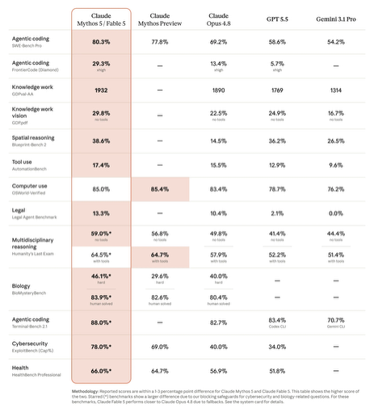

Claude Fable 5 and Mythos 5
Claude Fable 5 and Claude Mythos 5 are Anthropic’s new top-end “Mythos‑class” models, launched on June 9, 2026
Fable 5 is same as Mythos 5, but sensitive questions (cyber, biology, model-distillation) are routed to Opus 4.8
It outperforms previous Claude models on software engineering, complex knowledge work, vision, and long‑context tasks
Pricing x2 higher: $10 / $50 in/out for 1M tokens
/model claude-fable-5
https://www.anthropic.com/news/claude-fable-5-mythos-5
https://www.youtube.com/watch?v=e-4xG1U7M70 - video
Haiku ~20B Small, fast model
Sonnet ~1T Mid-to-high tier
Opus ~5T Top regular class
Fable-5 ~6T MoE 400B active

Slide 4
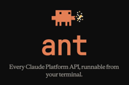
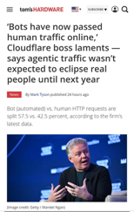

AI Updates
Anthropic’s "ant" CLI
Use Claude Code via shell commands brew install anthropics/tap/ant ant auth login --no-browser ant auth login --profile <profile-name> ant auth status ant messages create--model claude-opus-4-8 \ --max-tokens 1024 \ --message '{role: user, content: "Hello"}'
https://platform.claude.com/docs/en/api/sdks/cli
Internet - more bots than humans
https://x.com/eastdakota/status/2062212701414187452
according to Cloudflare CEO Matthew Prince
Anthropic stops testing new Mythos model after unreleased 'Oceanus' leak
Anthropic’s Logan Graham says AI is now finding flaws faster than organizations can patch them
But at the same time a secret, unreleased version of their next Mythos model, codenamed Oceanus, was just leaked and sold via Chinese API proxies, forcing Anthropic to panic-pause its pre-launch safety testing
The company just launched a massive Partner Hub to help consulting giants like Accenture and Deloitte train hundreds of thousands of workers on Claude.

Slide 5

Claude Pricing
Starting June 15, 2026, Anthropic splits Claude into two separate usage buckets
If you have a Pro or Max subscription, its limits stay the same and covers interactive use - but only when you are using Anthropic tools: Claude Code in the terminal, Cowork, and chat Pro: ~44K tokens per 5-hour window Max 5x ($100) = 5x Pro (up to 220K tokens per 5-hour window) Max 20x ($200) = 20x Pro (up to 880K tokens per 5-hour window)
Additionally paid subscribers will get a new, separate monthly Agent SDK credit (at standard API token costs) to cover "automated" use - Agent SDK calls, claude -p, GitHub Actions, and third-party apps
The dollar size of the credit is the same as subscription ($20, $100, $200). Credits don't roll over. Once depleted, SDK calls stop. You have an option to enable "extra usage" at standard API costs
Starting June 22, 2026 Claude Fable 5 will be removed from monthly subscriptions. It iwll be only available via credits at API token pricing.
Claude Ultracode = xhigh reasoning + Dynamic Workflows
Ultracode = xhigh reasoning effort + Dynamic Workflows (span many subagents)
/effort ultracode
Both Pro and Max subscribers can use it
Max has Dynamic Workflows "ON" by default
It requires Opus 4.8 or 4.7 and won't appear on Sonnet 4.6
After June 15th, terminal sessions (Claude Code CLI) remain unaffected, but headless use via "claude -p" draws from the new Agent SDK credit
Beware: ultracode carries no spending cap and can exhaust your session budget extremely quickly.

Slide 6

AI Updates
Anthropic employees' about AI vs Human:
"On days where everything works well, I can't help but think nothing I do matters, everything is automated and better and faster than I ever will be," they said.
"But then there are days where everything breaks and I don't understand why and I realize I have no idea what I've been up to anymore," the employee added.
Other employee accounts included one worker who said they had not written any code themselves in about five months, and another who predicted that AI-generated code would outperform human-written code within a year.
Anthropic added a Tiered Services Track and the Claude Partner Hub portal on June 1
There are three (3) tiers are based on measurable deployments, not company size:
Tier | Certified Practitioners | Deployed Customers | Public Stories
Select | 10+ | 2+ | 1+
Preferred | 100+ | 15+ | 3+
Global Premier | 1,000+ | 100+ (3+ regions) | 15+
Claude Partner Hub
Backed by a $100 Mln investment in partner training, technical support, ...
powered by Euler - a Partner Relationship Management (PRM)
https://partnerhub.anthropic.com/signin/anthropic
https://www.anthropic.com/news/services-track-partner-hub

Slide 7
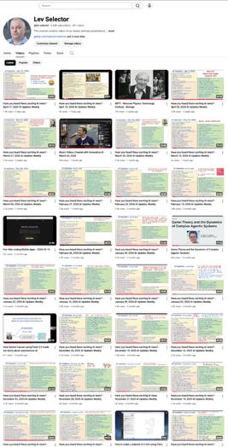
We do these weekly videos every Friday
Stats: 6.88K subscribers, 290 videos
1. Subscribe to this channel https://www.youtube.com/@lev-selector
2. Download slides from GitHub using links under the videos
3. Please pause the video - and answer the pinned question in comments under the video

Slide 8
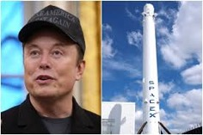
AI Updates
SpaceX IPO
555.6M shares at $135 each - raising $75B
Trading set to begin Friday on Nasdaq as SPCX
The book was four times oversubscribed
Synthetic exposure on Hyperliquid is already pricing SPCX at $167 (a classic ~20% pop), giving underwriters the option to release another 83.3M shares for ~$11B more
Musk becomes the world's likely first trillionaire

Slide 9
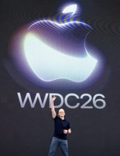


AI Updates
Apple held its WWDC 2026 keynote Monday June 8
Fully redesigned Siri powered by Google Gemini
Apple also unveiled iOS 27, compatible with iPhone 11 and newer, featuring significant performance improvements, Liquid Glass design refinements with new customization options, and expanded Apple Intelligence capabilities
macOS 27 officially drops Intel Mac support
All other platforms - iPadOS, watchOS, tvOS, and visionOS - received "27" updates as well
The keynote also marked CEO Tim Cook's final WWDC appearance, as he plans to hand leadership to hardware chief John Ternus in September
Pentagon adds Alibaba, Baidu and BYD to military blacklist
Also added nearly 200 other Chinese companies
This bars listed companies from U.S. defense contracts, complicates access to U.S. capital markets, and signals serious risk to investors and American business partners
Google DiffusionGemma
Experimental 26B MoE Open Model Using Text Diffusion
Up to 4x Faster Generation, 1K tok/sec on Nvidia H100 at 4b FP

Slide 10

AI Updates
Eli Lilly and Company (https://www.lilly.com/)
founded in 1876 by Colonel Eli Lilly in Indianapolis, Indiana
A 150-year-old pharmaceutical giant employing over 50K people with a ~$1 Trillion market cap
Known for GLP-1 blockbusters Mounjaro and Zepbound, Lilly is rapidly repositioning as an AI-powered drug discovery platform
Its TuneLab initiative (tunelab.lilly.com) gives biotech startups access to AI/ML models trained on Lilly's vast proprietary research
Key partnerships include Nvidia (1,000 Blackwell GPUs), Google DeepMind's Isomorphic Labs (AlphaFold), and a $2.8B deal with Insilico Medicine
Its core moat: 150 years of irreplaceable proprietary metabolic disease data covering diabetes and obesity that no public-data-trained AI model can replicate.

Slide 11


Choose an Agent
Open
Name / Project | What it is (role) | Notes (personal-use angle)
OpenClaw | Local personal AI assistant | runs on your devices, uses Telegram, WhatsApp, etc.
Agent Zero | Open-source agentic computer assistant | Autonomous agent that runs on its own OS, uses/creates tools, self-corrects, and can be specialized as a personal assistant
CrewAI | Multi-agent “crew” for workflows | Open-source platform - define agents that collaborate; often used as personal “teams” for research and ops
Hermes Agent | Open-source general-purpose agent | Listed among top open-source agents for autonomous workflows; can be adapted as a personal digital employee
OpenDevin / Devon | Open-source software dev “AI engineer” | Autonomous coding agent; can act as a personal dev assistant handling tickets and PRs
AutoGPT (modern forks) | Autonomous task-running agent | Classic open-source autonomous agent you can configure as a personal concierge, though still prone to drift without careful constraints
Open Interpreter | Open-source computer control / assistant | Lets an LLM act as a “local operator” on your machine; good base for a sysadmin / research personal agent
Jarvis-type agents (various repos) | Personal general assistant | Multiple OSS “Jarvis” projects listed in open-source agent roundups; typically positioned as always-on personal helpers
Blinky | Debugging agent | VS Code debugging agent that feels like a specialized engineering coworker
VoltAgent / Volt | TypeScript agent framework | OSS framework; example agents include personal assistants operating across local/cloud resources
Rowboat | Agent dev tool with MCP/RAG | Built as a dev platform, but you can spin up a persistent assistant agent with tools (email, docs, etc.)
n8n + LLM agent nodes | Workflow + agent hybrid | Open-source automation tool that, combined with agent nodes, can function like a digital employee across SaaS apps
Closed
Name / Product | What it is (role) | Notes (personal/digital employee angle)
Abacus DeepAgent | top‑tier general‑purpose agent | “AI super assistant” for professionals and enterprises
Marblism | Admin / ops digital worker | Reported as useful for ongoing admin and content tasks; better for repetitive, well-scoped work
DigitalEmployees.io | “Digital employees” for business processes | Commercial platform that sells pre-built digital workers as team members
WorkFusion AI Agents | Pre-built AI “digital employees” | Agents framed explicitly as digital employees embedded into back-office workflows
Digital Workforce agents | Enterprise digital coworkers | Commercial AI agents offered as digital workers for process automation
DataRobot digital coworkers | AI agents in enterprise context | Positioned as digital coworkers that learn org context and support teams. datarobot
Doozer AI | Digital worker platform | Listed as a top digital worker product; oriented toward business workflows
XAgent (commercial flavor) | General-purpose autonomous agent | Featured among top digital worker tools; acts like a higher-autonomy assistant
Sintra AI | Ops / back-office digital worker | Commercial digital worker for repetitive knowledge work.
AiNGEL | Digital worker / assistant | Operational tasks
MSFT 365 Copilot | Role‑specific agents | Primarily enterprise; also M365 Copilot licenses
Google Gemini Spark | Personal AI agent | Personal (AI Ultra subscribers) + some business
Perplexity Agent | Autonomous research | Both consumer and pro tiers
Perplexity Computer | General‑purpose agent orchestrator / workspace | Power users and teams (pro/enterprise)
Salesforce | Agents in CRM | Enterprise
IBM watsonx | Agent | Enterprise

Slide 12
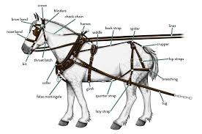
Choose a Harness
Open
Name | Type / Category | Notes
OpenCode | AI coding agent / harness | Open source terminal/IDE/desktop agent; BYO model or use included free models.
Archon | Harness builder | YAML-defined harness workflows; runs via CLI/Web/Slack/GitHub.
Open Harness (Max) | Lightweight harness building blocks | Minimal building blocks for creating custom coding harnesses.
OpenHarness (HKU DS) | Open agent harness framework | Python implementation modeling production-style AI agents and harness patterns.
Awesome Harness Engineering | Curated list / meta-resource | Awesome-list of harness tools, patterns, evals, MCP, permissions, observability.
Aider | Terminal / editor harness | FOSS CLI coding agent using git diffs; supports many providers and local models.
Cline | VS Code / JetBrains agent | Open-source extension acting as an agent harness over LLMs and tools.
Continue.dev | VS Code / JetBrains extension | FOSS IDE assistant; can act agentically over your codebase.
Roo (legacy) | VS Code multi-agent harness | Historically open; local multi-agent harness for local models; likely in maintenance mode.
Local multi-agent harness (FOSS) | CLI multi-agent harness | FOSS harness to run local CLI agents (Claude Code–like, Codex-style, etc.).
Closed
Name | Type / Category | Notes
Claude Code | Agentic coding harness | Anthropic’s first‑party harness (planning, tools, multi-step edits).
Cursor | IDE + multi-model agent | Commercial IDE with strong agentic coding and workflow orchestration.
Replit Agent | Browser IDE agent | Replit’s cloud IDE agent experience.
Amazon Q Developer | IDE assistant / agent | AWS developer assistant with agent-like flows.
GitHub Copilot (Chat/Workspace) | IDE/Cloud agent | Workspace/Agents features approximate a coding harness around repos.
Windsurf | IDE agent | Commercial IDE with structured agentic coding.
Gemini CLI | CLI coding assistant | Google’s CLI with some harness-like flows when wired to tools.

Slide 13

How to make a harness
Harness Engineering - by Mehdi Allahyari
Harness - execution environment, safety rails, and feedback loops around an LLM
Reliable agents come not from bigger models but from better infrastructure
LLM = car engine, Harness = chassis, brakes, and steering
A harness typically provides an execution loop, context compaction, a secure sandbox, lifecycle hooks, and human-in-the-loop gates
Feedforward controls (configs), feedback controls (self-correction)
Tuning the harness beats upgrading the model
https://substack.com/home/post/p-200045389
Five architectural pillars:
a State Controller maintaining durable conversation history
a Tool Registry validating and dispatching tool calls
an Execution Sandbox isolating commands
Middleware hooks intercepting calls before and after execution
Boundary Controls enforcing hard limits like iteration caps
Example - in python using Anthropic API
Errors become structured feedback rather than crashes, letting the model self-correct while guaranteed termination keeps the system safe to run unsupervised
https://mlnotes.substack.com/p/inside-the-machine-the-anatomy-of
Part 3 will cover sandboxing and execution security.

Slide 14
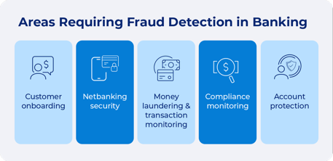
Fraud Detection - and AI
Modern AI - LLM/deep learning
LLM-based document analysis — understanding free-text insurance claims, loan applications, or support tickets for deceptive language; requires semantic understanding, not just features
Multimodal forgery detection - combining vision + language models to detect forged IDs, manipulated invoices, or deepfake KYC (Know Your Customer) videos
LLM-generated attack detection - defending against AI-written phishing emails or synthetic identity narratives requires a model that understands language at the same level the attacker used
Conversational fraud probing - an LLM agent asks follow-up questions during onboarding and detects inconsistencies in answers
Most fraud detection today runs on classical ML - Isolation Forest, XGBoost - plus good feature engineering and rules
Deep Learning or LLMs have narrow use cases - documents, images - and adversarial LLM-generated attacks
Rules - deterministic, hand-written logic
Velocity checks - block if >N transactions in T minutes
Amount thresholds - flag big transactions
Geo-blocking - deny from specific countries or IPs
Blacklists - match against known bad accts, cards, devices
Time-of-day rules - flag outside normal business hours
Card-not-present rules - apply stricter checks for online vs. in-person
Classical / Adaptive ML
Isolation Forest, Random Cut Forest (AWS), One-Class SVM, Classifiers - Logistic Regression, Random Forest, XGBoost, LightGBM, etc, Clustering (K-Means / DBSCAN), Autoencoders (high reconstruction error = likely fraud ), Recurrent Neural Networks (RNNs / LSTMs) - detect unusual temporal patterns; Graph algorithms (PageRank, Louvain) - detect fraud rings and money laundering networks from account relationship graphs

Slide 15

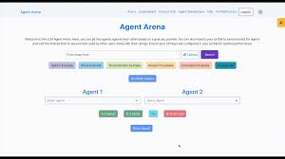
AI Updates
Stateful Swarms: How Persistent Memory Beats Traditional Agent Architectures https://www.artificialintelligencemadesimple.com/p/stateful-swarms-how-persistent-memory
Stateful Swarms is an agentic architecture that replaces long-context prompts and stateless multi-agent chains with a persistent “blackboard” memory shared by specialized workers
Agents read from and write to an append-only, typed knowledge base with provenance, so documents are read once and then queried cheaply and repeatedly instead of being reprocessed each run
On the 1,251-task Harvey Legal Agent Benchmark, this design achieved 17.75% strict all-pass at about $1.30 per task, versus Harvey’s 10.4% at roughly $50.90, yielding about 39x cost reduction using the same Gemini models
The paper argues that persistent state, auditability, and structured coordination matter more than raw model scale for scalable knowledge work
Agent Arena
https://arena.ai/leaderboard/agent - live, crowdsourced leaderboard ranking AI models on real-world agentic tool use across 455K+ sessions, currently led by Claude Opus 4.7 and GPT 5.5
https://docs.factory.ai/benchmarks/agent-arena - uses Elo-based crowdsourced voting to compare coding agents on complex autonomous tasks
https://microsoft.github.io/WindowsAgentArena - benchmarks multimodal desktop agents on 150+ Windows OS tasks, with the best agent reaching only 19.5% vs. 74.5% human success
https://arena.xlang.ai - XLang Lab's Computer Agent Arena - open platform for evaluating computer-use agents on real desktop tasks across Windows and Ubuntu

Slide 16

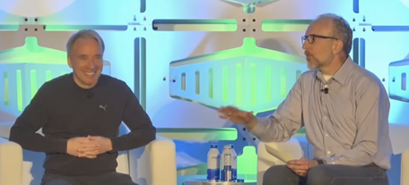
AI Updates
Google Dreambeans app
Processes your data overnight while you sleep
Creates 10-14 "beans" - curated personalied story cards for you based on your data and photos, illustrated with AI-generated artwork, detects people or places from your Photos
Linus Torvalds on AI’s Flood of Bugs https://www.youtube.com/watch?v=4_x0USuQ9Ss
More commits (20% increase)
Love/hate; pain points for the maintenance
Influx of duplicate bug reports overwhelming the mailing list
AI can reverse-engineer bug fixes into exploits, maintaining secrecy is no longer effective
Frustration with companies that create branding and logos for bugs, publicizing them for fame before providing patches or allowing maintainers time to address the issues
Positive about the integration of AI

Slide 17
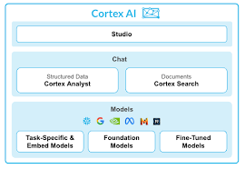

AI in Snowflake
Snowflake Cortex - use LLMs and ML models inside Snowflake
https://docs.snowflake.com/en/guides-overview-ai-features
https://www.snowflake.com/en/product/features/cortex/
https://www.snowflake.com/en/product/ai/
https://www.snowflake.com/en/blog/integrated-developer-environment-ai/
AISQL - Cortex AI Functions - call LLMs directly from SQL to summarize, classify, translate, or extract from text, images, and audio
Cortex Analyst - natural language to SQL conversion
Cortex Agents - multi-step reasoning across structured and unstructured data
Cortex Search - RAG-style semantic search over your Snowflake data
Cortex Fine-tuning - fine-tune select models on your own data
Snowflake CoCo (formerly Cortex Code) - AI coding agent within Snowsight
Snowflake CoWork - a personal work agent - query data, run deep research, and act in Slack, Gmail, Jira, and Salesforce
Snowflake Cortex can use various LLMs - Claude, Meta Llama, Mistral, Snowflake's own Arctic LLM, and various task-specific models for translation, summarization, sentiment analysis, and document processing
Managed MCP servers - making Snowflake a data backend for your own agents
Snowflake Cortex Code CLI - with MCP and ACP (Agent Client Protocol) support
Snowflake ML - traditional ML models (forecasting, classification, etc.) using a feature store, model registry, and framework connectors for popular libraries
AI runs inside Snowflake's governance perimeter. Your data is never used to train shared models and is not accessible to other customers. Standard RBAC, data masking, and row-level policies apply to AI features just like regular data access
Snowflake has 9K employees and current valuation is ~ 82-88 Bln

Slide 18
Databricks at $165B Valuation
Databricks in talks for funding at $165 billion valuation
Databricks was founded in 2013 by seven researchers from UC Berkeley's AMPLab, the same team that created Apache Spark in 2009 to fix Hadoop MapReduce's slowness
Apache Spark has introduced in-memory distributed computing with high-level APIs in Scala and Python, making big data processing dramatically faster and more accessible
Databricks commercialized Spark by offering managed clusters, collaborative notebooks, and a unified platform for batch and streaming workloads using distributed DataFrames as the core abstraction
In 2019, Databricks introduced Delta Lake - an open-source storage layer built on top of Parquet files that adds ACID transactions, versioning, and reliable metadata handling to data lakes
This "lakehouse" architecture merges the flexibility of data lakes with the reliability of data warehouses
Today, Databricks has expanded deeply into AI: it hosts MLflow for experiment tracking, supports LLM fine-tuning, integrates models from OpenAI and Anthropic, and recently launched Agent Bricks for production-scale AI agent development
https://en.wikipedia.org/wiki/Databricks - 10K employees
https://www.databricks.com
Databricks has robust SQL support
Databricks has a multi-layer security model with full RBAC and fine-grained data visibility controls (RBAC - Role-Based Access Control - GRANT / REVOKE SQL statements on catalogs, schemas, and tables; Row-level security (RLS) — filter rows based on the querying user's identity; Column-level security — mask or restrict access to specific columns; ABAC (Attribute-Based Access Control) — dynamic policies based on user attributes, currently in private preview; Audit logs and data lineage — track who queried what and when).
Snowflake vs Databricks
Pick Snowflake if you mostly doing SQL and run BI dashboards and reports from structured or semi-structured data
Pick Databricks if you need serious ML, LLM fine-tuning, or AI agent pipelines; if you work with streaming data or mixed data types (logs, unstructured text, etc.); if you want open formats (no lock-in) and multi-language flexibility with Python/Scala; when you do complex data transformations at scale

Slide 19
Build agent workflow pipeline
Tool | URL | Notes
Microsoft Agent Framework | https://github.com/microsoft/agent-framework | Open source, v1.0 April 2026; replaced AutoGen github+1
Microsoft Power Automate | https://powerautomate.microsoft.com | Not open source
Zapier | https://zapier.com | Not open source
Make (Integromat) | https://www.make.com | Not open source
LangChain | https://www.langchain.com | Open source
Node-RED | https://nodered.org | Open source
n8n | https://n8n.io | Open source / cloud
AutoGen | https://microsoft.github.io/autogen/ | Superseded by Agent Framework; maintenance-only linkedin+1
LlamaIndex | https://www.llamaindex.ai | Open source
CrewAI | https://www.crewai.com | Open source
FlowiseAI | https://flowiseai.com | Open source
Langflow | https://www.langflow.org | Open source
LangGraph | https://langchain-ai.github.io/langgraph/ | Open source
Haystack | https://haystack.deepset.ai | Open source
Activepieces | https://www.activepieces.com | Open source
StackStorm | https://stackstorm.com | Open source
SuperAGI | https://superagi.com | Open source
Huginn | https://github.com/huginn/huginn | Open source
RelevanceAI | https://relevance.ai | Not open source
Letta (formerly MemGPT) | https://www.letta.com | Rebranded Sep 2024 letta+1
Latenode | https://latenode.com | Not open source
Relay | https://relay.app | Not open source
Lindy | https://www.lindy.ai | Not open source
Gumloop | https://www.gumloop.com | Not open source getmaxim
Dify (add) | https://dify.ai (GitHub: https://github.com/langgenius/dify) | Open source, visual canvas, very popular github
Rivet (add) | https://github.com/Ironclad/rivet | Open source desktop node-based AI builder github
Windmill (add) | https://www.windmill.dev | Open source, self-hostable, multi-language windmill
OpenAI Agent Builder (add) | https://platform.openai.com/agents | Visual drag-and-drop, MCP support reddit

Slide 20
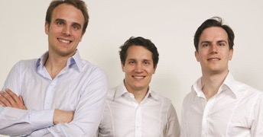

Samwer Brothers Copy-Cats
Samwer brothers - Multi-Billion Copy-cats
3 brothers from Germany - have built a Multi-Billion Empire using the following copy-cat strategy:
Find a hot U.S. startup,
Copy it fast,
Launch it in Europe,
Sell it to the original company
In 1999 - cloned eBay as Alando, sold to eBay just 100 days later for $43M
In 2004 they built Jamba!, a mobile content platform, sold to Verisign for $273M
In 2007, they founded Rocket Internet to do this cloning massively, for example:
CityDeal - sold to Groupon
Zalando (IPO valued at €5.3B)
Lazada
Jumia
Foodpanda
... and dozens more across over 50 countries
Rocket Internet itself went public in 2014 at a €6.5 Bln valuation
Today, each brother is worth over $1 billion
https://en.wikipedia.org/wiki/Rocket_Internet
The Wildest Part - the original companies (like eBay, Groupon, or Airbnb) were grateful, because the Samwer brothers were basically doing their international expansion for them https://stories.byburk.net/how-three-brothers-made-billions-by-shamelessly-copying-ideas-6ab866cd420c

Slide 21
AI Jobs by demand
On average AI‑focused roles pay more than "regular" software engineering roles at the same level and company
Levels.fyi data: AI‑focused software engineers earn about 8–12.5% more than non‑AI peers at the same internal level, with roughly a 10% premium persisting even at staff level.
Multiple salary guides report AI/ML engineers earning 10–20% more than general software engineers, especially in US tech hubs
Example ranges: entry‑level software engineers often see 85k–105k base in the US, while entry‑level AI engineers commonly start around 100k–120k, with total comp 130k–160k
Recent guides put the median US AI engineer base around 130k+, not counting equity and bonuses, reinforcing that AI roles sit at the high end of the SWE spectrum
The premium tends to grow with specialization (LLMs, generative models, MLOps, infra/agentic systems) and at companies where AI is core business, but you still see overlap: a top‑tier infra SWE in FAANG‑ish environments can match or exceed many generic "AI engineer" roles.
FAANG = Facebook, Apple, Amazon, Netflix, and Google
1. AI Engineer / Applied AI Engineer
2. Machine Learning Engineer
3. MLOps Engineer / ML Platform Engineer
4. AI Solutions Architect / AI Architect
5. Data Scientist (AI/ML‑focused)
6. Agentic AI / AI Agent Engineer
7. AI Product Manager
8. Generative AI / LLM Engineer
9. AI Security / AI Safety Engineer
10. AI Data Engineer / Data Platform Engineer (for AI)
11. AI Research Scientist / Research Engineer
12. Prompt Engineer / Prompt & Workflow Designer
13. Chief AI Officer (CAIO) / Head of AI

Slide 22
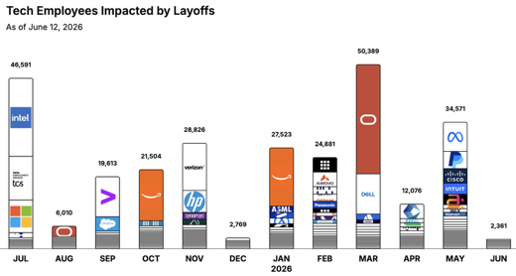
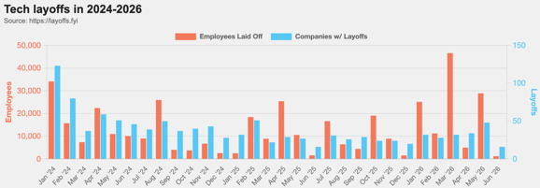
https://layoffs.fyi
https://trueup.io/layoffs
Jobs
The Tech Layoff Tracker
In 2026: 151,801 people laid off (931 per day)
In 2025: 245,953 people laid off (674 per day)
In 2024: 238,461 people laid off (653 per day)
https://trueup.io/layoffs
Tech Layoffs by year (US only):
118K in 2026 (as of June 12, 2026)
124K in 2025
153K in 2024
264K in 2023
165K in 2022 https://layoffs.fyi

Slide 23


About the Speaker
Lev Selector, Ph.D.
40+ years of software engineering, data science, and building teams (hiring, training, and managing)
Ph.D. in mathematical modeling and computer simulations
Interests:
Generative AI, Using LLM with your data
Local AI for Local Private Data
Cloud architecture, fin-tech, application security
Find/connect: Linkedin, GitHub, YouTube, Google
https://eais.ai
Enterprise AI Systems

Slide 24
Thank You!

