Slide 1
AI Updates - Jan 09, 2026
"Machine intelligence is the last invention that humanity will ever need to make." - Nick Bostrom
Crowd-sourced "LM Arena" Leaderboard
Best 14-40B Params Open LLMs
New Moore's Law - 2x every 4 months
Yann LeCun AMI Startup
Gemini AI in Gmail
Lightricks LTX-2 Open-Source Video Model
Memory Shortage Causes GPU Price Increase
Anthropic raised $10 Bln at $350 Bln Valuation
Claude Code 2.1.0 Released January 7
Boris Cherny Work Setup
Google's Gemini CLI - Agent Skills
Oh My Open Code Framework
Rocket.new - text to app Framework
ChatGPT Health
CES 2026 Consumer Electronics Show
Nvidia Alpamayo & Cosmos
Nvidia Rubin Supercomputer Platform
Humanoid Robots Security Problems
Google ADK - Agent Development Kit
MIT RLM - Recursive Language Model
Tencent HY-Motion 1.0
Combining Tools and Models
DeepSeek MHC
AI Changes Structure of Startups
Julia McCoy - AI Business Model
Create Content for for AI chat citations
Jobs, Layoffs, demand for AI Engineers

Slide 2
Crowd-sourced "LM Arena" Leaderboard
Data for December 30
Starting Elo rating = 1000
https://en.wikipedia.org/wiki/Elo_rating_system
English - https://lmarena.ai/leaderboard/text
Coding - https://lmarena.ai/leaderboard/text/coding
Model | Score
gemini-3-pro | 1490
gemini-3-flash | 1480
grok-4.1-thinking | 1477
claude-opus-4-5-20251101-thinking-32k | 1470
claude-opus-4-5-20251101 | 1467
grok-4.1 | 1466
gemini-3-flash (thinking-minimal) | 1464
gpt-5.1-high | 1458
gemini-2.5-pro | 1451
claude-sonnet-4-5-20250929-thinking-32k | 1450
claude-opus-4-1-20250805-thinking-16k | 1448
ernie-5.0-preview-1203 | 1448
claude-sonnet-4-5-20250929 | 1446
gpt-5.2 | 1443
gpt-4.5-preview-2025-02-27 | 1443
claude-opus-4-1-20250805 | 1442
chatgpt-4o-latest-20250326 | 1441
gpt-5.2-high | 1439
glm-4.7 | 1439
gpt-5.1 | 1438
gpt-5-high | 1436
o3-2025-04-16 | 1434
qwen3-max-preview | 1434
grok-4-1-fast-reasoning | 1431
Model | Score
claude-opus-4-5-20251101-thinking-32k | 1542
claude-sonnet-4-5-20250929-thinking-32k | 1525
gemini-3-pro | 1519
claude-opus-4-5-20251101 | 1515
claude-opus-4-1-20250805-thinking-16k | 1514
grok-4.1-thinking | 1509
gemini-3-flash | 1507
claude-sonnet-4-5-20250929 | 1506
claude-opus-4-1-20250805 | 1499
gemini-3-flash (thinking-minimal) | 1499
claude-opus-4-20250514-thinking-16k | 1495
gpt-5.2-high | 1493
grok-4.1 | 1493
gpt-5.1-high | 1491
gpt-5.2 | 1483
kimi-k2-thinking-turbo | 1482
glm-4.7 | 1482
qwen3-max-preview | 1481
gpt-5.1 | 1478
qwen3-max-2025-09-23 | 1475
longcat-flash-chat | 1475
claude-haiku-4-5-20251001 | 1474
deepseek-v3.2-exp-thinking | 1472
gemini-2.5-pro | 1470
Google Gemini
Claude
OpenAI
x.ai
Open Source
x.ai
x.ai
https://lmarena.ai/leaderboard/text
Design Arena -
https://www.designarena.ai
https://openlm.ai/chatbot-arena/
https://beta.lmarena.ai
Web Leaderboard - 1T params
https://web.lmarena.ai/leaderboard
LLM Leaderboard - by @LlmStats -
https://llmworld.net/llm_leaderboards/
LLM Leaderboard - by StackAI -
https://www.stack-ai.com/llm-leaderboard
LLM Leaderboard - by Artificial Analysis -
https://artificialanalysis.ai/leaderboards/models
Open LLM Leaderboard - by Hugging Face -
https://huggingface.co/open-llm-leaderboard
LLM Leaderboard - by Vellum -
https://www.vellum.ai/llm-leaderboard
AI Benchmarking Hub -
https://epoch.ai/data/ai-benchmarking-dashboard
Grok 4 Benchmarks -
https://artificialanalysis.ai/models/grok-4
Image arena (alibaba) -
http://aiarena.alibaba-inc.com/corpora/arena/leaderboard?arenaType=T2I
image arena - https://lmarena.ai/leaderboard/text-to-image
China
x.ai
China
China
China
China
China
China
China
China
x.ai

Slide 3
Best 14-40B Params Open LLMs
top open-source medium-sized LLMs
(mostly 14-40B parameters) for fine-tuning and local deployment:
Name | Size (Params) | Architecture | Quality Score | Memory
Qwen3-235B-A22B | 235B (22B active) | MoE | 9.2/10 | ~470GB (FP16), ~118GB (4-bit)
MiniMax M2 | 230B (10B active) | MoE | 8.8/10 | ~460GB (FP16), ~115GB (4-bit)
GLM-4.7 | 355B (32B active) | MoE | 9.0/10 | ~710GB (FP16), ~178GB (4-bit)
Qwen3-30B-A3B-Instruct | 30B (3B active) | MoE | 8.5/10 | ~60GB (FP16), ~15GB (4-bit)
NVIDIA Nemotron-3-Nano-30B-A3B | 30B (3B active) | MoE | 8.3/10 | ~60GB (FP16), ~15GB (4-bit)
OLMo 3 32B | 32B | Dense | 8.6/10 | ~64GB (FP16), ~16GB (4-bit)
Qwen2.5-32B-Instruct | 32B | Dense | 8.4/10 | ~64GB (FP16), ~16GB (4-bit)
OLMo 2 32B | 32B | Dense | 8.5/10 | ~64GB (FP16), ~16GB (4-bit)
DeepSeek-R1-Distill-Qwen-32B | 32B | Dense | 8.2/10 | ~64GB (FP16), ~16GB (4-bit)
Qwen2.5-Coder-32B-Instruct | 32B | Dense | 8.1/10 | ~64GB (FP16), ~16GB (4-bit)
Mistral Small 3.1 24B | 24B | Dense | 8.4/10 | ~48GB (FP16), ~12GB (4-bit)
Devstral Small 2 24B | 24B | Dense | 8.0/10 | ~48GB (FP16), ~12GB (4-bit)
Gemma 3-27B | 27B | Dense | 7.8/10 | ~54GB (FP16), ~14GB (4-bit)
OLMo 2 13B | 13B | Dense | 7.5/10 | ~26GB (FP16), ~7GB (4-bit)
Phi-4 | 14B | Dense | 7.6/10 | ~28GB (FP16), ~7GB (4-bit)
Ministral 3-14B (dense) | 14B | Dense | 7.4/10 | ~28GB (FP16), ~7GB (4-bit)
Qwen2.5-14B-Instruct | 14B | Dense | 7.5/10 | ~28GB (FP16), ~7GB (4-bit)
OLMo 3 7B | 7B | Dense | 7.2/10 | ~14GB (FP16), ~4GB (4-bit)

Slide 4
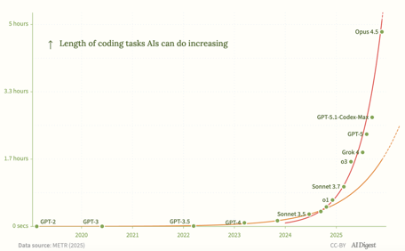
New Moore's Law - 2x every 4 months
New Moore's Law - 2x every 4 months
The length of coding tasks frontier systems can complete is growing exponentially - doubling every 7 months.
Recently, the trend has accelerated
In 2024-2025, time horizons doubled every 4 months, down from every 7 months over 2019-2025
https://theaidigest.org/time-horizons
https://metr.org/blog/2025-03-19-measuring-ai-ability-to-complete-long-tasks/

Slide 5


Yann LeCun AMI Startup
Yann LeCun startup AMI ("Advanced Machine Intelligence Labs")
Launched in 2026 in Paris, France (LeCun is French)
Seeking to raise €500 million (~$586 million) at a valuation €3 .. €5 billion before even officially launching
LeCun - Executive Chairman, Alex LeBrun - CEO
Technology Focus: World Models
These systems train on video and spatial data rather than text alone to understand how the physical world works, enabling them to plan, reason, and maintain persistent memory over time
The technology builds on V-JEPA architecture LeCun created at Meta
LeCun has been vocal that "we are not going to get to human-level AI just by scaling LLMs" because they simply predict text rather than truly understand the world
AMI Labs has formed a strategic partnership with health-tech company Nabla (Alex LeBrun)
They will develop FDA-certifiable AI agents for healthcare

Slide 6


Gemini AI in Gmail
Google announced major Gemini AI updates for Gmail on Jan 7-8
Expanding AI to all of Gmail's 3+ billion users
Email Thread Summaries
AI Overviews in Search
Enhanced Writing Tools
Smarter Suggested Replies
AI Inbox view (Coming Soon) - replaces chronological email lists with a personalized briefing. This view automatically highlights to-dos, pending bills, upcoming appointments, and emails from important contacts
The updates are rolling out gradually, starting with English-speaking users in the United States

Slide 7
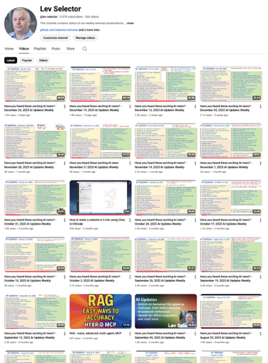
We do these weekly videos every Friday
Stats: 5.97K subscribers, 260 videos
Subscribe to this channel
https://www.youtube.com/@lev-selector
Download slides from GitHub using links under the videos
Please pause the video - and answer the pinned question in comments under the video

Slide 8
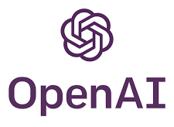

ChatGPT Health
ChatGPT Health
Prepare for a doctor’s appointment
Choose the right insurance plan for you
Personalized nutrition tips
Securely connecting your information and apps with ChatGPT Health
When you choose to connect your health data, such as medical records or wellness apps, your responses are grounded in your own health information.
You can also connect your Apple Health information and other wellness apps, such as Function, MyFitnessPal, Peloton
Apps may only be connected to your health data with your explicit permission

Slide 9


CES 2026 Consumer Electronics Show
CES 2026 Consumer Electronics Show
Las Vegas January 5-8 - AI, robotics, semiconductors, consumer electronics
Nvidia CEO Jensen Huang dominated the show with major announcements including Cosmos, an AI foundation model trained to replicate real-world physics, and Alpamayo, a specialized AI model for autonomous vehicles.
He also revealed that Nvidia's next-generation AI superchip platform, Vera Rubin, has entered full-scale production
AMD CEO Lisa Su introduced new Ryzen AI processors for AI-driven personal computing and the Ryzen 9 85X3D for gaming enthusiasts
She also unveiled the Helios rack-scale system for the Instinct MI445X GPU and previewed next-generation MI500 chips
Intel announced Core Ultra 3 PC processors (Panther Lake) and plans for a handheld gaming device platform
Qualcomm showcased the Snapdragon X 2 for AI applications
Robotics everywhere
Lenovo - Qira AI platform, new ThinkPads in the Aura edition, and Motorola's first book-style folding phone, the Razr Fold
Google presented Gemini 3 integration with Google TV for natural language searches and image editing
Samsung showcased the Galaxy Zifold in the United States for the first time, featuring built-in AI functionalities
Atlas
TCL announced the RayNeo Air 4 Pro smart glasses with HDR-capable Micro-OLED displays
Siemens unveiled the Digital Twin Composer, launching mid-year on the Siemens Xcelerator Marketplace, which combines digital twin technology with Nvidia Omniverse simulations for visualizing products, processes, and plants in virtual 3D
Caterpillar CEO Joe Creed introduced the Cat AI Assistant, bringing the company's digital ecosystem into one conversational interface for construction sites

Slide 10
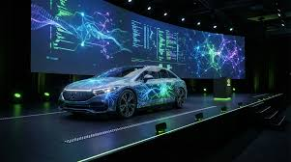
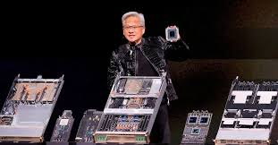
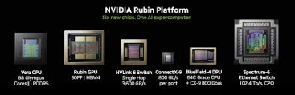
Nvidia Alpamayo & Cosmos
NVIDIA Alpamayo - Open AI for Driving
Full stack autonomous driving framework
Open AI models, simulation, and datasets for reasoning-based autonomous vehicles
Using synthetic data for training
Kosmos
https://www.nvidia.com/en-us/solutions/autonomous-vehicles/alpamayo/
NVIDIA Cosmos - A platform for physical AI, featuring state-of-the-art generative world foundation models (WFMs),
https://www.nvidia.com/en-us/ai/cosmos/
Announced at Consumer Electronics Show (CES) Jan 6-9, 2006 in Las Vegas
Nvidia Rubin Supercomputer Platform
Nvidia announced the Vera Rubin platform at CES 2026, their next-generation AI architecture succeeding Blackwell
The system delivers 10x cost reduction in inference and 4x reduction in GPUs required to train mixture-of-experts models compared to Blackwell
Rubin comprises six chips forming one AI supercomputer, including Vera CPU and Rubin GPUs
The platform uses 45°C hot water cooling without requiring water chillers, making it highly power efficient
Each system contains 1,152 GPUs across 16 racks, with 72 Rubins per rack. The platform is already in production and will be available to partners later in 2026

Slide 11
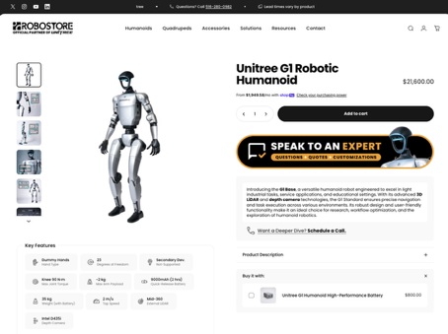
Humanoid Robots Security Problems
Humanoid Robot Unitree G1 can be purchased online, but there are problems with their security
Video "39C3 -: From Embodied AI Jailbreak to Remote Takeover of Humanoid Robots" by the security research group Dark Navy.
http://www.youtube.com/watch?v=qjA__5-Bybs
Security analysis of the Unitree G1 humanoid robot, demonstrate how researchers were able to bypass security measures to gain full remote control and jailbreak the device to unlock premium features.
Key Vulnerabilities and Attacks:
Remote Control Hijacking (RF Layer):
Network Service Exploits - Bluetooth Command Injection, Authentication Bypass, Cloud Token Theft
AI and LLM Attacks: LLM voice assistant, Unsafe Code Execution using eval(), Prompt Injection, redirecting the LLM API traffic via a WebRTC interface
Jailbreaking and "Unlock" Features - De-obfuscating Code, Runtime Patching, Physical Accessvia hidden internal Ethernet interface
Conclusion - security is bad

Slide 12

Google ADK - Agent Development Kit
Google ADK - Agent Development Kit - Open Source
Architecting efficient context-aware multi-agent framework for production
https://developers.googleblog.com/en/architecting-efficient-context-aware-multi-agent-framework-for-production/
ADK is addressing the critical challenge of managing large context in production-grade AI agent systems
Rather than relying solely on ever-larger context windows, ADK structures context, uses compressed summaries, searching for only relevant data, etc - treating context as a first-class architectural concern requiring systematic engineering
Context length explosion causes problems: increased latency from processing massive contexts, escalating token costs, and reduced accuracy as critical information gets buried in noise
The framework separates three distinct layers:
Session State (the ground truth storage of all events),
Working Context (an ephemeral, model-specific view compiled for each invocation),
Memory/Artifacts (external searchable knowledge and large data objects).
Agents use Context Compilation Pipeline to transform the Session's event stream into a Working Context by filtering events, formatting them for specific model APIs, and applying compaction or caching strategies
When sessions exceed configurable thresholds, ADK triggers asynchronous compaction that uses an LLM to summarize older events over sliding windows, writing summaries back as new events. This reduces token usage while preserving conversation history
ADK also supports context caching by dividing the context window into a stable prefix (instructions and identity) and dynamic suffix (recent history), allowing inference engines to reuse attention computation across calls
Relevance Management - Instead of dumping all data into prompts, ADK uses two specialized patterns:
Artifacts—large objects like CSVs or PDFs—live in an external store, with agents seeing only lightweight references until they explicitly load specific items using LoadArtifactsTool
The Memory layer - provides searchable, long-lived knowledge from past sessions that agents retrieve on-demand rather than carrying permanently
Multi-Agent Context Scoping - ADK prevents context explosion in multi-agent systems by allowing explicit control over what sub-agents see during handoffs
Developers can configure whether a called agent receives full conversation history, only the latest query, or a custom subset
When transferring control, ADK reframes the conversation from each agent's perspective, translating prior agents' messages into contextual references to prevent role confusion

Slide 13
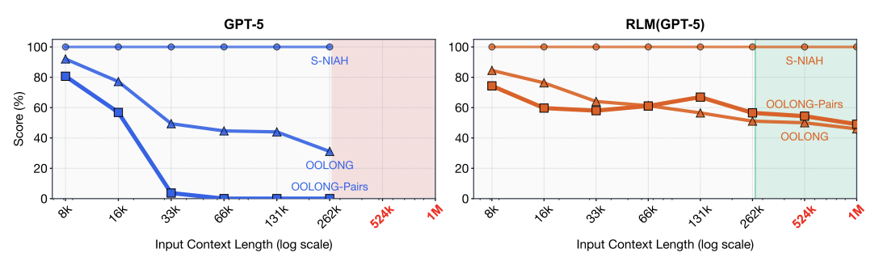
MIT RLM - Recursive Language Model
On complex reasoning tasks with quadratic complexity, standard GPT-5 achieves only 0.04% accuracy at 32K context while costing $0.16.
RLM-wrapped GPT-5 achieves 58% accuracy for $0.33 - doubling the cost but delivering over 1000x performance improvement.
The architecture has three components:
a root LLM that generates orchestration code,
deterministic Python execution handling loops and logic,
recursive sub-LLM instances that perform actual text processing and summarization.
This demonstrates that neural attention mechanisms alone are insufficient for large-scale reasoning over information-dense tasks
Symbolic logic structures help maintain coherence and avoid hallucination
https://arxiv.org/pdf/2512.24601v1 - paper
MIT researchers developed a Recursive Language Model (RLM)
It extends GPT-5's effective context window from its failing point at 16-33K tokens to 1 million tokens and beyond
It treats long prompts as external environment files rather than feeding them directly into the transformer
The LLM writes Python code to programmatically chunk, inspect, and recursively process data through spawned sub-instances of itself, similar to an operating system using virtual memory

Slide 14

AI Updates
Tencent HY-Motion 1.0
A Billion-Parameter Text-to-Motion Model
Built on the Diffusion Transformer (DiT) Architecture and Flow Matching
https://www.marktechpost.com/2025/12/31/tencent-released-tencent-hy-motion-1-0-a-billion-parameter-text-to-motion-model-built-on-the-diffusion-transformer-dit-architecture-and-flow-matching/
Combining Tools and Models
Claude Code + GLM-4.7
AntiGravity + ClaudeCode (Gemini & Clause models)
https://www.youtube.com/watch?v=tK2MOxGsB-o
Gemini CLI + Conductor plugin + GLM-4.7
Kilo Code + MiniMax M2.1
etc.

Slide 15
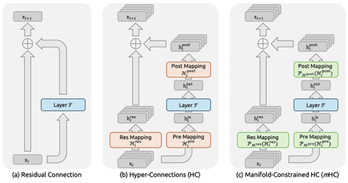
DeepSeek MHC
DeepSeek published research introducing Manifold-Constrained Hyperconnections (MHC), a new AI architecture that challenges the decade-old residual connection design used in all major models
Traditional residual connections create a bottleneck by forcing information through a narrow single stream. Previous attempts to widen this with hyper connections failed due to training instability and sudden collapse
MHC solves this by mathematically constraining how multiple information streams mix, using the Sinkhorn-Knopp algorithm to keep signal strength constant while allowing controlled information redistribution
DeepSeek tested this on models from 3 to 27 billion parameters, showing significant performance gains on reasoning tasks - for example, their 27B model jumped from 46.7 to 53.8 on GSM8K math benchmarks.
Through custom GPU kernels and memory optimization, they expanded internal data flow by 400% while increasing training time only 6.7%.
The openly published research follows their R1 model release that disrupted the industry, and may appear in their upcoming R2 or V4 models. This architectural innovation addresses both stability and efficiency, potentially reshaping how large AI models are built.
https://www.youtube.com/watch?v=0rinBUI6ViE - video
https://www.arxiv.org/abs/2512.24880 - paper
https://www.youtube.com/watch?v=HmhV76_3nuA - amination
Transformer architecture fundamentally relies on residual connections. They exist since the original transformer design and appear in both the encoder and decoder.
Residual connections are applied around each sub-layer within transformer blocks (around the self-attention mechanism and the feedforward neural network) in each layer
RCs mitigate vanishing gradients by providing direct pathways for gradient flow during backpropagation, which is crucial when training deep networks
They also enable the construction of much deeper transformer architectures without performance degradation, allowing models to capture complex long-range dependencies in sequential data

Slide 16
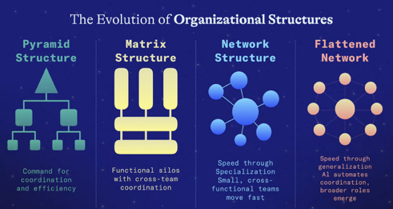
AI Changes Structure of Startups
AI fundamentally changes how startups organize
Traditional hierarchies optimize for control over creativity
AI now enables single person to accomplish what previously required entire teams
Speed over coordination. The fastest seed-stage companies optimize for shipping speed, creative iteration, and decision velocity
Early hires should own outcomes not functions, with AI handling repetitive work while humans provide judgment and critical decisions
Teams work as integrated units rather than departments
Success requires hiring adaptable people who experiment thoughtfully with AI rather than rejecting or blindly trusting it
Leadership in flat organizations demands clear vision and designing systems that enable movement rather than micromanaging
The strongest founders delegate early, know when to trust or override AI, and create clean boundaries between automated and human work
Companies structured for speed will outpace those using outdated models.
https://www.youtube.com/watch?v=S06CDLDiFhk

Slide 17




AI Updates
Lightricks LTX-2 Open-Source Video Model
Generates up to 20-sec videos at 4K resolution and 50 frames per second with synchronized audio and accurate lip sync
Users can control first and last frames to chain clips together
The model includes LoRA adapters for customization
LTX-2 is optimized for consumer GPUs like the RTX 5090
Ranks #1 on the artificial analysis open weights leaderboard
https://ltx.io/model/model-blog/ltx-2-is-now-open-source
https://github.com/Lightricks/LTX-2
Memory Shortage Causes GPU Price Increase
Price of RTX 5090 could rise from $2K to $5K
Memory component scarcity is affecting supply chains
Anthropic raised $10 Bln at $350 Bln Valuation
This nearly doubles its valuation from four months prior

Slide 18
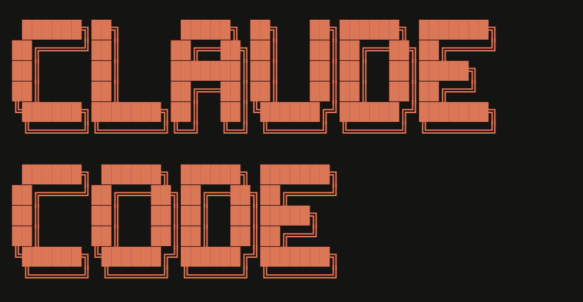
Claude Code 2.1.0 Released January 7
Automatic skill hot-reload - skills created or modified in `~/.claude/skills` or `.claude/skills` immediately available without restarting sessions
Skills now show progress while executing, displaying tool uses as they happen
Skills can now run in forked sub-agent contexts using `context: fork` in frontmatter, preventing unintended side effects on the main agent's state
Skills support an `agent` field to specify which agent type should execute them
Enhanced hooks - support across agents, skills, and slash commands with PreToolUse, PostToolUse, and Stop logic
Agent frontmatter can now define hooks scoped to the agent's lifecycle
PreToolUse hooks can modify tool inputs when returning `ask` permission decisions
Subagents resilience improvements - they now continue working after permission denial by exploring alternative approaches rather than halting entirely
Session teleportation via `/teleport` and `/remote-env` commands allows resuming sessions between local terminals and claude.ai/code
Wildcard tool permissions like `Bash(npm *)` or `Bash(*-h*)` simplify rule configuration with fewer entries
Permission prompts received UX improvements with cleaner input labels and contextual placeholders
Shift+Enter now works out of the box in iTerm2, WezTerm, Ghostty, and Kitty without configuration changes
A new language setting supports workflows requiring outputs in specific languages like Japanese or Spanish, eliminating post-processing steps
New Vim motions include `;` and `,` to repeat f/F/t/T motions, `y` operator for yank with `yy`/`Y`, `p`/`P` for paste, text objects (`iw`, `aw`, `i"`, `a"`, etc.), `>>` and `<<` for indent/dedent, and `J` to join lines
MCP servers can now send `list_changed` notifications to dynamically update tools and resources without reconnection
Unified Ctrl+B backgrounding works for both bash commands and agents simultaneously
The `/plan` command provides quick entry to plan mode directly from prompts
The release also includes a critical security fix preventing OAuth tokens, API keys, and passwords from appearing in debug logs
plus 45+ bug fixes addressing session persistence, file discovery, and API context overflow issues

Slide 19
Boris Cherny Work Setup
Boris Cherny, creator of Claude Code at Anthropic, shared his detailed workflow - running multiple AI coding sessions in parallel
Cherny runs 5 Claude CLI sessions simultaneously in his terminal, numbering tabs 1-5 and using system notifications to track when each session needs input
He also runs 5-10 additional sessions on claude.ai/code in parallel with his local sessions, treating them as one fluid workflow
The CLI and web interfaces aren't separate - sessions can be handed off between them using the `&` operator to send tasks to the web or the `--teleport` command to pull web sessions back to the terminal
To avoid conflicts when running parallel agents, Cherny uses separate git checkouts for each session
If something goes wrong, pressing escape twice cancels the session and rolls back changes
https://www.youtube.com/watch?v=aqtseECSdtY
CLAUDE.md for Shared Context
Cherny's team maintains a single CLAUDE.md file at the repo root that every Claude session automatically reads. This file captures project conventions, expectations, and lessons learned—especially mistakes Claude has made that shouldn't be repeated. The team updates it multiple times per week, and it serves as shared memory across all sessions, keeping behavior consistent even when running multiple agents. During code reviews, tagging `@claude` on pull requests automatically adds new learnings to CLAUDE.md through a GitHub Action
Cherny almost always starts in Plan Mode (accessed by pressing Shift+Tab twice) to iterate on a solid plan before writing code
Once the plan is good, he switches to "accept edits on" mode and lets Claude execute the entire implementation in one shot
This approach significantly improves results compared to jumping straight into coding
Handing Off Between Terminal and Web
The web interface acts as a session manager for longer-running or background tasks. When a task is well-defined in the terminal, Cherny uses the `&` prefix to create a new web session that persists even after closing the laptop.
These sessions can be monitored from anywhere, including from a phone
The `/teleport` command brings web sessions back into the terminal for hands-on work
Verification and Quality
The most important factor for quality is giving Claude a way to verify its own work, which can improve quality 2-3×.
For example, Claude uses a Chrome extension to test UI changes and ensure the user experience feels good
This self-verification capability combined with the continuously improving CLAUDE.md file creates a workflow where the system gets smarter over time

Slide 20
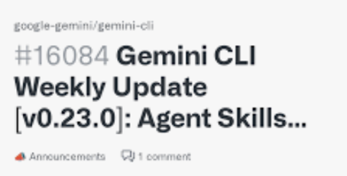
Google's Gemini CLI - Agent Skills
Google's Gemini CLI version 0.23.0 introduced experimental support for Agent Skills, following Anthropic's earlier implementation of the same feature for Claude
This update enables the terminal-based AI agent to dynamically load specialized expertise for specific tasks without cluttering the context window
Agent Skills allow users to extend Gemini CLI with modular, task-specific capabilities including specialized expertise, procedural workflows, and domain-specific resources
Skills are discovered from three tiers:
.. project-level (`.gemini/skills/`),
.. user-level (`~/.gemini/skills/`),
.. and extension-bundled skills
To enable the feature, users must install the preview build (`npm install -g @google/gemini-cli@preview`), activate it in `/settings`, and toggle the experimental skills option
Skills can be managed via the `/skills` command to list, enable, disable, or reload available capabilities
The release also includes full integration of Gemini Conductor, which brings context-driven development by storing project context in persistent markdown files alongside code
https://www.youtube.com/watch?v=pK-EvgvR_ms

Slide 21
AI Updates
Oh My Open Code Framework
https://github.com/code-yeongyu/oh-my-opencode
https://www.youtube.com/watch?v=YuKUMEDGTF0
Enhances the open-source AI coding agent OpenCode by adding advanced multi-agent orchestration capabilities

Slide 22

Rocket.new - text to app Framework
Rocket.new - text to app Framework
Includes backend infrastructure, integrations, and deployment
"vibe solutioning" to transform single-sentence descriptions into working applications
Automatically handles database schema generation, authentication configuration, API endpoint creation, payment gateway integration, and cloud infrastructure provisioning
It supports multiple AI models including OpenAI, Claude, Gemini, and Perplexity, allowing users to orchestrate different models within a single application
Generates clean React and Next.js code with TypeScript support, and can also build Flutter mobile apps that can be downloaded as APKs and installed directly on devices
All generated code is exportable and can be pushed to GitHub or self-hosted, giving users full ownership rather than locking them into a proprietary platform
The platform includes over 100 structured commands that perform specific actions like adding Stripe payments or fixing layout issues. It integrates seamlessly with services including Supabase for databases, Stripe for payments, and Resend for email functionality. A Figma import feature translates design hierarchies into responsive, interactive components rather than just converting pixels
https://www.rocket.new
https://www.youtube.com/watch?v=S2MP49Xr9PI
The interface combines a chat window, live preview, visual editor, and code panel that sync in real-time, allowing users to interact at whichever layer they prefer. The platform also offers a mobile companion app for tracking builds and reviewing projects on the go
Rocket.new offers a free tier with 1 Mln tokens, though data may be used for training at this level.
Paid plans start at $25/month for the Personal plan with 5 million tokens, and $50/month for the Rocket plan with over 10 million tokens. Users can opt out of data training on paid plans
The platform raised $15 million in seed funding led by Salesforce Ventures in September 2025, just three months after launching in beta. Since launch, it has attracted over 400,000 users across 180 countries, including more than 10,000 paid subscribers, and reached $4.5 million in annual recurring revenue. The company projects scaling to $20-25 million in revenue by year-end and $60-70 million by mid-2026

Slide 23

Julia McCoy - AI Business Model
How AI Brings Me Customers on Autopilot (While I Sleep)
- by Julia McCoy
https://www.youtube.com/watch?v=PbNdaP0szhw
Julia McCoy demonstrates her AI-powered customer acquisition system that generates millions of impressions monthly
She uses Claude Projects to create YouTube scripts, then deploys an AI clone (HeyGen, ElevenLabs) to deliver content while a production team handles editing
Her strategy focuses exclusively on YouTube, publishing 3-4 long-form videos weekly, which are repurposed into shorts, tweets, LinkedIn posts, and emails
Her business model features a three-tier funnel:
1. free YouTube content
2. leads to a $250 AI training program (AI Labs)
3. or $10,000 consulting services
With 320,000 monthly YouTube views generating 1,500-2,000 email subscribers, she converts approximately 185 AI Labs sales and 6 consulting clients monthly, totaling around $106,000
She employs a small team including video producers, community managers, and AI integrators
She spends just 12-17 hours weekly on strategic work while AI and her team handle execution
The video provides a detailed roadmap for building a similar automated business system from scratch
Julia McCoy

Slide 24
Create Content for for AI chat citations
Optimizing for AI chat citations is becoming increasingly important alongside traditional Google SEO
NotebookLM offers a powerful workflow for this purpose. This approach is often called "AI Search Engine Optimization" (AEO) or "Generative Engine Optimization" (GEO)
NotebookLM serves as a research and content planning hub that helps you create citation-worthy content by analyzing what already works. The tool can simulate how AI systems select sources and references, making it valuable for understanding citation patterns
Once you create content - you can publish it to your actual website
The core workflow involves uploading competitor content, top-ranking pages, and research materials into NotebookLM, which then analyzes patterns across these sources to identify what makes content "AI-friendly"
Since NotebookLM is built by Google and powered by Gemini, it understands how information should be structured to match search intent and AI citation preferences
Step-by-Step NotebookLM Strategy:
Research and upload sources - gather the top 10 ranking URLs for your target keyword and upload them to a new NotebookLM notebook. Include competitor articles, keyword research documents, and backlink data
Analyze citation patterns - Ask NotebookLM to identify keyword clusters, search intent, content gaps, and structural patterns across all competitors. This reveals what attributes make content more likely to be cited by AI systems
Generate optimized outlines - Request SEO content outlines that include title, meta description, headings, recommended word count, search intent, LSI keywords, and suggested external links. NotebookLM can create data tables comparing your content with competitors to identify missing subtopics and opportunities
Create structured content - Transfer your notebook to Gemini 3 to generate content optimized with real sources and contextual understanding. Request FAQ schema in JSON-LD format that you can embed directly into your pages for rich results eligibility
Key Principles for AI Citation Success
Structured formatting - Use clear headings, bullet points, short paragraphs, and schema markup (Q&A, HowTo, Article, FactCheck) to make content easily parsable
Concise, direct answers - AI favors content that directly addresses user questions with factual utility and specificity
Authority signals - Include citations, quotations from relevant sources, statistics, and references to authoritative sites
Topic clusters - Build interconnected content clusters with strong internal linking that demonstrates topical authority
Freshness signals - Maintain publication dates, update timestamps, and temporal relevance markers
Research shows that retrieval-augmented AI systems like Perplexity achieve citation density 2-3 times higher than other models and prioritize structured, fresh content with clear source attribution
Interestingly, AI citations often come from pages ranking in positions 21 and lower, not just top-ranking results

Slide 25
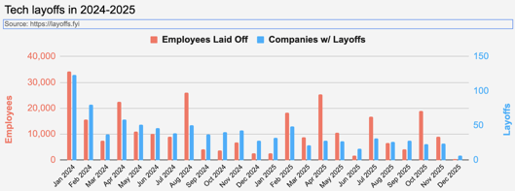
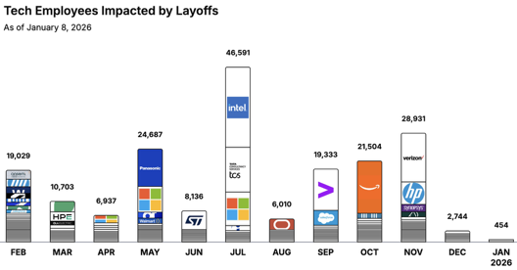
Jobs
https://layoffs.fyi
https://trueup.io/layoffs
Tech Layoffs by year (US only):
  123K in 2025 (as of January 8, 2026)
  153K in 2024
  264K in 2023
  165K in 2022 https://layoffs.fyi
The Tech Layoff Tracker
In 2026, 454 people laid off
In 2025, 245,953 people laid off (674 per day)
In 2024, 238,461 people laid off (653 per day)
https://trueup.io/layoffs

Slide 26


About the Speaker
Lev Selector, Ph.D.
40+ years of software engineering, data science, and building teams (hiring, training, and managing)
Ph.D. in mathematical modeling and computer simulations
Interests:
Generative AI, Using LLM with your data
Local AI for Local Private Data
Cloud architecture, fin-tech, application security
Find/connect: Linkedin, GitHub, YouTube, Google
https://eais.ai
Enterprise AI Systems

Slide 27
Thank You!

